Slide 1
Automatic Facial Emotion Recognition
Presented by: Bharathraj.k,
au211521104021,
Pre-Final Student,
Computer Science and Engineering,
Panimalar Institute of Technology.

Slide 2
Overview
INTRODUCTION
RELATED WORK
EMOTION RECOGNITION
✵
CLASSIFICATION
VISUALIZATION
✵
FACE DETECTOR
DEMO
✵
EVALUATION
FUTURE WORKS
CONCLUSION
QUESTIONS

Slide 3
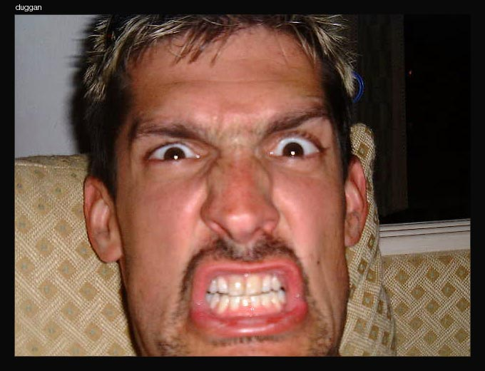
Emotions
Emotions are reflected in voice, hand and body gestures, and mainly through facial expressions

Slide 4
Emotions (2)
Why is it important to recognize emotions?
Human beings express emotions in day to day interactions
Understanding emotions and knowing how to react to people’s expressions greatly enriches the interaction
Notes:
Example with the audience

Slide 5
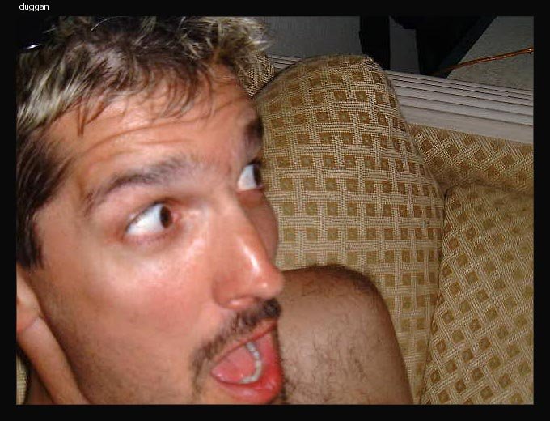
Human-Computer interaction
Knowing the user emotion, the system can adapt to the user
Sensing (and responding appropriately!) to the user’s emotional state will be perceived as more natural, persuasive, and trusting
We only focus on emotion recognition…

Slide 6
Related work
Cross-cultural research by Ekman shows that some emotional expressions are universal:
  Happiness
  Sadness
  Anger
  Fear
  Disgust (maybe)
  Surprise (maybe)
  Other emotional expressions are culturally variable.
Notes:
Facial expressions of blind and normally sighted children are similar; thus emotional expression (smiling) is probably inherited and not learned

Slide 7
Facial Expression Recognition
Pantic & Rothkrantz in PAMI 2000 performed a survey of the field
Recognize a generic procedure amongst all systems:
  Extract features (provided by a tracking system, for example)
  Feed the features into a classifier
  Classify to one of the pre-selected emotion categories (6 universal emotions, or 6+neutral, or 4+neutral, etc)

Slide 8
Field overview: Extracting features
Systems have a model of the face and update the model using video frames:
  Wavelets
  Dual-view point-based model
  Optical flow
  Surface patches in Bezier volumes
  Many, many more
From these models, features are extracted.

Slide 9
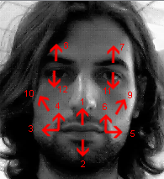
Facial features
We use features similar to Ekmans:
Displacement vectors of facial features
Roughly corresponds to facial movement (more exact description soon)

Slide 10
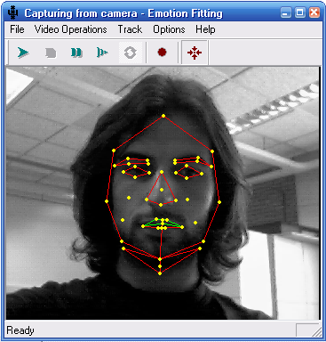
Our Facial Model
Nice to use certain features, but how do we get them?
Face tracking, based on a system developed by Tao and Huang [CVPR98], subsequently used by Cohen, Sebe et al [ICPR02]
First, landmark facial features (e.g., eye corners) are selected interactively

Slide 11
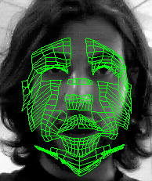
Our Facial Model (2)
A generic face model is then warped to fit the selected facial features
The face model consists of 16 surface patches embedded in Bezier volumes
Notes:
So: from this mask, which can be tracked, we get our 12 features

Slide 12
Face tracking
2D image motions are measured using template matching between frames at different resolutions
3D motion can be estimated from the 2D motions of many points of the mesh
The recovered motions are represented in terms of magnitudes of facial features

Slide 13
Related work: Classifiers
People have used the whole range of classifiers available on their set of features (rule-based, Bayesian networks, Neural networks, HMM, NB,
k-Nearest Neighbour, etc).
See Pantic & Rothkrantz for an overview of their performance.
Boils down to: there is little training data available, so if you need to estimate many parameters for your classifier, you can get in trouble.

Slide 14
Overview
INTRODUCTION
RELATED WORK
EMOTION RECOGNITION
✵
CLASSIFICATION
VISUALIZATION
✵
FACE DETECTOR
DEMO
✵
EVALUATION
FUTURE WORKS
CONCLUSION
QUESTIONS

Slide 15
Classification – General Structure
Java Server
x₁
x₂
.
.
x_{n}
Feature Vector
Classifier
Video Tracker (C++)
Visualization

Slide 16
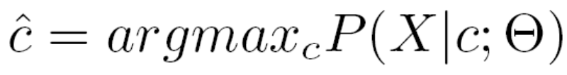
Classification - Basics
We would like to assign a class label c to an observed feature vector X with n dimensions (features).
The optimal classification rule under the maximum likelihood (ML) is given as:

Slide 17
Classification - Basics
Our feature vector has 12 features
Classifier identifies 7 basic emotions:
    Happiness
    Sadness
    Anger
    Fear
    Disgust
    Surprise
    No emotion (neutral)

Slide 18
The Classifiers
We compared two different classifiers for emotion detection
Naïve Bayes
  Implemented ourselves
TAN
  Used existing code

Slide 19
The Classifiers - Naïve Bayes
Well known classification method
Easy to implement
Known to give surprisingly good results
Simplicity stems from the independence assumption

Slide 20
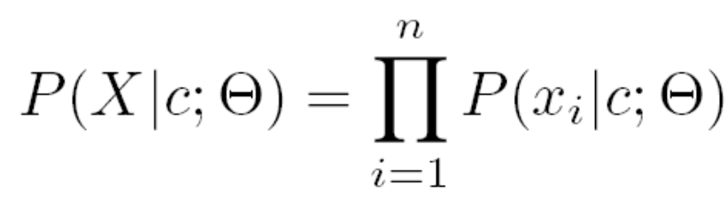
The Classifiers - Naïve Bayes
In a naïve Bayes model we assume the features to be independent
Thus the conditional probability of X given a class label c is defined as

Slide 21
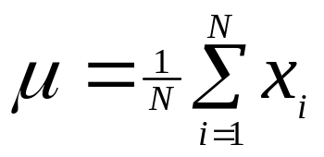
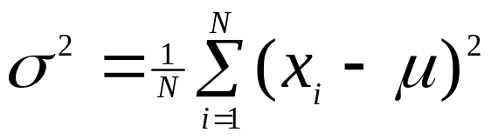
The Classifiers - Naïve Bayes
Conditional probabilities are modeled with a Gaussian distribution
For each feature we need to estimate:
  Mean:
  Variance:

Slide 22
The Classifiers - Naïve Bayes
Problems with Naïve Bayes:
  Independence assumption is weak
  Intuitively we can expect that there are dependencies among features in facial expressions
  We should try to model these dependencies

Slide 23
The Classifiers - TAN
Tree-Augmented-Naive Bayes
Subclass of Bayesian network classifiers
Bayesian networks are an easy and intuitive way to model joint distributions
(Naïve Bayes is actually a special case of Bayesian networks)

Slide 24
The Classifiers - TAN
The structure of the Baysian Network is crucial for classification
Ideally it should be learned from the data set using ML
But searching through all possible dependencies is NP-Complete
We should restrict ourselves to a subclass of possible structures

Slide 25
The Classifiers - TAN
TAN models are such a subclass
Advantage: There exist an efficient algorithm [Chow-Liu] to compute the optimal TAN model

Slide 26
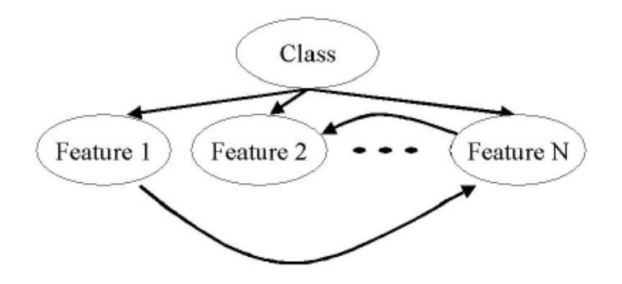
The Classifiers - TAN
Structure:
  The class node has no parents
  Each feature has as parent the class node
  Each feature has as parent at most one other feature

Slide 27
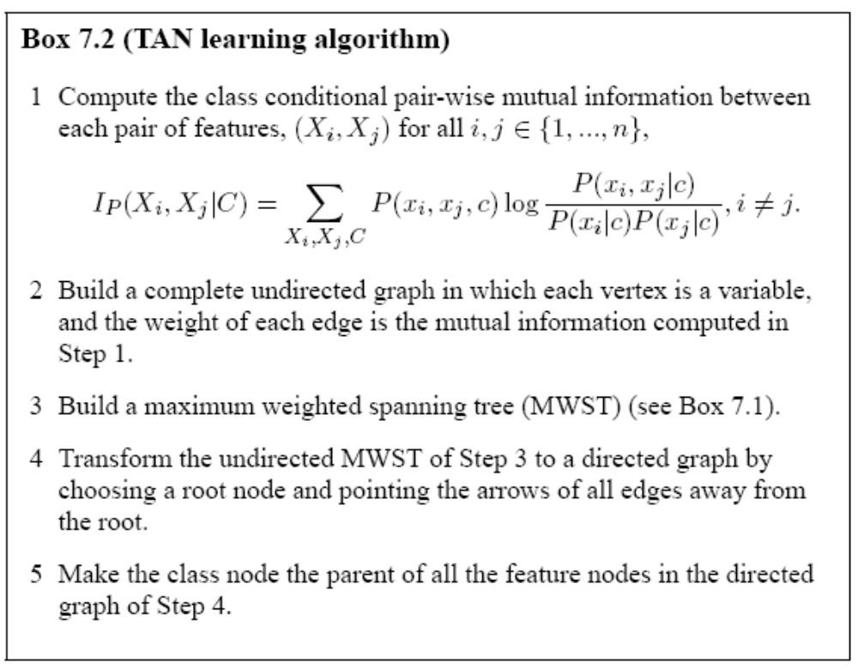
The Classifiers - TAN

Slide 28
Visualization
Classification results are visualized in two different ways
  Bar Diagram
  Circle Diagram
Both implemented in java

Slide 29
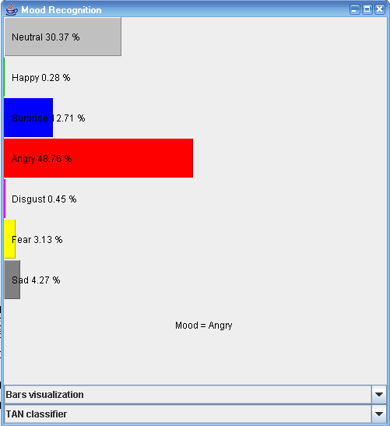
Visualization – Bar Diagram

Slide 30
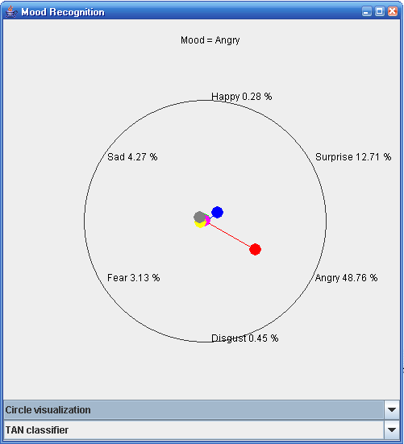
Visualization – Circle Diagram

Slide 31
Overview
INTRODUCTION
RELATED WORK
EMOTION RECOGNITION
✵
CLASSIFICATION
VISUALIZATION
✵
FACE DETECTOR
DEMO
✵
EVALUATION
FUTURE WORKS
CONCLUSION
QUESTIONS

Slide 32
Landmarks and fitted model

Slide 33
Problems
Mask fitting
  Scale independent
  Initialization “in place”
Fitted Model
  Reinitialize the mesh in the correct position when it gets lost
Solution?
FACE DETECTOR

Slide 34
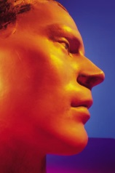

New Implementation
Face
Detector
Solid mask
Repositioning
yes
OpenGL
converter
Face
Fitting
Capture
Module
Lost?
Movie DB
no
Send data to
classifier
Classify and
visualize results

Slide 35
Face Detector
Looking for a fast and reliable one
Using the one proposed by Viola and Jones
Three main contributions:
  Integral Images
  Adaboost
  Classifiers in a cascade structure
Uses Haar-Like features to recognize objects

Slide 36
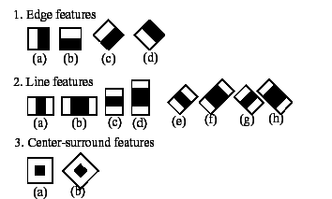
Face Detector – “Haar-Like” features

Slide 37
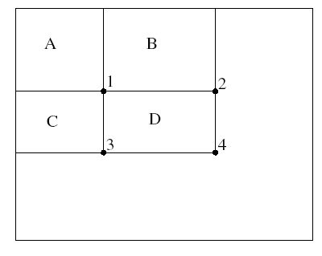
Face Detector – Integral Images
A = 1
B = 2-1
C = 3-1
D = 4-A-B-C
D = 4+1-(2+3)

Slide 38
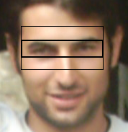
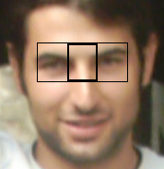
Face Detector - Adaboost
Results of the first two Adaboost Iterations
This means:
  Those features appear in all the data
  Most important feature: eyes

Slide 39
Face Detector - Cascade
All Sub-windows
T
T
T
1
2
3
4
F
F
F
F
Reject Sub-window

Slide 40
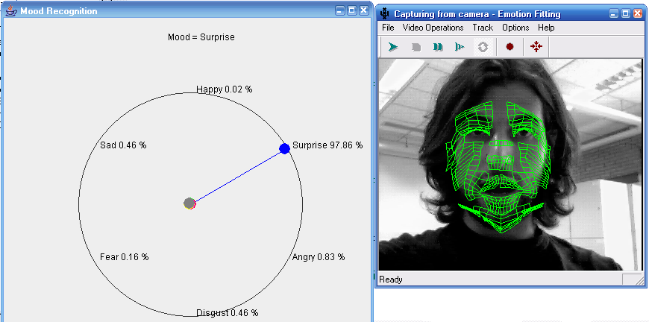
Demo

Slide 41
Overview
INTRODUCTION
RELATED WORK
EMOTION RECOGNITION
✵
CLASSIFICATION
VISUALIZATION
✵
FACE DETECTOR
DEMO
✵
EVALUATION
FUTURE WORKS
CONCLUSION
QUESTIONS

Slide 42
Evaluation
Person independent
  Used two classifiers: Naïve Bayes and TAN.
  All data divided into three sets. Then two parts are used for training and the other part for testing. So you get 3 different test and training sets.
  The training set for person independent tests contains samples from several people displaying all seven emotions. For testing a disjoint set with samples from other people is used.

Slide 43
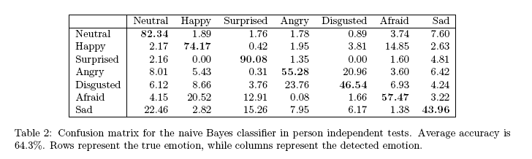
Evaluation
Person independent
  Results Naïve Bayes:

Slide 44
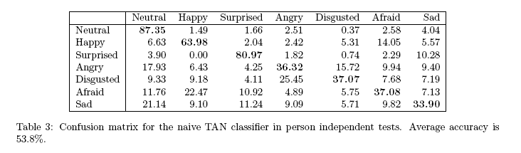
Evaluation
Person independent
  Results TAN:

Slide 45
Evaluation
Person dependent
  Also used two classifiers: Naïve Bayes and TAN
  All the data from one person is taken and divided into three parts. Again two parts are used for training and one for testing.
  Training is done for 5 people and is then averaged.

Slide 46
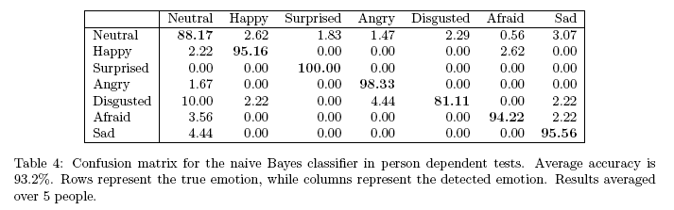
Evaluation
Person dependent
  Results Naïve Bayes:

Slide 47
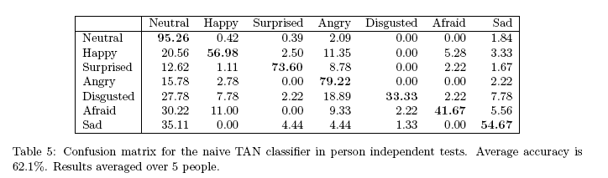
Evaluation
Person dependent
  Results TAN:

Slide 48
Evaluation
Conclusions:
  Naïve Bayes works better than TAN (indep: 64,3 – 53,8 and dep: 93,2 – 62,1).
  Sebe et al had more horizontal dependencies while we got more vertical dependencies.
  Implementation of TAN has probably a bug.
  Results of Sebe et al were:
  TAN: dep 83,3 indep 65,1
  NB is similar to ours.

Slide 49
Future Work
Handle partial occlusions better.
Make it more robust (lighting conditions etc.)
More person independent (fit mask automatically).
Use other classifiers (dynamics).
Apply emotion recognition in applications. For example games.

Slide 50
Conclusions
Our implementation is faster (due to server connection)
Can get input from different camera’s
Changed code to be more efficient
We have visualizations
Use face detection
Mask loading and recovery

