Slide 1
Twitter Sentiment Analysis

Slide 2
INTRODUCTION
Twitter is an online news and social networking site where people communicate in short messages called tweets.
Twitter is easy to use, we can join with a free account and Twitter name and we can send broadcasts (tweets) daily, hourly, or as frequently as you like
Tweeting is posting short messages for anyone who follows you on Twitter.
Another description of Twitter and tweeting might be microblogging.
Twitter helps to track hundreds of interesting Twitter users and read their content with a glance.
In Twitter, every microblog tweet entry is limited to 280 characters or less.
This size restriction made Twitter a popular social tool.
People send tweets for all sorts of reasons: vanity, attention, shameless self-promotion of their web pages, or simple boredom.
Thousands of people advertise their recruiting services, consulting businesses, and retail stores by using Twitter, and it works.

Slide 3
About Sentiment Analysis
Opinion mining or sentiment analysis refers to the use of natural language processing, text analysis, computation linguistics and biometrics to systematically identify, extract, quantify, and study affective states and subjective information.
The most common use of Sentiment Analysis is this of classifying a text to a class. Depending on the dataset and the reason, Sentiment Classification can be binary (positive or negative) or multi-class (3 or more classes) problem.
Sentiment analysis is widely applied to voice of Customer Reviews, Survey Responses, Online, Social Media, Healthcare etc.
sentiment analysis aims to determine the attitude of a speaker, writer, or emotional reaction to a document, interaction, or event.

Slide 4
Data set
The Data Set is available on https://www.kaggle.com/kulgen/elon-musks-tweets
It has 3,219 rows and 5 Column.

Slide 5
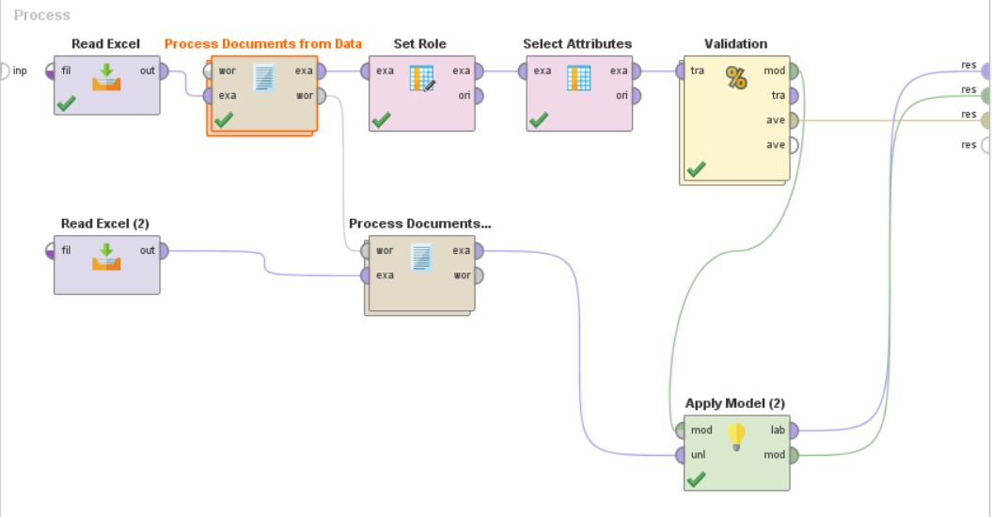
RapidMiner process

Slide 6
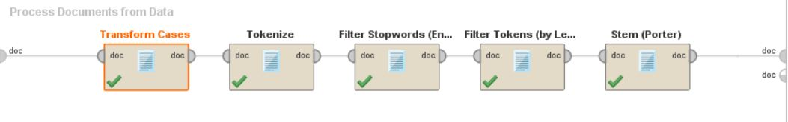
Documents

Slide 7
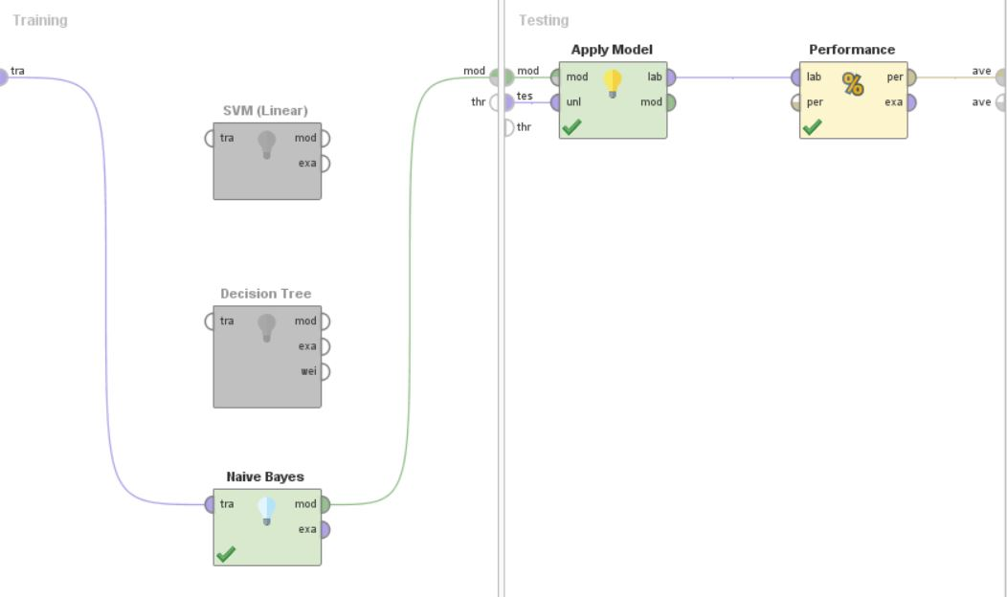
Models Used

Slide 8
process
Using Read excel operator the training set is loaded .
Different algorithms are used to predict and test the accuracy of the predictions on the cross validation set.
In order to predict the sentiment and accuracy the validated model is used on the test set.

Slide 9
Algorithm used
We have used three different algorithms, which are as below
*Naive Bayes
*Decision tree
*SVM
Among the above mentioned algorithms, Naïve Bayes showed the maximum accuracy.

Slide 10
Crisp-dm model
In all the steps of analysis was driven by CRISP-DM modelling steps.
Business understanding
Data Understanding
Data Preparation
Modelling
Evaluation
Deployment

Slide 12
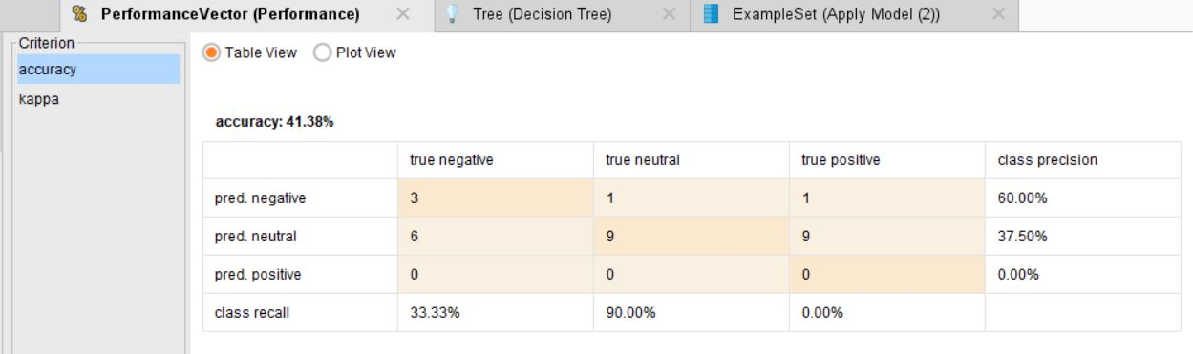
Decision tree Performance

Slide 13
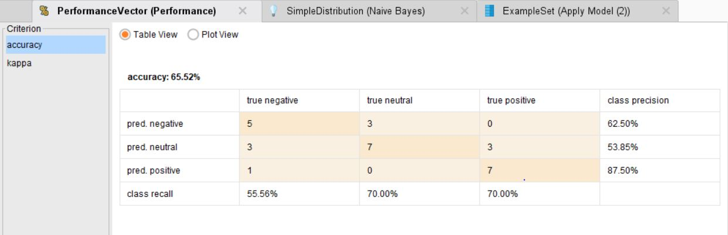
Naive Bayes Performance

Slide 14
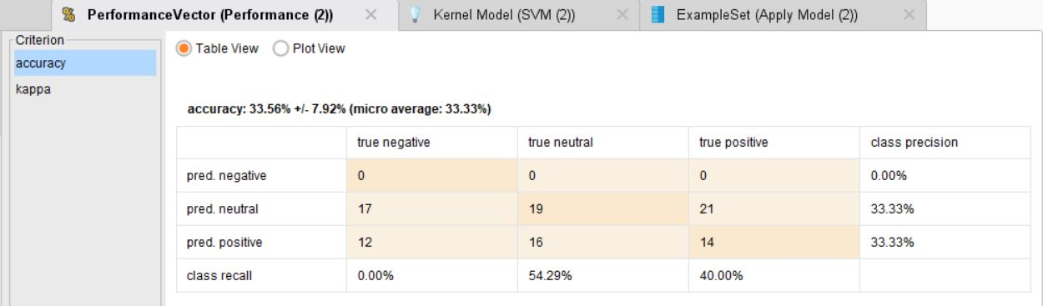
SVM Performance

Slide 15
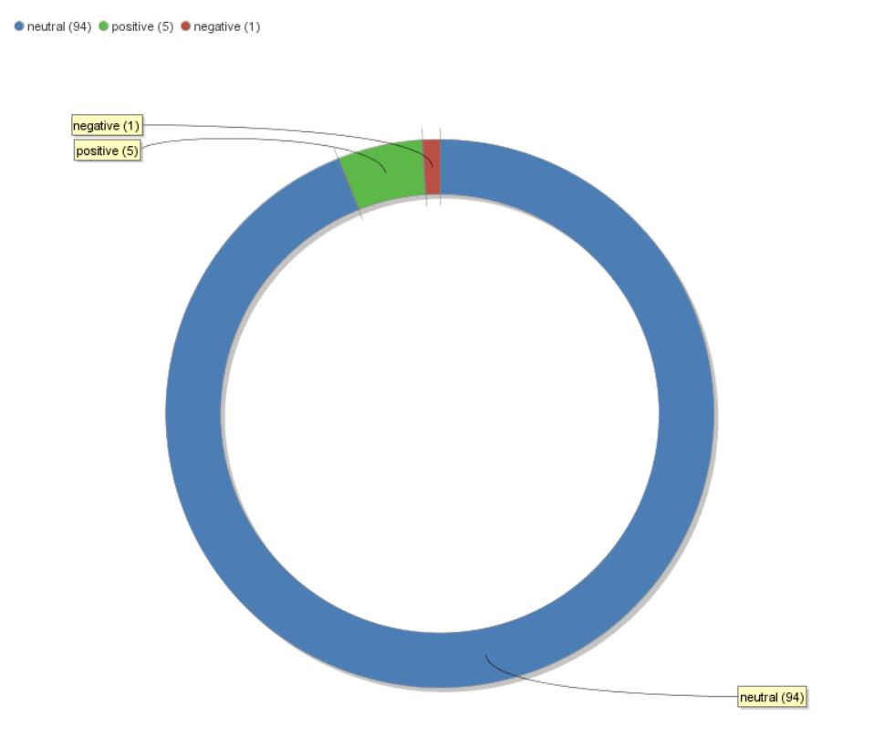
Usage of different data sets and its results 1-AVENGERS END GAME

Slide 16
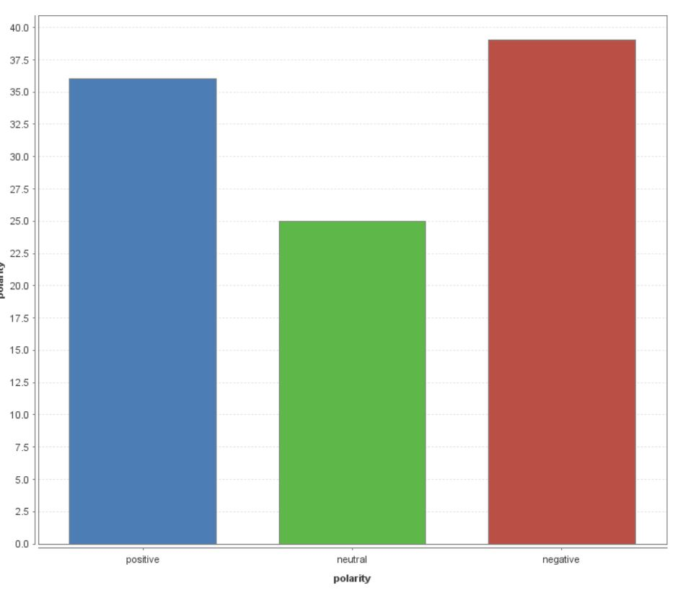
2-#MEtoo

Slide 17
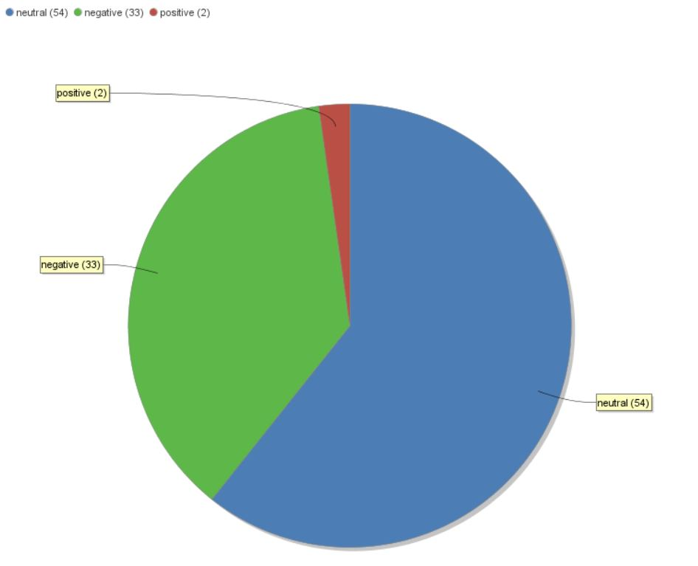
3-Demonetization In India

Slide 18
THANK YOU

