Slide 1
CharlotteHack
A website which ranks the hospitals that are most favourable

Slide 2
What we did?
Data cleaning and processing using Matlab
Setup Microsoft Azure for deploying the application
Used Python, HTML, CSS and jQuery

Slide 3
Our project idea!
Used Measure group, all the measure codes and user’s location to efficiently rank the hospitals
These hospitals are nearer to the user’s given location and are among the top hospitals in the given region

Slide 4
Future Enhancements
Using more data about the hospital visits, we can enhance the application by adding big data APIs in Azure to predict the future visits.

Slide 5
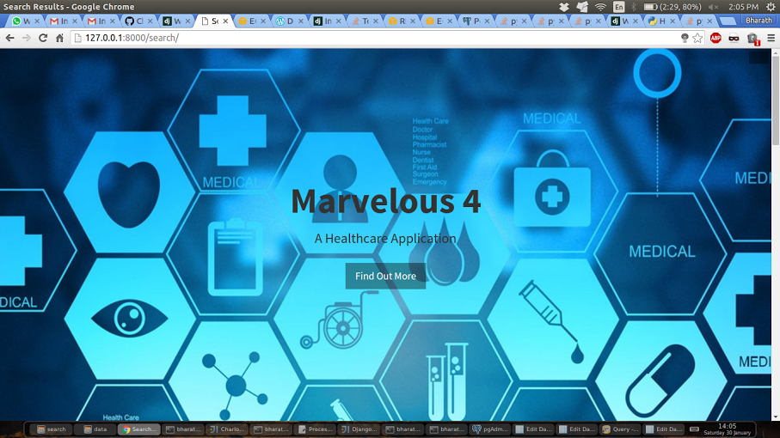
Output-1

Slide 6
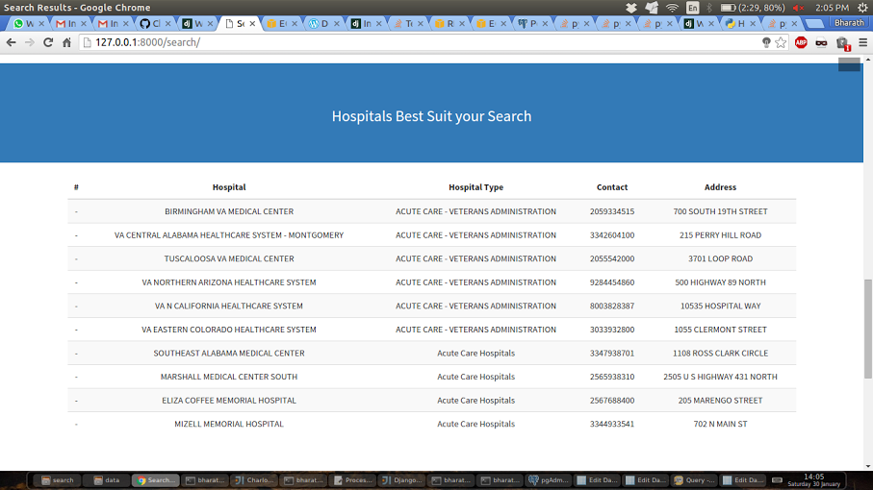
Output-2

