Slide 1
EV Market Size Analysis

Slide 2
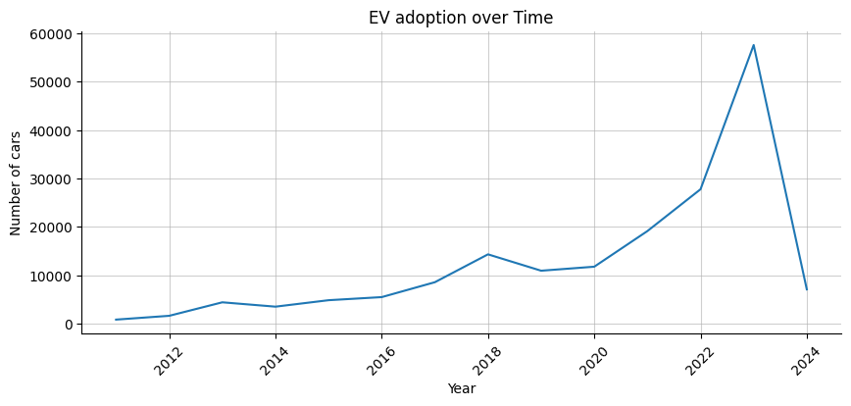
Note : The lower number of cars recorded in 2024 is due to the availability of only partial data for the year.
The data reveals a significant upward trend in EV adoption, highlighting a remarkable growth rate, especially post the 2020 pandemic. This surge underscores the accelerating shift towards electric vehicles, driven by increasing environmental awareness and advancements in technology.

Slide 3
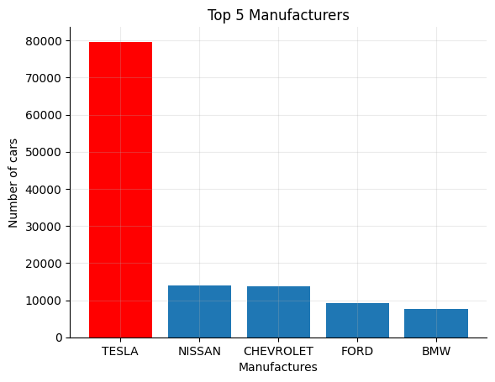
Despite facing intense competition from the giants like Ford, BMW, Nissan, Tesla has emerged as the undisputed leader in the electric vehicle market. The company's relentless focus on innovation, from cutting-edge battery technology to autonomous driving capabilities, has won over consumers and secured the highest market share of about 45%.

Slide 4
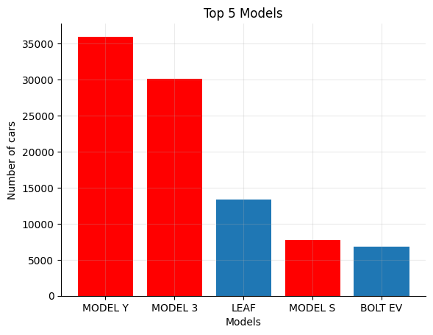
It's no surprise that three of the top five electric vehicle models are from Tesla, given the company's leadership in the EV industry. Tesla's innovation, performance, and brand reputation continue to set the standard, solidifying its position at the forefront of the market.

Slide 5
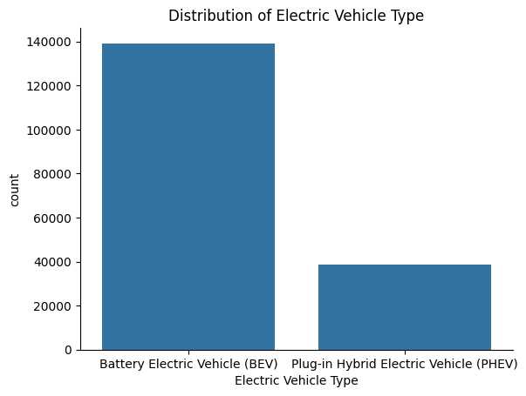
The race is on, and BEVs (Battery Electric Vehicles) are speeding ahead of PHEVs (Plug-in Hybrid Electric Vehicles). Consumers are clearly favoring the all-electric experience that BEVs offer, embracing their zero emissions, lower maintenance costs, and cutting-edge technology.
This preference marks a significant shift towards a greener future, where “The roar of combustion engines is replaced by the quiet hum of electric motors”.

Slide 6
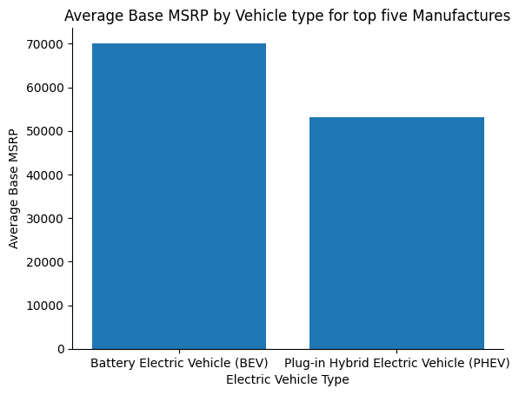
Despite BEVs (Battery Electric Vehicles) being 30% more expensive than PHEVs (Plug-in Hybrid Electric Vehicles), consumers are still choosing BEVs. This preference highlights the value placed on zero emissions, advanced technology, and long-term savings, demonstrating a strong commitment to a sustainable future.

Slide 7
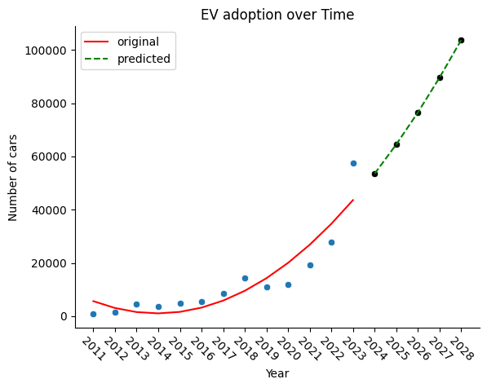
The EV market is set to electrify the future, with a staggering 14% CAGR projected from 2024 to 2028. This impressive growth trajectory underscores a powerful shift towards sustainable transportation, fueled by cutting-edge technology and an unwavering demand for cleaner, greener vehicles. The road ahead is clear: “The electric revolution is unstoppable!”

Slide 8
Key takeaways
🚀 Electric Vehicles: Powering the Future
Rapid Growth: The data reveals a significant upward trend in EV adoption, highlighting a remarkable growth rate, especially post the 2020 pandemic
.
Tesla's Dominance: Three of the top five EV models are from Tesla, underscoring its leadership in the industry.
Sustainability Drive: Consumers increasingly prefer BEVs despite being 30% more expensive than PHEVs, highlighting the demand for zero-emission vehicles.
Technological Advancements: Advances in EV technology and rising environmental awareness are driving the shift towards cleaner transportation solutions.
Future Outlook: The EV market is projected to grow at a staggering 14% CAGR from 2024 to 2028.The electric revolution is poised to reshape the automotive landscape, promising a sustainable and dynamic future.

