Slide 1
Airline Customer Satisfaction Prediction
Enhancing Customer Experience Using Predictive Analytics
Presented by: Bharath Reddy Donadula

Slide 2

Business Problem
Airlines need to proactively identify dissatisfied customers.
High churn rate and negative feedback affect brand perception and revenue.
Goal: Predict customer satisfaction (Yes/No) based on flight and service data.
Enable targeted service improvements and better customer engagement.

Slide 3
Dataset Overview
Content:
120,000+ records, 23 variables
Mix of categorical, ordinal, and numerical data
Target variable: Satisfaction (Satisfied / Neutral or Dissatisfied)
Key Features:
Demographics: Gender, Age, Type of Travel
Services: Inflight Wi-Fi, Onboard Service, Baggage Handling, etc.
Flight metrics: Departure/Arrival Delay, Flight Distance

Slide 4
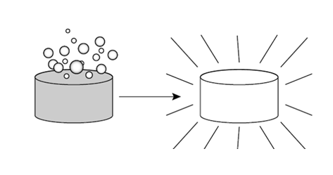
Data Cleaning & Preprocessing
Imputed ~400 missing values in the column – Arrival Delay using median due to skewed distributions.
Converted flight distance and delay times to float types after cleansing text anomalies.
Detected outliers by analysing boxplots; retained variability for model richness.
Need to convert categorical variables using Label Encoding / One-Hot Encoding.
Verified data balance: No major class imbalance.

Slide 5
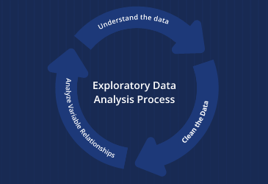
Exploratory Data Analysis
Most passengers aged 25–50; Gender distribution is balanced.
Business travelers dominate user base but still use Economy class frequently.
Inflight services rated higher than ground services like Gate location, and Booking convenience.
Longer delays → strong correlation with dissatisfaction.
Short-distance travelers often less satisfied, possibly due to limited services.

Slide 6
What Drives Satisfaction?
Age and Gender → no visible impact.
Class of travel (Business > Eco Plus > Economy) → strong impact.
Frequent flyers more satisfied than first-time users.
Dissatisfaction clusters around poor ratings in:
Wi-Fi Service
Gate Location
Online Booking Ease
Arrival/Departure Convenience

Slide 7
Feature Selection
Applied Chi-square test for categorical variables and ANOVA for continuous.
All features found statistically significant (p < 0.05).
Top predictors:
Type of Travel
Flight Class
Delay Times
Service Ratings
Flight Distance

Slide 8
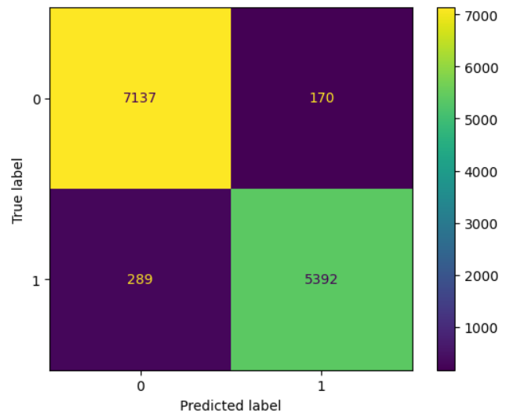
Model Building & Performance
Applied ensemble techniques:
Random Forest
XGBoost
Used RandomizedSearchCV for hyperparameter tuning.
XGBoost emerged as best with:
Precision: 97%
Accuracy: ~96%
Robust handling of outliers and large feature space

Slide 9

Passenger Satisfaction – Key Pain Areas
🖥️ Online Booking Inconvenience → Navigation and booking flow not intuitive, especially for new users.
⏱️ Long Waiting Times & Delays → Direct correlation with negative satisfaction scores.
💼 Economy Class Discomfort → Lower comfort ratings from business travelers using economy seats
✈️ Inconsistent Inflight Wi-Fi Service → Frequent dissatisfaction across all travel classes.
📍 Poor Gate Location & Wayfinding → Passengers report confusion and delays in locating gates.

Slide 10

Customer Experience – Strategic Action Plan
🚀 Upgrade Digital Experience → Redesign online booking interface for speed and ease.
📡 Enhance Onboard Connectivity → Partner with telecom vendors to improve WiFi consistency.
🛫 Optimize Gate Access → Use signage, mobile notifications, and maps for better gate navigation.
📊 Use Predictive Model Insights → Real-time flagging of low satisfaction passengers
→ Trigger proactive service (e.g., upgrade offers, surveys).
💺 Targeted Service Improvements → Focus resources on enhancing economy class comfort based on usage patterns.

Slide 11
Thank You

