Slide 1
Module 3 : part 2
Syntax Directed Definitions
Evaluation Orders of SDD’s
Applications of Syntax Directed Translation
Syntax Directed Translation Schemes
Implementation of L attributed Syntax Directed Definition

Slide 2
Syntax-Directed Translation
Syntax-directed translation (SDT) refers to a method of compiler implementation where the source language translation is completely driven by the parser, i.e., based on the syntax of the language.
The parsing process and parse trees are used to direct semantic analysis and the translation of the source program.
SDT can be a separate phase of a compiler or we can augment our conventional grammar with information to control the semantic analysis and translation. Such grammars are called attribute grammars.
We augment a grammar by associating attributes with each grammar symbol that describes its properties. With each production in a grammar, we give semantic rules/ actions, which describe how to compute the attribute values associated with each grammar symbol in a production.

Slide 3
The general approach to Syntax-Directed Translation is two fold
1.To construct a parse tree or syntax tree
2. compute the values of attributes at the nodes of the tree by visiting them in some order.
In many cases, translation can be done during parsing without building an explicit tree.
Types of translations
L-attributed translations
L for left-to right
Includes almost all translations that can be performed during parsing.
No need of explicit tree construction
2. S-attributed translations
S for synthesized
Performed easily in connection with a bottom-up parse.
Two ways to represent the semantic rules associated with grammar symbols.
Syntax-Directed Definitions (SDD)
Syntax-Directed Translation Schemes (SDT)

Slide 4
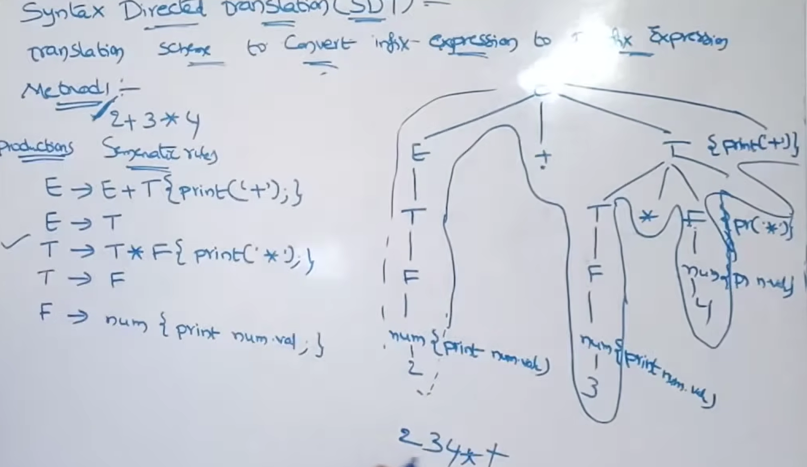

Slide 5
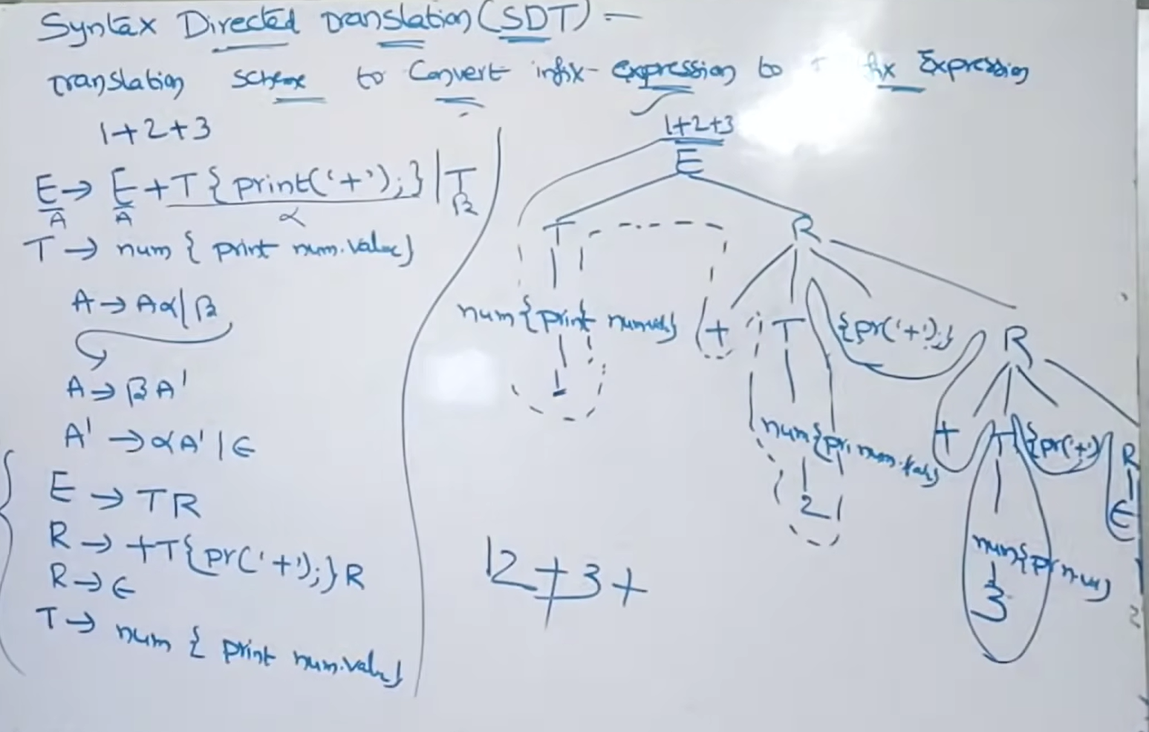

Slide 6
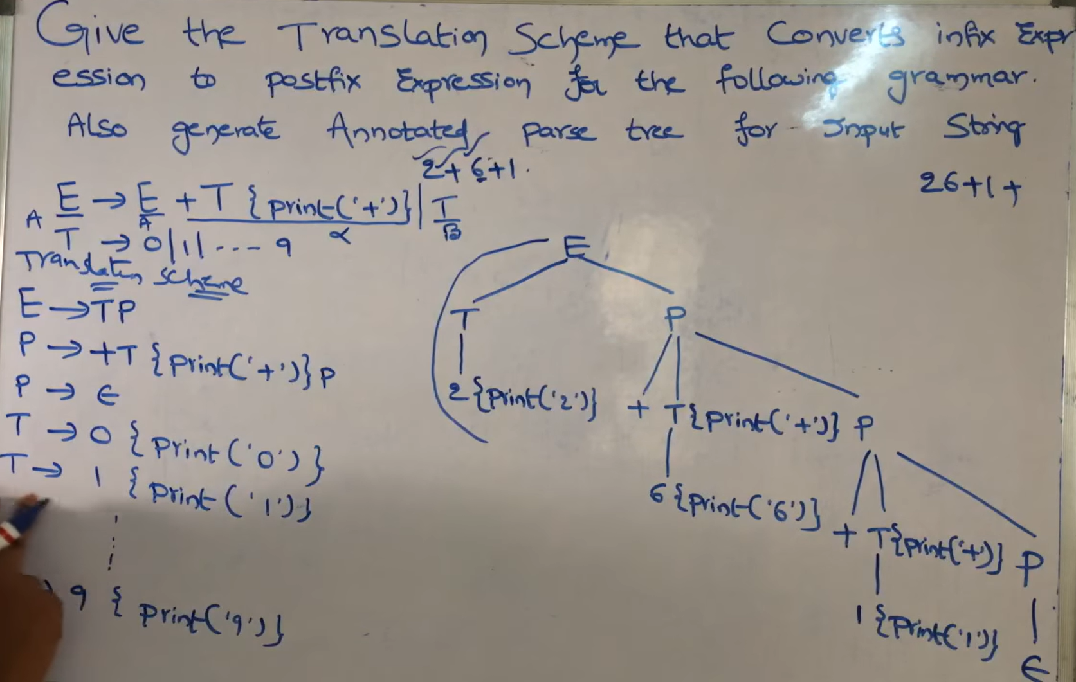

Slide 7
Syntax-Directed Translation Schemes (SDT)
SDT embeds program fragments called semantic actions within production bodies.
The position of semantic action in a production body determines the order in which the action is executed.
Example: In the rule E E1 + T { print ‘+’ }
the action is positioned after the body of the production.
SDTs are more efficient than SDDs as they indicate the order of evaluation of semantic actions associated with a production rule.
This also gives some information about implementation details.

Slide 8
Syntax Directed Translations
Syntax Directed Definitions
Till now, we are given some grammar, and for that grammar, we are given some parsers. In a practical implementation of compiler design and grammar, there is some association notation with informal notation.
For example:
Grammar | Semantic rules (informal notations)
E->E+T / T | E.value=E.value+T.value E.value=T.value
T-> T*F/ F | T.value=T.value*F.value T.value=F.value
F->Num | F.val=num.value.
Grammar + Semantic Rules = Syntax Directed Translation (SDT).

Slide 9
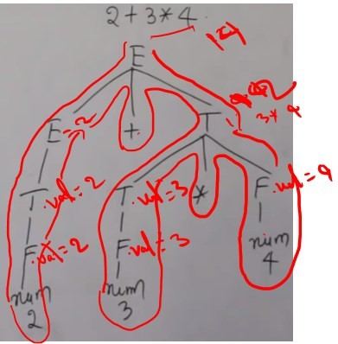
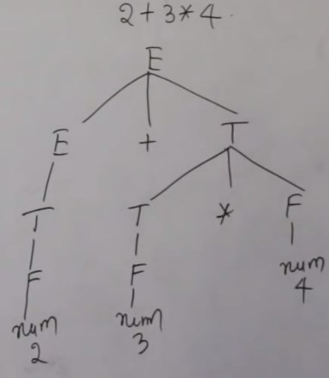
Example: SDT: Example-1
Grammar | Semantic rules (informal notations)
E->E+T / T | E.value=E.value+T.value E.value=T.value
T-> T*F/ F | T.value=T.value*F.value T.value=F.value
F->Num | F.val=num.value.
2+3*4 expression evaluate it. The value will be 14.
To get 14 as output, if I carry out this (table data) SDT on given input expression.
As a process rule, first derive the parser tree.
Annotated Parse-Trees
Grammar + Semantic Rules
= Syntax Directed Translation (SDT).
Here the number is nothing but token 2,3,4 are lexical values.
Lexical values mean what does this number actually mean. After generating the parse tree, we are going to traverse it top down left to right.

Slide 10
SDT: Another example-2 (with both Top down and Bottom up approach)
Grammar | Semantic rules (Informal Notation)
E->E+T / T | {printf(“+”);}
 | { }
T-> T*F/ F | {printf(“*”); }
 | { }
F->Num | {print(num.lval)}
Convert infix expression to postfix expression Top down
This SDT is going to convert infix expression to postfi expression.
This SDT is going to be carried out along with a synta
analyzer or parser.
While doing the parsing itself, the parser will carry out all th actions associated with the productions.
Grammar + Semantic Rules
= Syntax Directed Translation (SDT).
Grammar | Semantic rules (Informal Notation)
E->E+T / T | {printf(“+”);} | 1
 | { } | 2
T-> T*F/ F | {printf(“*”); } | 3
 | { } | 4
F->Num | {print(num.lval)} | 5
While Constructing the parse tree, consider semantic actions also.
That is a semantic actions follow each production.
This means, along with the production, write semantic actions.

Slide 11
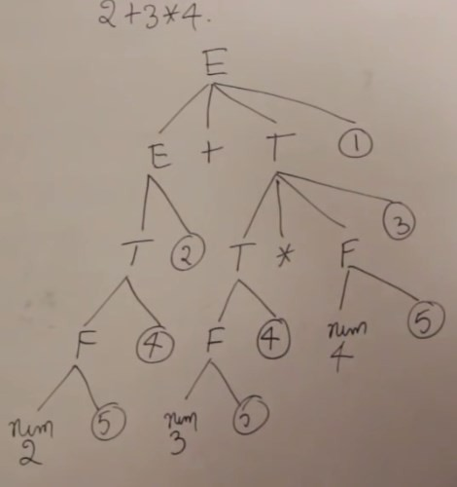
SDT: Another example-2(with both Top down and Bottom up approach)
Grammar | Semantic rules (Informal Notation)
E->E+T / T | {printf(“+”);} | 1
 | { } | 2
T-> T*F/ F | {printf(“*”); } | 3
 | { } | 4
F->Num | {print(num.lval)} | 5
Convert infix expression to postfix expression using
Top down Approach
Annotated Parse-Trees
How does the Top-down parser work for this grammar is,
The top-down parser takes the SDT and constructs the parse tree.
After constructing the parse tree, the way it evaluates is, traverse the parse tree is top-down and left to right.
Whenever we come across semantic actions, perform that action.
Input: 2+3*4 Output: 234*+

Slide 12
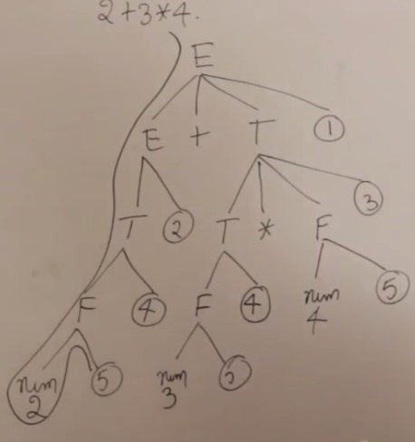
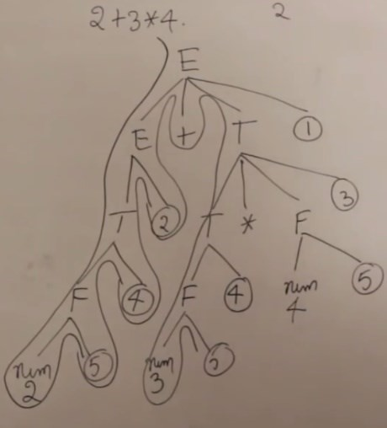

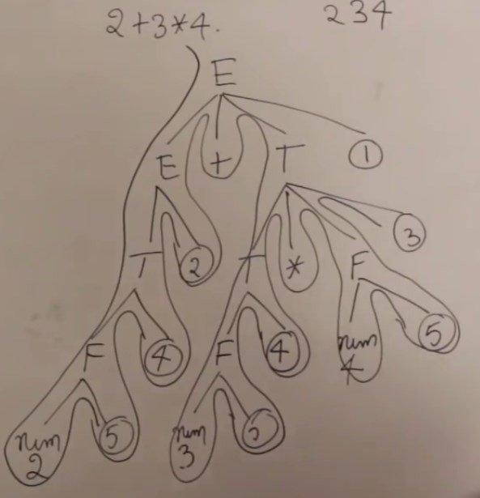
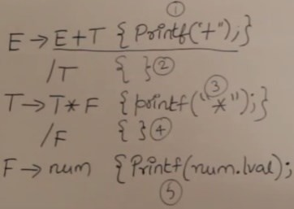


Convert infix expression to postfix expression using Top down Approach
Grammar | Semantic rules
E->E+T / T | {printf(“+”);} | 1
 | { } | 2
T-> T*F/ F | {printf(“*”); } | 3
 | { } | 4
F->Num | {print(num.lval)} | 5
Here semantic action is 5 that is print lexical value that is 2.
Display 2,
During traversing, semantic actions 4 and 2 are nothing.
After continuing traversing, again semantic action is 5, which is print lexical value 3.
Display 3
During traversing semantic action, 4 is nothing.
After continuing traversing, again semantic action is 5, which is print lexical value 4.
Display 4.
After continuing traversing, at semantic action 3, display *
After continuing traversing, at semantic action 1, display +

Slide 13
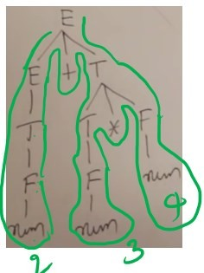

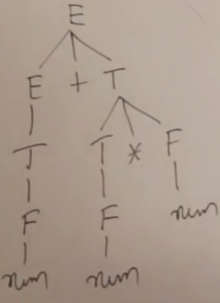
Convert infix expression to postfix expression using Bottom-up parsers
Grammar | Semantic rules
E->E+T / T | {printf(“+”);} | 1
 | { } | 2
T-> T*F/ F | {printf(“*”); } | 3
 | { } | 4
F->Num | {print(num.lval)} | 5
For the same example, how Bottom-up parser will work.
Bottom-up parsers are mainly focused on reductions.
Therefore, they try to reduce the terminals to the variables (i.e., right-hand side to the left-hand side).
Simple, Whenever they go for reduction, take the production and
then perform the action.

Slide 14
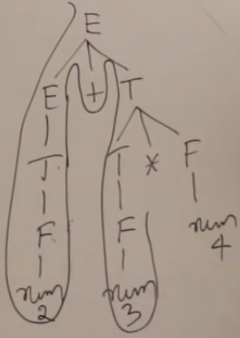
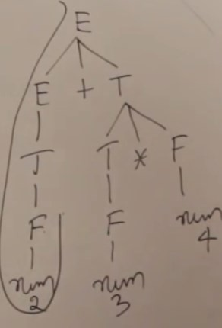

Bottom-up parsers
Grammar | Semantic rules
E->E+T / T | {printf(“+”);} | 1
 | { } | 2
T-> T*F/ F | {printf(“*”); } | 3
 | { } | 4
F->Num | {print(num.lval)} | 5
Now there is reduction,
The action is for that production is print lexical value, that is 3,
Print 3,
Now there is reduction,
The action is for that production is print lexical value, that is 2, Print 2,

Slide 15
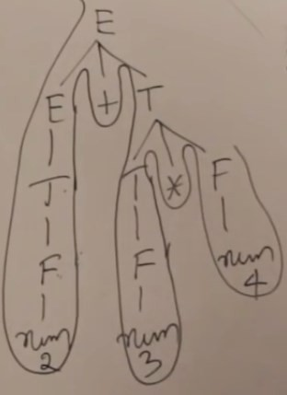
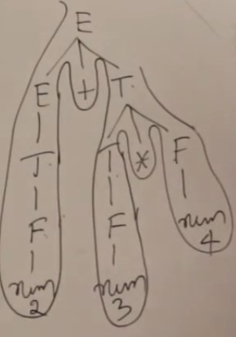
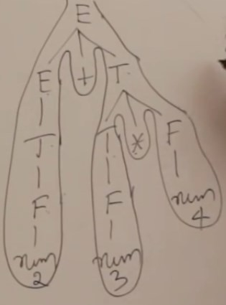

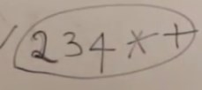

Bottom-up parsers
Grammar | Semantic rules
E->E+T / T | {printf(“+”);} | 1
 | { } | 2
T-> T*F/ F | {printf(“*”); } | 3
 | { } | 4
F->Num | {print(num.lval)} | 5
Now there is reduction,
The action is for that production is print lexical value, that is 4, Print 4,
Now there is reduction, T*F is reduced to T, The action is for that production is print *Print
*,
Now there is reduction,
E*T is reduced to W, The action is for production is print +
that

Slide 16
Top-down
Grammar | Semantic rules
E->E+T / T | {printf(“+”);} | 1
 | { } | 2
T-> T*F/ F | {printf(“*”); } | 3
 | { } | 4
F->Num | {print(num.lval)} | 5
Bottom-up
Note: We are getting the same answer using both top-down and bottom-up approaches.
Therefore SDT can be used both by the bottom-up parser as well as the top-down parser. Just the difference is when parser going to actions

Slide 17
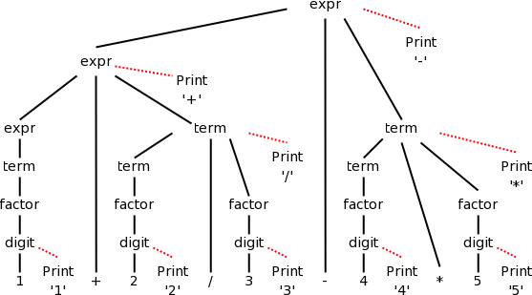
Infix → postfix translator
expr → expr + term expr → expr - term
{ print('+') }
{ print('-’) }
Grammar | Semantic rules
E->E+T / T | {printf(“+”);} | 1
 | { } | 2
T-> T*F/ F | {printf(“*”); } | 3
 | { } | 4
F->Num | {print(num.lval)} | 5
Here, the grammar contains only +,* terminals. If more terminal are there, such as
: division (\), subtraction (-), Then new SDT
is
term → term * factor { print(‘*') } term → term / factor { print('/') }
term → factor
factor → num
{ null }
{ print(‘lval') }
The diagram for 1+2/3-4*5 with attached semantic actions is
Given an input, e.g. our favorite 1+2/3-4*5, we just do a depth first (postorder) traversal of the corresponding diagram and perform the semantic actions as they occur.
When these actions are print statements as above, we can be said to be emitting the translation.
Do a depth first traversal of the diagram on the board,
performing the semantic actions as they occur,
Final output: 123/+45*-
shown on the right.
Annotated Parse-Trees

Slide 18
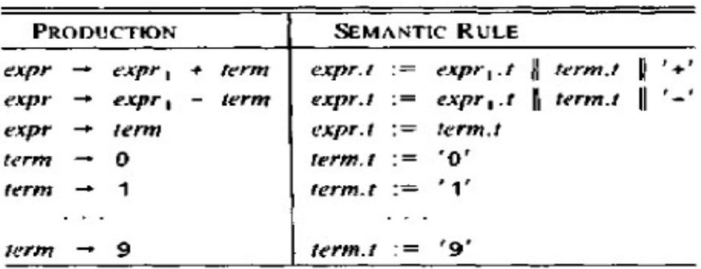
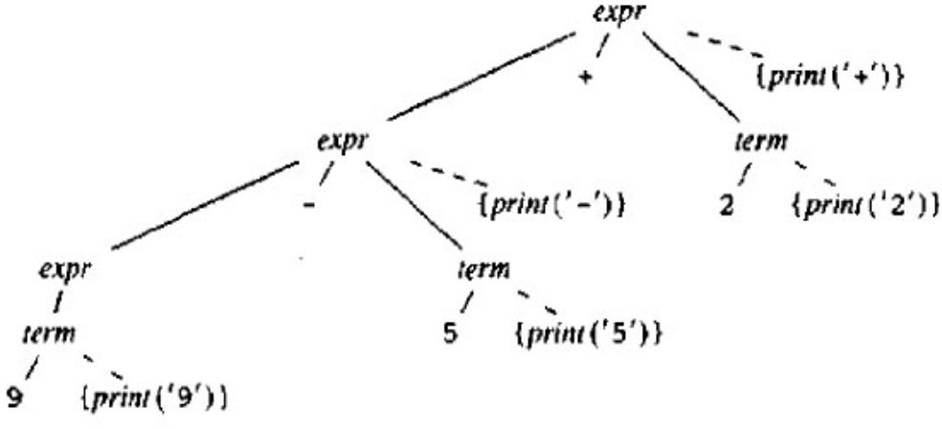
Conversion from infix to prefix expression
The annotated parse tree of 9-5+2 is based on the following syntax directed definition. || represents string concatenation
Annotated Parse-Trees
Actions translating 9-5+2 into -+952

Slide 19
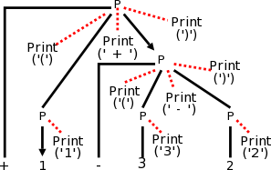
Prefix to infix translation
The following grammar, which generates the simple language of prefix expressions consisting of addition and subtraction of digits between 1 and 3 without parentheses (prefix notation and postfix notation do not use parentheses).
P → + P P | - P P | 1 | 2 | 3
Input: +1-32
Annotated Parse-Trees
The resulting parse tree for +1-32 with the semantic actions attached is shown on the right. Note that the output language (infix notation) has parentheses.
Production with Semantic Action | Semantic Rule
P → + { print('(') } P₁ { print(')+(') } P₂ { print(')') } | P.t := '(' || P₁.t || ')+(' || P.t || ')'
P → - { print('(') } P₁ { print(')-(') } P₂ { print(')') } | P.t := '(' || P₁.t || ')-(' || P.t || ')'
P → 1 { print('1') } | P.t := '1'
P → 2 { print('2') } | P.t := '2'
P → 3 { print('3') } | P.t := '3'

Slide 20
SDT: Another example-3

Slide 21


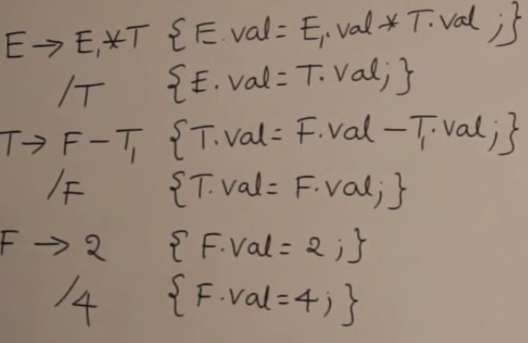





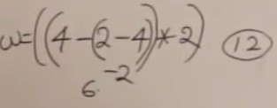




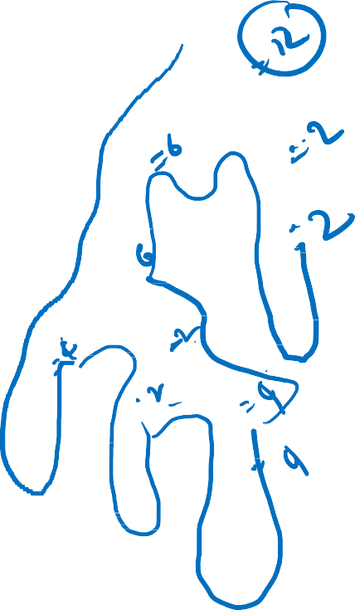
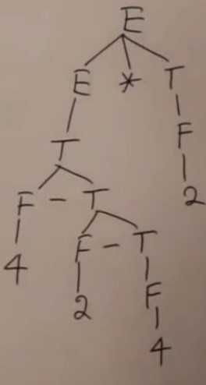
SDT: Another example-4

Slide 22
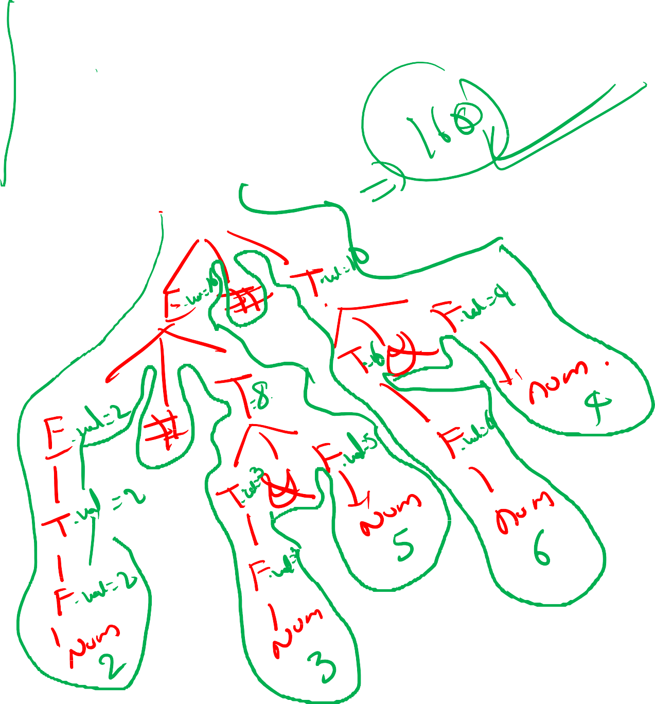
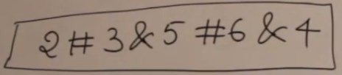
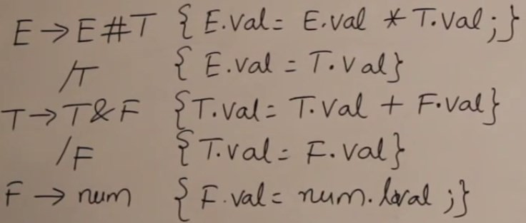



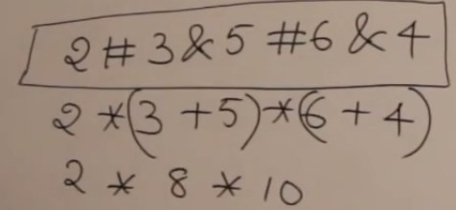

SDT: Another example-5

Slide 23
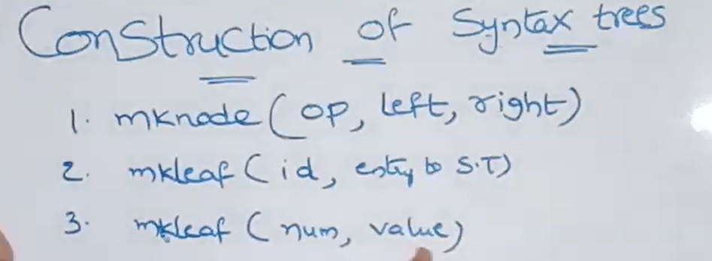

Slide 24
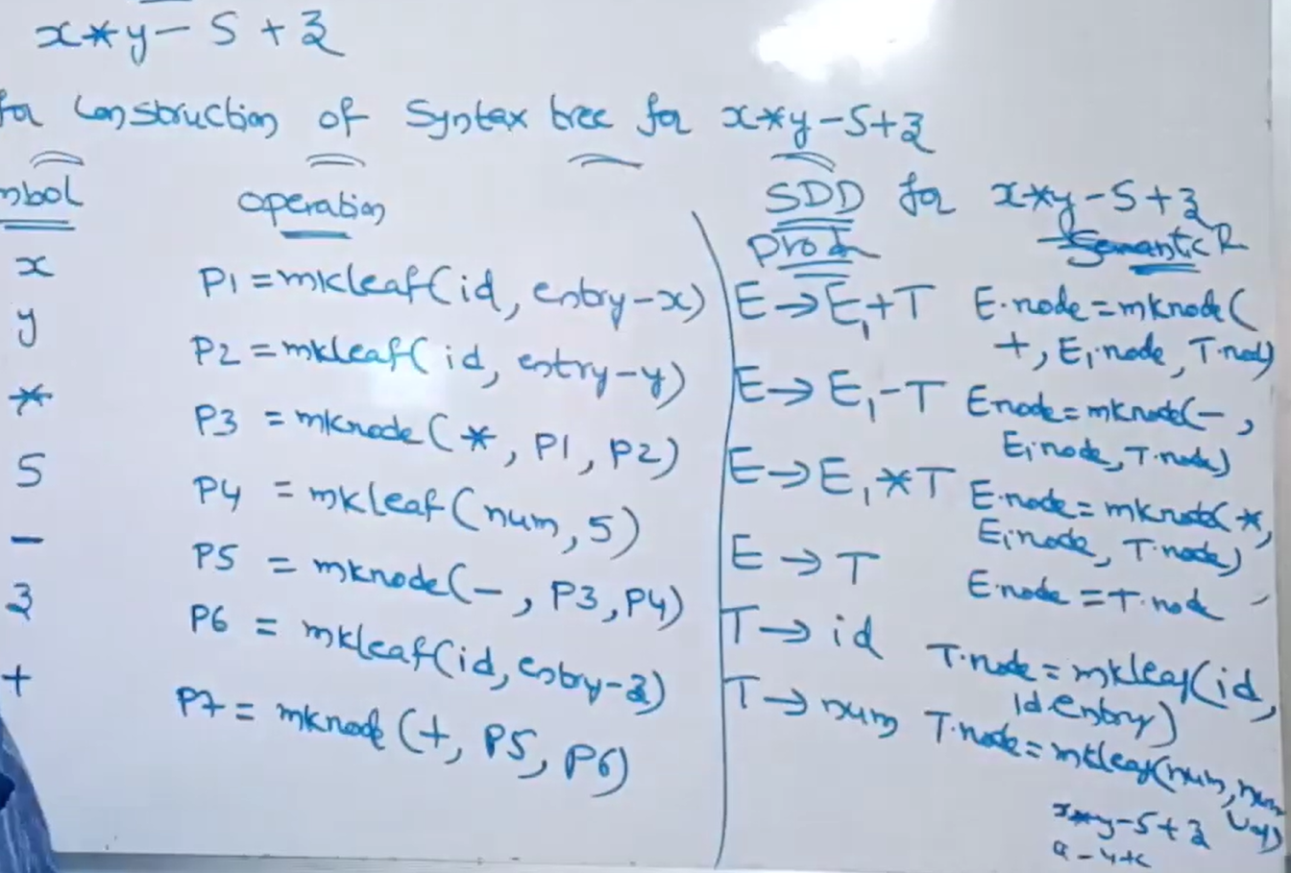

Slide 25
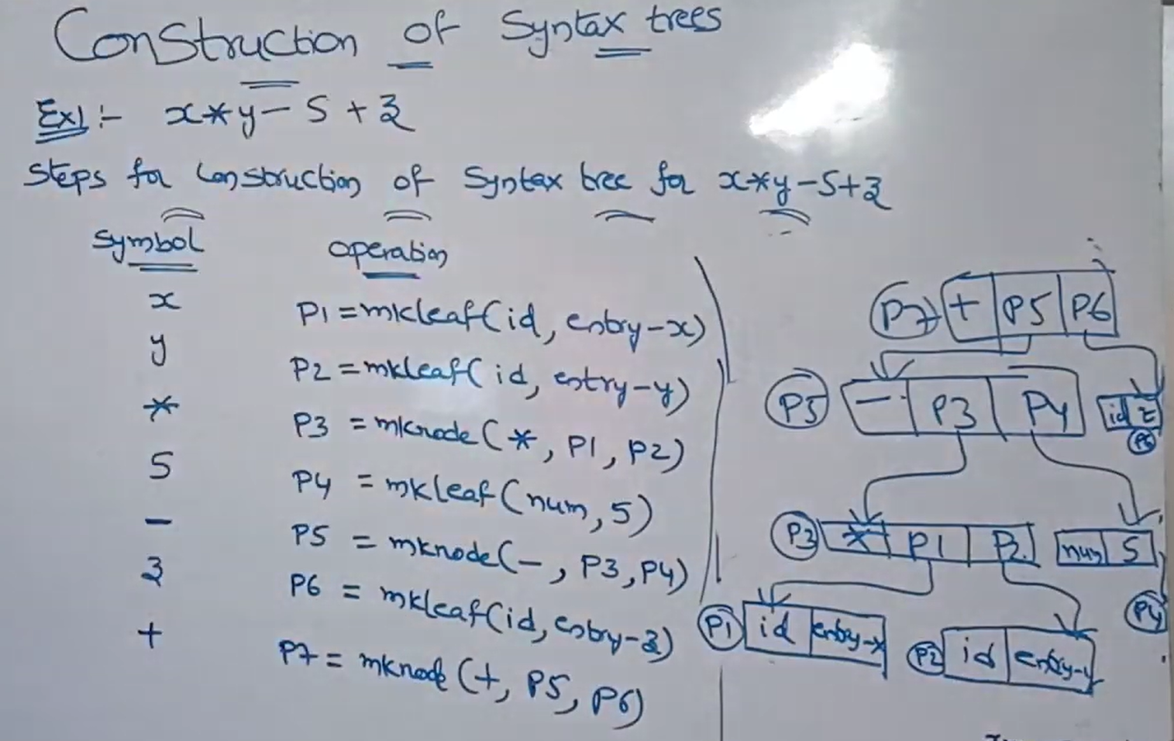

Slide 26
