Slide 1
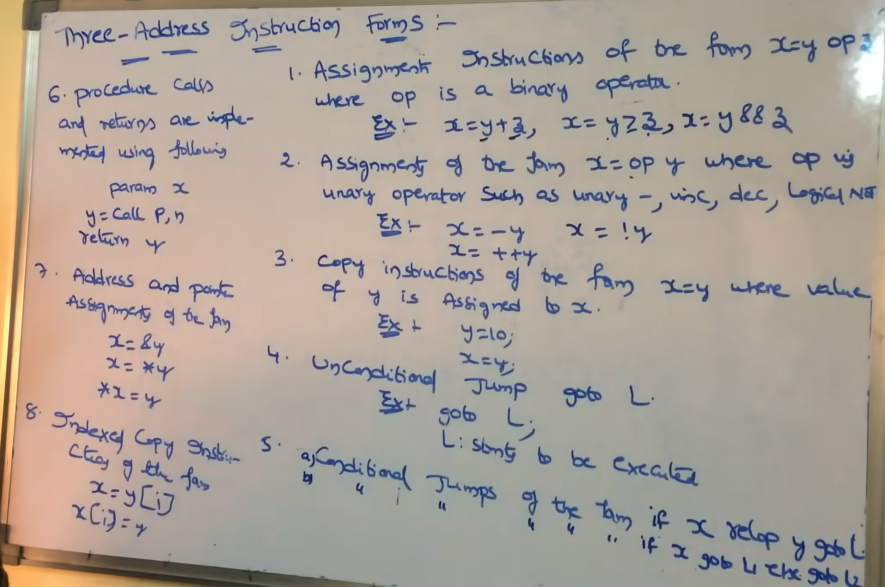

Slide 2
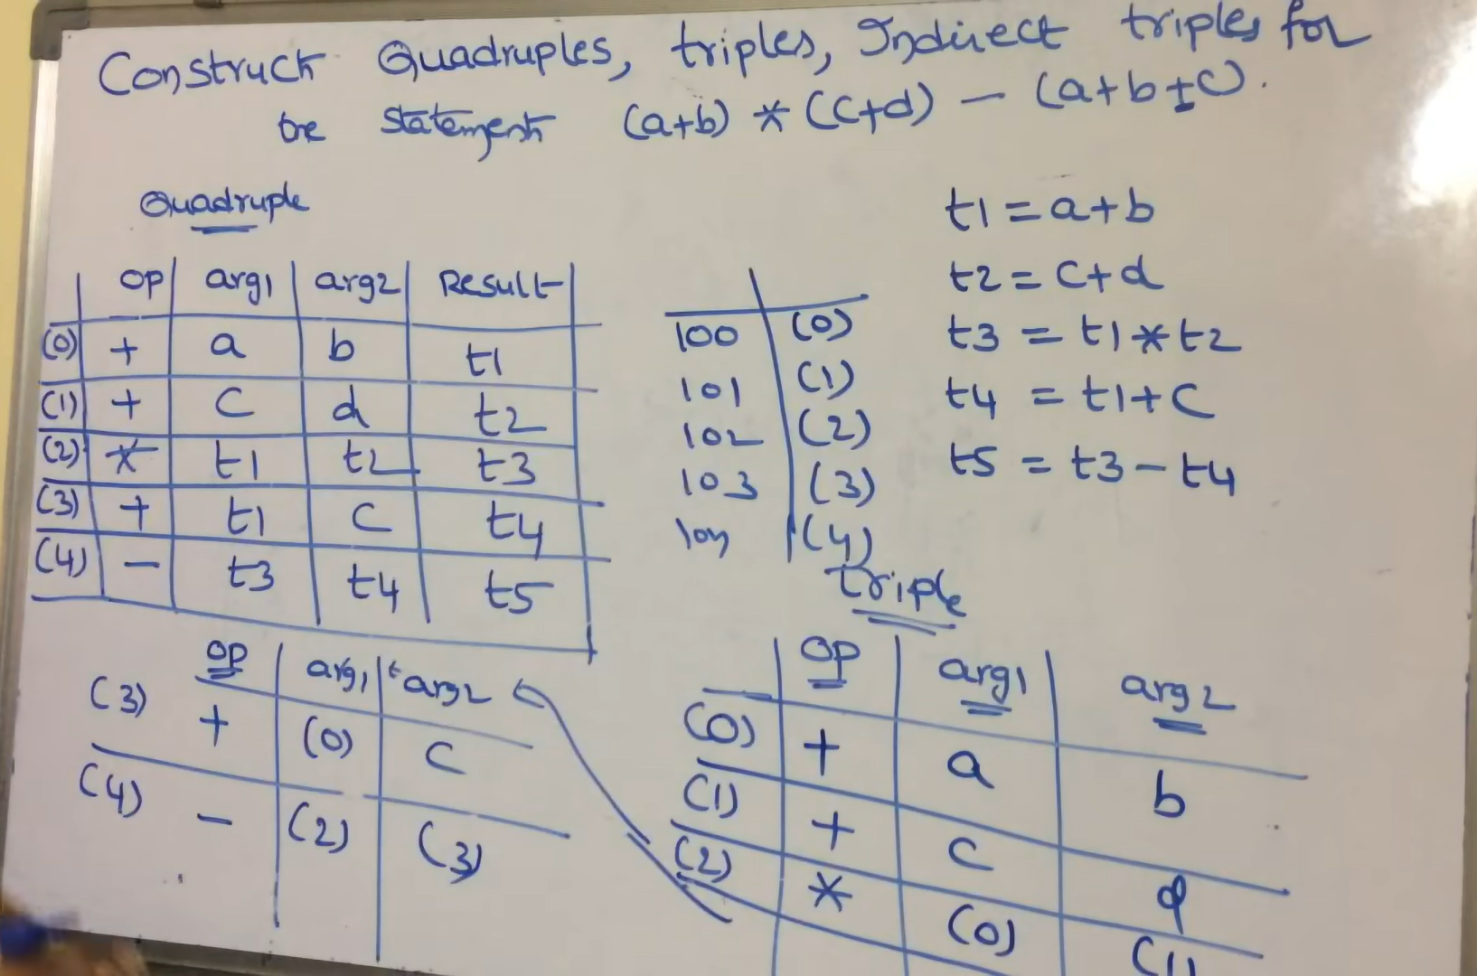

Slide 3
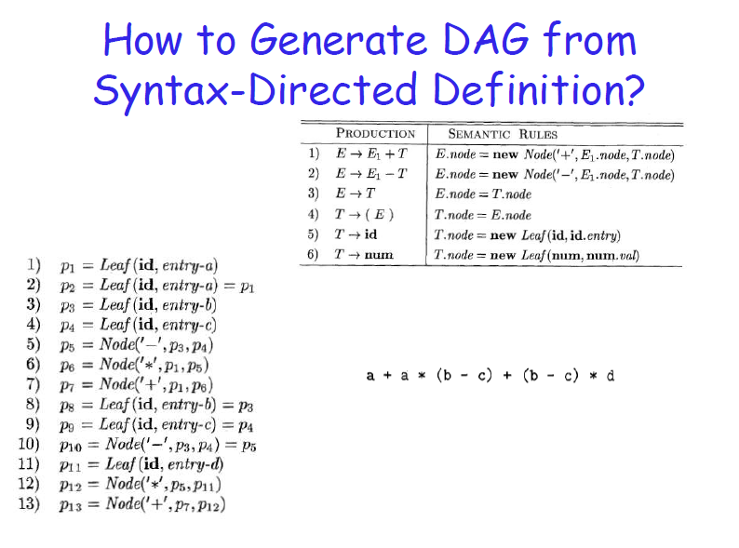
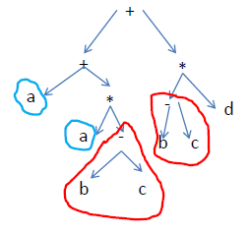
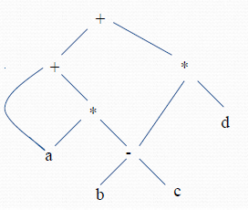
Steps for constructing the DAG

Slide 4
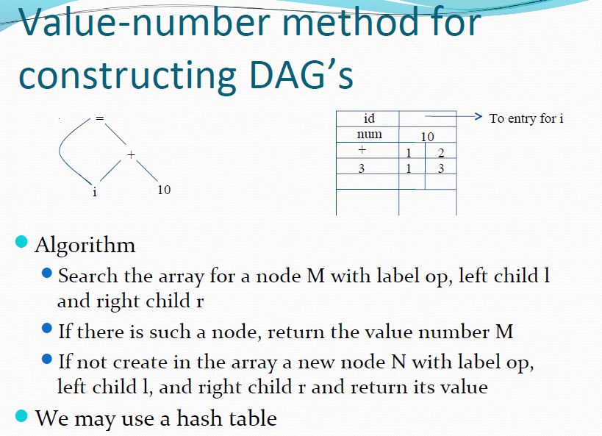
Nodes of DAG for i = i +10 allocated in an array

Slide 5
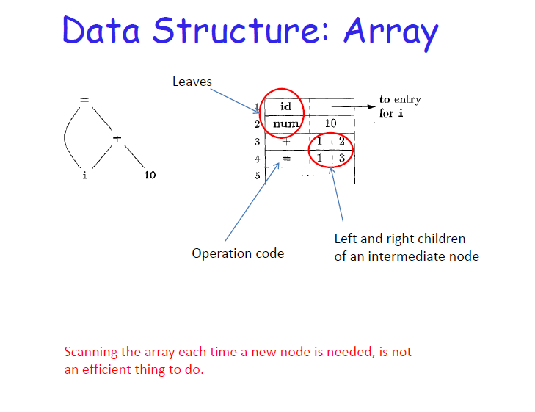
In each record, the first field is an operation code, indicating the label of the node. Leaves have one additional field to hold lexical value and interior nodes have two additional fields indicating left and right children.
In this array we refer to nodes by giving the integer index of the record for that node within the array. This integer is historically called the value number for the node

Slide 6
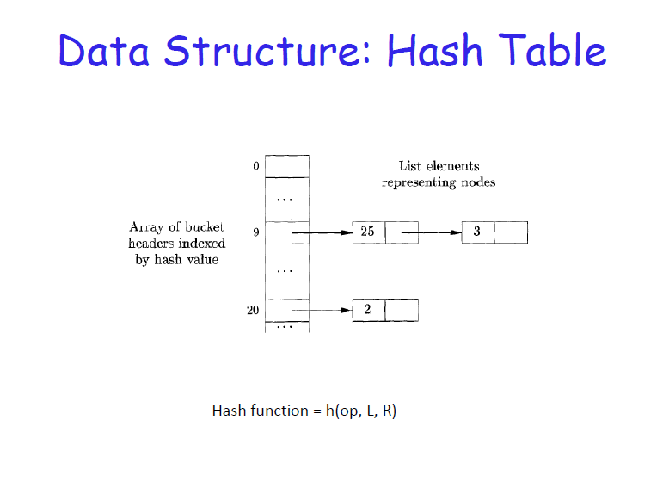
A more efficient method is to use a hash table, in which the nodes are put into “buckets”. Each bucket will have only a few nodes. Hash table supports Dictionaries efficiently. A dictionary is an abstract data type that allows us to insert and delete elements of a set, and to determine whether a given element is currently in the set
The buckets can be implemented as Linked lists. An array indexed by hash value, holds the bucket headers, each of which points to the first cell of a list. The node <op,l,r> can be found on the list whose header is at index h(op,l,r)
To Construct hash table for the nodes of a DAG, a hash function h that computes the index of the for a signature<op,l,r>, in the way that distributes across buckets, is needed.
If a match is found the value number V is returned. Else, new cell is created and added to list of cells for bucket index h(op,l,r) and return the value number V

Slide 7
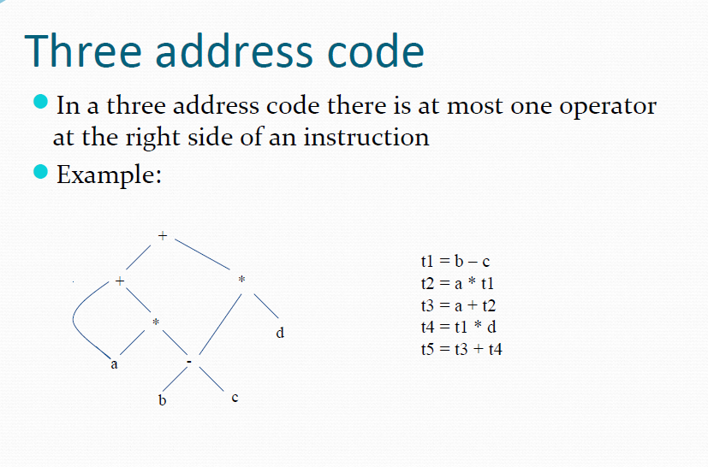
DAG
Three-address code
t1 to t5 are compiler generated temporary names
DAG and its corresponding Three-address code

Slide 8
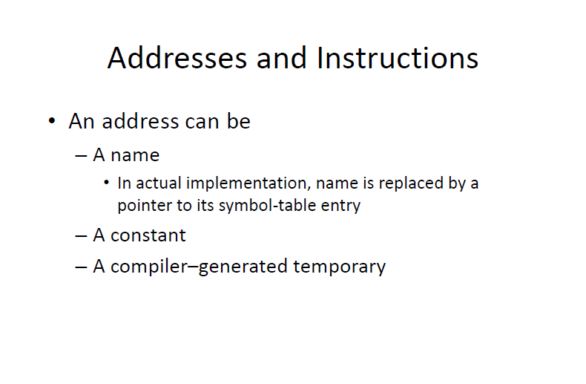
Three- address code is built from two concepts: addresses and instructions.
…… One of the following
Source program name

Slide 9

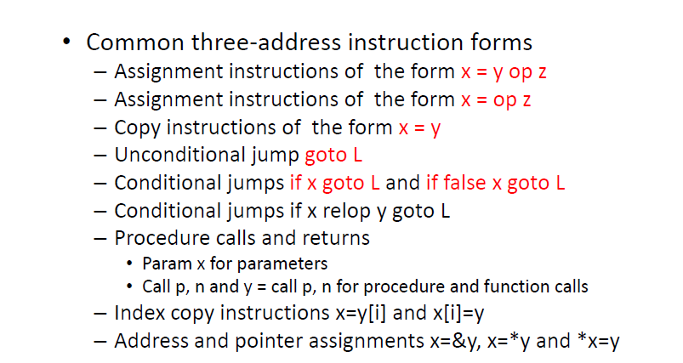
Binary
Unary

Slide 10
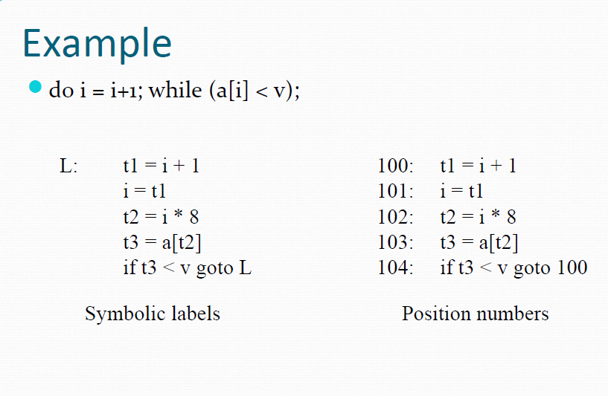
Two ways of assigning labels to three address statements

Slide 11
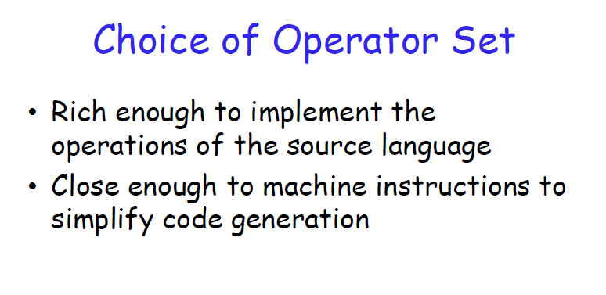

Slide 12

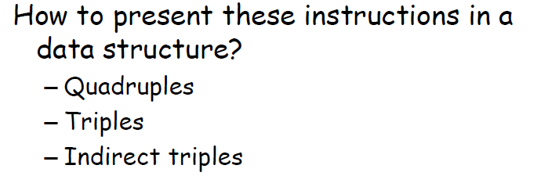
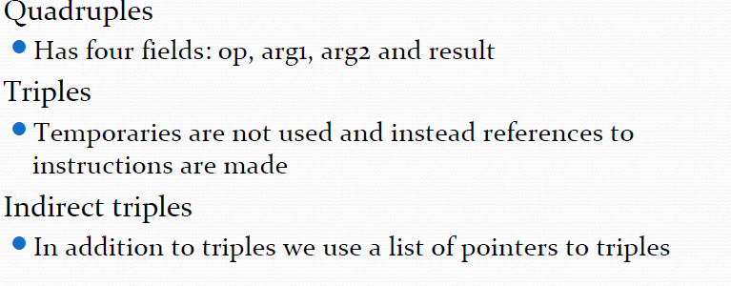

Slide 13
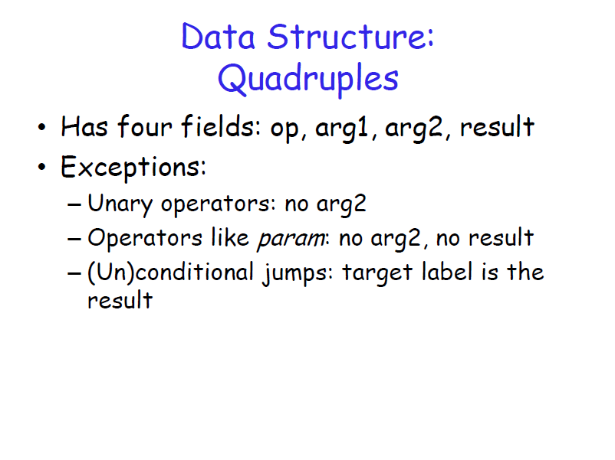
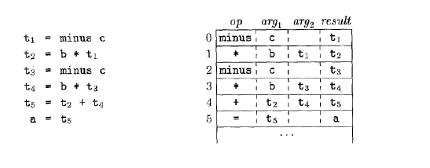

Three-address code
Quadruples

Slide 14
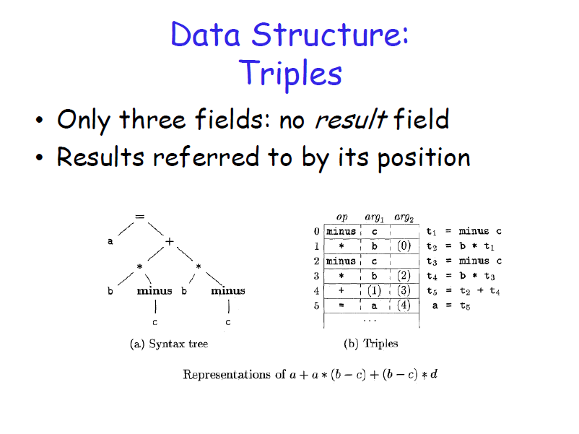

Slide 15
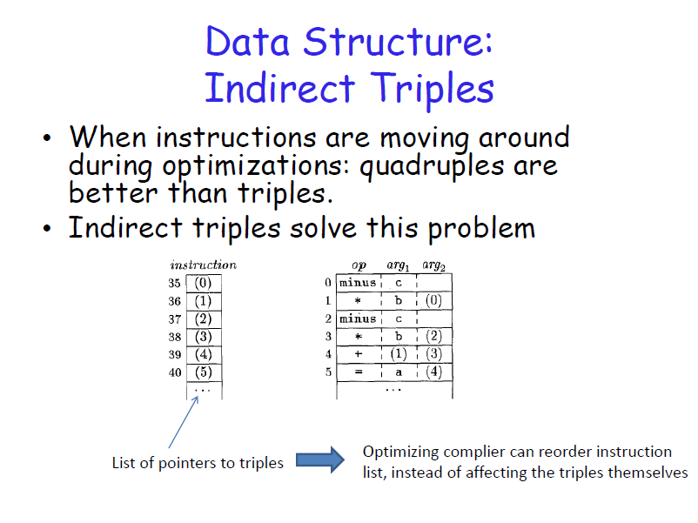

Slide 16
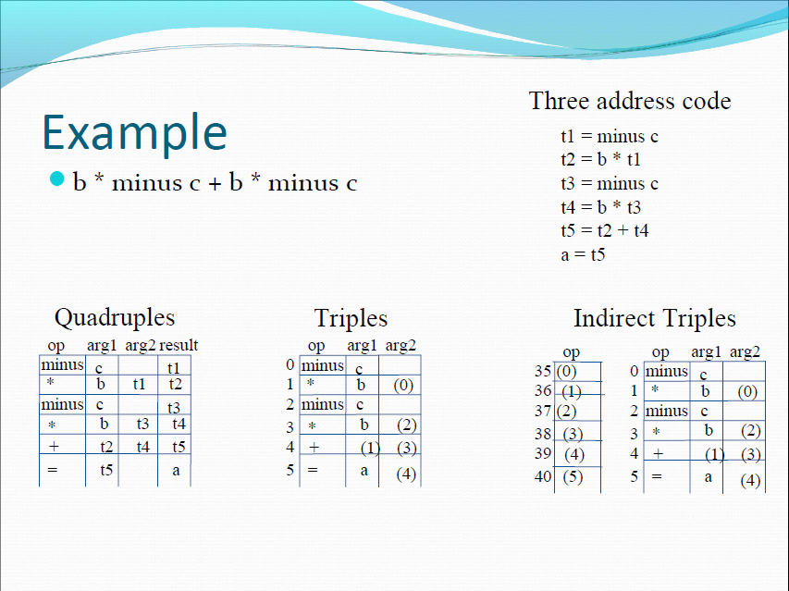

Slide 17
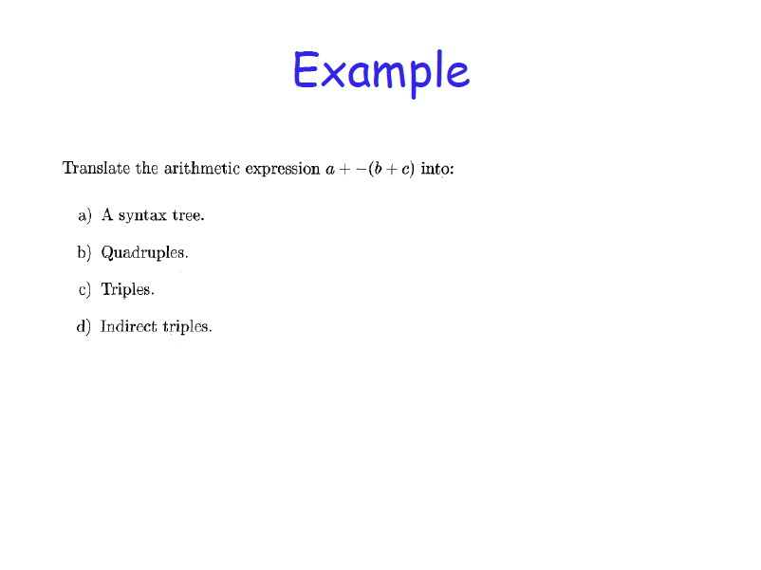

Slide 18
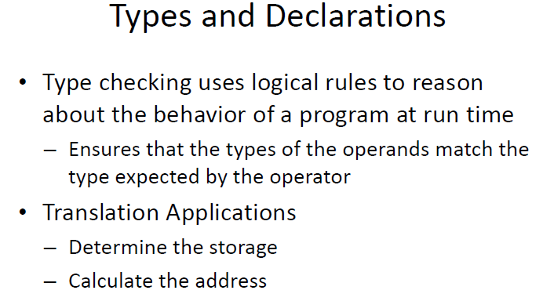

Slide 19
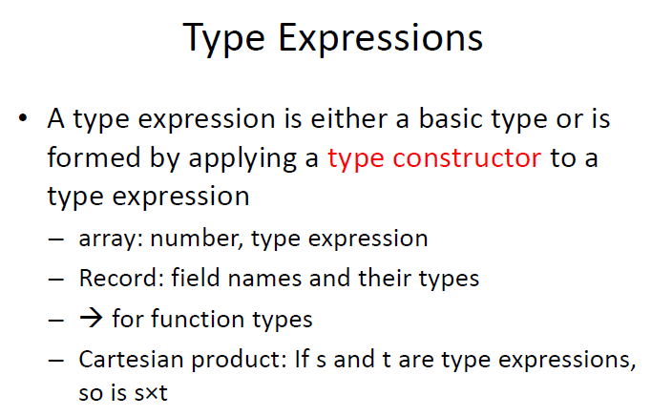

Slide 20
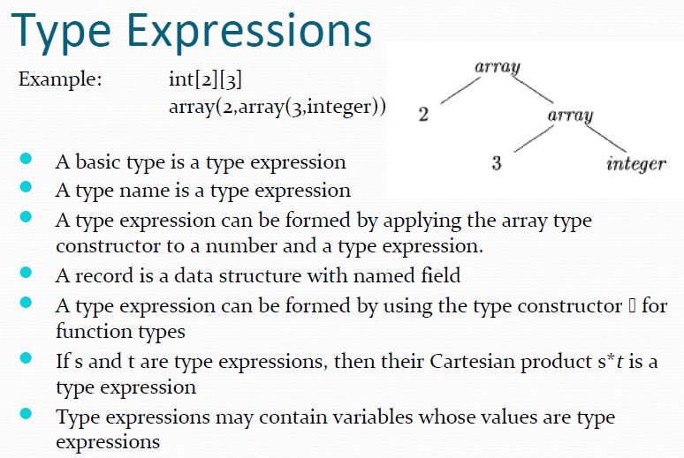

Slide 21
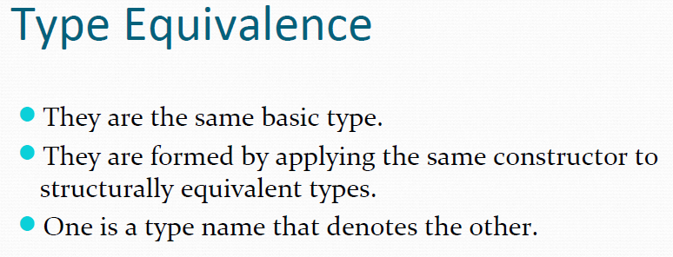
When type expressions are represented by graphs, two types are structurally equivalent if and only if one of the above conditions is true:

Slide 22
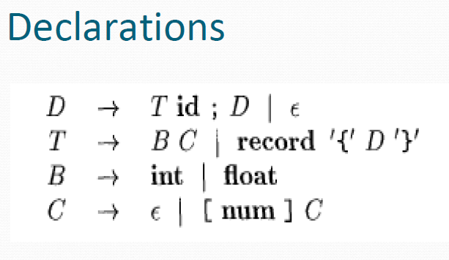
NT “D” generates a sequence of declarations.
NT “T” generates basic, array, or record types.
NT “B” generates one of the basic types int and float.
NT “C” for “component” generates strings of zero or more integers, each integer surrounded by brackets.
An array type consists of a basic type specified by “B”, followed by array components specified by NT “C”.
A record type is a sequence of declarations for the fields of the record, all surrounded by curly braces

Slide 23
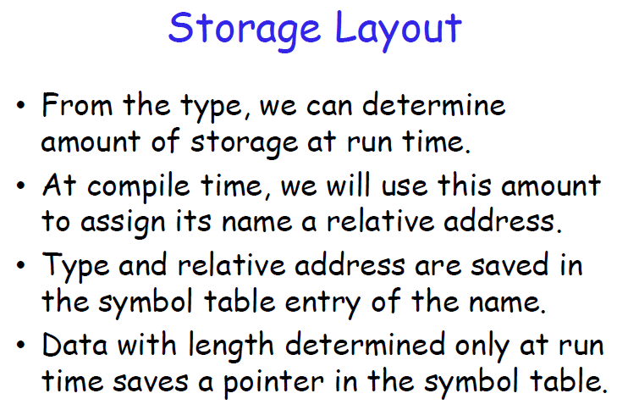

Slide 24
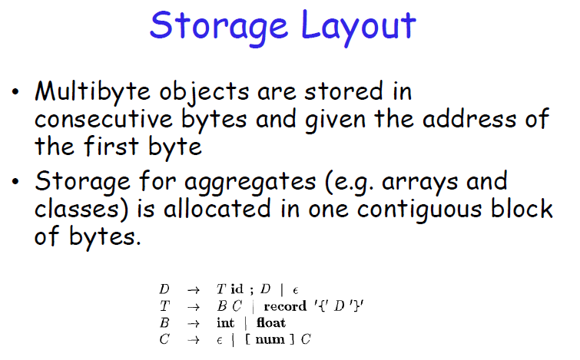

Slide 25
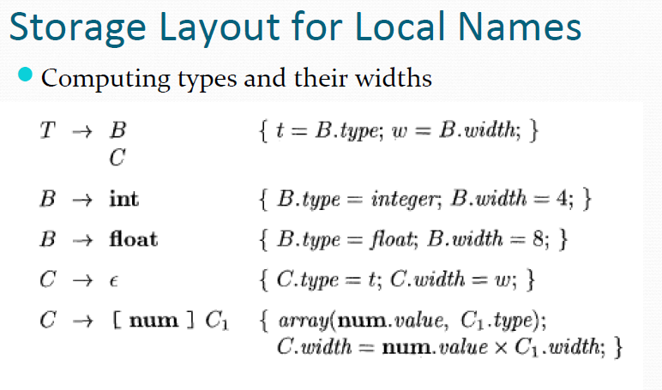
SDT uses synthesized attributes type and width for each NT and two variables t and w to pass type and width information from a B node in a parse tree to the node for the production C->E. In SDD, t and w would be inherited attributes for C.
The body of the T-production consist of NT B, an action and C, which appears on the next line.
The action b/w B and C sets t to B.type and w to B.width.
If B -> int then B.type is set to integer and B.width is set to 4, the width of an integer.
If B-> float then B. type is float and B.width is 8, the width of float.
The Productions for C determine whether T generates a basic type or an array type.
If C-> E, then t becomes C.type and w becomes C.width. Otherwise, C specifies an array component. The action for C->[num]C₁ forms C.type.

Slide 26
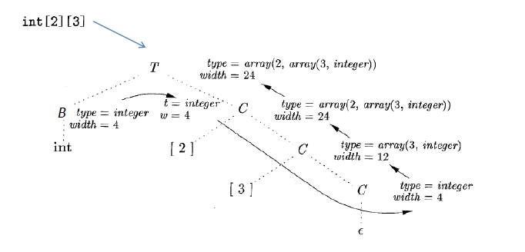
SDT of array types
The solid lines show how the type and width are passed from B, down the chain of C’s through variables t and w, and then back up the chain as synthesized attributes type and width .
The variables t and w are assigned the values of B.type and B.width , respectively, before the subtree with the C nodes is examined.
The values of t and w are used at the node for C->E to start the evaluation of the synthesized attributes up the chain of C nodes.

Slide 27
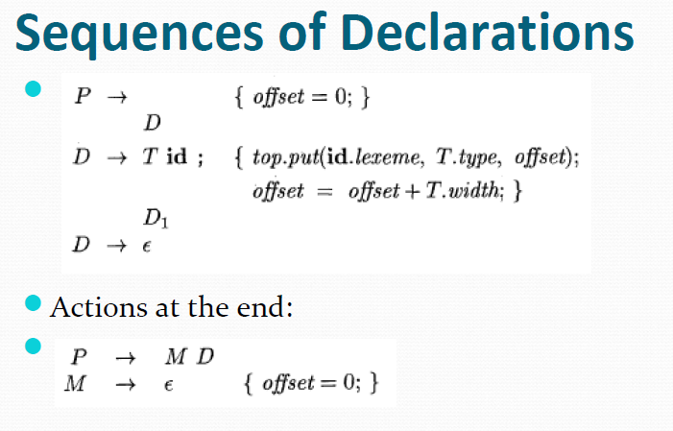
NT generating E, called marker nonterminals, can be used to rewrite productions so that all actions appear at the ends of right sides.
Using a marker nonterminal M
The variable offset is used to keep track of next available relative address. The translation scheme deals with a sequence of declarations of the form T id, Where T generates a type.
Before the first declaration is considered, offset is set to 0.
As each new name x is seen, x is entered into the symbol table with its relative address set to the current value of offset, which is then incremented by the width of the type of x.

Slide 28
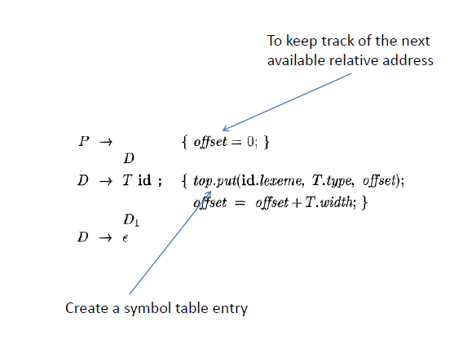
The schematic action within the production D->T id; D₁ creates a symbol table entry by executing top.put(id.lexeme, T.type, offset). Here top denotes the current symbol table.
The method top.put creates a symbol-table entry for id.lexeme, with T.type and relative address offset in its data area.

Slide 29
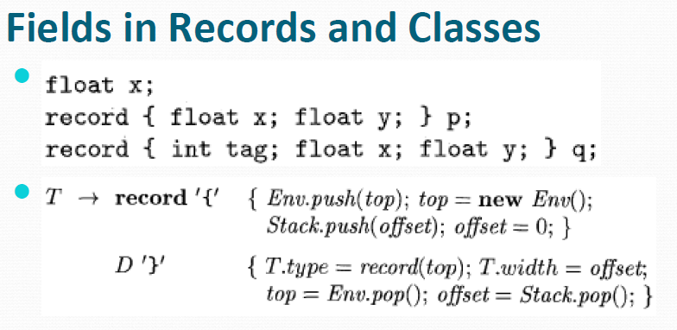
This production has 2 semantic actions.
The embedded action before D saves the existing symbol table, denoted by top and sets top to a fresh symbol table. It also saves the current offset, and sets offset to 0.
2. The declarations generated by D will result in types and relative address being put in the fresh symbol table. The action after D creates a record type using top, before restoring the saved symbol table and offset.

