Slide 1
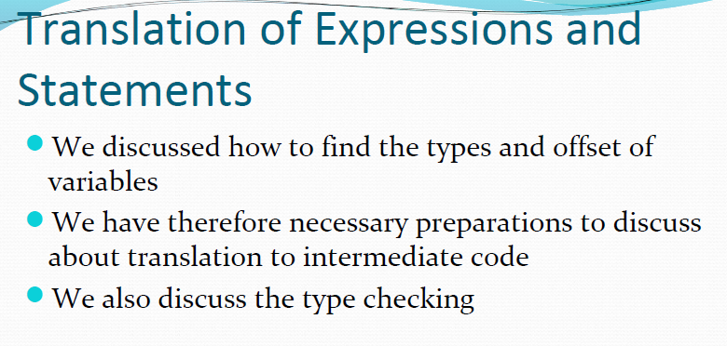

Slide 2
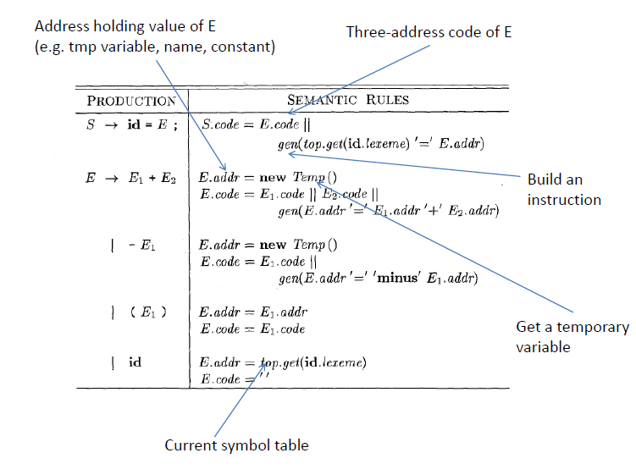
Translation of Expressions
1. Operations within Expressions : The syntax-directed definition builds up the three-address code for an assignment statement S using attribute code for S and attribute addr and code for an expression E. Attributes S.code and E.code denote the three-address code for S and E. Attribute E.addr denotes the address that will hold the value of E.
Three-address code for expressions

Slide 3
Production E->id, the semantic rules define E.addr to point symbol-table entry for the instance of id. The Fn. top.get retrieves instance of id. E.code is set to the empty string.
When E->(E1), the translation of E is the same as that of the sub-expression E₁. Hence, E.addr, and E.code equals E₁.code.

Slide 4
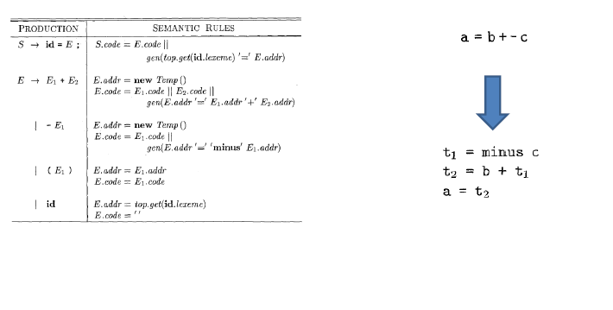

Slide 5
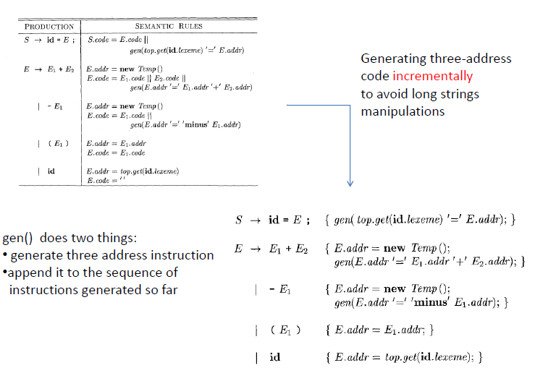

Slide 6
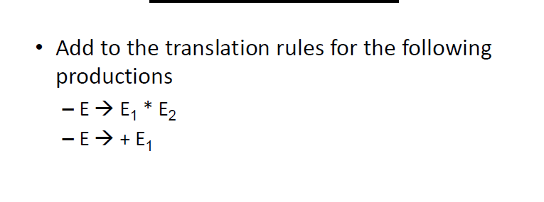

Slide 7
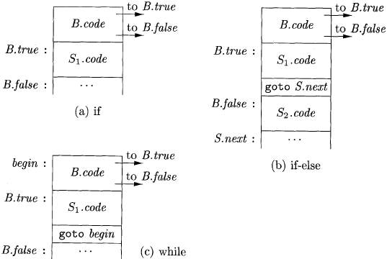

Flow-of-Control Statements

Slide 8
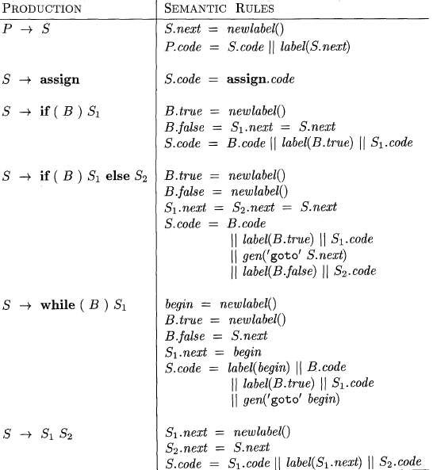
Syntax-directed definition

Slide 9
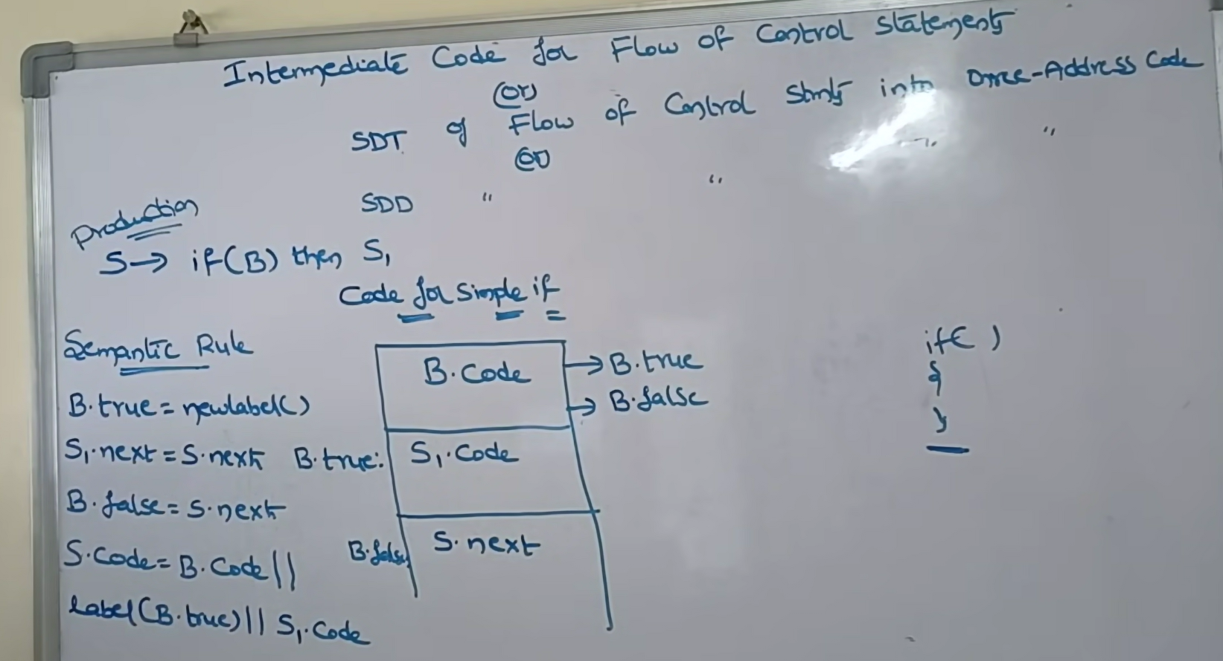

Slide 10
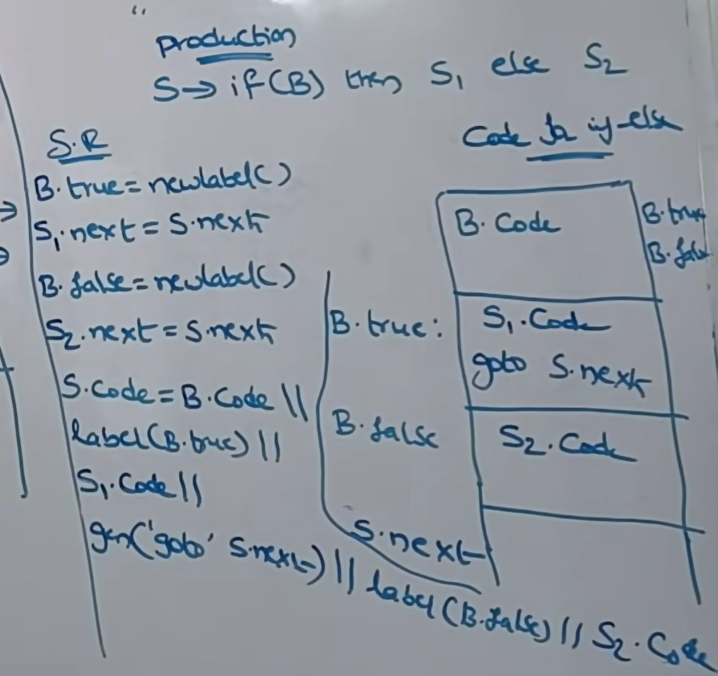

Slide 11
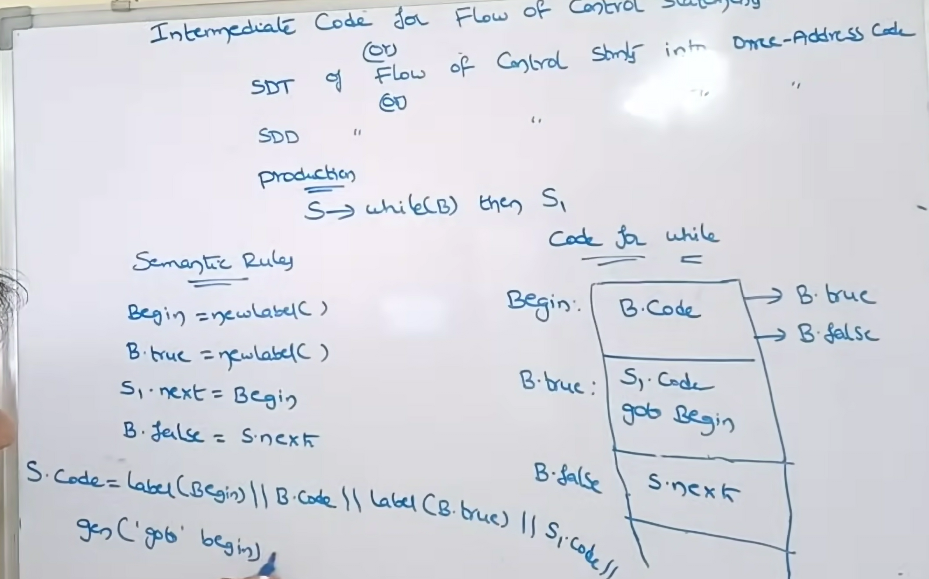

Slide 12
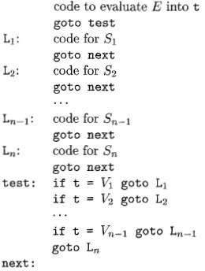
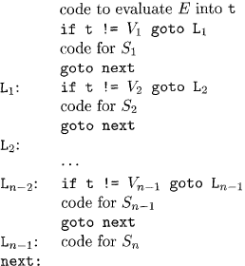
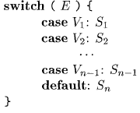
Translation of a switch-statement

Slide 13
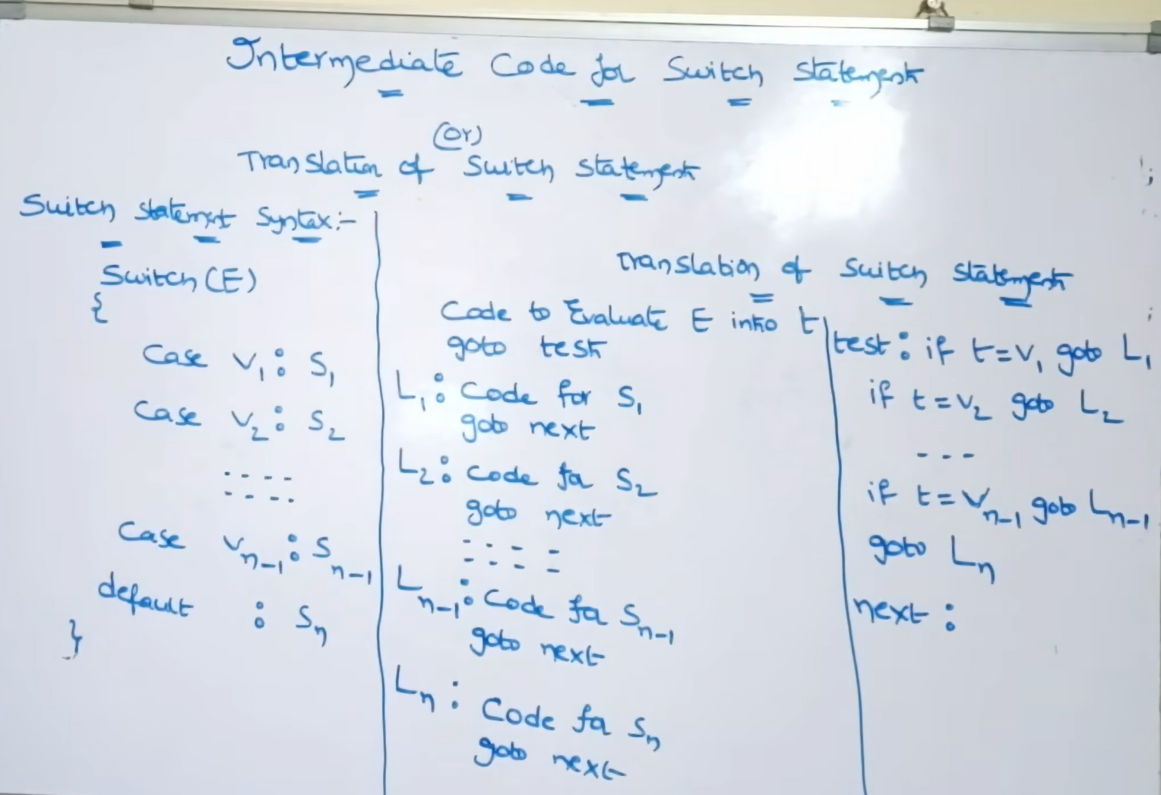

Slide 14
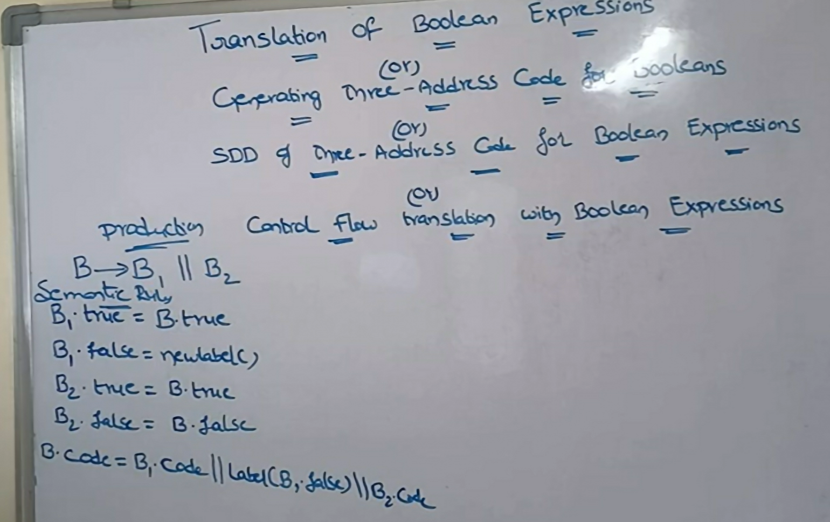
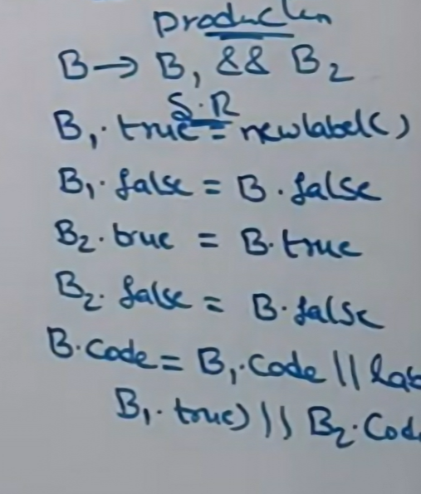

Slide 15
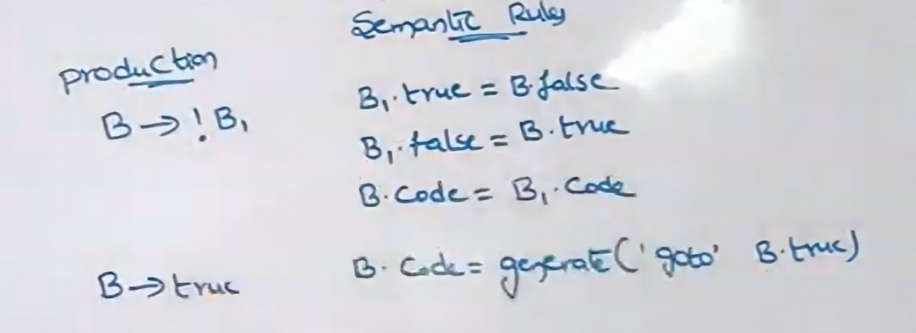

Slide 16
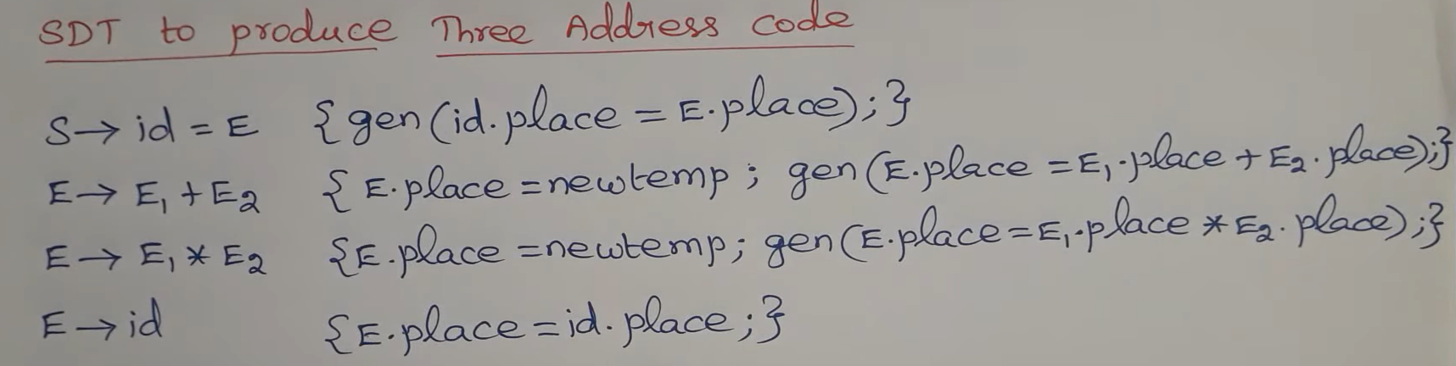

Slide 17
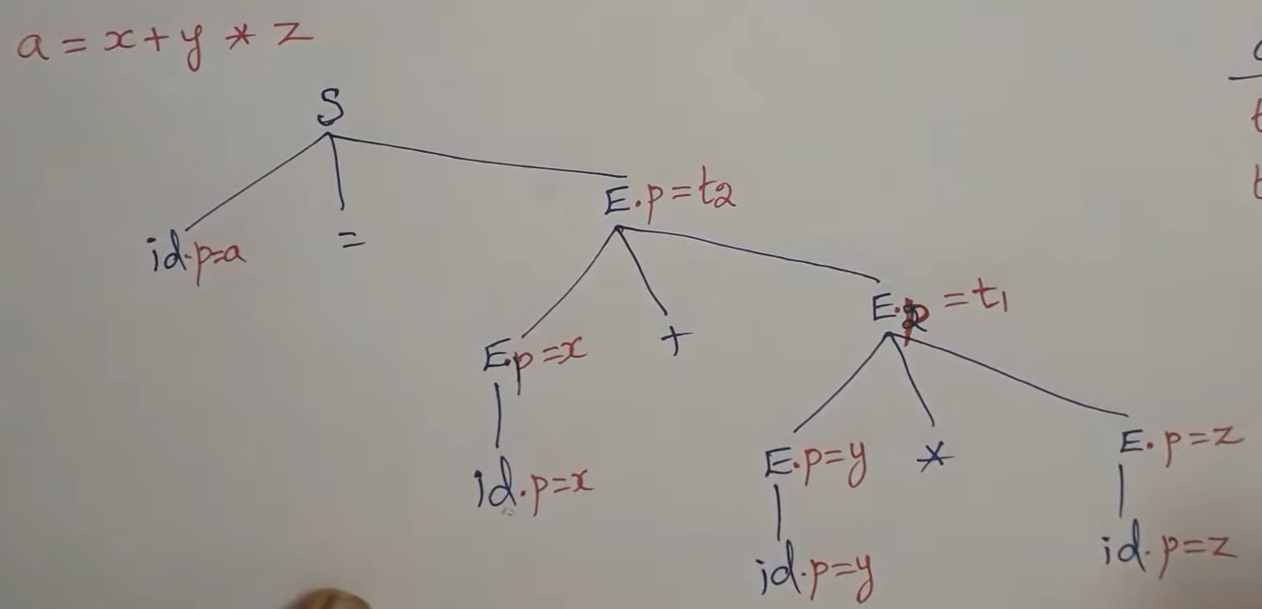
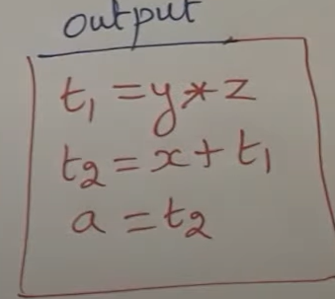

Slide 18
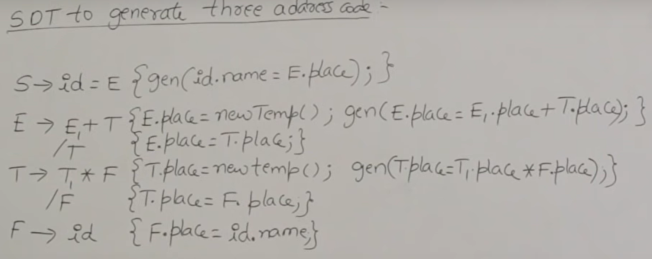

Slide 19
