Slide 1
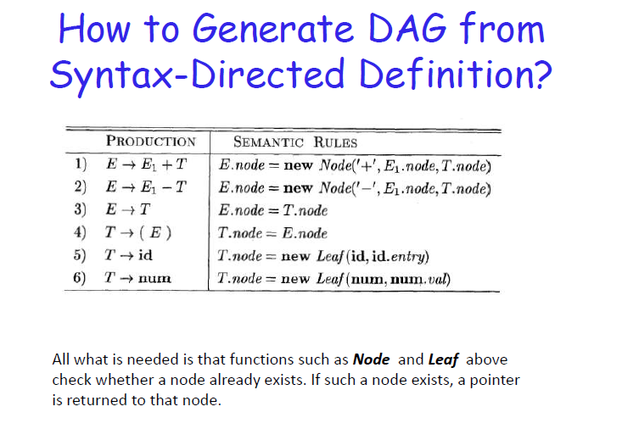

Slide 2
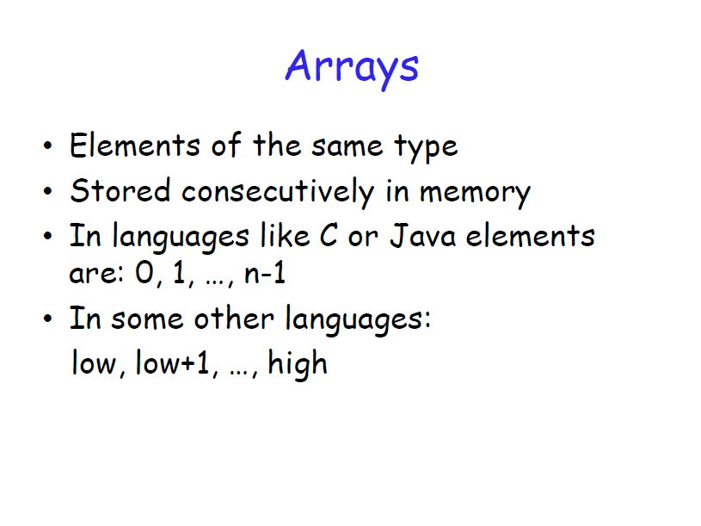

Slide 3
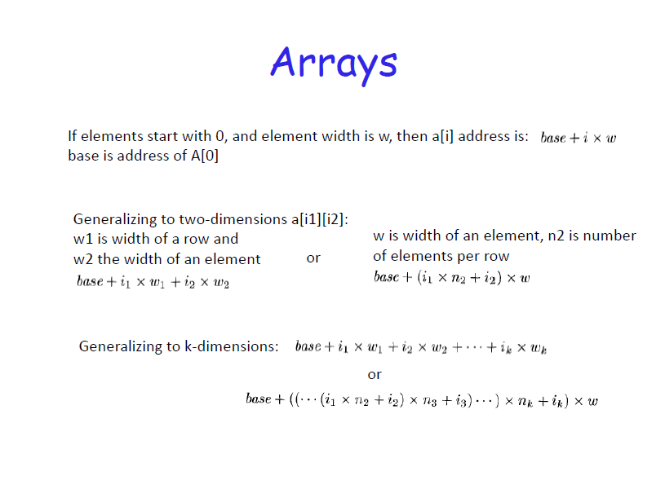

Slide 4
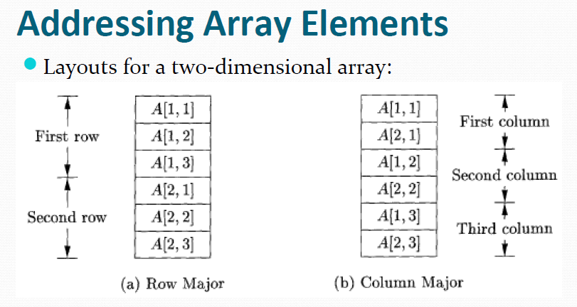

Slide 5
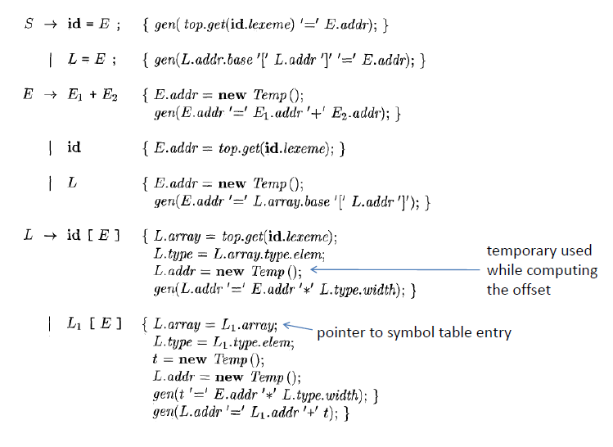

Slide 6
Control Flow
boolean expressions are often used to:
Alter the flow of control.
Compute logical values.

Slide 7
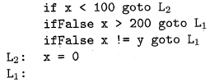
Short-Circuit Code
⚫
⚫

Slide 8
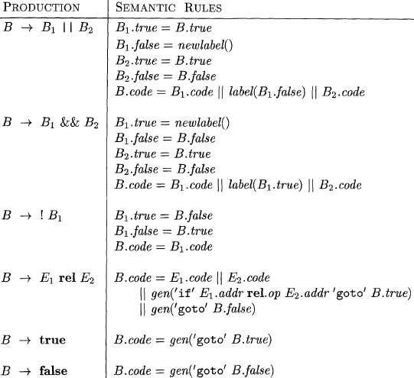
Translation of Boolean expression (or) Control flow translations with Boolean expressions (or) SDD of Three address code for Boolean expressions (or) Generating three-address code for booleans

Slide 9
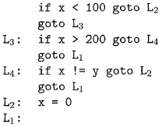
translation of a simple if-statement
⚫
⚫

Slide 10
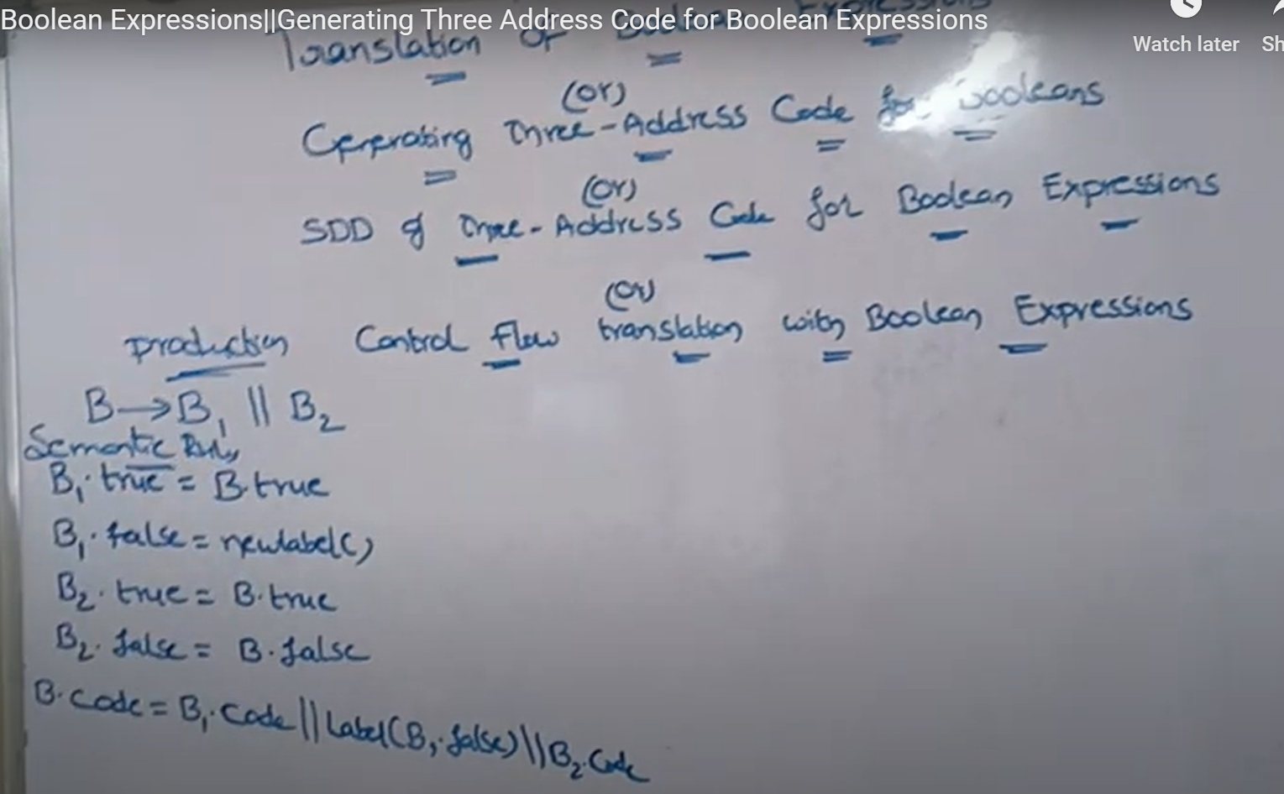
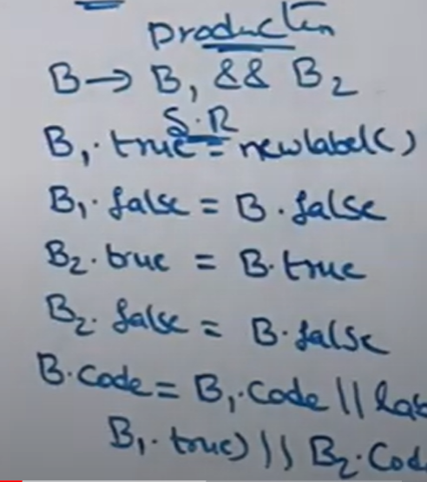

Slide 11
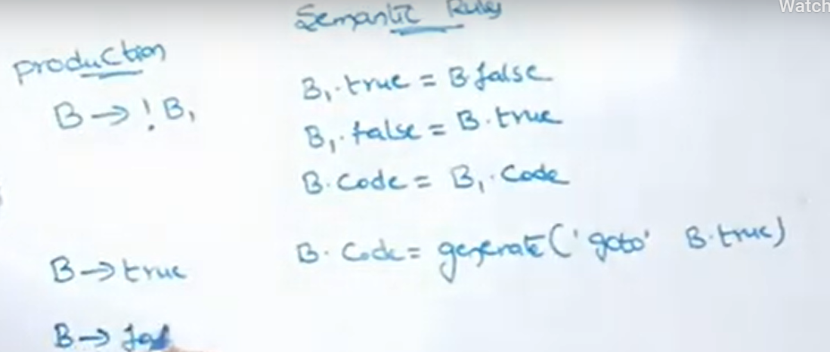

Slide 12
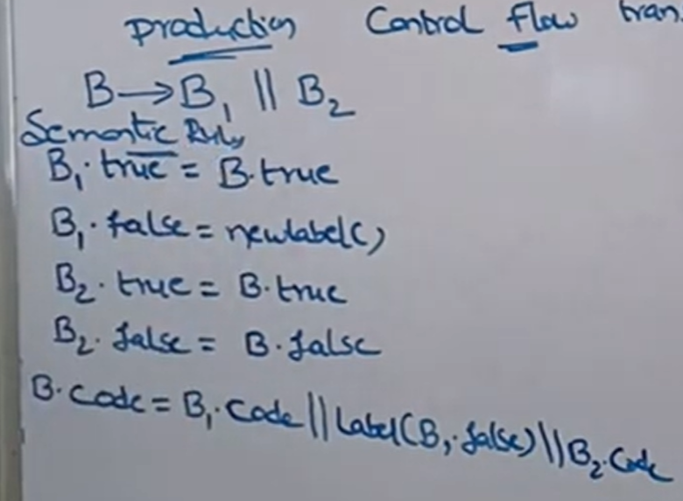

Slide 13
Backpatching
Previous codes for Boolean expressions insert symbolic labels for
jumps
It therefore needs a separate pass to set them to appropriate addresses
We can use a technique named backpatching to avoid this
We assume we save instructions into an array and labels will be indices
in the array
For nonterminal B we use two attributes B.truelist and B.falselist
together with following functions:
makelist(i): create a new list containing only I, an index into the array of instructions
Merge(p1,p2): concatenates the lists pointed by p1 and p2 and returns a
pointer to the concatenated list
Backpatch(p,i): inserts i as the target label for each of the instruction
on the list pointed to by p

Slide 14
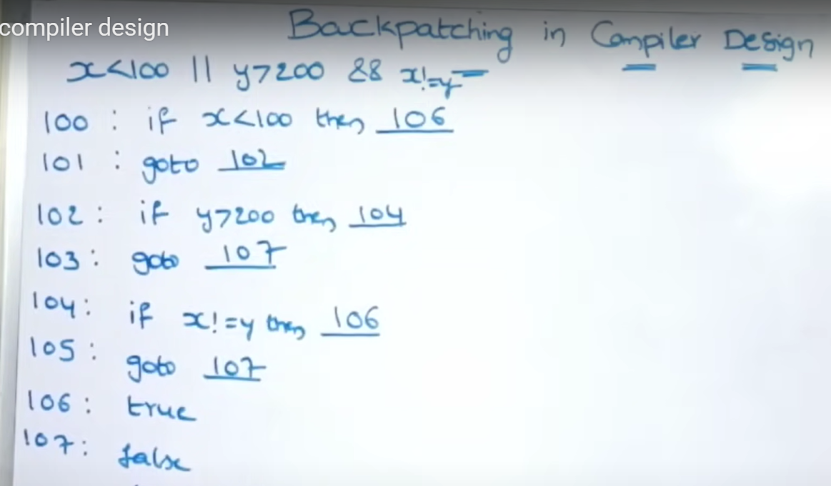
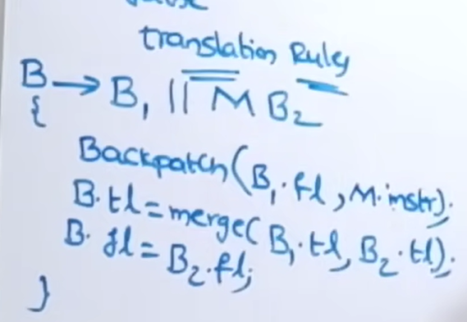

Slide 15
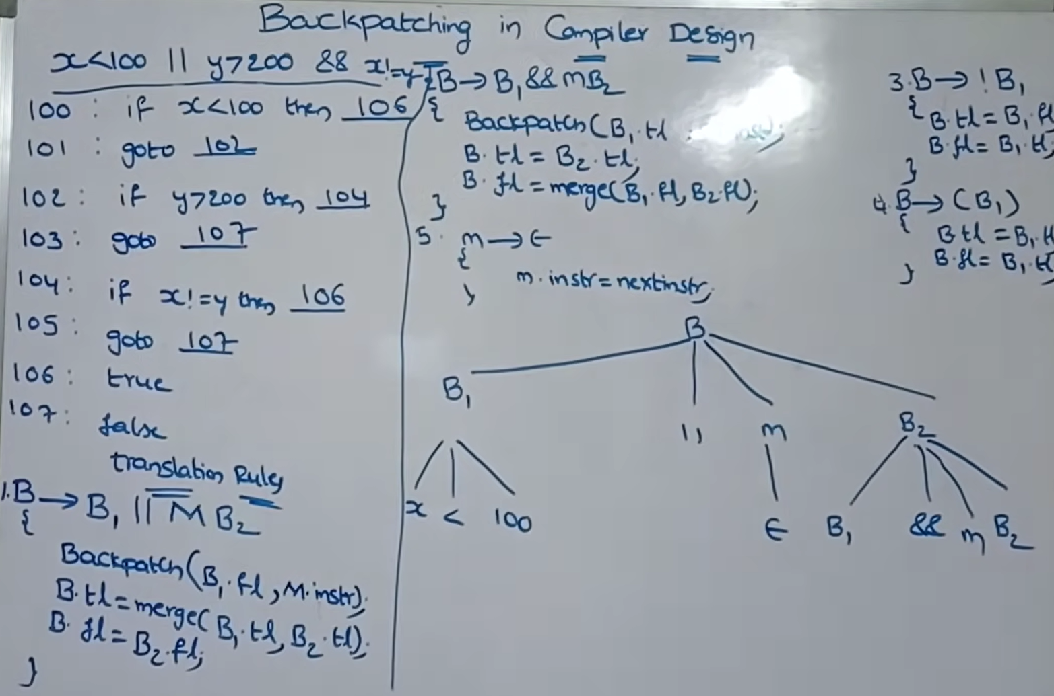

Slide 16
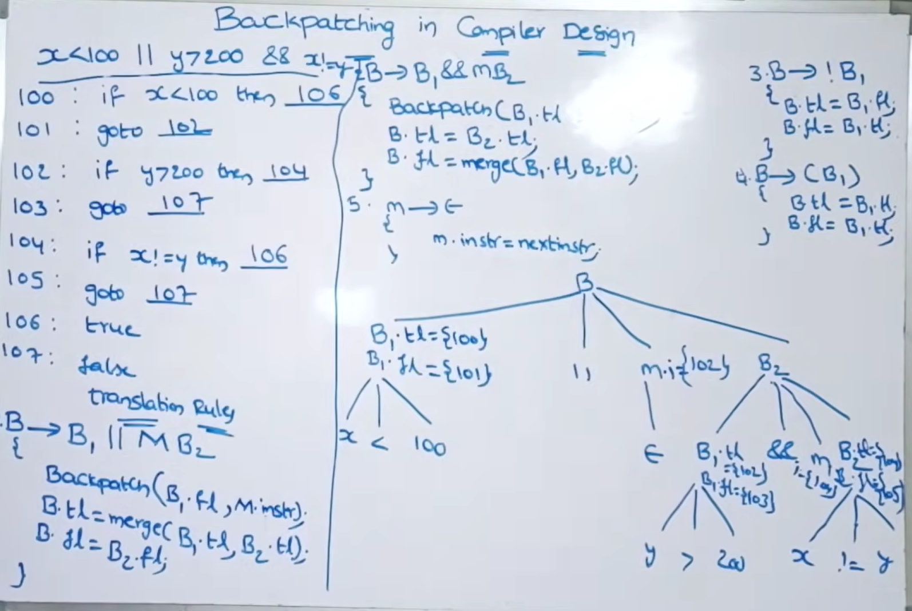

Slide 17
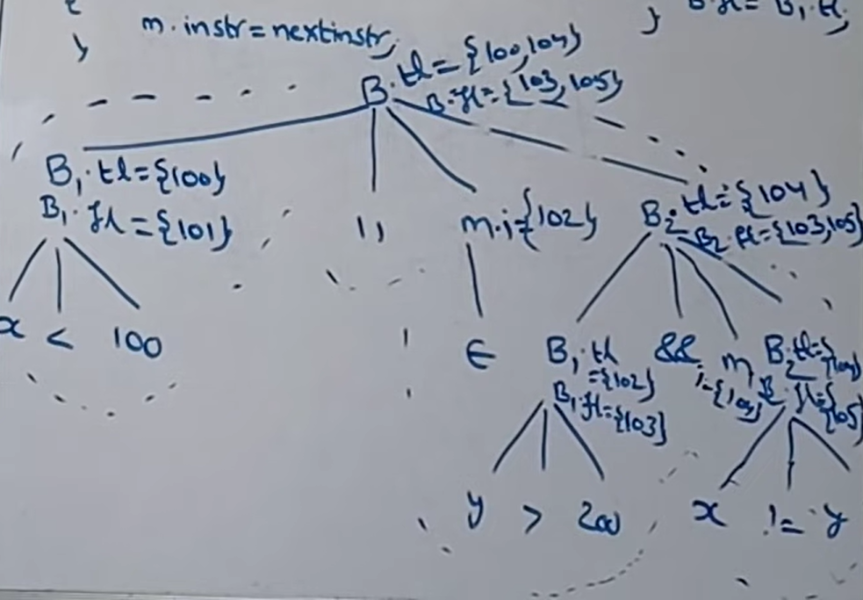

Slide 18
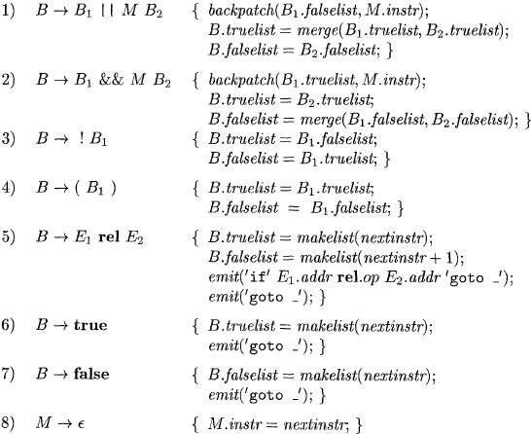
Backpatching for Boolean Expressions
⚫
⚫

Slide 19
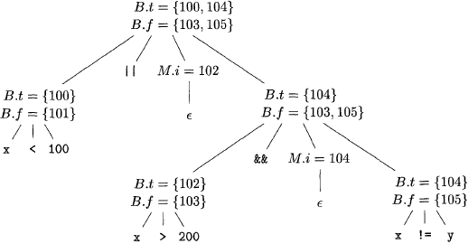
Backpatching for Boolean Expressions
Annotated parse tree for x < 100 || x > 200 && x ! = y

Slide 20
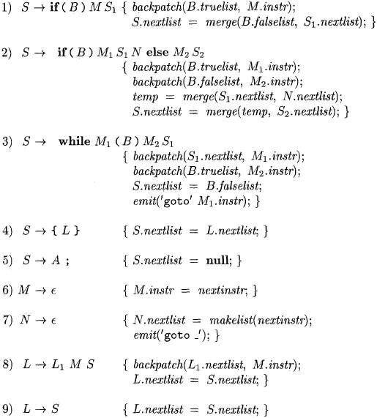
Flow-of-Control Statements

