Slide 1




Slide 2

GRAPH COLORING

Slide 3

TEST TIME ON ACTIVITY SELECTION PROBLEM
URL:https://forms.gle/xBEqaAHK7WPC2FdD7
QR CODE:

Slide 4
Graph Coloring
Introduction
Graph Coloring is an assignment of labels traditionally called "colors" to elements of a graph subject to certain constraints.
A way of coloring the vertices of a graph such that no two adjacent vertices are of the same color -- a common graph coloring problem
Other kinds of Graph coloring are Edge Coloring and Face coloring
Graph coloring enjoys many practical applications as well as theoretical challenges.

Slide 5
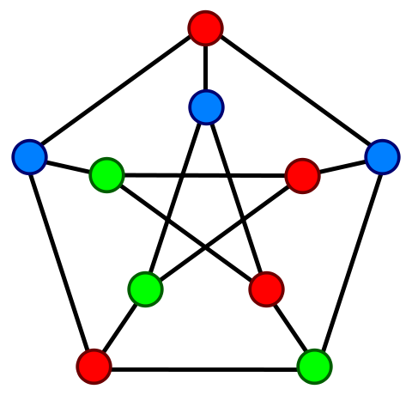
Graph Coloring
Example
Vertex coloring of the “Petersen graph” with 3 colors, the minimum number possible
Chromatic Number: The smallest number of colors needed to color a graph G is called its chromatic number. For example, the graph on the right can be colored minimum 3 colors.

Slide 6
Graph Coloring
Applications
1) Making Schedule or Time Table
2) Mobile Radio Frequency Assignment
3) Sudoku
4) Register Allocation
5) Bipartite Graphs
6) Map Coloring

Slide 7
Graph Coloring
Greedy method to solve it
There is no efficient algorithm available for coloring a graph with minimum number of colors as the problem is a known NP-Complete problem
The algorithm doesn’t guarantee to use minimum colors, but it guarantees an upper bound on the number of colors.
The basic algorithm never uses more than d+1 colors where d is the maximum degree of a vertex in the given graph.

Slide 8
Graph Coloring
Algorithm
1. Color first vertex with first color.
2. Do following for remaining V-1 vertices.
Consider the currently picked vertex and color it with the lowest numbered color that has not been used on any previously colored vertices adjacent to it.
If all previously used colors appear on vertices adjacent to v, assign a new color to it

Slide 9
Graph Coloring
Program
graphcoloring1.java
Output
Coloring of graph 1
Vertex 0 ---> Color 0
Vertex 1 ---> Color 1
Vertex 2 ---> Color 2
Vertex 3 ---> Color 0
Vertex 4 ---> Color 1
Coloring of graph 2
Vertex 0 ---> Color 0
Vertex 1 ---> Color 1
Vertex 2 ---> Color 2
Vertex 3 ---> Color 0
Vertex 4 ---> Color 3

Slide 10
Graph Coloring
import java.io.*; import java.util.*; import java.util.LinkedList; class Graph { private int V; // No. of vertices private LinkedList<Integer> adj[]; Graph(int v) { V = v; adj = new LinkedList[v]; for (int i=0; i<v; ++i) adj[i] = new LinkedList(); } void addEdge(int v,int w) { adj[v].add(w); adj[w].add(v); //Graph is undirected } | void greedyColoring() { int result[] = new int[V]; Arrays.fill(result, -1); result[0] = 0; boolean available[] = new boolean[V]; Arrays.fill(available, true); for (int u = 1; u < V; u++) { Iterator<Integer> it = adj[u].iterator() ; while (it.hasNext()) { int i = it.next(); if (result[i] != -1) available[result[i]] = false; }

Slide 11
Graph Coloring
int cr; for (cr = 0; cr < V; cr++){ if (available[cr]) break; } result[u] = cr; Arrays.fill(available, true); } for (int u = 0; u < V; u++) System.out.println("Vertex " + u + " ---> Color " +result[u]); } | public static void main(String args[]) { Graph g1 = new Graph(5); g1.addEdge(0, 1); g1.addEdge(0, 2); g1.addEdge(1, 2); g1.addEdge(1, 3); g1.addEdge(2, 3); g1.addEdge(3, 4); System.out.println("Coloring of graph 1"); g1.greedyColoring(); System.out.println(); Graph g2 = new Graph(5); g2.addEdge(0, 1); g2.addEdge(0, 2); g2.addEdge(1, 2); g2.addEdge(1, 4); g2.addEdge(2, 4); g2.addEdge(4, 3); System.out.println("Coloring of graph 2 "); g2.greedyColoring(); }}

Slide 12
Graph Coloring
Program
graphcoloring1.java
The algorithm doesn’t always use minimum number of colors.
The number of colors used sometime depend on the order in which vertices are processed.
Order in which the vertices are picked is important. There are different ways to do so
The most common is Welsh–Powell Algorithm which considers vertices in descending order of degrees.

Slide 13
Graph Coloring
Welsh Powell Algorithm
Find the degree of each vertex
List the vertices in order of descending degrees.
Colour the first vertex with color 1.
Move down the list and color all the vertices not connected to the coloured vertex, with the same color.
Repeat step 4 on all uncolored vertices with a new color, in descending order of degrees until all the vertices are coloured.

Slide 14
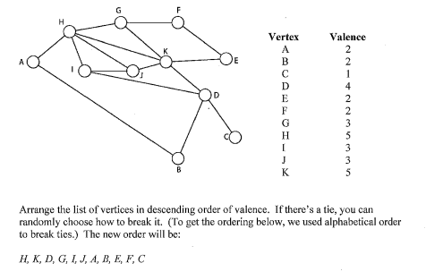
Graph Coloring
Welsh Powell Algorithm

Slide 15
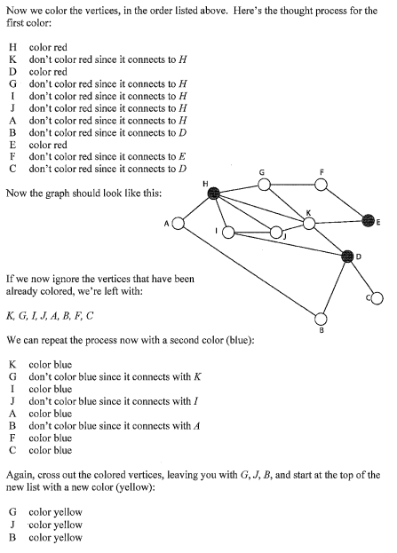
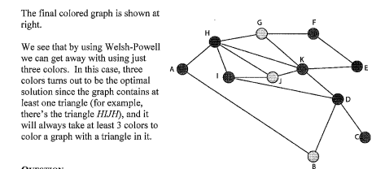
Graph Coloring
Welsh Powell Algorithm

Slide 16
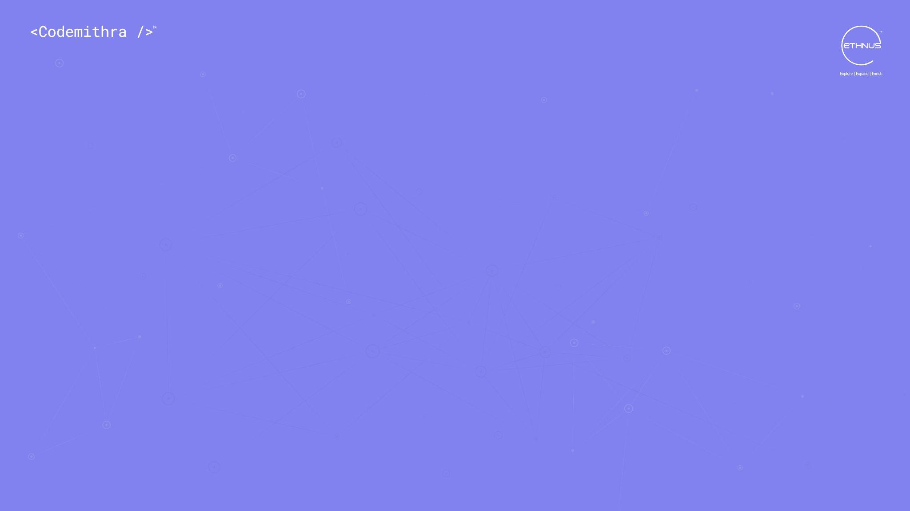



THANK YOU
+91 78150 95095
codemithra@ethnus.com
www.codemithra.com

