Slide 1
BSTS301P
Quiz PPT

Slide 2

Java introduction, Features, Structure, Data Types
URL:https://forms.gle/gaGM3PgURvrSd96G6
QR CODE:

Slide 3
Test time on basic input,output,operators
URL:https://forms.gle/vLep53Dn1cNGn6ks9
QR CODE:

Slide 4

Decision-making and Control structures
URL:https://forms.gle/eeUKnoLr6kuVMPPQ9
QR CODE:

Slide 5
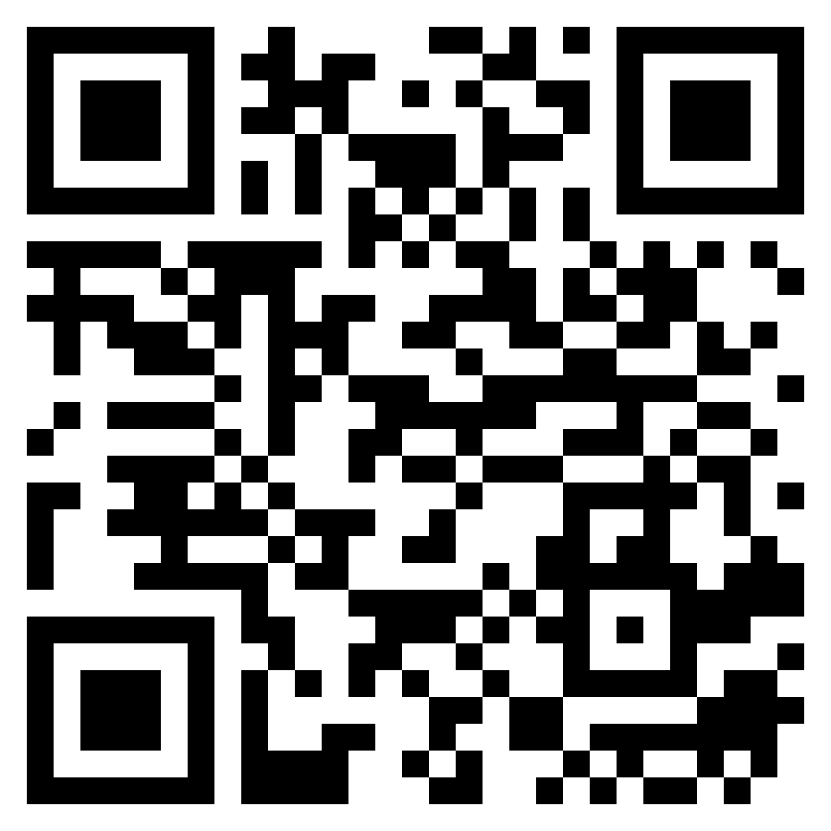
INTRODUCTION TO ALGORITHMS
URL: https://forms.gle/LsD6CnjK5gaVNHg98
QR CODE:

Slide 6
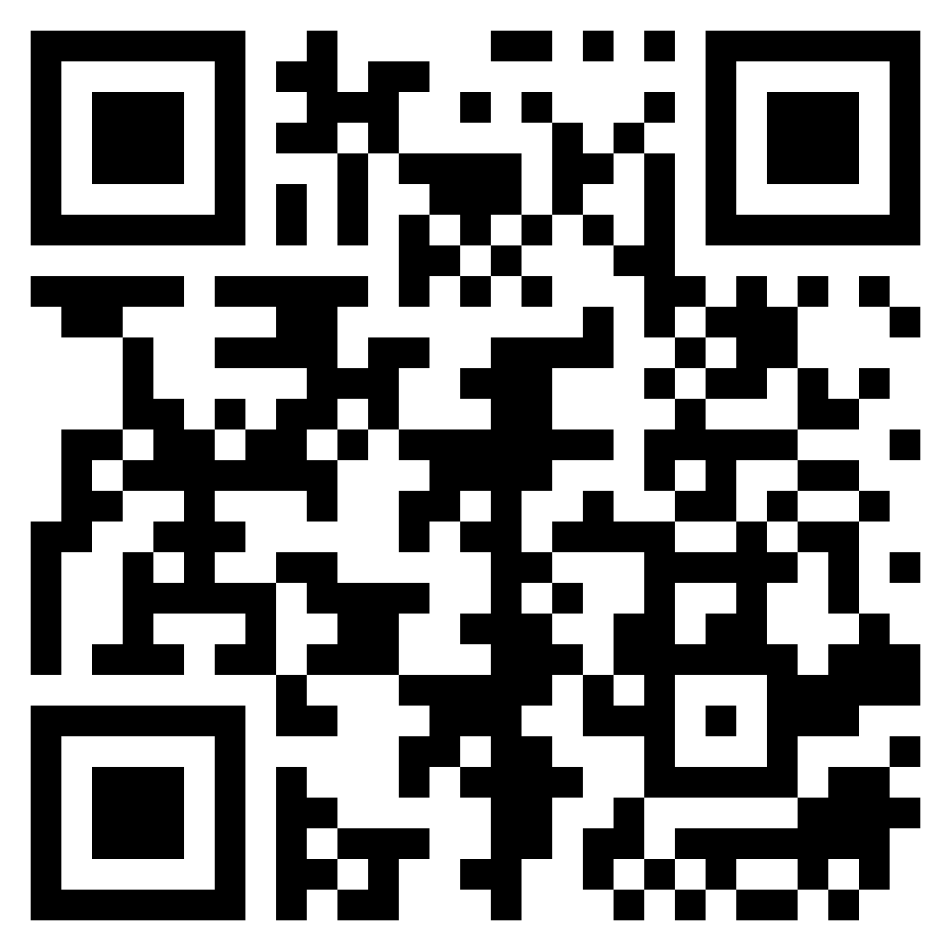
TEST TIME ON TIME AND SPACE COMPLEXITY
URL:https://forms.gle/YDWLEoCL7apATTAU8
QR CODE:

Slide 7
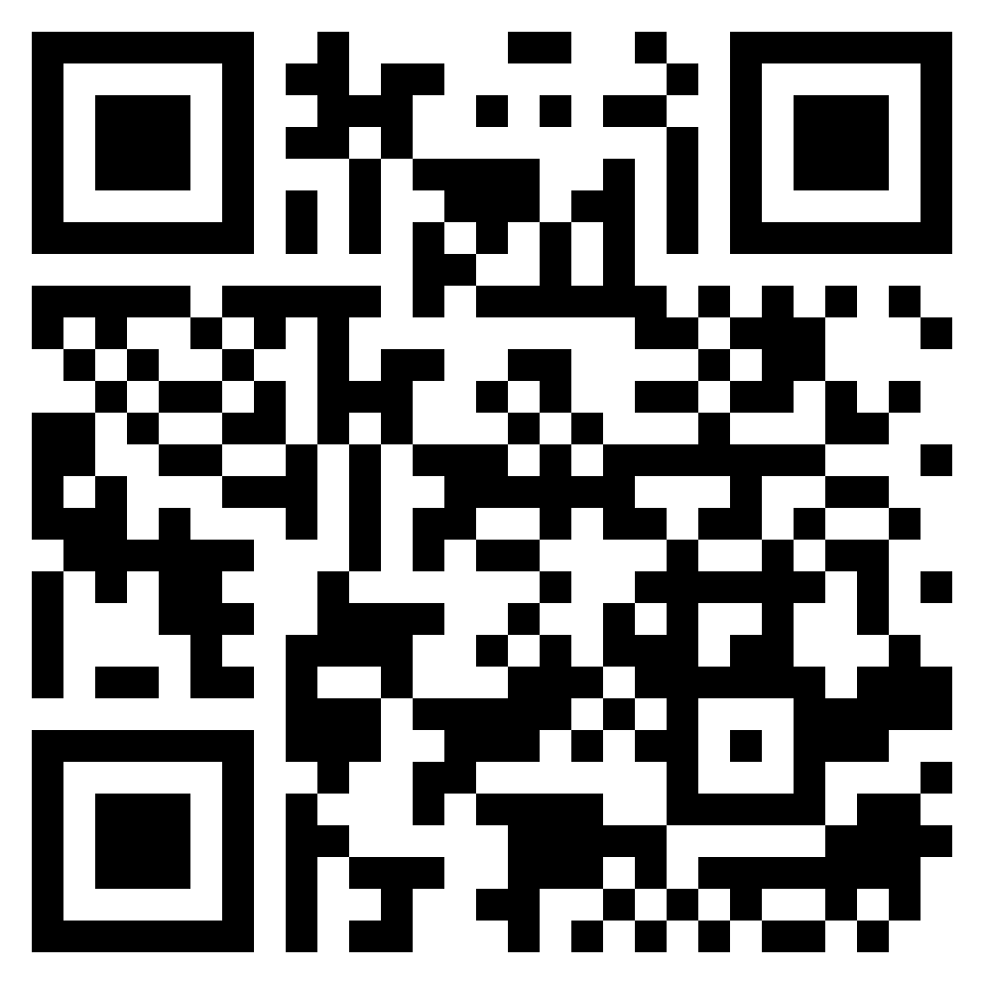
TEST TIME ON SIMPLE SIEVE
URL:https://forms.gle/rfiS4B5bPgnaRVgg6
QR CODE:

Slide 8
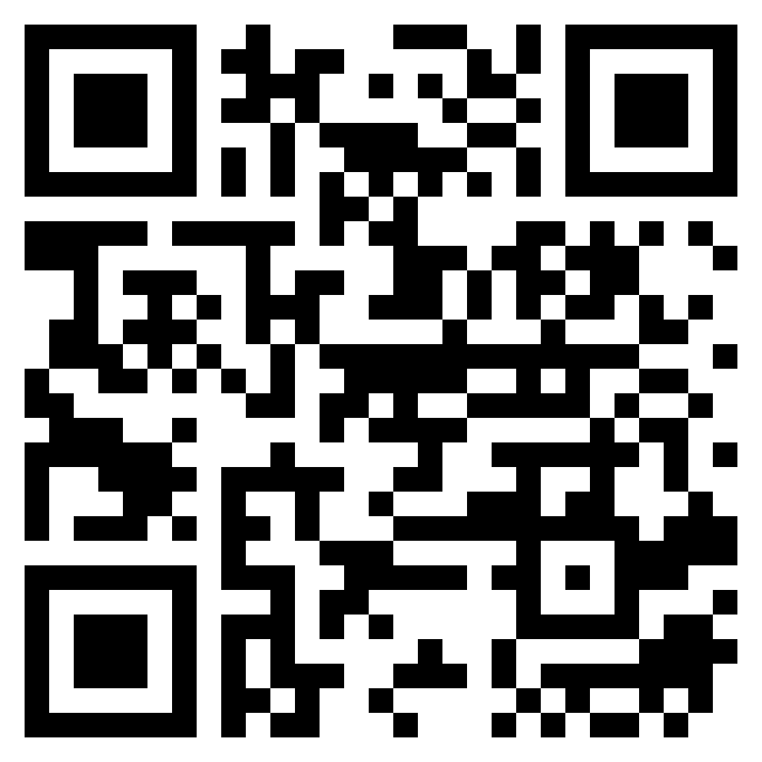
TEST TIME ON SEGMENTED AND INCREMENTAL SIEVE
URL:https://forms.gle/geq3XgXnt7WCk3qMA
QR CODE:

Slide 9

TEST TIME ON EULER’S PHI ALGORITHM
URL: https://forms.gle/hghiSo2Yd4KmiExg6
QR CODE:

Slide 10
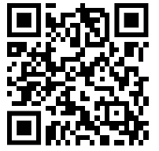
Test on Strobogrammatic number
URL : https://forms.gle/X9YBo21L7PU9enHU8
QR CODE:

Slide 11
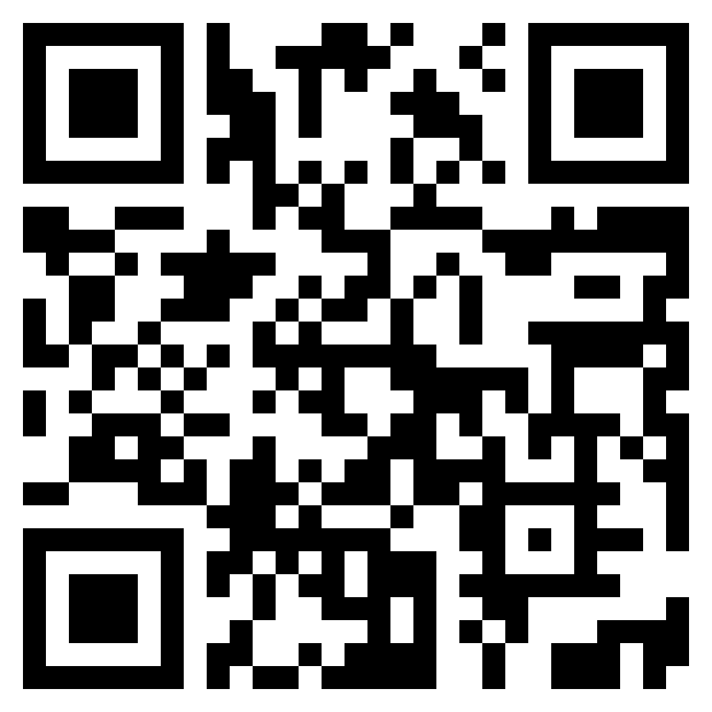
TEST TIME ON REMAINDER THEOREM
URL: https://forms.gle/VR1E4L6Q92xy9LBU7
QR CODE:

Slide 12

TEST TIME ON MAXIMUM SUM OF HOUR GLASS IN MATRIX
URL: https://forms.gle/wG88PDGGY5RKX98u6
QR CODE:

Slide 13

TEST TIME ON MAX EQUILIBRIUM SUM
URL: https://forms.gle/n73PA2jM3vLYM9bK7
QR CODE:

Slide 14
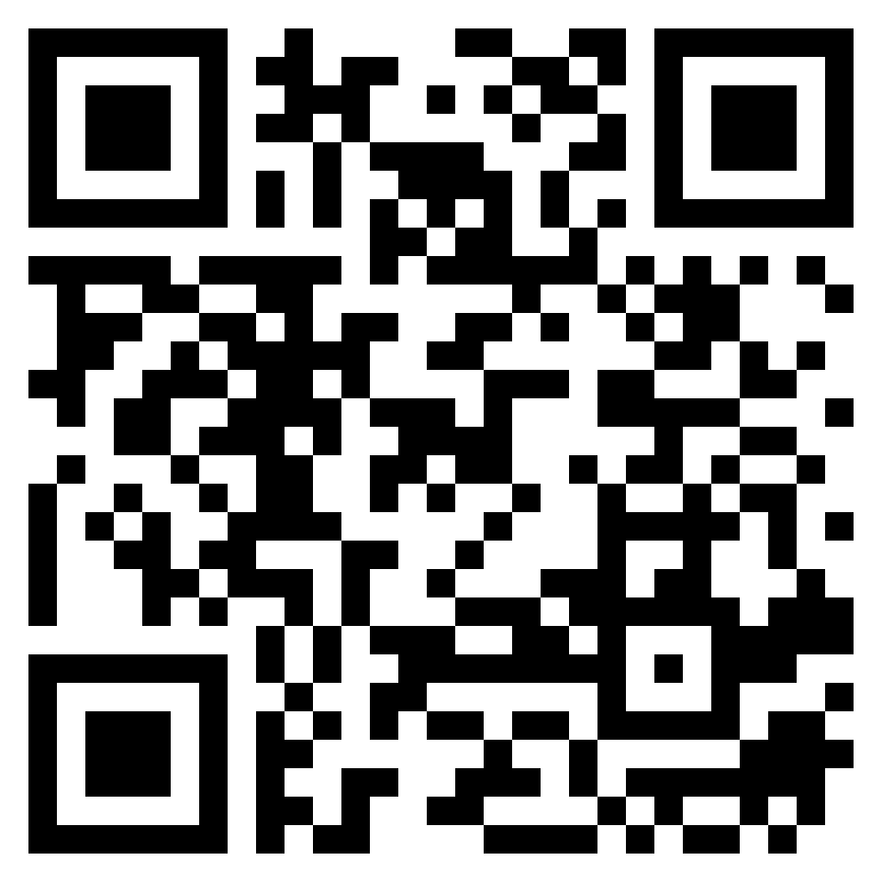
TEST TIME ON LEADERS IN ARRAY
URL:https://forms.gle/RPJsrq95tk79c2my5
QR CODE:

Slide 15
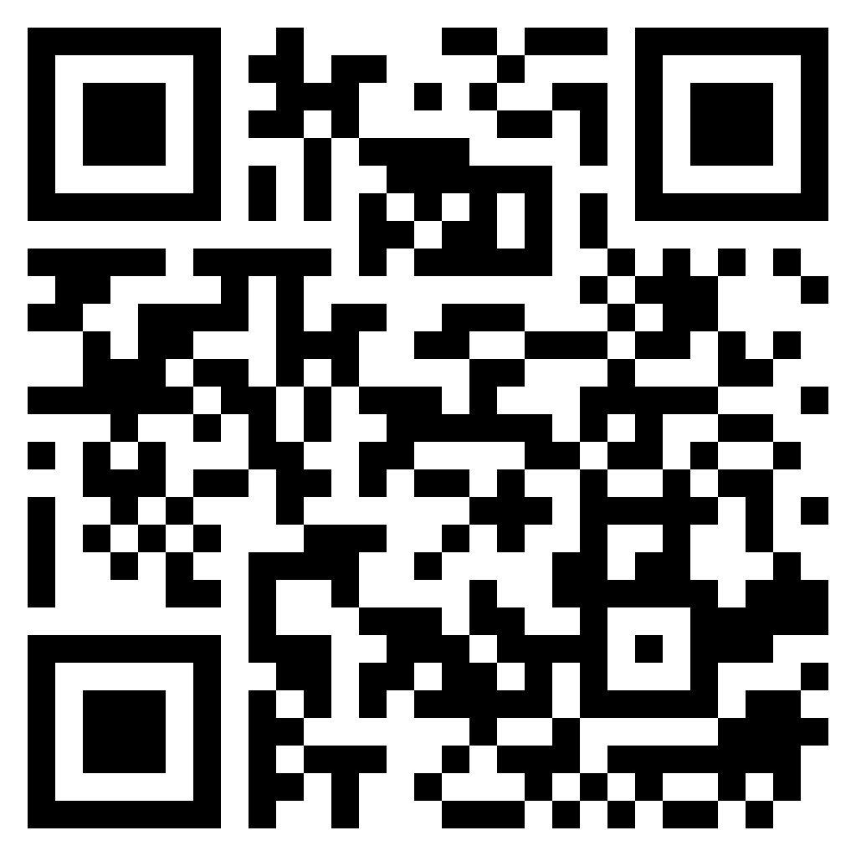
TEST TIME ON MAJORITY ELEMENT
URL:https://forms.gle/SFDVg26roZ2rtzcy5
QR CODE:

Slide 16
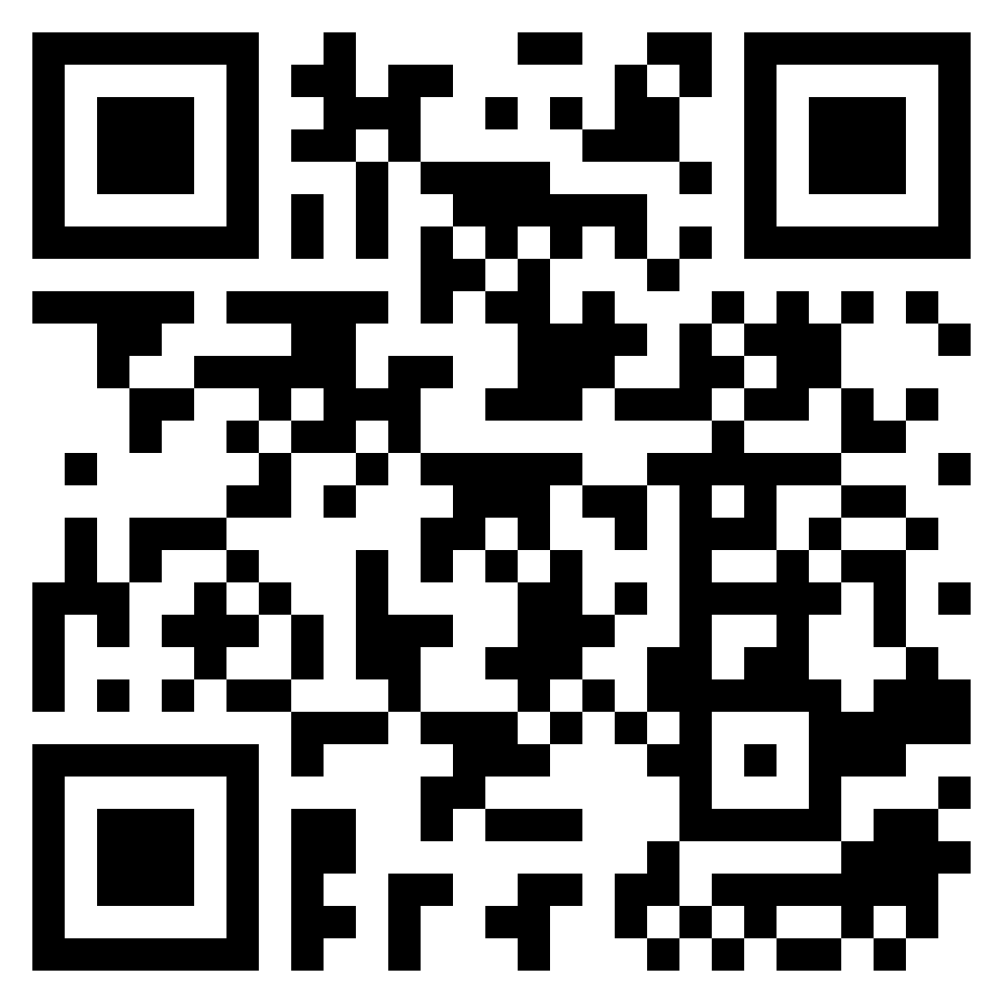
TEST TIME ON LEXICOGRAPHICALLY FIRST PALINDROMIC STRING
URL: https://forms.gle/UgBKp3nRGePA2eXMA
QR CODE:

Slide 17
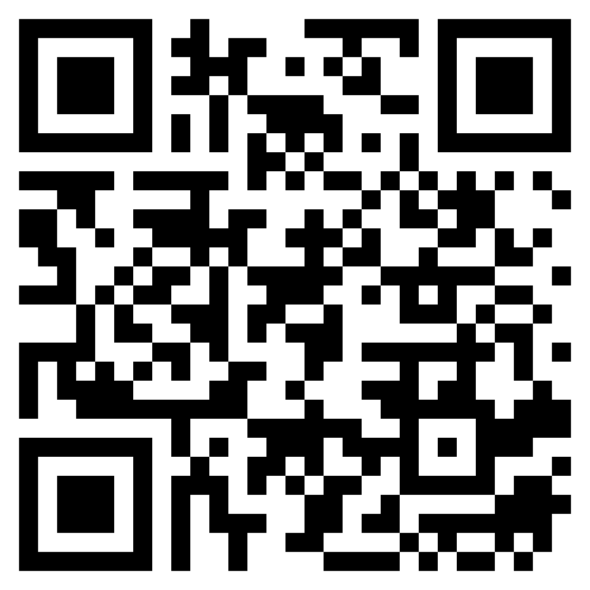
TEST TIME ON NATURAL SORT ORDER
URL: https://forms.gle/eaLan5f1DZq9XBVD9
QR CODE:

Slide 18
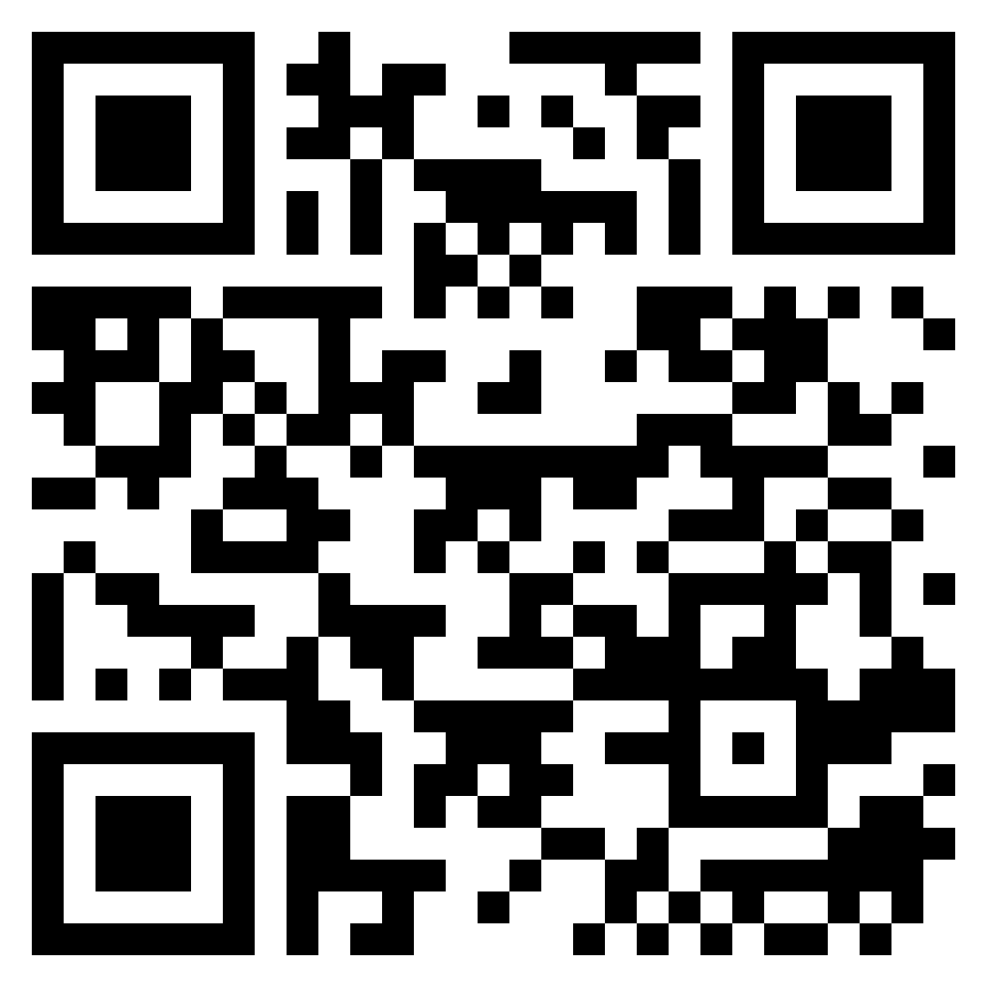
TEST TIME ON QUICK, SELECTION SORT
URL: https://forms.gle/L9yNisQKr1XjdLHH9
QR CODE:

Slide 19
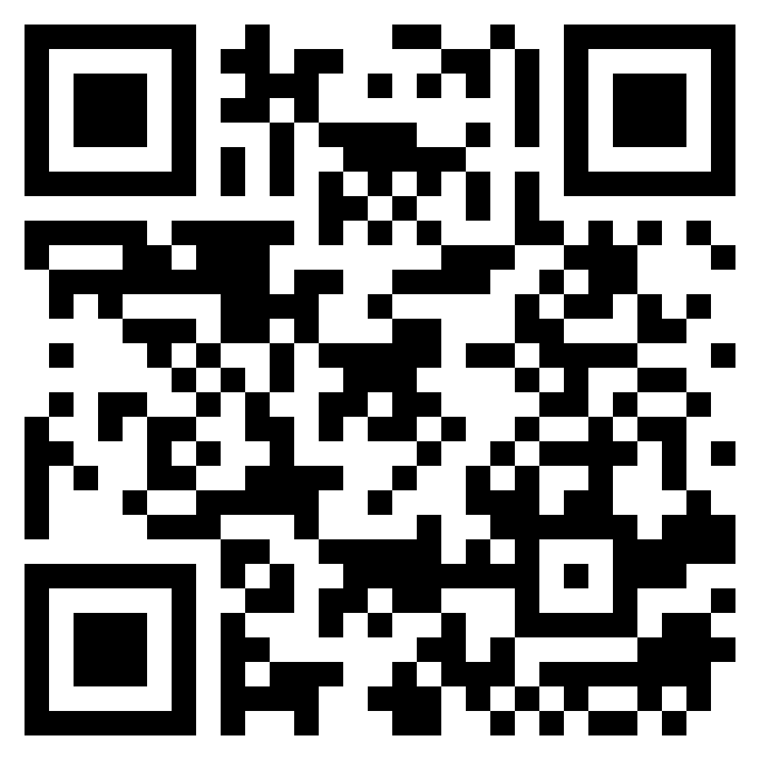
TEST TIME ON WEIGHTS SUBSTRING
URL: https://forms.gle/144U2FKEpCzTmZdS9
QR CODE:

Slide 20

TEST TIME ON MOVE HYPHEN TO BEGINNING
URL: https://forms.gle/eujGZJtiSaQ9aKbz5
QR CODE:

Slide 21
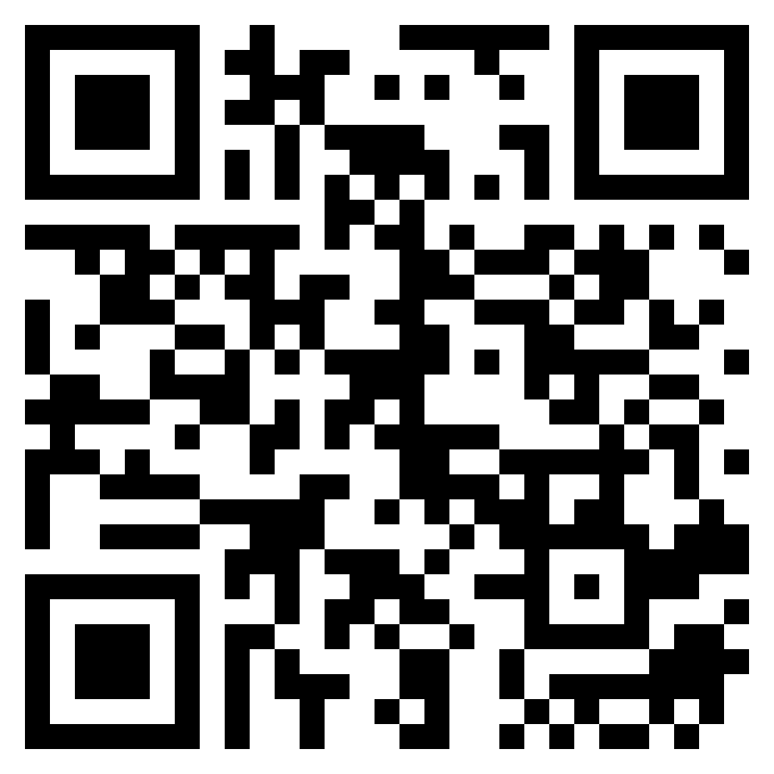
TEST TIME ON MANACHER'S ALGORITHM
URL: https://forms.gle/aVqbiUfE2quWLoPQA
QR CODE:

Slide 22
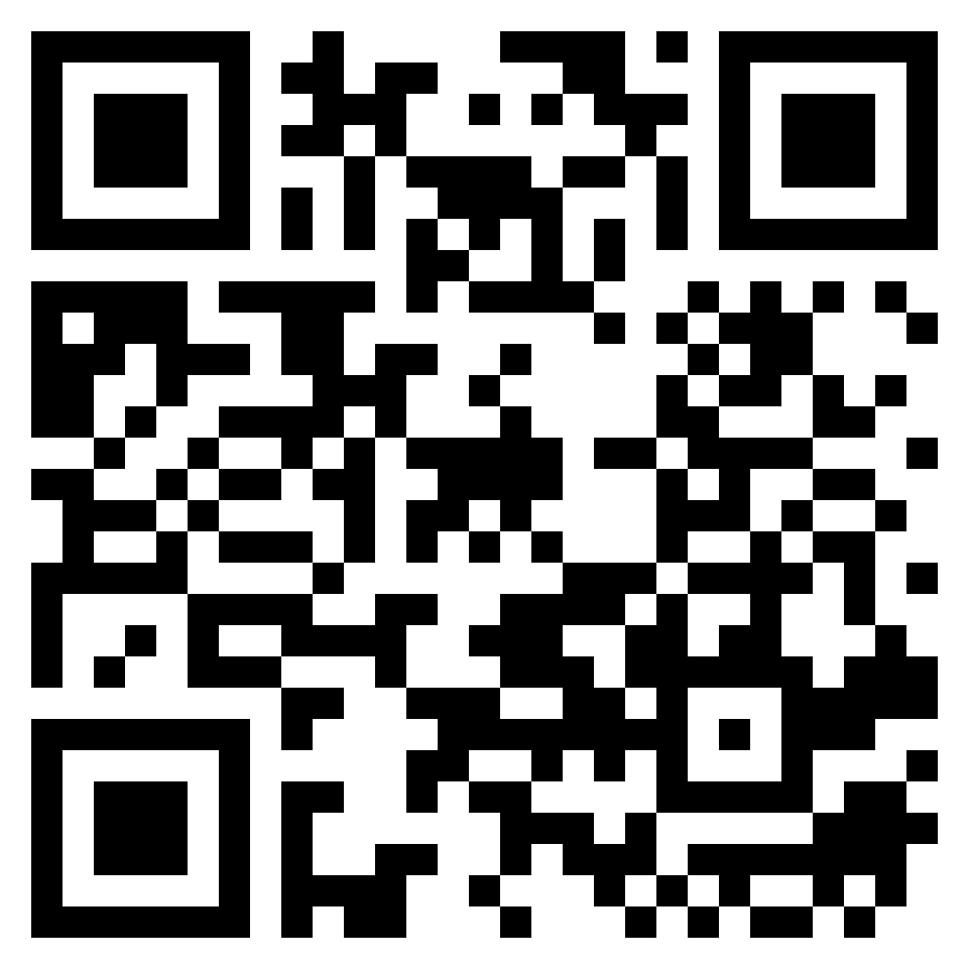
TEST TIME ON SORTED UNIQUE PERMUTATION
URL: https://forms.gle/54ANJLeEKjZBG59B7
QR CODE:

Slide 23
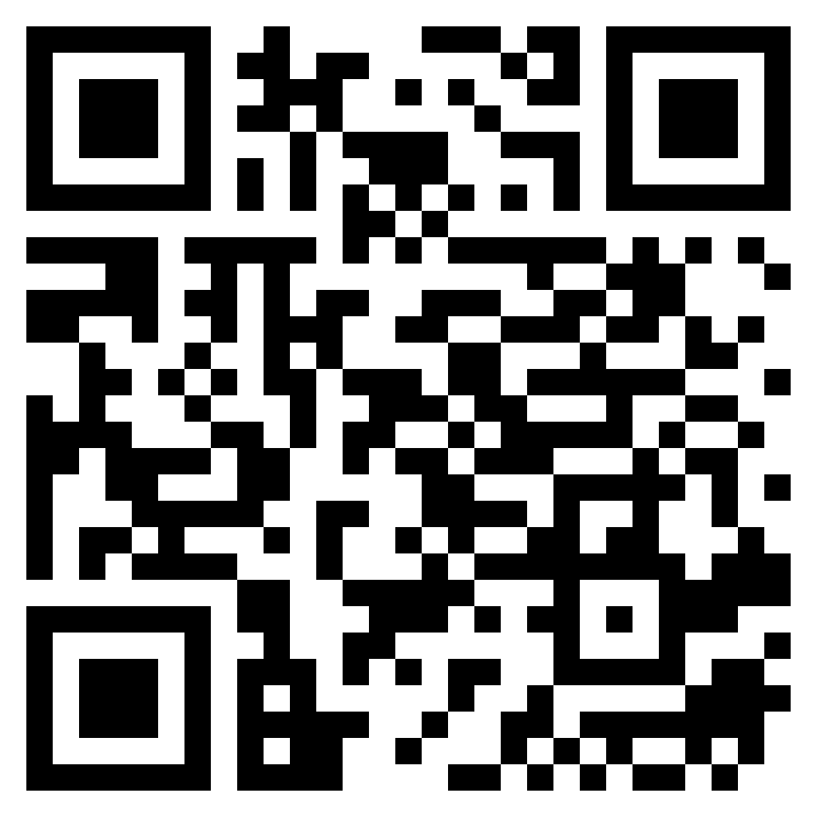
TEST TIME ON MANEUVERING
URL: https://forms.gle/Ng9gye6z37pzzGFy8
QR CODE:

Slide 24
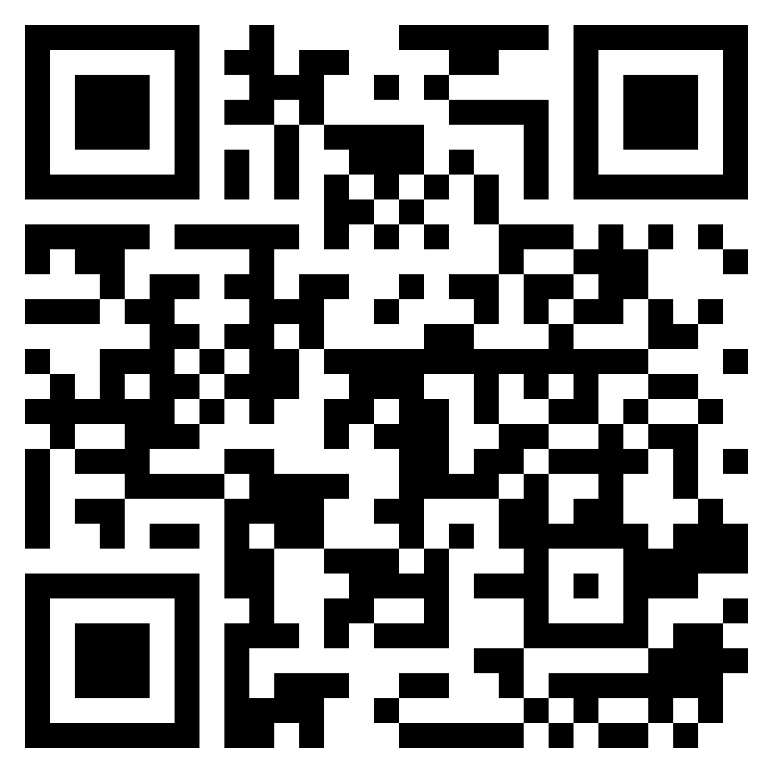
TEST TIME ON COMBINATION
URL: https://forms.gle/9e9Xk6RhCqE37aTZ8
QR CODE:

Slide 25

TEST TIME ON JOSEPHUS TRAP
URL:https://forms.gle/Dg1PM3HuHVQ7FQbL8
QR CODE:

Slide 26
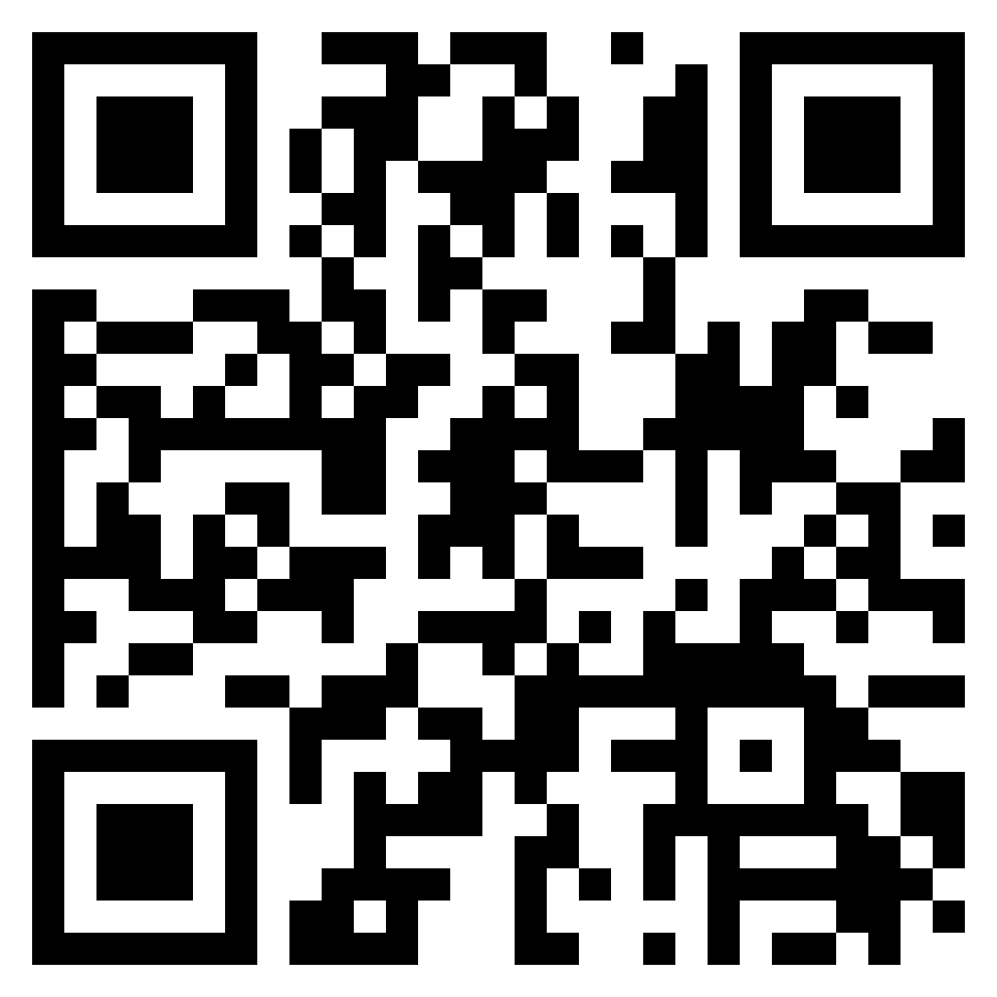
TEST TIME ON MAZE SOLVING
URL:https://forms.gle/AEkomEEm51wVk58EA
QR CODE:

Slide 27

TEST TIME ON N QUEENS
URL:https://forms.gle/fbopASmReiwLuH8L9
QR CODE:

Slide 28

TEST TIME ON WARNSDORFF’S ALGORITHM
URL:https://forms.gle/M8GtMx9D5MN5Xx879
QR CODE:

Slide 29

TEST TIME ON HAMILTONIAN CYCLE
URL:https://forms.gle/gh43AnHbnZjrFVgu8
QR CODE:

Slide 30

TEST TIME ON KRUSKAL'S ALGORITHM
URL:https://forms.gle/UEMmeQcjPSFFMrMq6
QR CODE:

Slide 31

TEST TIME ON ACTIVITY SELECTION PROBLEM
URL:https://forms.gle/xBEqaAHK7WPC2FdD7
QR CODE:

Slide 32
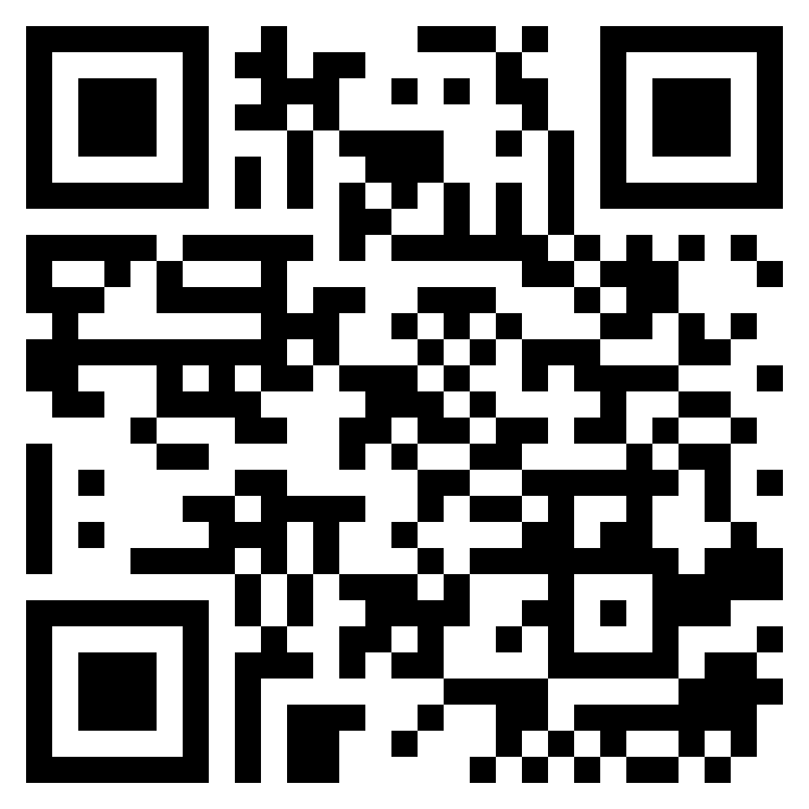
TEST TIME ON GRAPH COLORING
URL:https://forms.gle/b8mJ8D6v34HjabLg6
QR CODE:

Slide 33

TEST TIME ON HUFFMAN CODING
URL:https://forms.gle/bx6ufbKmHZWFp6rr7
QR CODE:

Slide 34
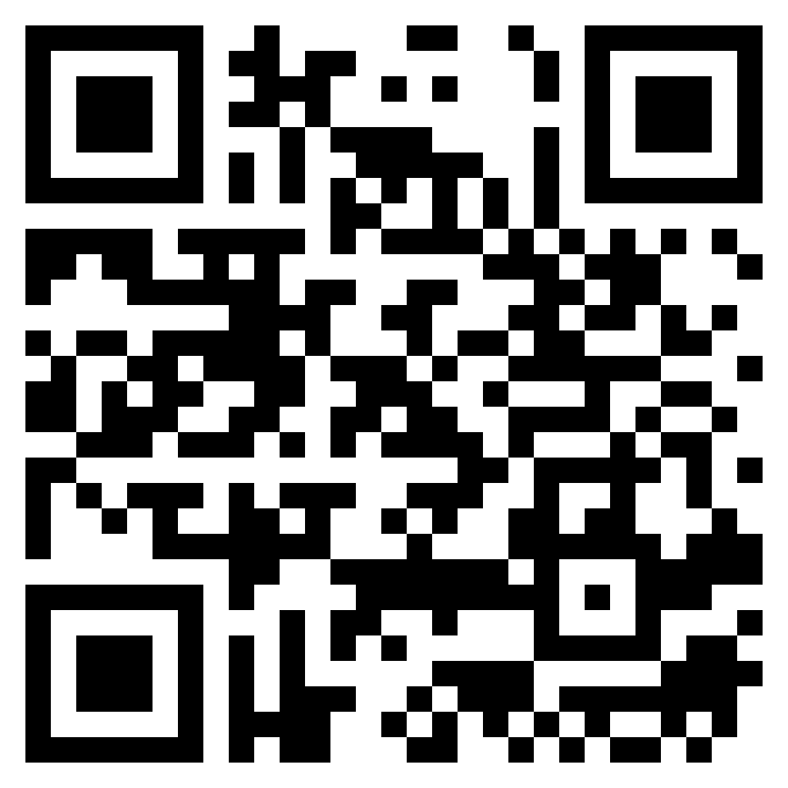
TEST TIME ON NETWORKING
URL:https://forms.gle/NwmE5Ve1oKJVoG4a7
QR CODE:

Slide 35
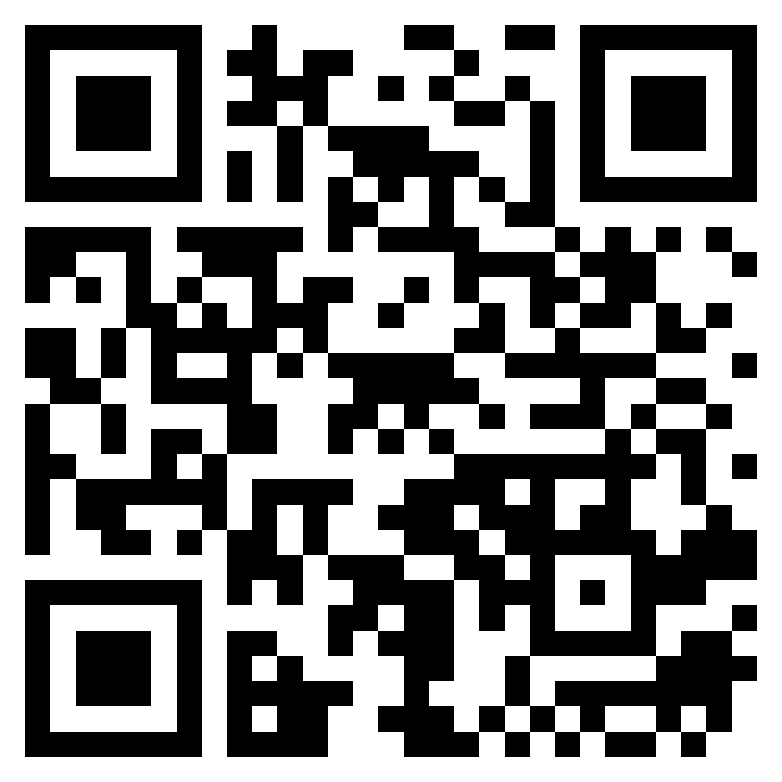
TEST TIME ON CRYPTION TECHNIQUES
URL:https://forms.gle/degRw7n6JhTtU59J7
QR CODE:

