Slide 1



Logistic solution – Cold Chain Tracking Practice POC
Objective
The objective of this initiative to use a Raspberry Pi as an IoT gateway and several IoT sensors (such as a smart lock ,TRH and Wiliot-Pixels), the goal is to send and store the sensor’s data to an Azure cloud for future analytics and visualize the data in sumo-logic.
Scope
Enable the logistics-Cold Chain Tracking solution on the
Azure cloud to tap new customers.
Attempting to use a Raspberry Pi as a gateway (replacing Optio3 Gateway).
TechStack
Python
Flask
Azure IoT-Hub
Sumo-Logic
Html, CSS, JavaScript

Slide 2
IoT Trainings :
Software development life cycle
Solid principles of programming
Real time applications of IoT
Different IoT services available in AWS & Azure
Azure-IoT Services ,Azure IoT hub

Slide 3
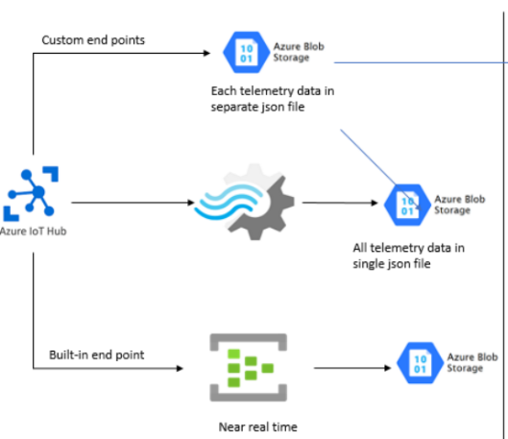
Azure IoT Hub
Azure IoT Hub is a managed service hosted in the cloud that acts as a central message hub for communication between an IoT application and its attached devices.
Enabled device to cloud communication
Stored the data to Azure blob Storage

Slide 4
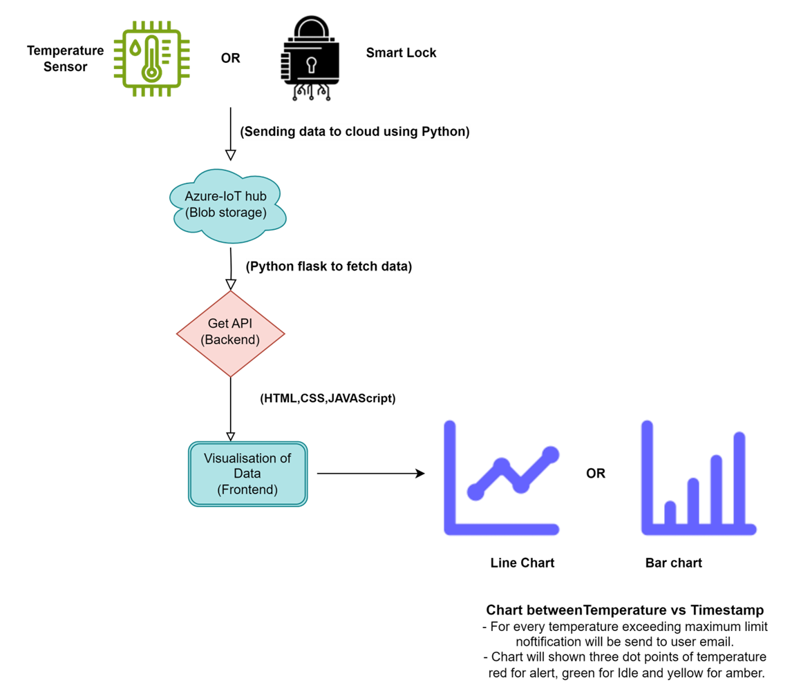
Sending “Simulated-Data” From RaspberryPi to Azure-IoT Hub
Powered by IoT Practice

Slide 5
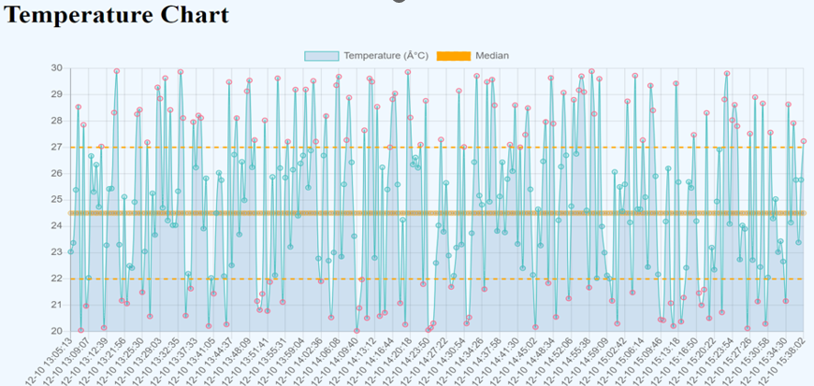
Visualization of Simulated-Temperature sensor data :

Slide 6
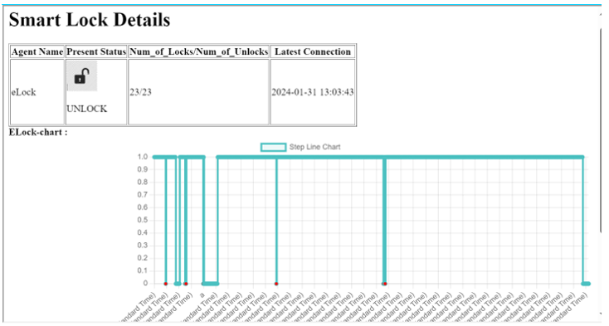
Visualization of Smart-Lock data :

Slide 7
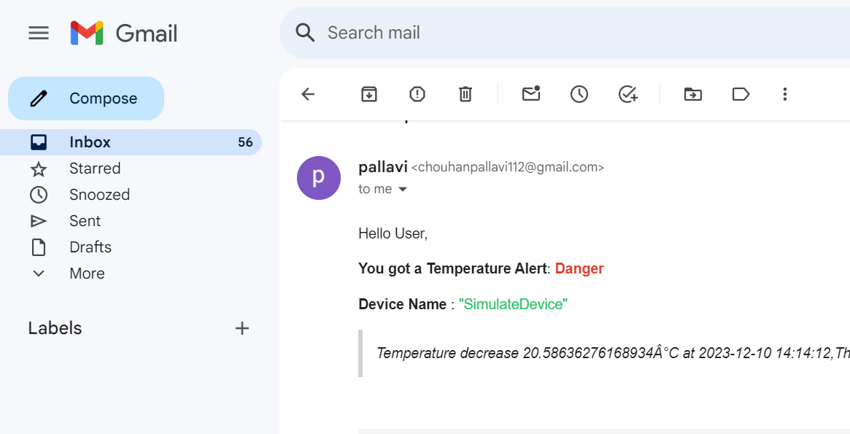
Email Alerts

Slide 8
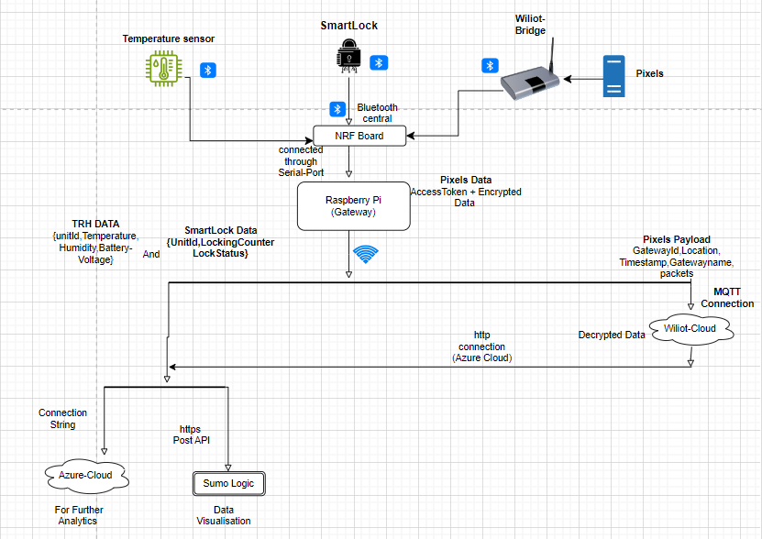
Streaming ‘Actual Sensors’ data like TRH, Smart-Lock, wiliot-Pixels.

Slide 9
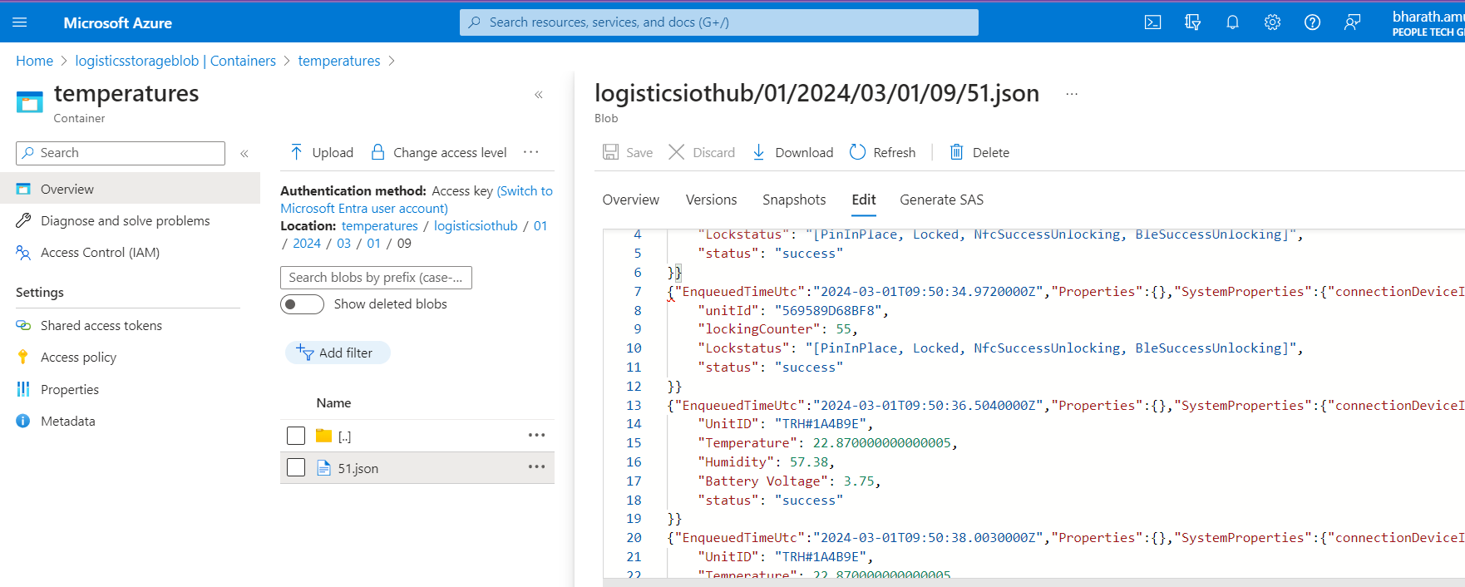
Temperature and Smart-Lock data stored in Azure:

Slide 10
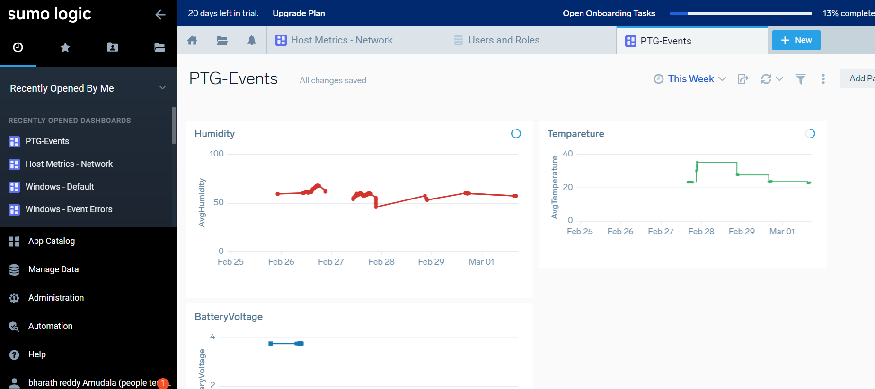
Data-Visualization in Sumo-Logic:

Slide 11
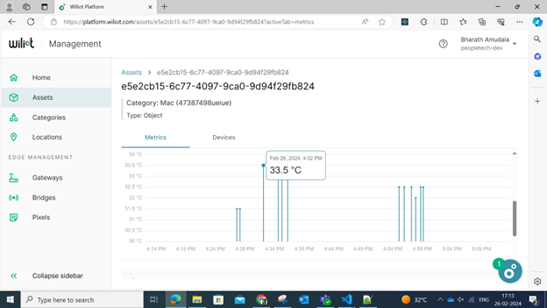
Pixels Data In wiliot-Cloud:

