Slide 1


Slide 2
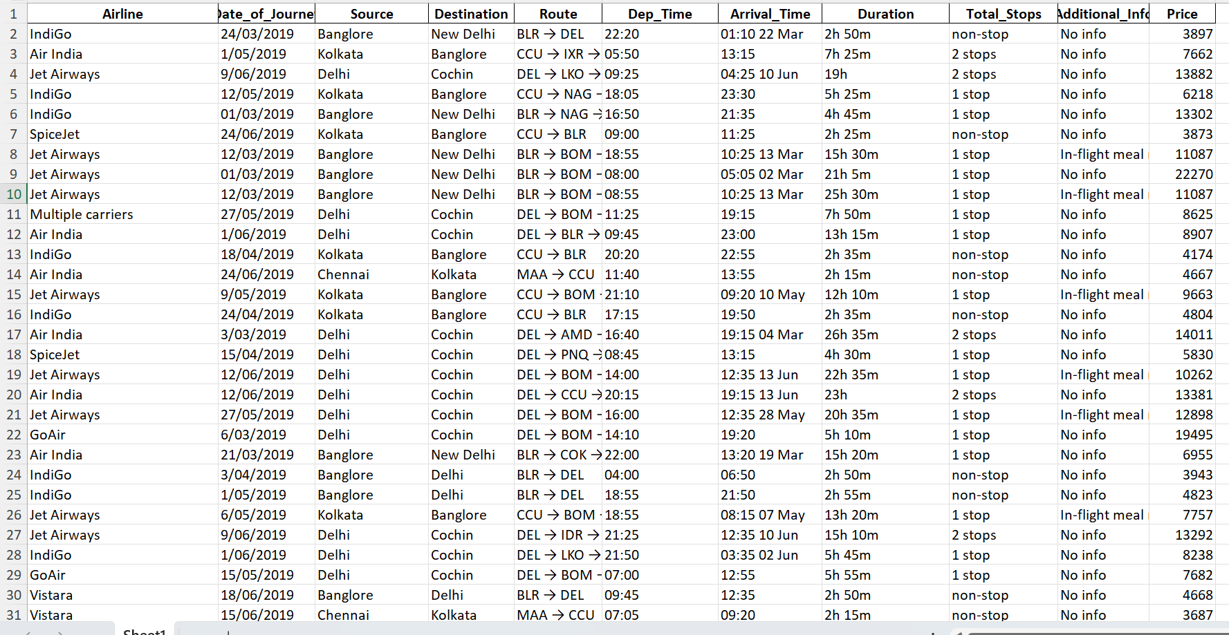
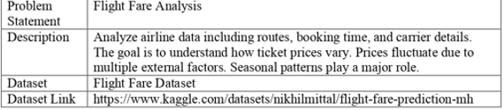
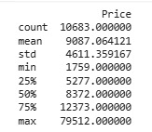
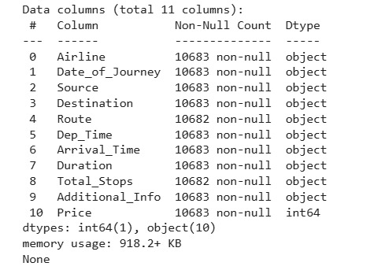

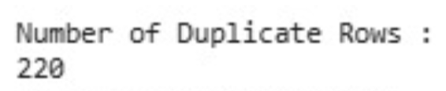
Problem Statement:
Dataset Structure :
Price Description (Target Vector):
Information regarding the Dataset:
Missing Values Detection:
Duplicate Rows Detection:

Slide 3
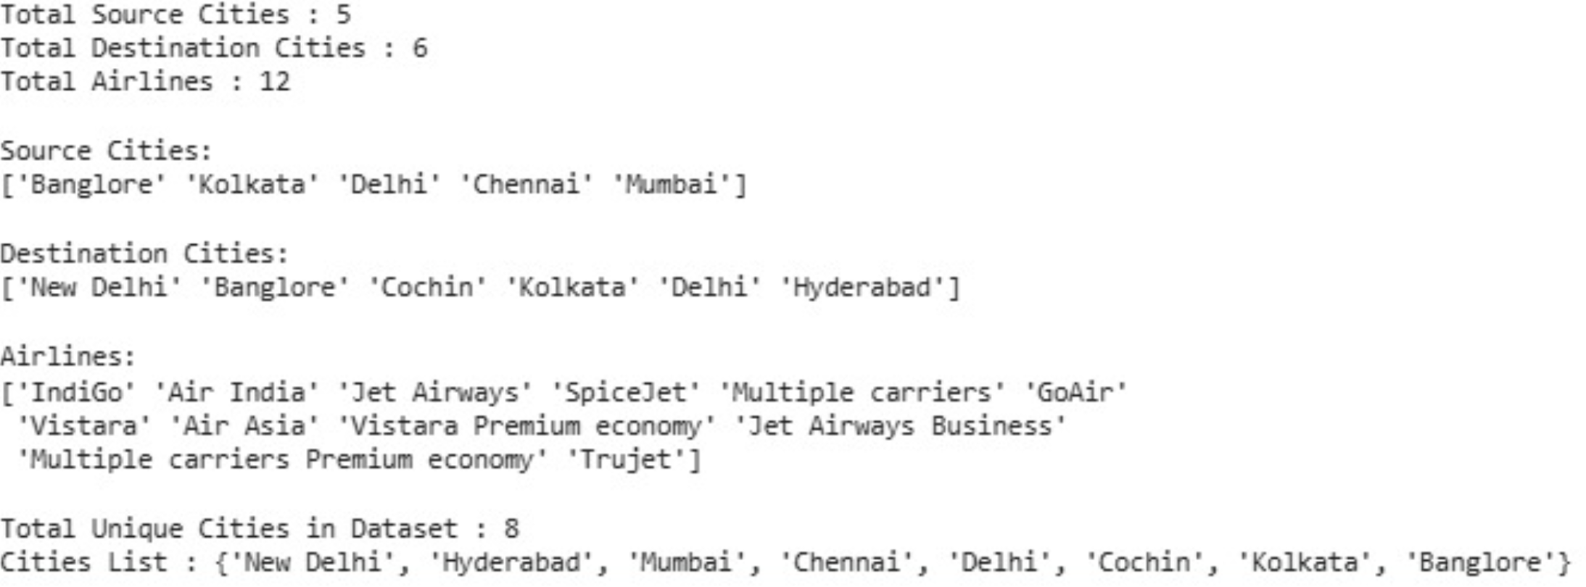
Class labels in each Attribute:

Slide 4
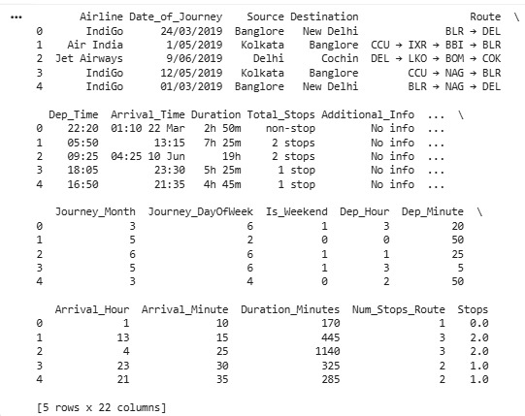
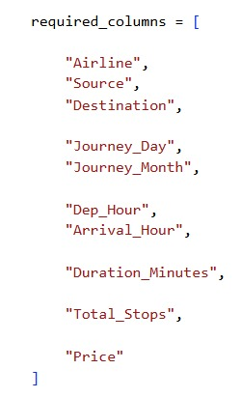
Visualisation of the Dataset: after converting categorical Columns into numeric
Required Columns(removing Redundant features):

Slide 5
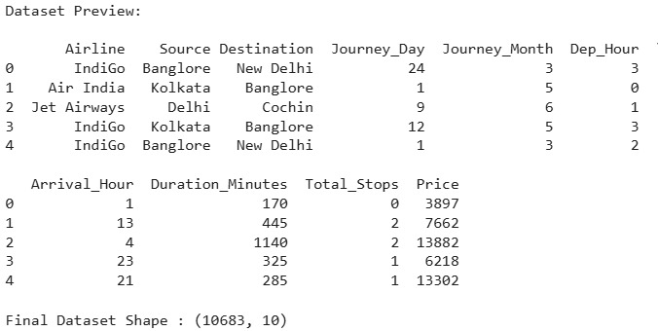
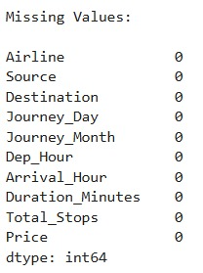
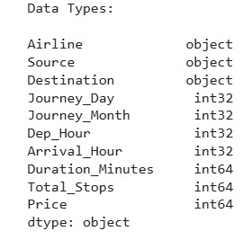

Data Preprocessing:
After removing Redundant Features:
After removal of missing values:
After dropping duplicate rows:

Slide 6
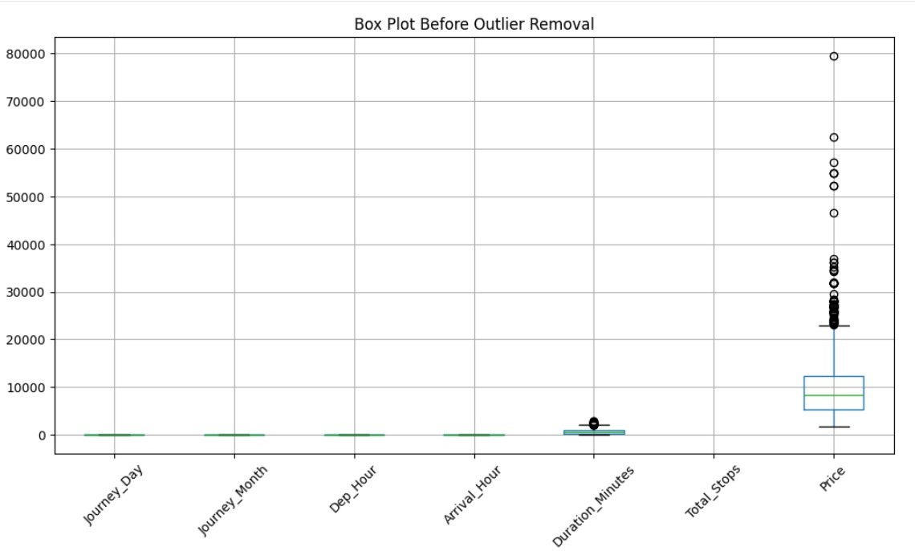
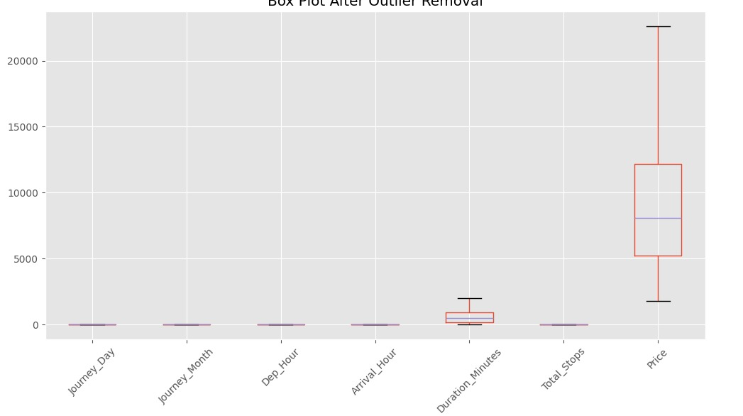
Data Preprocessing:
Before outlier removal
After outlier removal

Slide 7
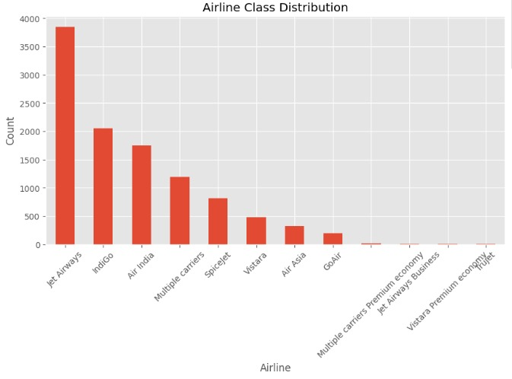
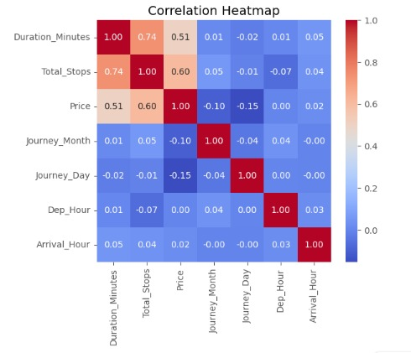
Exploratory Data Analysis(EDA):
Class Distribution
Heat Map among the Numeric Attributes:

Slide 8
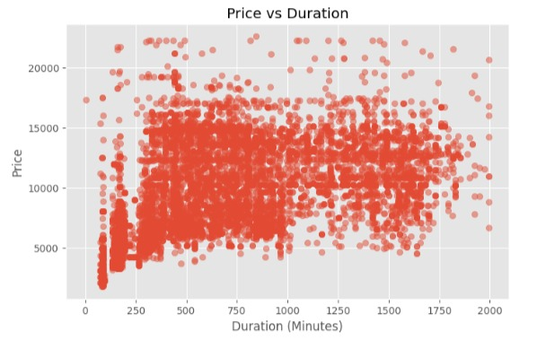
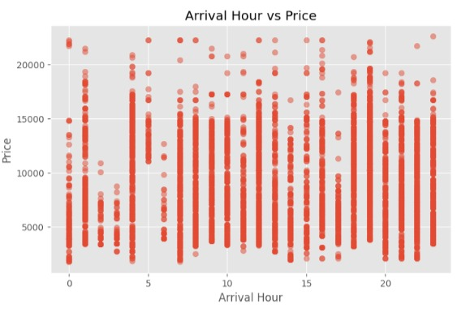
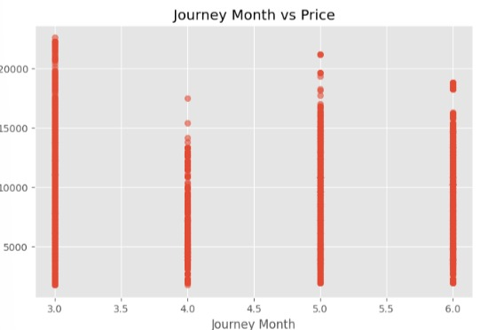
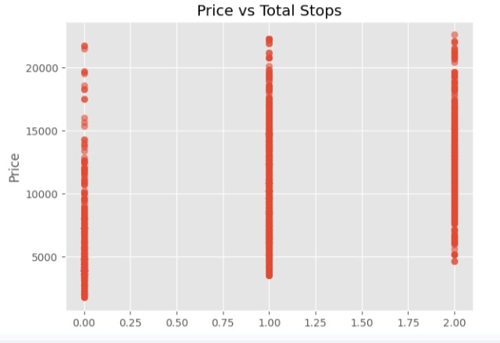
Scatter Plot(to Visualise Relationships)

Slide 9
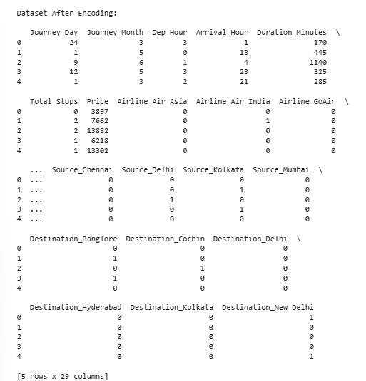

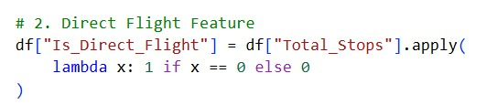
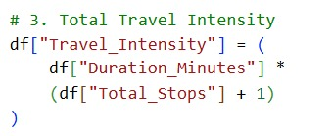

Encoding:
Feature Engineering(For Model Improvement)
Logic : 10-3+5+6+11=29 Columns

Slide 10
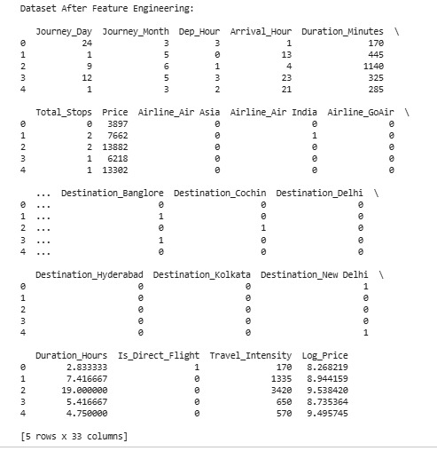
Feature Engineering(For Model Improvement) continued..

Slide 11
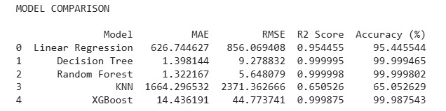
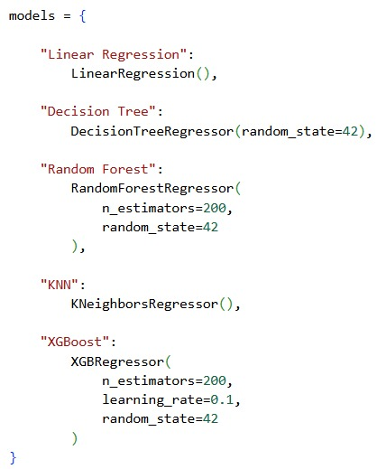
Models used
Linear Regression
Decision Tree
KNN
Random Forest
XG Boost
Parameter Tuning:
Case I: with log as feature selection

Slide 12
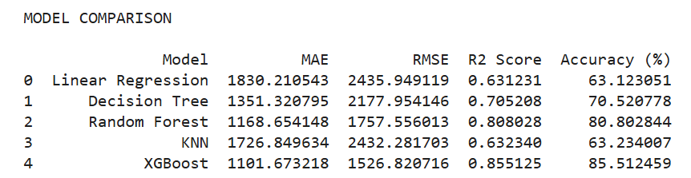
Case II: without log as feature selection

Slide 13
Decision Making:
Feature engineering and log transformation significantly improve model performance.
Ensemble models such as Random Forest and XGBoost outperform traditional regression models. The best overall performance was achieved using:
Random Forest Regression with Log Transformation of Target Vector
This model provided:
Highest accuracy
Lowest error
Most reliable fare prediction results
Hence, Random Forest Regression with feature engineering and logarithmic transformation is recommended for flight fare prediction systems.

