Slide 1


Introduction to OOPs concepts
An overview of Object-Oriented Programming (OOP) concepts in Java, including the fundamental principles and benefits.

Slide 2
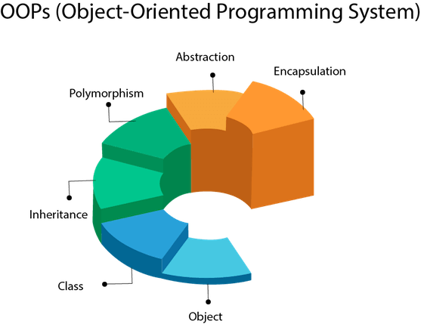

Slide 3
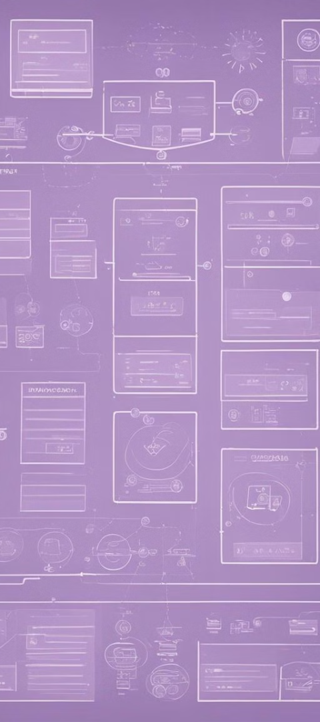
Class
Collection of objects is called class. It is a logical entity.
A class can also be defined as a blueprint from which you can create an individual object. Class doesn't consume any space.
Object means a real-world entity such as a pen, chair, table, computer, watch,

Slide 4
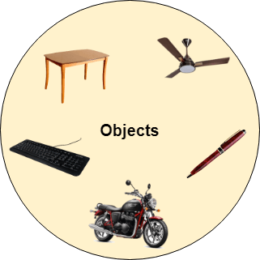
Object
Any entity that has state and behavior is known as an object. For example, a chair, pen, table, keyboard, bike, etc. It can be physical or logical.

Slide 5
Inheritance
When one object acquires all the properties and behaviors of a parent object, it is known as inheritance. It provides code reusability. It is used to achieve runtime polymorphism.
Polymorphism
If one task is performed in different ways, it is known as polymorphism. For example: to convince the customer differently, to draw something, for example, shape, triangle, rectangle, etc.
In Java, we use method overloading and method overriding to achieve polymorphism.
Another example can be to speak something; for example, a cat speaks meow, dog barks woof, etc.
Abstraction
Hiding internal details and showing functionality is known as abstraction. For example phone call, we don't know the internal processing.

Slide 6
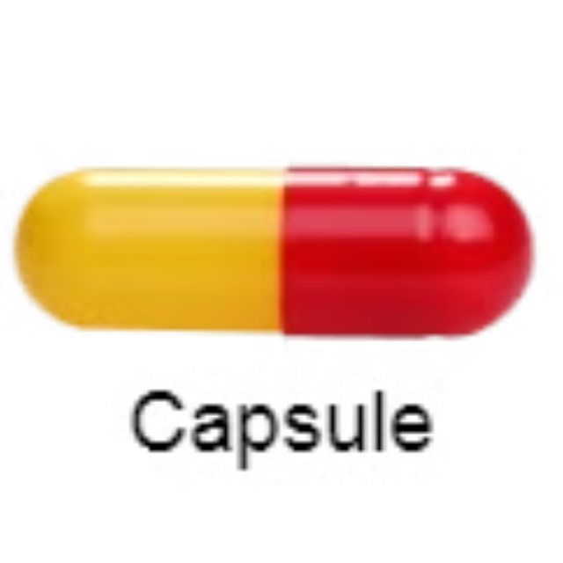
Encapsulation
Binding (or wrapping) code and data together into a single unit are known as encapsulation. For example, a capsule, it is wrapped with different medicines.

Slide 7
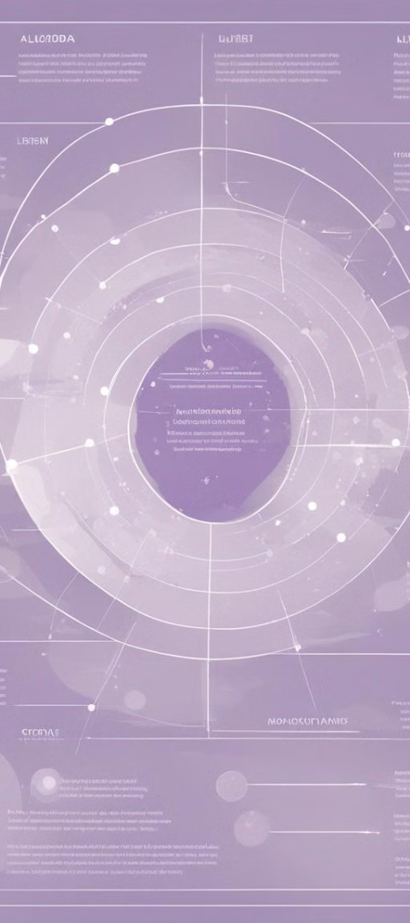
Association, Aggregation, and Composition
1
Association
Describes the relationship between two or more classes, emphasizing their multiplicity and navigation.
2
Aggregation
Represents a "whole-part" or "has-a" relationship between classes, with independent lifetimes.
3
Composition
Depicts a "strong" aggregation relationship, where the "part" cannot survive without the "whole".

Slide 8

Conclusion
Unified Code
Complex Systems
OOPs concepts enable the creation of unified, modular, and reusable code.
Facilitates the handling of complex systems through effective organization and abstraction.
Real-World Modeling
Provides an effective way to model and simulate real-world objects and interactions.

