Slide 1



Lending club case study
TEAM MEMBERS
SIVASKANDAN P
Bharathveer KS

Slide 2
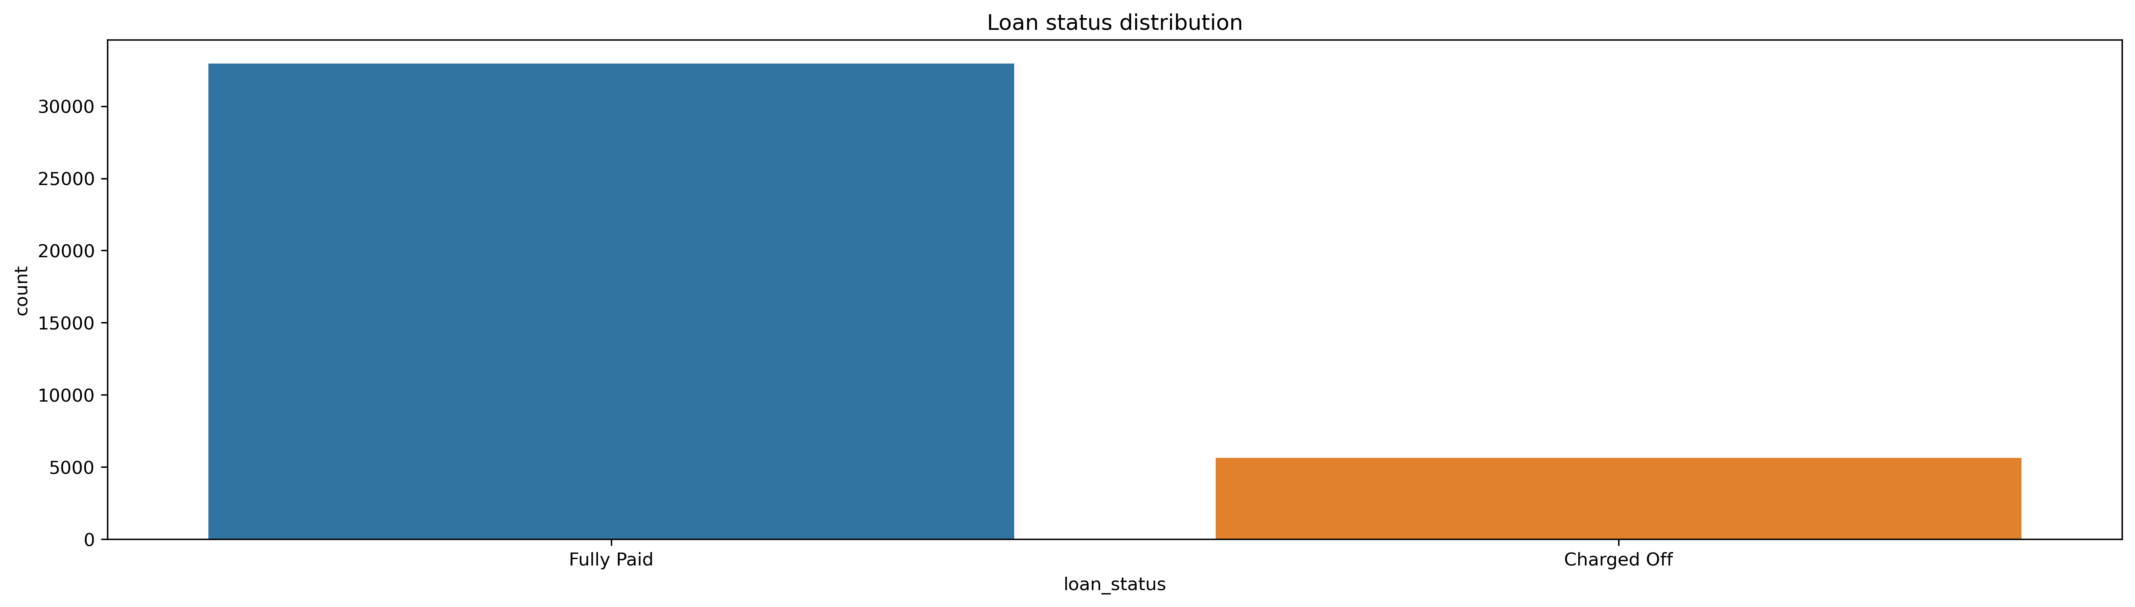
Business problem
Analysing the given loan dataset to identify the patterns to determine if
The loan applicant will most likely to pay the loan
The loan applicant most likely to default the loan

Slide 3

Structured approach
Data analysis
Data cleaning
Univariate analysis
Bi Variate analysis
Multivariate analysis
Recommendations

Slide 4
Data analysis
Import
Import the data and identify the target column (loan_status)
Understand
Understand the pre loan approval attribute columns
Analyze
Analyze the columns that are meant only for post approval
Identify
Identify the columns which is not relevant for loan approval process
List down
List down customer behavioral columns which could help derive insights

Slide 5



Data clean up
We removed all columns that has only null values
Analyze columns with redundant values and eliminate
We standardized number columns by removing unwanted characters and convert them to numeric
Derive new columns from existing columns to plot various graphs

Slide 6
Insights on data cleanup/correction
Dropped all columns with all values as NA.
Dropped columns with lot of NA values and having same value across all rows.
Dropped columns which doesn’t have any significance for our business problem (like – url)
Dropped columns with loan status as current since this records can't be used for our analysis.

Slide 7
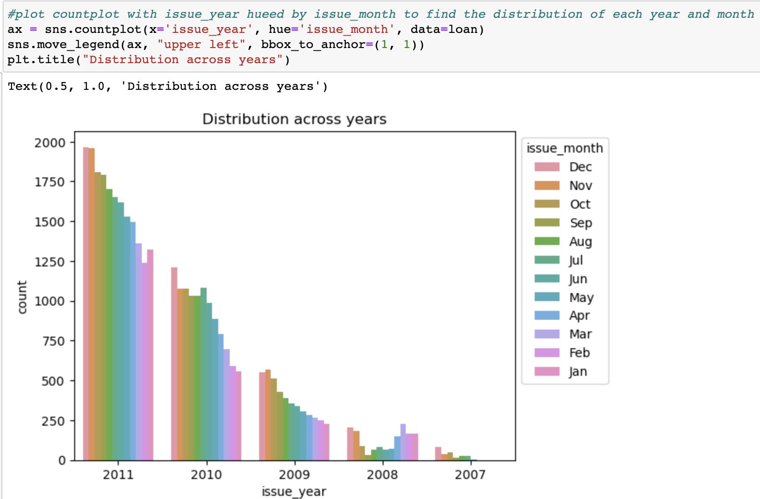
Univariate analysis
Broadly done on three types of columns
Segmented categorical
Ordered categorical
Quantitative
What strategies used
Single frequency tables
Derive new columns wherever possible
Curate columns that could correlate target variable

Slide 8
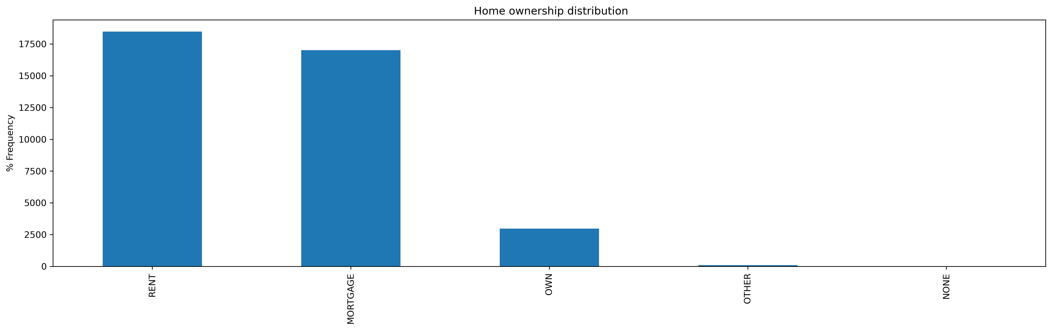
Frequency Plot of home_ownership
Observation
The people who are in rent or mortgaged houses have more tendency to apply for loan.

Slide 9
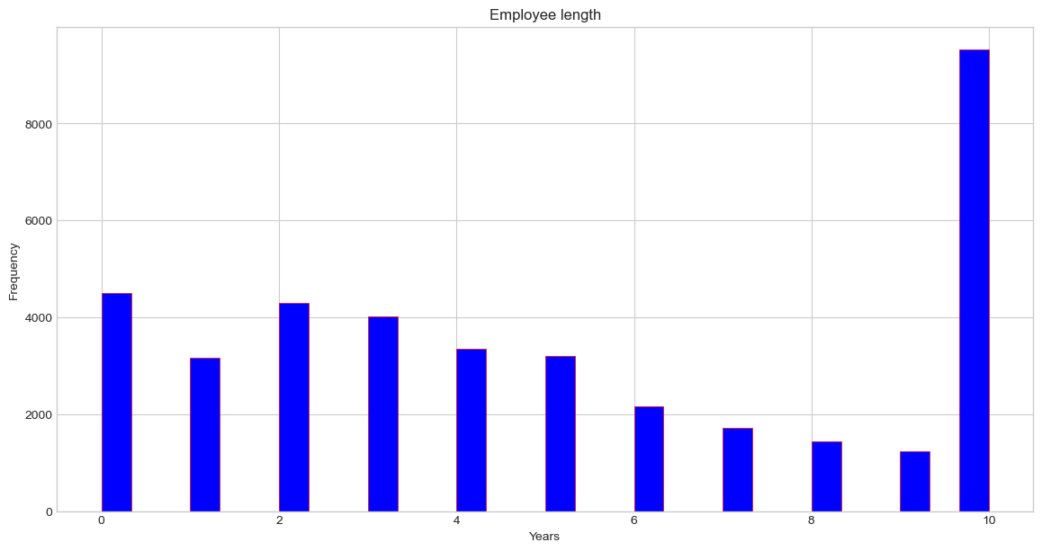
Frequency plot of Emp_length
Observation:
The people with experience 10+ years are taking more loan.

Slide 10
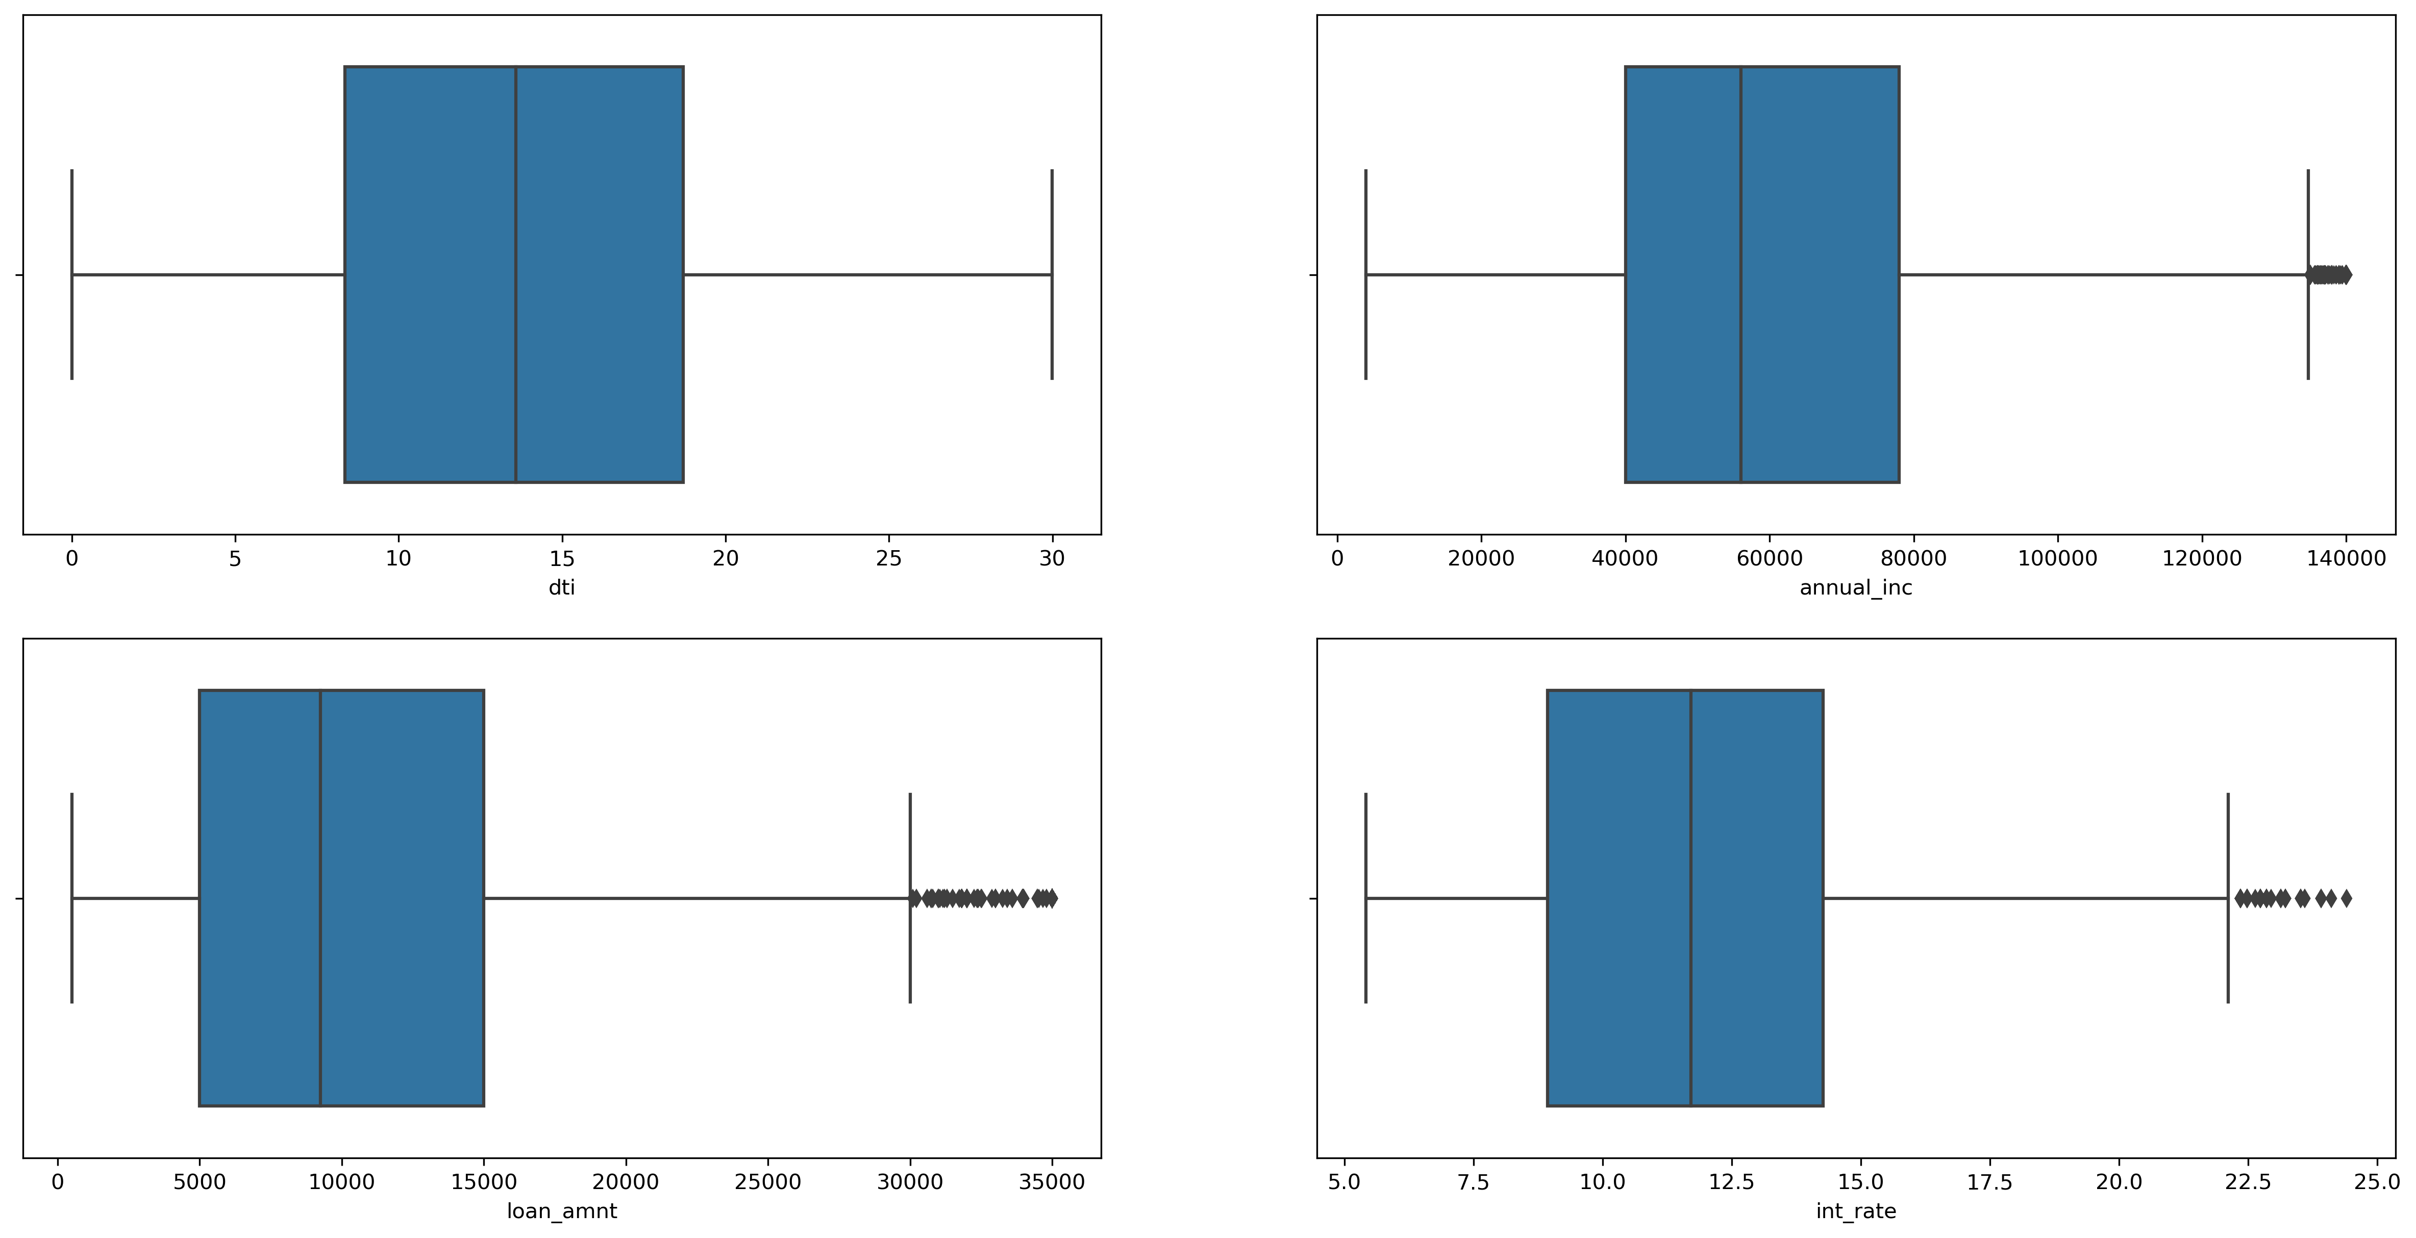
Summary on Univariate analysis
Year-end has more applicants for loan than year start
Rent and Mortgage house holders are seeking for loan more than own house people
People above 10+years seeks loan more than lower experienced
Removed outliers in Annual income field to get proper distribution of data.
Annual income of 50K is the median of people who needs loan
In int_rate charging off is less in case of interest rate 21-24% but the total people taken 21-24% is less
If we see the total proportion in interest rate 9-13% interest rate has increased chance of being fully paid.
The interest rate 13-17% high percentage of getting charged off.
In annual_inc groups people with 112k - 140k has less percentage of getting charged off.
The annual_inc group with 31k-58k has higher percentage of getting charged off.

Slide 11
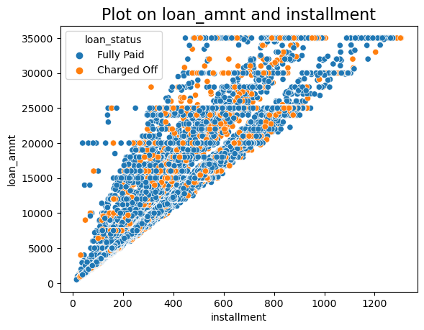
Bi variate analysis
Plotting ideas used to understand the defaulters are mentioned below
Heatmap to find correlation matrix
Scatter plot to understand correlation between loan_amnt
Cross tabs to correlate categorical vs categorical
Count plots to visualize the grades again target variable

Slide 12
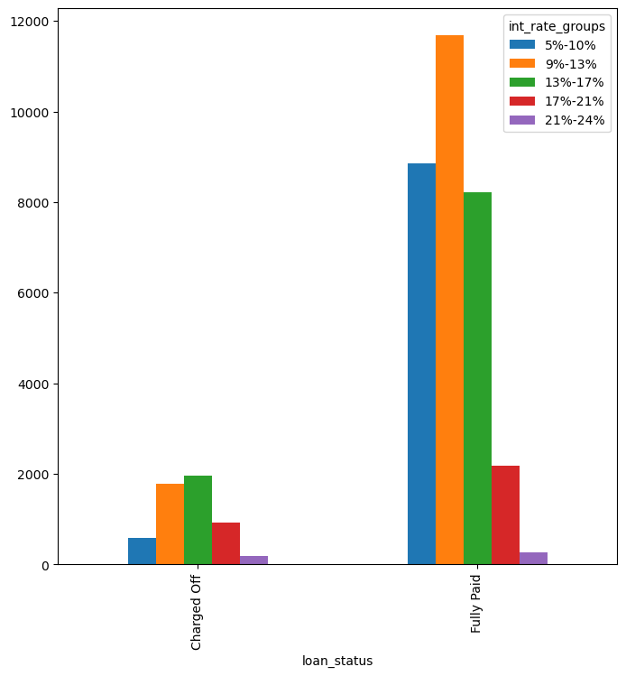
Frequency plot of int_rate_groups over loan_status
The interest rate 13-17 % has slight increase in charged off percentage.
The interest rate 9-13% has a higher chance of getting paid.

Slide 13
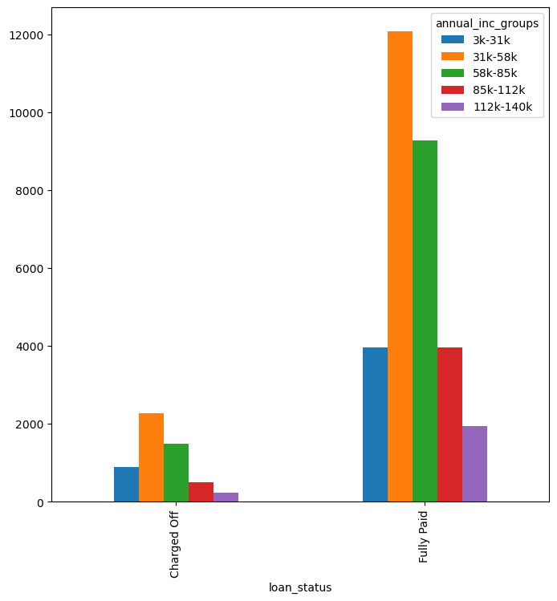
Frequency plot of annual_inc_groups over loan_status
The income group 31k - 58k has high percentage in both fully paid and charged off loan status.
The income group 112k - 140k has less charged off count. Could be due to their high income.

Slide 14
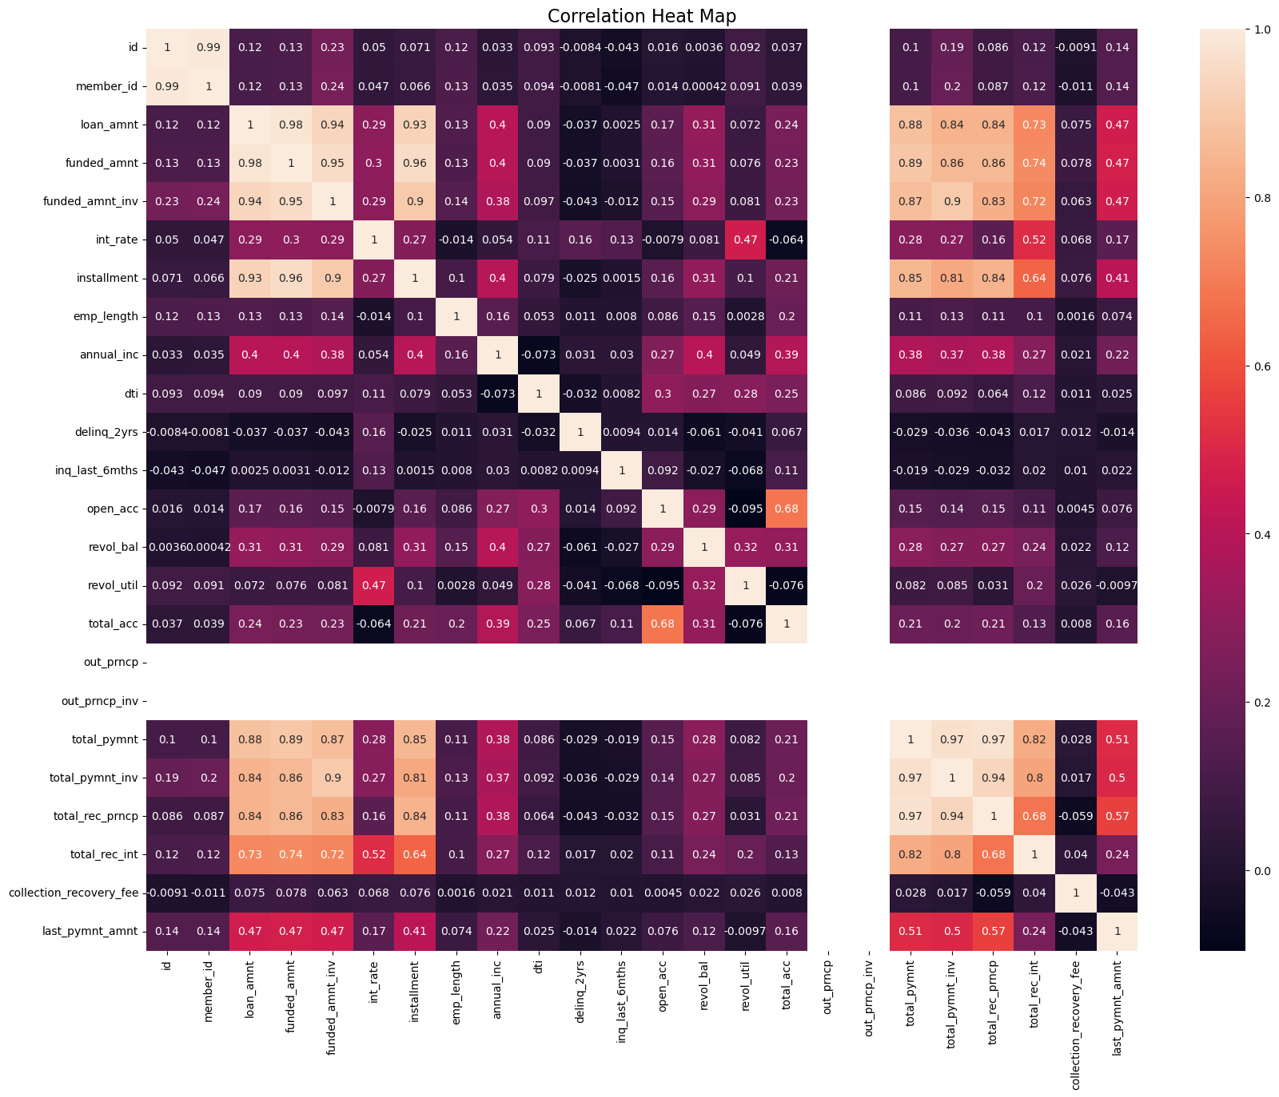
Summary of Bivariate analysis
Below are the probable defaulters' reasons
Higher the interest rate as higher (13-17%) interest range has high defaulters
Debt consolidation stands out in the defaulter's loan where it could be borrowers took a loan to close existing loan but failed again
We can clearly see during the year 2011 end there are more defaulters which is directly correlating to recession in U.S hence market situation-based loan approvals would solve most of these.
Employees with 10+ years has more probability of being a defaulter
Employees with annual income range 31k-58k has more probability of being a defaulter
The people who are marked as grade G has higher chance of getting charged off
The Sub Grade F5 has the highest percentage of Charged off
Good candidates for providing loan which is inversely proportional to defaulters
Obviously, lesser interest rate helps borrowers repay the loan without fail
People who owns a house have good records of closing the committed loan amount
The grade B has higher chance of getting fully paid
The interest rate 9-13% has a higher chance of getting paid.
The Sub Grade A1 has the highest percentage of fully paid
The income group 112k - 140k has less charged off count. Could be due to their high income.

Slide 15
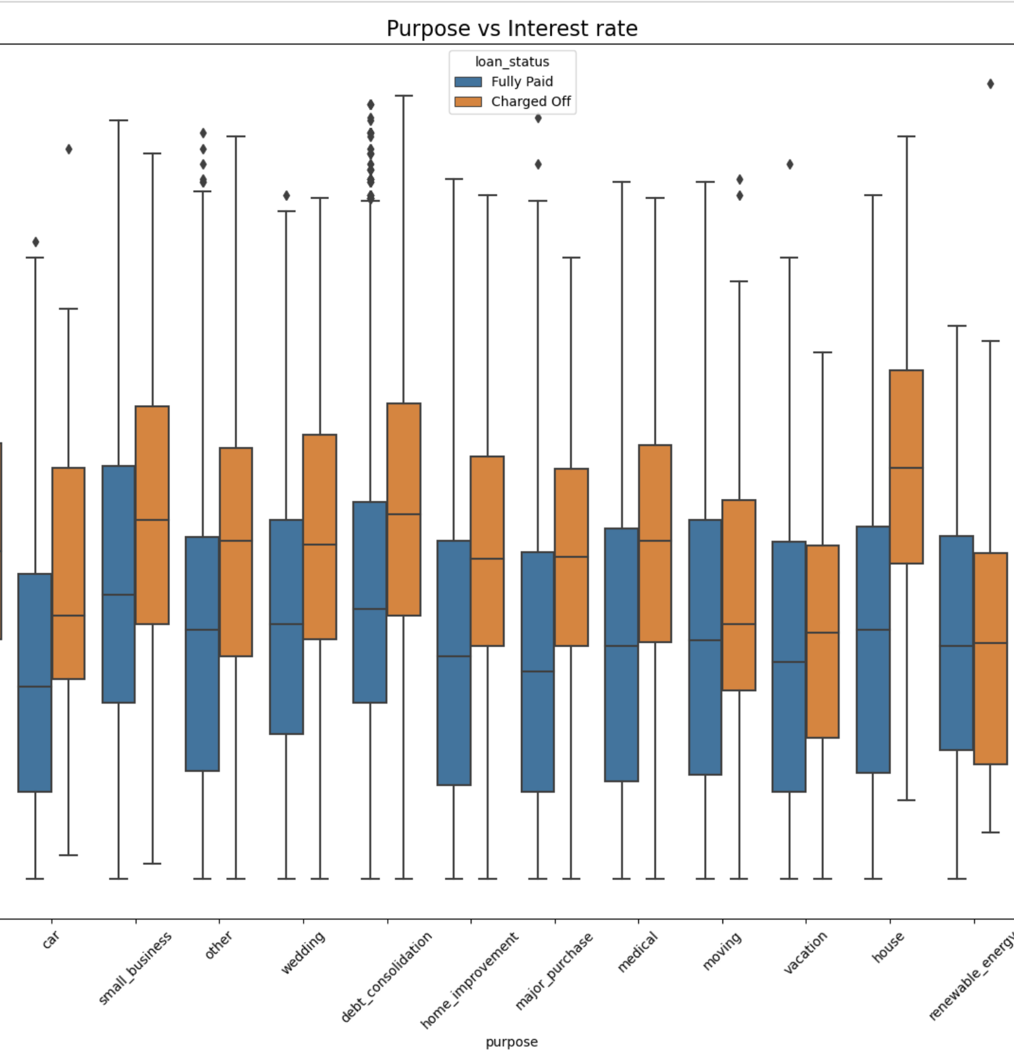
Multi variate analysis
We did multi variate analysis on top of our bi variate attributes to understand the impact of a third variable on the target
For example, when we validated purpose column debt consolidation appears to be on higher level on defaulters, however when purpose is imposed as third column we could see the percentage small_business has higher defaulters in real
By doing above step we were able to derive some depth insights on the influence of one variable over other

Slide 16
Recommendations
Probability of defaulters
Loan amnt higher than 12000 dollars for small buisiness has slightly high chance of geting Charged off.
The employees with 10+ years of experience and a annual income of 31k - 58k are more likely to get charged off
People who are buying loan for their house between interest rate 12.5 - 17.5 are more likely to get charged off
Car loan with interest rates above 15 are more likely to get charged off
Small_buisness loans with higher interest (above 11%) are more likely to be charged off
The People in 31k - 58 k income group with house in mortgage or living in a rented house has higher chance of defaulting the loan
The people who are buying loan for debt consolidation with home ownership has rent or mortgage has higher chance of getting charged off
Probability of eligible candidates
The employees with 10+ years of experience and a annual income of 51k - 85k are more likely to fully pay the loan
People who are buying loan for their house less than 13% interest are more likely to fully pay the loan
Car loan within interest rates 7.5 to 10 are more likely to get Fully Paid
Small_buisness loans with less interest (11%) are more likely to be fully paid
Loan amount lesser than 12000 dollars for small buisiness has high chance of geting fully paid.
The People in 31k - 58 k income group with a own house has higher chance of paying the loan
Intrest rate group in 21 - 24% having annual income 70k+ has the good candidated for offering the loan

