Slide 1
Dynamic weather dashboard
CAPSTONE PROJECT
Presented By:
Student Name-Bharath V N
College Name-Seshadripuram Degree College
Department- BCA
AICTE Student ID: STU67d5361a0e3b61742026266
Internship ID: INTERNSHIP_17522267216870dba1e54a96

Slide 2
OUTLINE
Problem Statement (Should not include solution)
System Development Approach (Technology Used)
Algorithm & Deployment (Step by Step Procedure)
Result
Conclusion
Future Scope(Optional)
References

Slide 3
Problem Statement
Many small businesses struggle to showcase their products online because existing e-commerce platforms are often complicated and costly.
This project creates a simple, lightweight, and visually attractive web app that displays weather data in an easy-to-understand way.
It uses real-time data from OpenWeatherMap to show current weather, hourly updates, and a 5-day forecast with interactive charts.
The app includes features like location search, voice input, and geolocation to make it user-friendly.
The clean design and smooth interactions make it easy for users to explore weather info, similar to how a product gallery should let customers browse and filter items effortlessly.

Slide 4
System Approach
Frontend Technologies:
HTML5: Builds the basic structure and content of the webpage.
CSS3: Adds colors, fonts, layouts, and makes the design look good on different screen sizes (responsive).
JavaScript: Makes the page interactive by fetching live weather data, updating the display, handling search, voice input, and showing charts.
Design Approach:
Focus on a clean, easy-to-use interface that anyone can navigate.
Ensures the app works well on both desktop and mobile devices.
Keeps code organized by separating structure (HTML), style (CSS), and behavior (JS) for easier maintenance and updates.

Slide 5
Algorithm & Deployment
Data Fetching: Use JavaScript to get real-time weather data from OpenWeatherMap API based on user input or geolocation.
UI Rendering: Display current weather, hourly updates, and 5-day forecast using HTML and CSS cards and grids for a clean layout.
Interactive Features: Enable city search, voice input, and location detection to update weather info dynamically. Use Chart.js to show temperature and precipitation charts for better visualization.
Testing: Make sure the app works well on different browsers and screen sizes (responsive design).
Deployment: Host the app on platforms like GitHub Pages or Netlify for free, allowing easy online access.

Slide 6
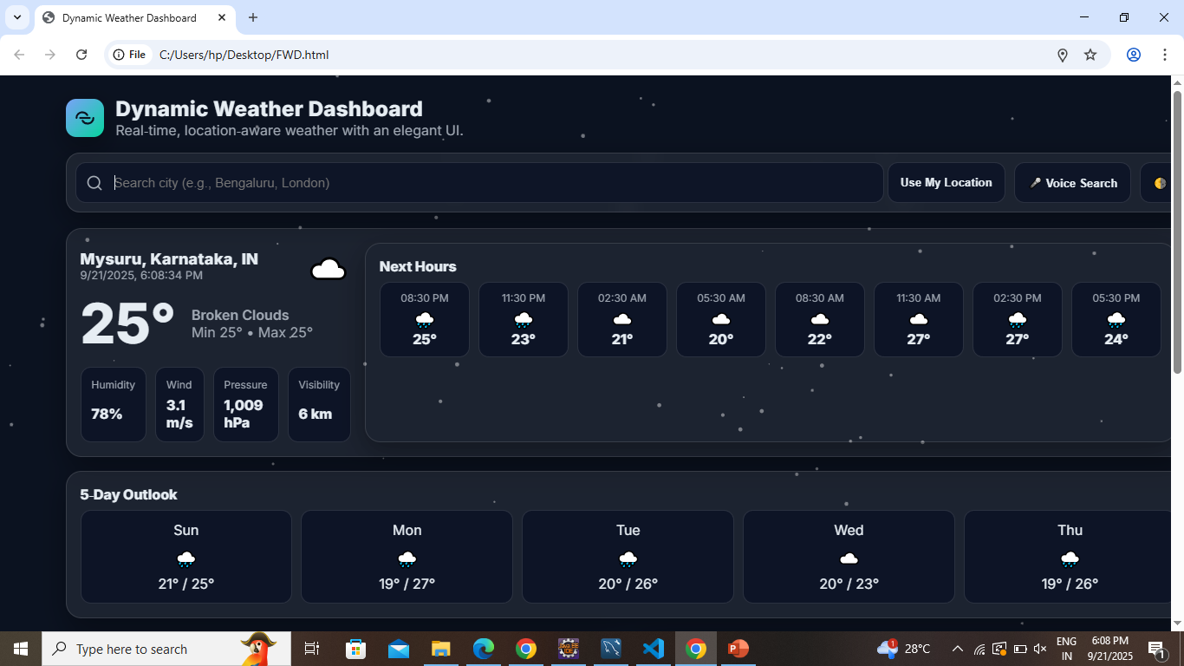
Result

Slide 7
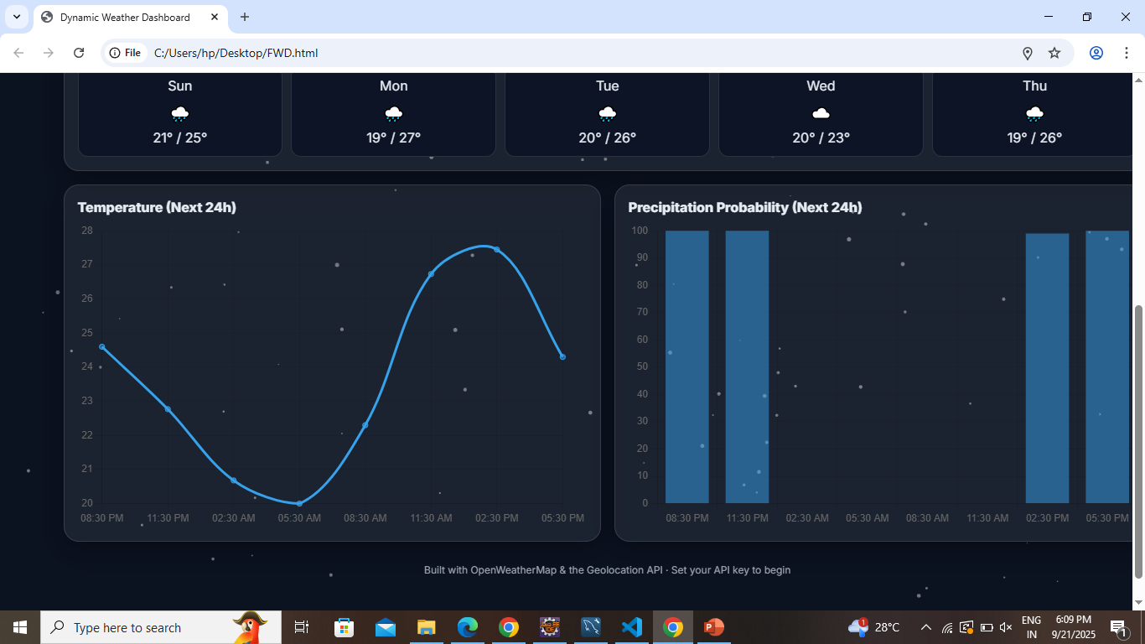
Result

Slide 8
Github link
https://github.com/bharathshetty29120/Dynamic-Weather-Dashboard1.git

Slide 9
Conclusion
Real-Time Data: Shows up-to-date weather information by connecting to reliable online sources.
User -Friendly Interface: Easy to navigate with clear buttons, search box, and helpful icons.
Multiple Input Options: Lets users search by typing, using their current location, or even voice commands.
Responsive Design: Works well on different screen sizes, from desktops to mobile phones.
Visual Appeal: Uses smooth animations and charts to make the information easy to understand and interesting to look at.
Customizable: Can be adapted or expanded with new features like theme switching or additional weather details.
Saves Time: Quickly provides all important weather details in one place without needing to visit multiple sites.
Educational Value: Helps students learn how to combine HTML, CSS, JavaScript, and APIs to build real-world applications.

Slide 10
Future scope(Optional)
Add Backend Integration: Connect the frontend with a backend (e.g., Node.js) to handle data like orders and user info securely, beyond just displaying data.
Integrate Secure Payments: Implement payment gateways so users can safely make purchases directly through the website.
Create Admin Dashboard: Build a separate frontend interface for admins to update products, inventory, and manage the site easily.
Use AI for Recommendations: Enhance user experience by adding AI features that suggest products based on user behavior, similar to how the dashboard personalizes weather info.

Slide 11
References
OpenWeatherMap API: Used to get live weather data displayed on the frontend.
Chart.js: Helped create interactive weather charts using JavaScript.
MDN Web Docs: Guided the use of HTML, CSS, and JavaScript features and best practices.
Google Fonts (Inter): Provided the clean font style for the website design.
Geolocation API: Allowed the app to get the user’s location for local weather info.
Speech Recognition API: Enabled voice search functionality for better user experience.

Slide 12
THANK YOU

