Slide 1

RUNPOD FLASH HACK DAY · JUNE 30, 2026
Geno-Thermal Targeting
Patient-Specific Magnetic Nanoparticle Cancer Therapy — Designed, Evolved, and Verified by an Autonomous Computational Pipeline
genomic discovery → ligand design → thermo-switch → nanoparticle → safety circuit

Slide 2
THE PROBLEM
One Therapy, Five Disconnected Disciplines
Personalized cancer nanotherapy requires chaining genomic analysis, protein structure prediction, thermal-switch engineering, nanoparticle surface design, and safety verification — normally fragmented, manual hand-offs across disconnected tools.
Genomic Analysis
1
Structure Prediction
2
THE CENTRAL SAFETY RISK
Thermal-Switch Engineering
Off-target activation in healthy tissue.
3
Nanoparticle Surface Design
4
Goal
A single reproducible pipeline — run_pipeline.py — that goes from a target gene to a verified, dual-trigger nanoparticle therapy design.
Safety Verification
5
Geno-Thermal Targeting
2

Slide 3
HOW IT FITS TOGETHER
Pipeline Architecture
Genomic
Discovery
Ligand
Engineering
Thermo-Switch
Design
Nanoparticle
Surface Opt.
Safety
Bio-Circuit
Promoter
GA + PPO RL
OpenMM
Physics Verify
Visualization
& Reports
* runs when OpenMM is installed; pipeline continues without it
CLI-orchestrated by run_pipeline.py — each stage logs independently · optional GPU fan-out across stages via RunPod Flash
Geno-Thermal Targeting
3

Slide 4
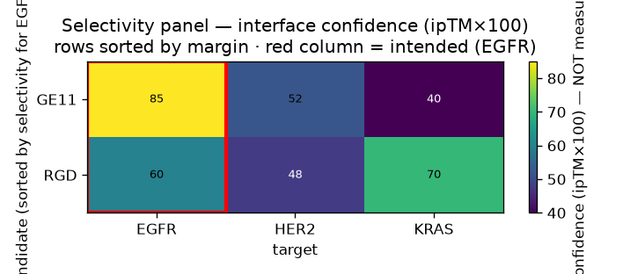
PHASE 1 – 2
Genomic Discovery & Ligand Engineering
GENOMIC DISCOVERY
LIGAND ENGINEERING
AlphaGenomeClient
Real AlphaGenome API or local heuristic fallback scores normal vs. mutated sequence context.
AlphaFold-Server / Boltz docking jobs
5 EGFR-targeting peptide candidates docked; ranked by pLDDT (85–91) and ranking/PAE-style score (0.46–0.73).
EGFR TARGET REPORT (real output)
TOP CANDIDATE vs. NEGATIVE CONTROL
12.5
85.0
0.98
Novel_Peptide_B
pLDDT 91 · ranking score 0.73
Poly_Alanine_Neg_Control
pLDDT 85 · ranking score 0.56
Normal Score
Mutated Score
Confidence
Classification: SUPER_ENHANCER · H3K27ac High · H3K4me1 High · H3K27me3 Low
Multi-target selectivity panel — EGFR (intended) vs. HER2 / KRAS off-targets, candidates ranked by selectivity margin
Geno-Thermal Targeting
4

Slide 5
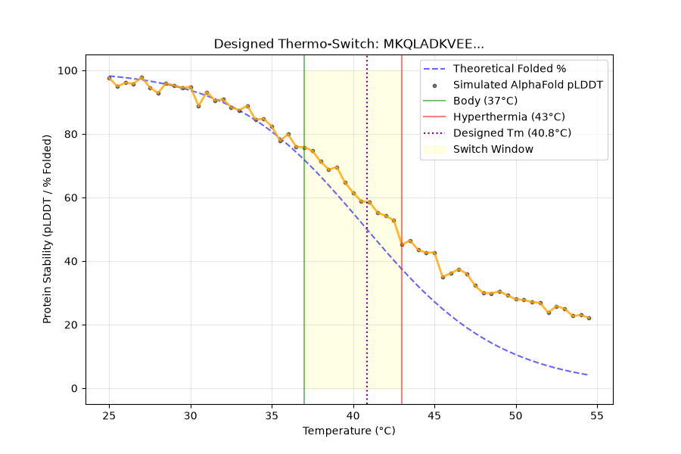
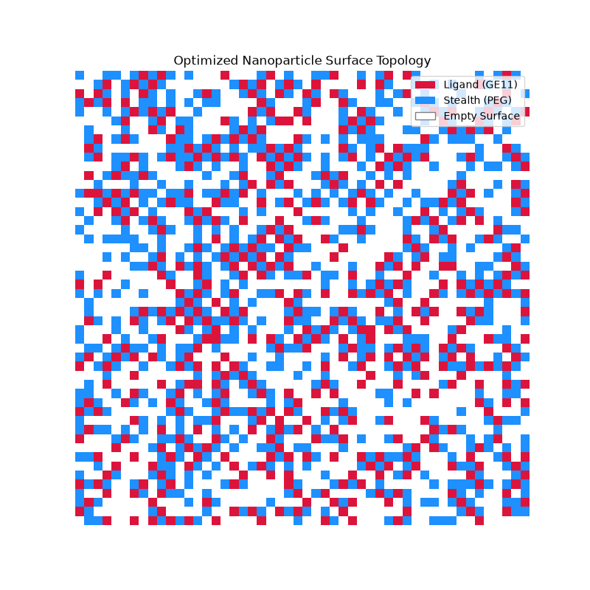
PHASE 3 – 4 · PHYSICS-BASED
Thermo-Switch & Nanoparticle Design
GCN4 leucine-zipper-like scaffold
Optimized via a two-state native/unfolded Gibbs free energy model.
Lattice Monte Carlo annealing
Metropolis algorithm distributes targeting ligand and PEG stealth-polymer on the nanoparticle surface, balancing binding accessibility against immune evasion.
37°C · STABLE
40°C · TARGET Tm
43°C · UNFOLDS
Geno-Thermal Targeting
5

Slide 6
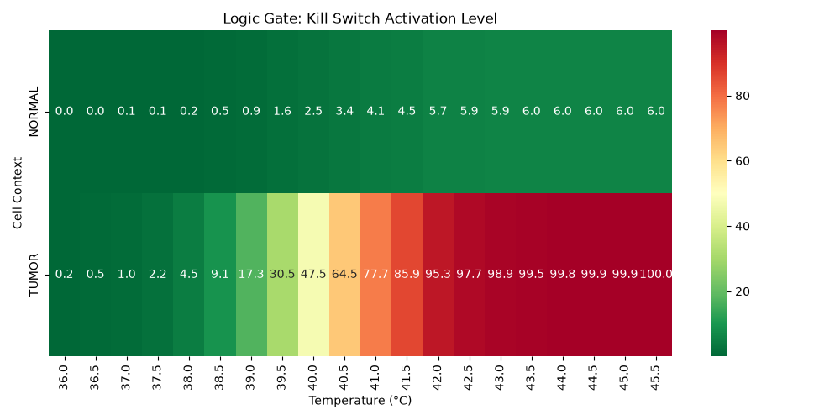
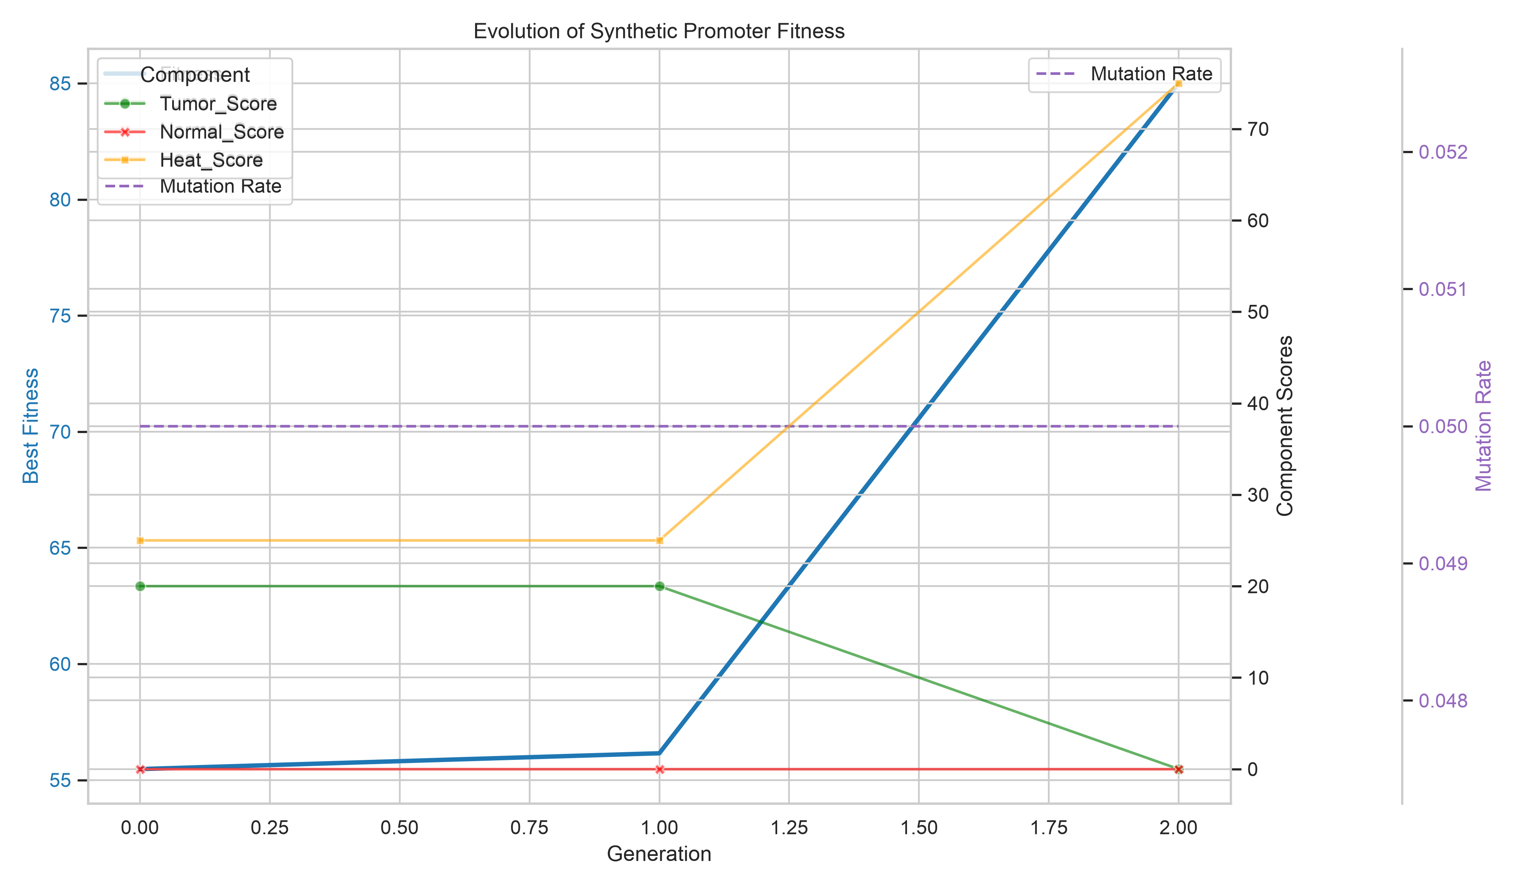
PHASE 5 – 6 · GA + RL
Safety Circuit & Sequence Design
AND-gate safety logic
Promoter (tumor-context) activity × thermal-switch activation — therapy fires only when BOTH cancer context AND ~43°C heat are present. Swept across normal/tumor context and ~36–45.5°C.
Genetic algorithm (hard_mode/evolver.py)
Evolves 200bp synthetic promoters — elitism, tournament selection, adaptive mutation-rate escalation on fitness plateaus; scored on tumor / normal / heat-motif components.
PPO RL agent (Stable-Baselines3)
Trains in a custom Gymnasium environment (PromoterDesignEnv) to write promoter sequences directly.
Geno-Thermal Targeting
6

Slide 7
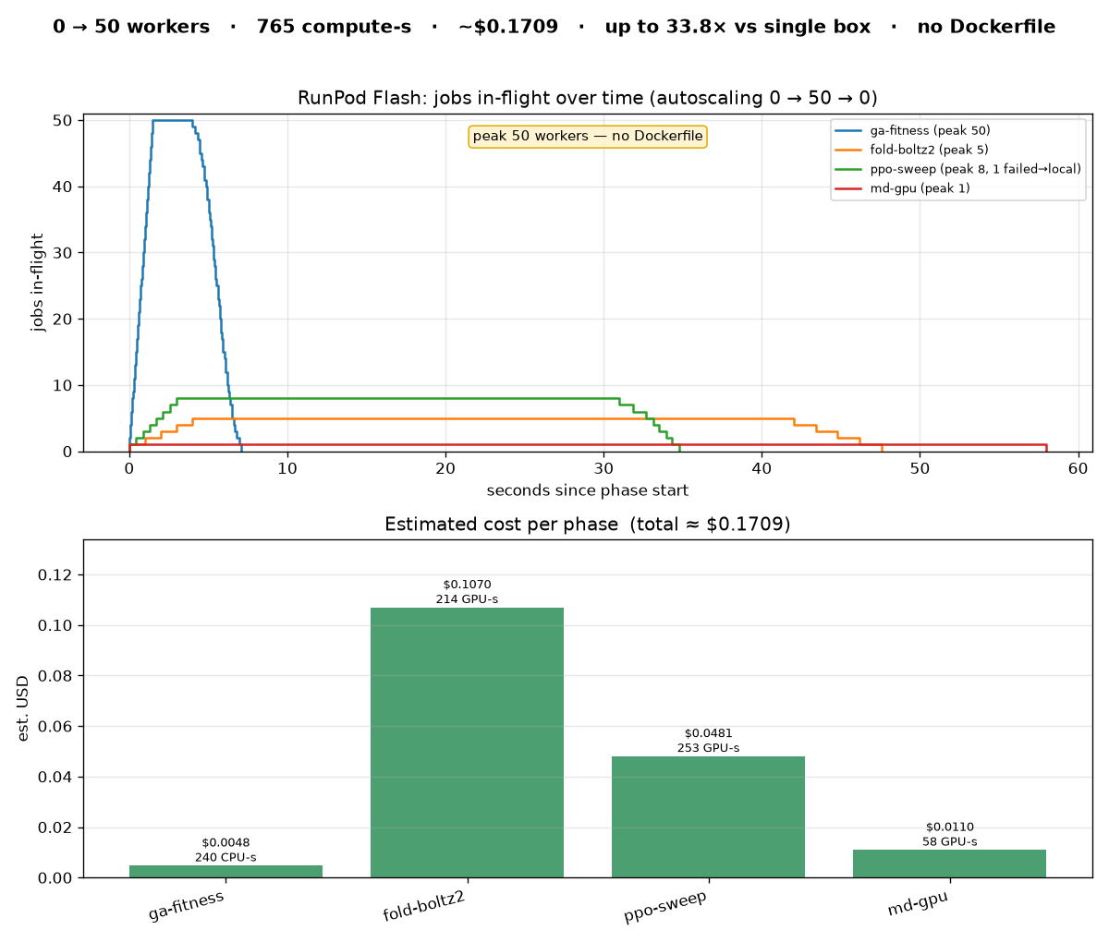
THE HACKATHON HEADLINE
RunPod Flash: Scaling the GA
GA fitness evaluation — normally serial — fans out across RunPod Flash GPU/CPU workers with a single --flash switch. No Dockerfile.
50 / 50
0
50
Jobs Succeeded
Failed
Peak In-Flight Workers
7.1s
4.8s / 5.6s
7.04 / s
Wall-Clock Time
Latency p50 / p95
Throughput
ESTIMATED COST FOR THE RUN
$0.0048
resource: cpu5c-4-8
By design: GA scoring runs in local-fallback mode on workers — avoids exceeding the AlphaGenome API rate limit across 50 concurrent workers.
Geno-Thermal Targeting
7

Slide 8
ENGINEERING HARDENING
Reliability, Cost & Observability
Per-Job Timeouts
Drop & Flag, Never Crash
asyncio.wait_for guards every job so one slow worker can't stall the run.
Failed jobs are dropped-and-flagged instead of aborting the whole fan-out.
Local Fallback
Cost & GPU-Second Tracking
GA auto-falls-back to a local threadpool if Flash workers error — "kill an endpoint mid-run, it finishes locally."
flash_metrics.py + flash_dashboard.py track per-phase GPU-seconds and est. dollar cost across all 3 fan-out sites: GA fitness, Boltz fold+affinity, PPO/OpenMM jobs.
Geno-Thermal Targeting
8

Slide 9
PHYSICS-GROUNDED, AUDITABLE
Validation
Optional OpenMM molecular-dynamics stage (hard_mode/physics_verify.py) compares folded-state RMSD at 37°C vs. 43°C to verify thermo-switch behavior.
PDBFixer repairs AlphaFold-style structures (missing atoms/hydrogens) before simulation.
Automatic CUDA / OpenCL / CPU hardware fallback.
target_report.json
candidate_library.csv
evolution_log.csv
thermo_profile.png
nano_surface.png
A REPRODUCIBLE ARTIFACT TRAIL
JSON target reports, CSV candidate libraries and evolution logs, and the chart images shown in this deck — auditable end to end.
circuit_heatmap.png
panel_selectivity_heatmap.png
Geno-Thermal Targeting
9

Slide 10
IMPACT
A complete, reproducible computational pipeline from a single target gene to a dual-trigger (tumor-context AND hyperthermia), nanoparticle-delivered therapy design.
The evolutionary search scales across a serverless GPU/CPU fleet on RunPod Flash in seconds, at fractions of a cent.
Built on RunPod Flash · github repo: Geno-Thermal_Targeting
Questions / live demo
Geno-Thermal Targeting
10

