Slide 1

Bank Analytics
Cheetiralla Veera Bharath

Slide 2

Introduction
This presentation aims to provide a comprehensive overview of key metrics and trends extracted from the bank's analytics data. By visualizing these insights, we can identify areas for improvement, optimize operations, and make data-driven decisions.

Slide 3
Microsoft Excel
Microsoft Power Bi
Tableau
MYSQL
Tools Used

Slide 4

OVERVIEW
The Bank Analytics project aims to analyze loan data using tools like Excel, Power BI, SQL, and Tableau. Key performance indicators (KPIs) include loan amounts, interest rates, borrower profiles, and financial situations. The project focuses on identifying trends and patterns to provide insights for debt consolidation, home improvement, educational expenses, small business funding, and personal needs. The analysis helps create interactive dashboards and data-driven recommendations for better decision-making.

Slide 5
PROJECT WORKFLOW
1. Extract Data/Import Files
2. Transform Data (remove blank and duplicates)
3. Manage Relationships
4. KPI and Visualization
5. Dashboard

Slide 6
Finance 1
Finance 2
JO INS
ID
ID
Notes:
ID

Slide 7
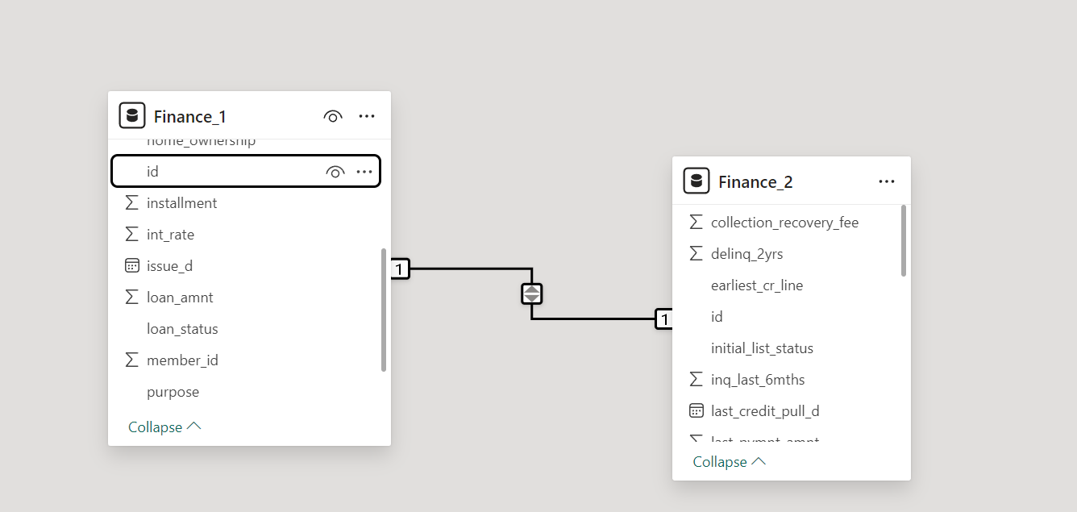
Relations

Slide 8
Main KPI’S
Year wise loan amount Stats
Grade and sub grade wise revol_bal
Total Payment for Verified Status Vs Total Payment for Non Verified Status
State wise and month wise loan status
Home ownership Vs last payment date stats

Slide 9
Analyzes the total loan amounts disbursed each year to identify trends and growth patterns over time.
KPI 1
Examines the revolving balances associated with different loan grades and sub-grades to assess credit risk and borrower behavior.
KPI 2
Compares the total payments made by borrowers with verified income versus those with non-verified income to evaluate the impact of income verification on loan repayment.
KPI 3
Tracks the status of loans across different states and months to identify regional and seasonal variations in loan performance.
KPI 4
Analyzes the relationship between borrowers’ home ownership status and their last payment dates to understand how home ownership influences loan repayment behavior.
KPI 5

Slide 10
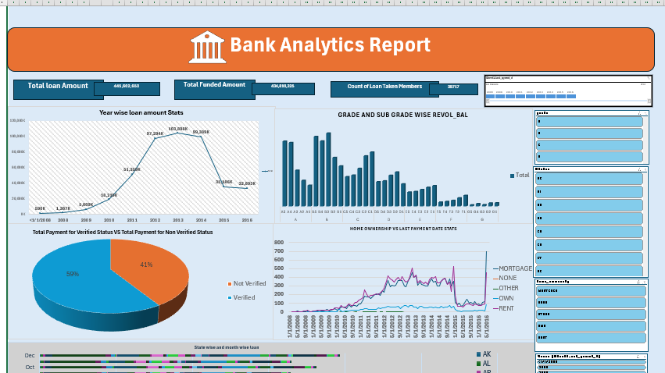
Excel Dashboard
Notes:
Excel Dashboard

Slide 11
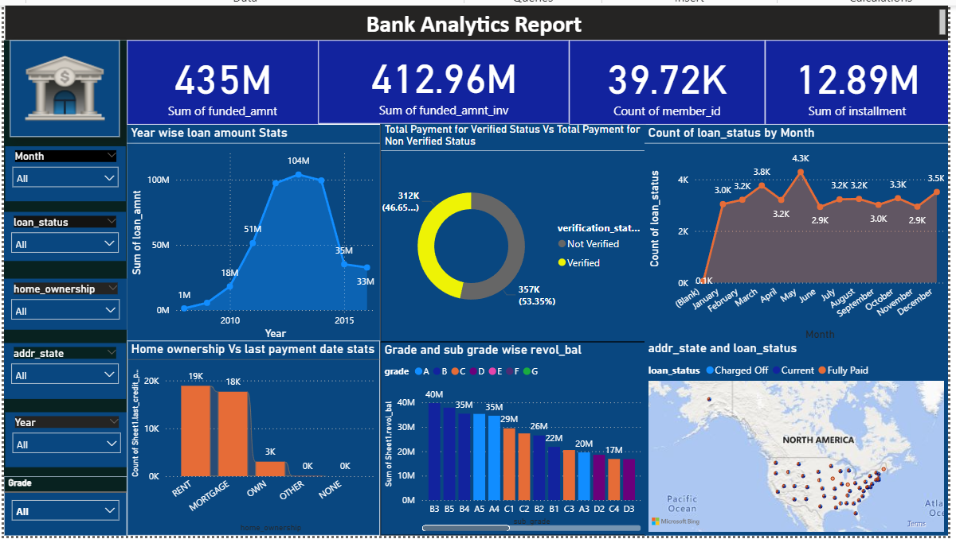
POWER BI DASHBOARD

Slide 12
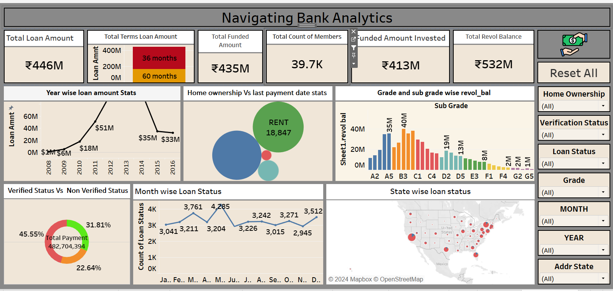
TABLEAU DASHBOARD

Slide 13
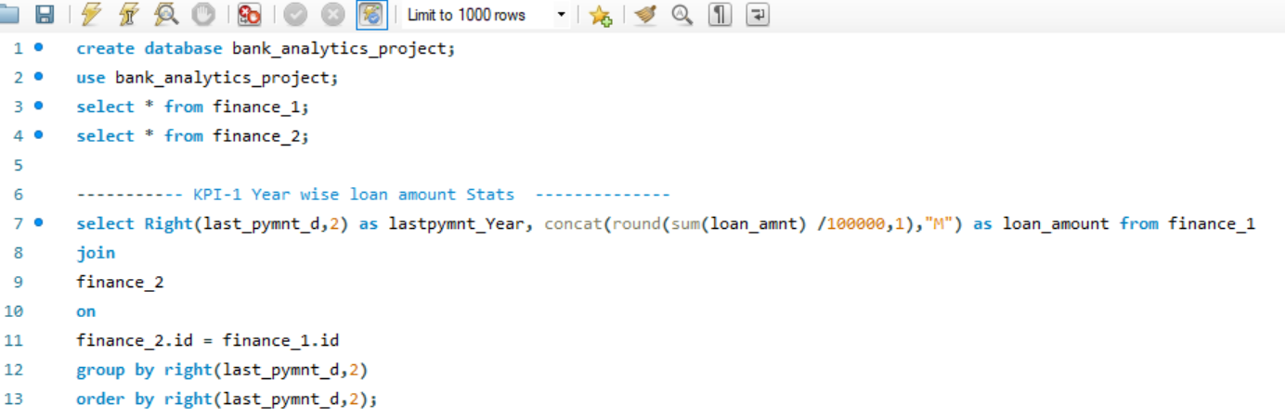
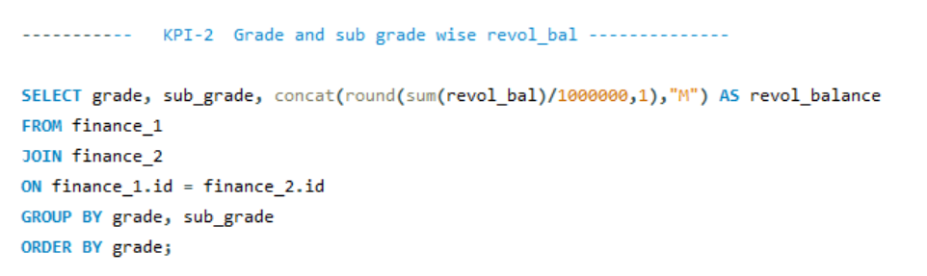
MYSQL Queries

Slide 14
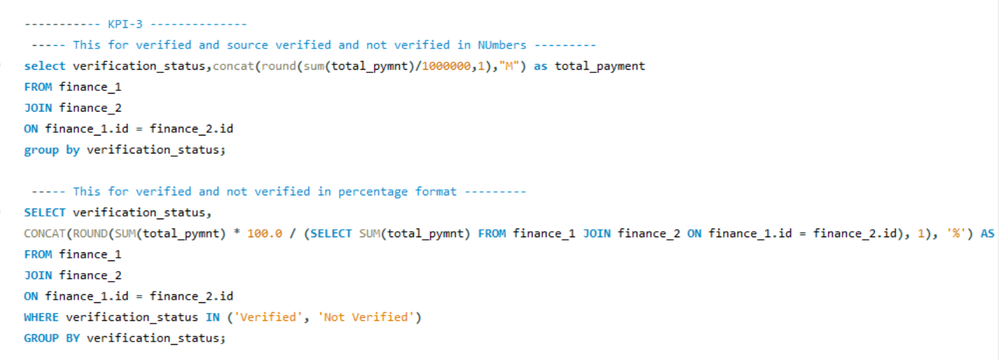
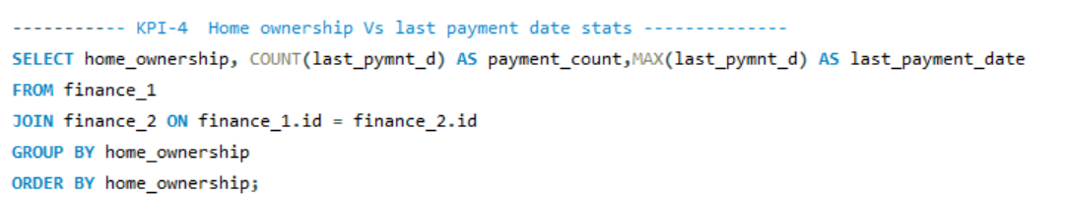

Slide 15
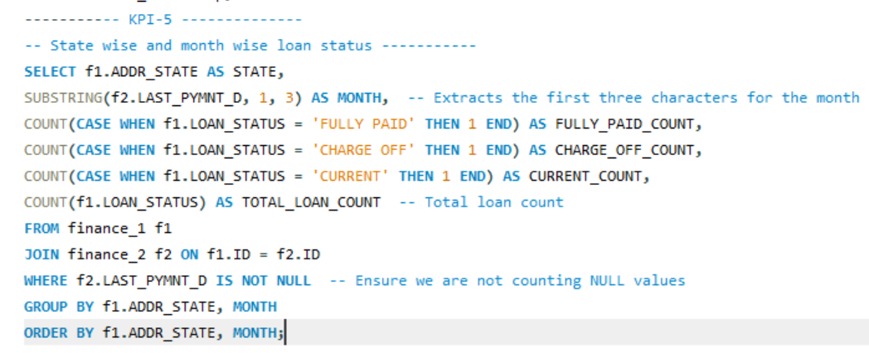

Slide 16
Insights
The analysis shows a steady increase in loan amounts over the years, indicating growing demand for loans and possibly an expanding customer base.
Higher revolving balances are associated with lower-grade loans, suggesting that borrowers with lower credit grades tend to carry more debt, which could indicate higher credit risk
Borrowers with verified income tend to make higher total payments compared to non-verified borrowers, highlighting the importance of income verification in ensuring loan repayment.
Certain states show higher rates of loan defaults, and there are seasonal trends in loan performance, with higher defaults observed during certain months, possibly due to economic cycles or seasonal expenses.
Homeowners generally have more consistent payment histories compared to renters, indicating that home ownership might be a factor in better loan repayment behavior.

Slide 17
Recommendations
Targeted Marketing: Focus on promoting debt consolidation and credit card loans to potential borrowers.
Risk Assessment: Enhance credit risk assessment models to evaluate borrowers' ability to manage longer-term loans.
Customer Engagement: Implement strategies to improve customer engagement and reduce loan delinquency rates.
Geographic Expansion: Consider expanding operations to regions with high growth potential, such as California, New York, and Texas.
Product Diversification: Explore opportunities to offer additional loan products tailored to specific customer needs.

Slide 18
Conclusion
the Bank Analytics project provides a comprehensive analysis of loan data, focusing on key performance indicators such as year-wise loan amounts, grade and sub-grade wise revolving balances, total payments for verified vs. non-verified statuses, state-wise and month-wise loan statuses, and home ownership vs. last payment date statistics. The insights derived from this analysis highlight trends in loan disbursements, credit risk associated with different loan grades, the impact of income verification on repayment, regional and seasonal variations in loan performance, and the influence of home ownership on payment behavior. These findings are crucial for making informed financial decisions and improving loan management strategies.

Slide 19
Thank You !

