Slide 1



TEACHER’S FEEDBACK FORM
Project Done by:
BHARATH WAJ R K
(23ADR018)

Slide 2
OBJECTIVE
The objective of this Student Feedback Form is to make it easy for students to share their thoughts and experiences about a course or subject. By filling out the form, students can:
Give Feedback: Share what they liked or didn’t like about the course.
Help Improve the Course: Suggest improvements or point out areas that need work.
Rate the Experience: Give a quick rating to show how satisfied they are.
Overall, the form helps teachers and schools understand students' opinions so they can make the course better for future students.

Slide 3
Concepts Used
Encapsulation:
Encapsulation is the practice of wrapping data (fields) and methods (functions) into a single unit or class and restricting access to the inner workings of that class.
Abstraction:
Abstraction is the concept of hiding the complex implementation details and showing only the essential features of an object.
3. Inheritance:
Inheritance is the process by which one class takes on the properties and behaviors of another class.
4. Polymorphism:
Polymorphism allows objects to be treated as instances of their parent class or interface, enabling the same action to do different things based on the context.

Slide 4
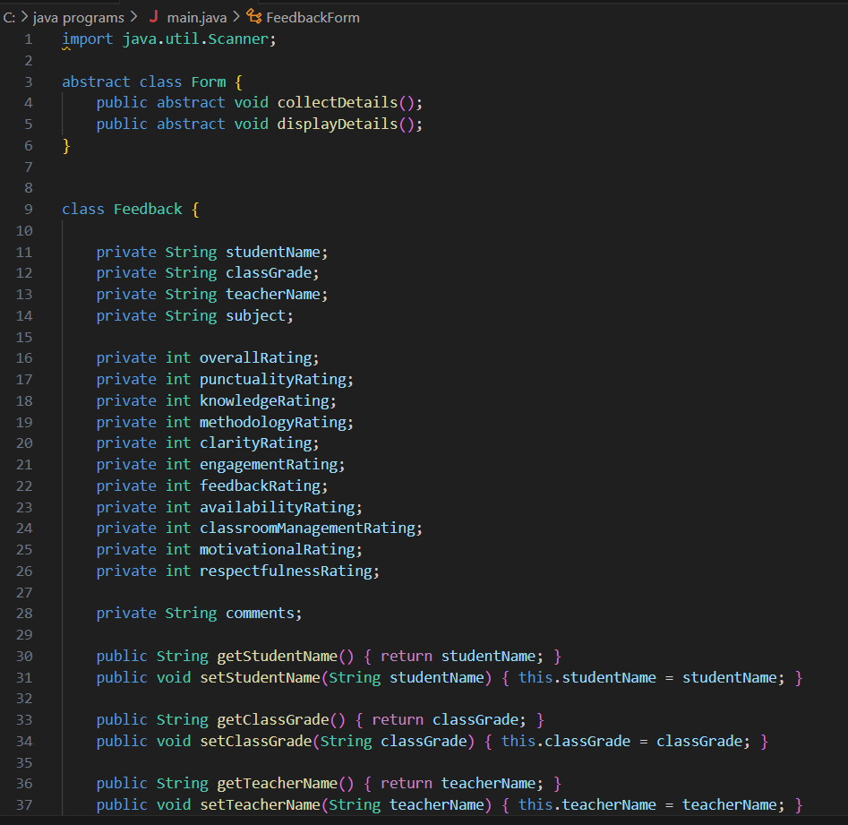
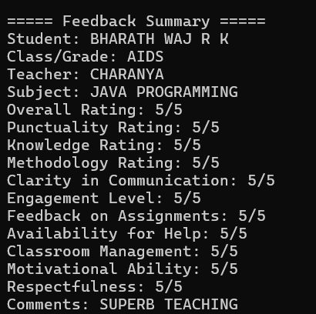
IMPLEMENTATION AND OUTPUT
Coding:
Output:

Slide 5
THANK YOU

