Slide 1
Cyclic Redundancy Check and Modulo-2 Division
CRC (Cyclic Redundancy Check), also known as a polynomial code.
It is a method of detecting accidental changes/errors in communication channel.
CRC uses Generator Polynomial which is available on both sender and receiver side.
An example generator polynomial is of the form like
x³ + x + 1.
This generator polynomial represents key 1011.
Another example is x² + 1 that represents key 101.
n : Number of bits in data to be sent from sender side.
k : Number of bits in the key obtained from generator polynomial.

Slide 2
Sender Side (Generation of Encoded Data from Data and Generator Polynomial (or Key)):
The binary data is first augmented by adding k-1 zeros in the end of the data
Use modulo-2 binary division to divide binary data by the key and store remainder of division.
Append the remainder at the end of the data to form the encoded data and send the same

Slide 3
Receiver Side (Check if there are errors introduced in transmission) Perform modulo-2 division again and if remainder is 0, then there are no errors.
In this article we will focus only on finding the remainder i.e. check word and the code word.
Modulo 2 Division:
The process of modulo-2 binary division is the same as the familiar division process we use for decimal numbers.
Just that instead of subtraction, we use XOR here.
In each step, a copy of the divisor (or data) is XORed with the k bits of the dividend (or key).
The result of the XOR operation (remainder) is (n-1) bits, which is used for the next step after 1 extra bit is pulled down to make it n bits long.
When there are no bits left to pull down, we have a result. The (n-1)-bit remainder which is appended at the sender side.

Slide 4
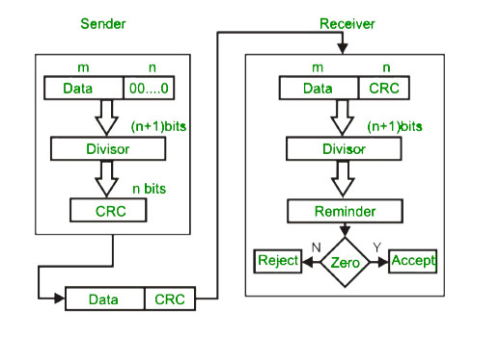

Slide 5
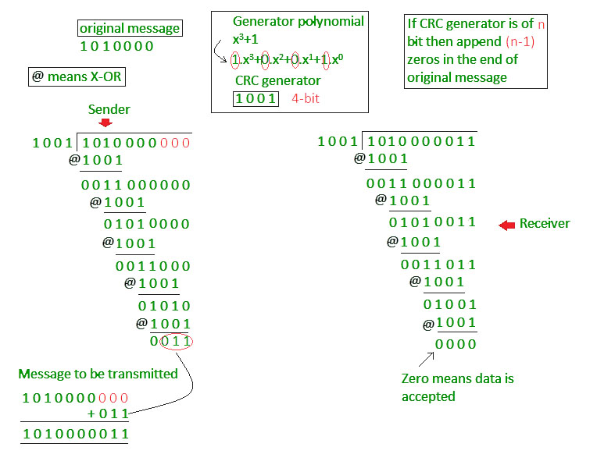

Slide 6
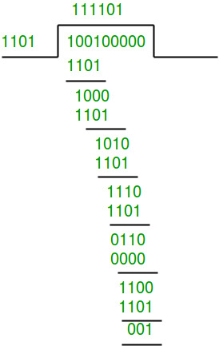
Example 1 (No error in transmission):
Data word to be sent - 100100
Key - 1101 [Or generator polynomial x³ + x² + 1]
Sender Side:
Therefore, the remainder is 001 and hence the encoded data sent is 100100001.

Slide 7
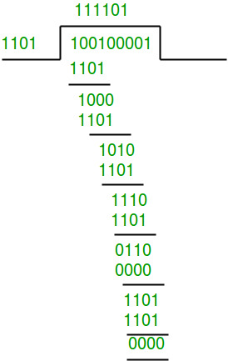
Receiver Side:
Code word received at the receiver side 100100001
Therefore, the remainder is all zeros. Hence, the data received has no error.

Slide 8
Example 2: (Error in transmission)
Data word to be sent - 100100
Key - 1101
Sender Side:
Therefore, the remainder is 001 and hence the code word sent is 100100001.

Slide 9
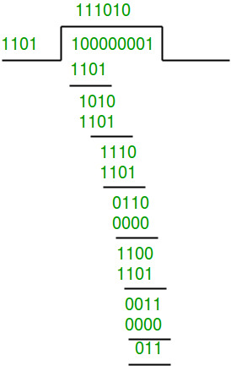
Receiver Side
Let there be error in transmission media Code word received at the receiver side - 100000001
Since the remainder is not all zeroes, the error is detected at the receiver side.

