Slide 1
MICROCONTROLLER AND INTERFACING (22EC104013)

Slide 2
UNIT-4 PROGRAMMIN ON-CHIP RESOURCES AT ASSEMBLY LEVEL
Syllabus
8051 timers and counters
operation
assembly language programming
mode-1 : pulse generation
mode-2: square wave generation
8051 serial communication
basics
rs-232 standard
simple programming in assembly and c to transmit and receive data serially.

Slide 3
Textbooks & References
Kenneth J. Ayala, The 8051 Microcontroller-Architecture, Programming & Applications, 3 rd Edition, Cengage learning, June 2007.
Muhammad Ali Mazidi and Janice Gillespie Mazidi and Rollin D, The 8051 Microcontroller and Embedded Systems-using assembly and C, PHI, 2006/ Pearson New International Edition 2014.
3

Slide 4
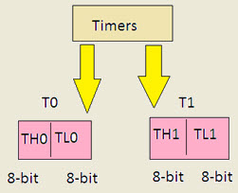
8051 TIMER- COUNTER

Slide 5
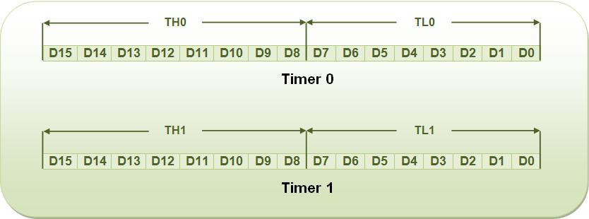
Contd.,

Slide 6
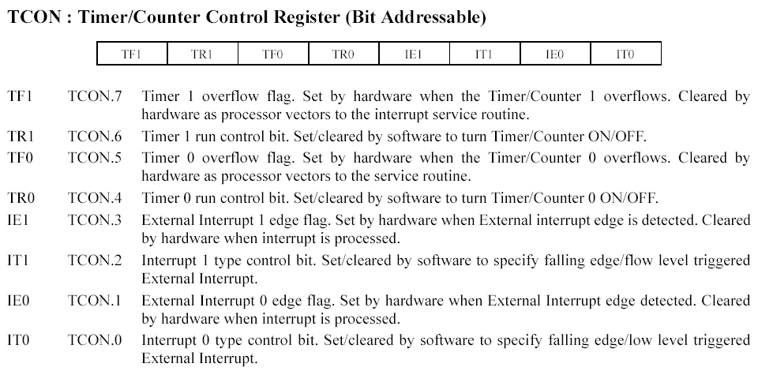
Timer Registers : TCON

Slide 7
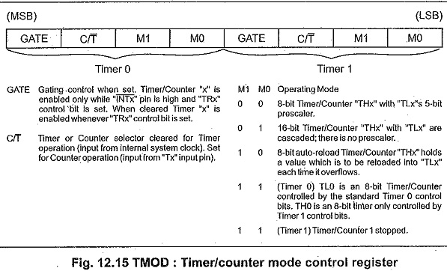
TMOD Register

Slide 8
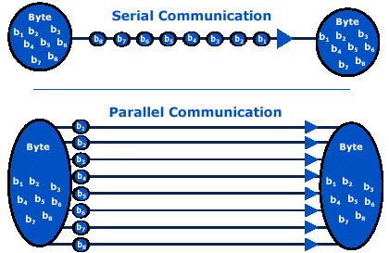
Serial communication

Slide 9
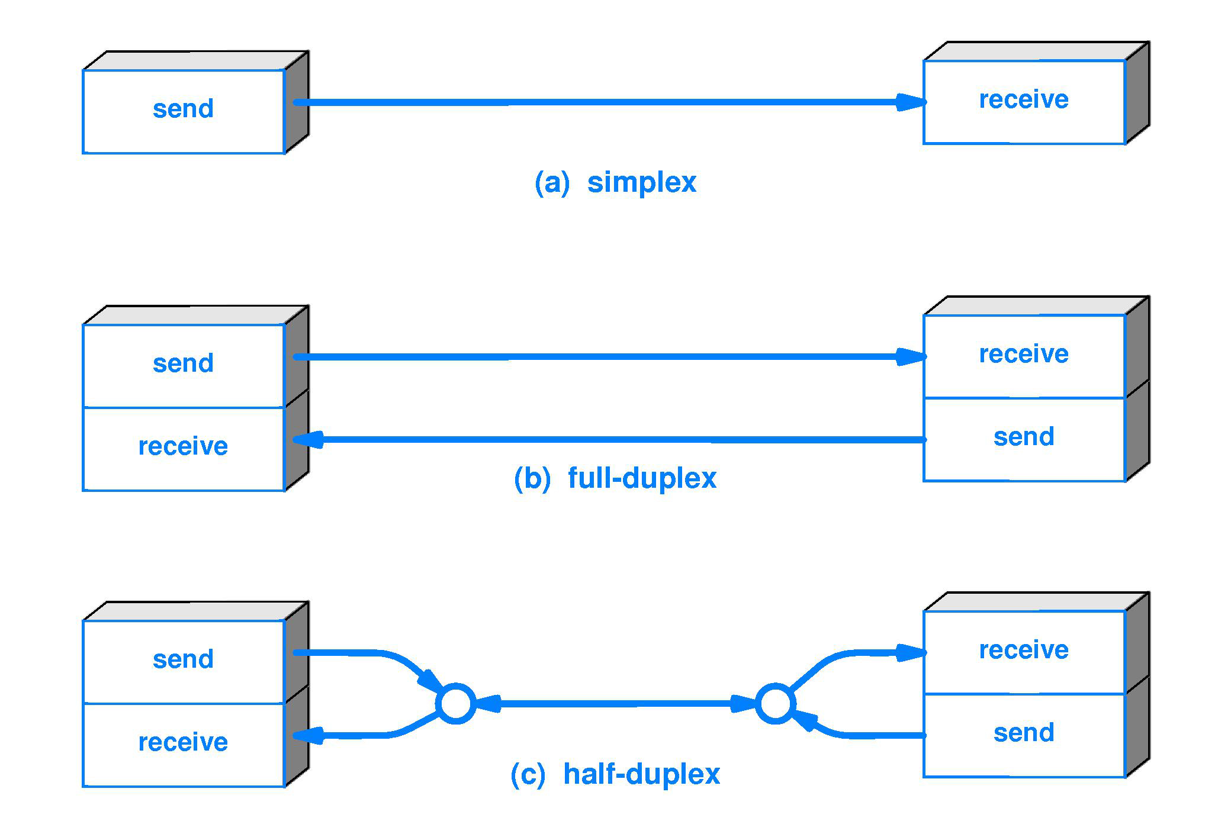
Data Transmission types

Slide 10
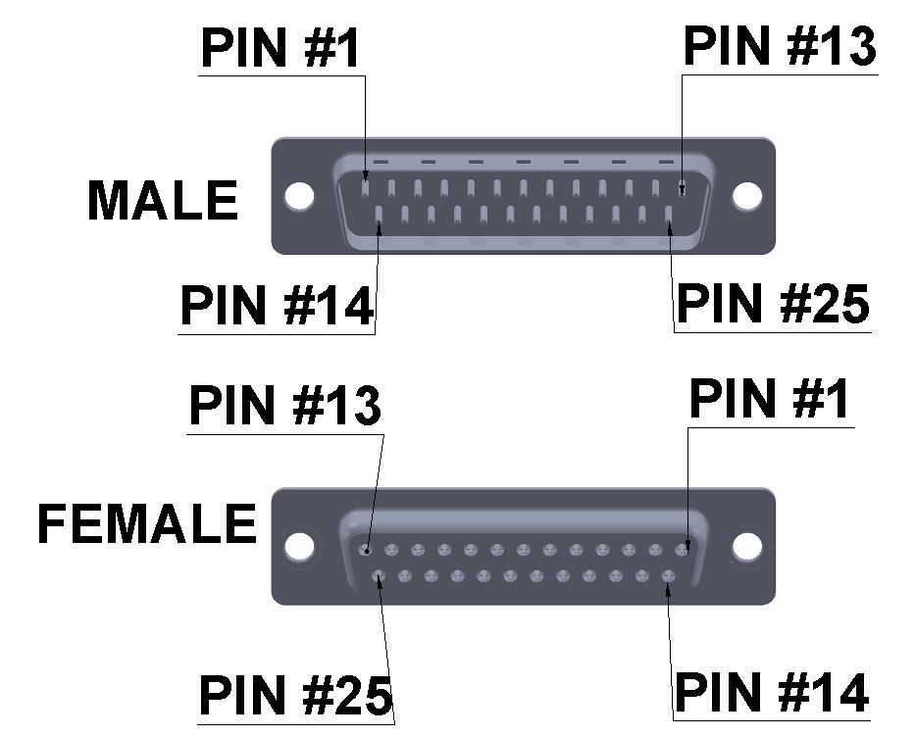
RS-232

Slide 11
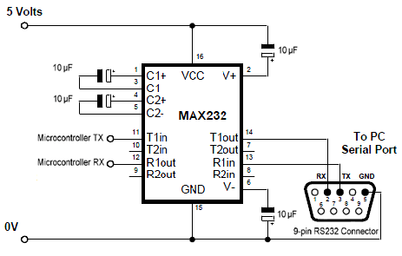
MAX-232

