Slide 1
MICROCONTROLLER AND INTERFACING
(22EC104013)

Slide 2
UNIT-2
Architecture of 8051
Syllabus:
Compare various members of 8051 family
Architecture of 8051
Register Organization, GPRS & SFRS
Pin out description of 8051
Extended mode (External memory interfacing)
Timing details
I/O ports functions
Internal memory organization, External memory
Architecture of 8051

Slide 3
Textbooks & References
Kenneth J. Ayala, The 8051 Microcontroller-Architecture, Programming & Applications, 3 rd Edition, Cengage learning, June 2007.
Muhammad Ali Mazidi and Janice Gillespie Mazidi and Rollin D, The 8051 Microcontroller and Embedded Systems-using assembly and C, PHI, 2006/ Pearson New International Edition 2014.
Architecture of 8051

Slide 4
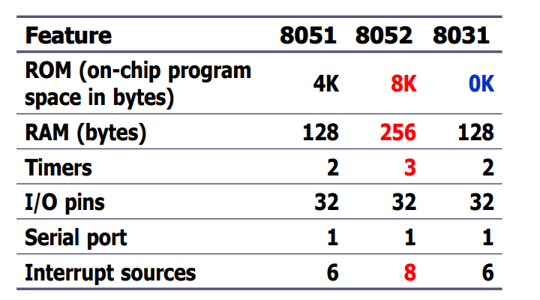
Comparison of various family members of 8051
Architecture of 8051

Slide 5
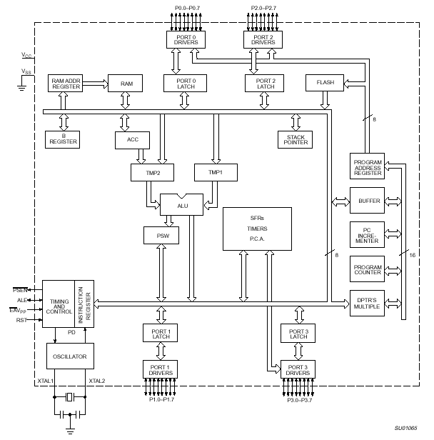
8051 Internal Block Diagram/Architecture
Architecture of 8051

Slide 6
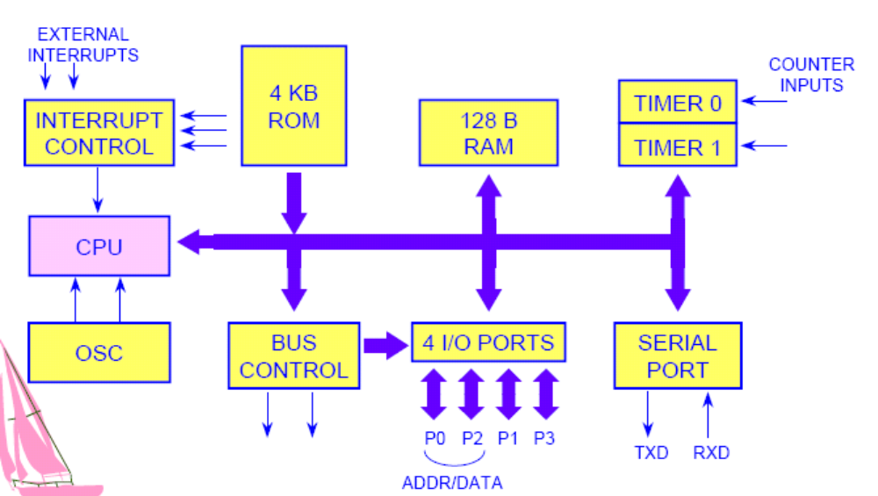
Basic Block of 8051
Architecture of 8051

Slide 7
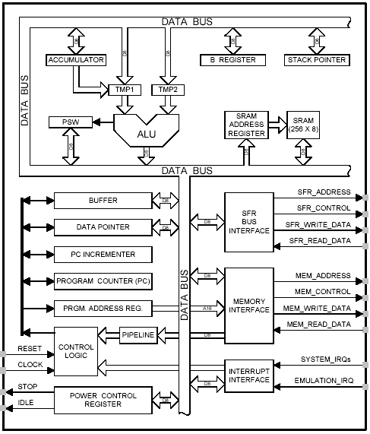
8051 CPU Registers
A (Accumulator)
B
PSW (Program Status Word)
SP (Stack Pointer)
PC (Program Counter)
DPTR (Data Pointer)
Used in assembler instructions
Architecture of 8051

Slide 8
Register Organization
General Purpose Registers based on BIT
A
B
R0
DPTR
DPH
DPL
R1
R2
PC
PC
R3
R4
Some 8051 16-bit Register
R5
R6
R7
Some 8-bit Registers of the 8051
Architecture of 8051

Slide 9
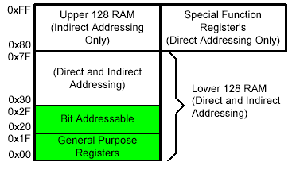
Registers
1F
18
Four Register Banks
Each bank has R0-R7
Bank 3
17
10
Bank 2
0F
08
Bank 1
07
06
05
04
03
02
01
00
R7
R6
R5
R4
R3
R2
R1
R0
Bank 0
Architecture of 8051

Slide 10
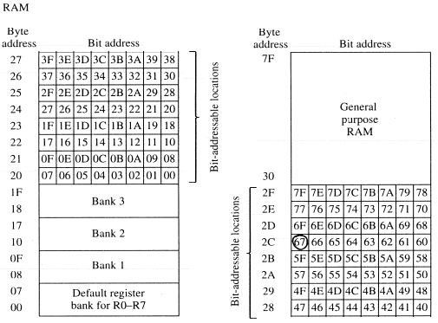
Bit Addressable RAM
Architecture of 8051

Slide 11
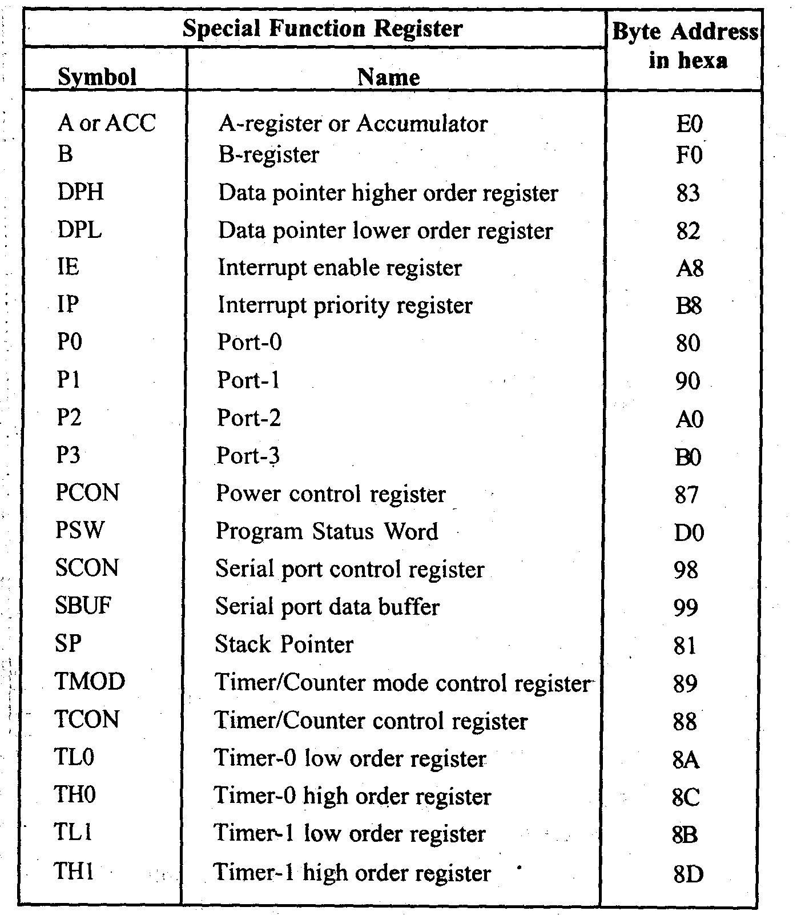
Architecture of 8051

Slide 12
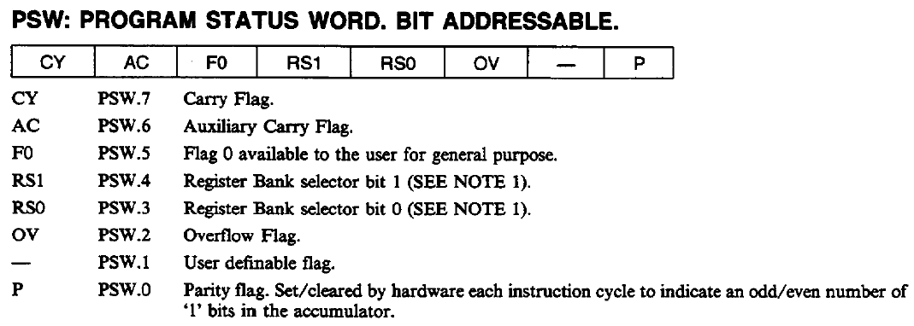
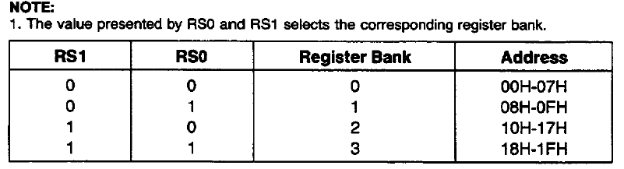
Architecture of 8051

Slide 13
Pin Description of the 8051
P1.0
1
40
Vcc
P1.1
2
39
P0.0(AD0)
P1.2
3
38
P0.1(AD1)
P1.3
4
8051
37
P0.2(AD2)
P1.4
5
36
P0.3(AD3)
P1.5
6
35
P0.4(AD4)
P1.6
7
34
P0.5(AD5)
P1.7
8
33
P0.6(AD6)
RST
9
32
P0.7(AD7)
(RXD)P3.0
10
31
EA/VPP
(TXD)P3.1
11
30
ALE/PROG
(INT0)P3.2
12
29
PSEN
(INT1)P3.3
13
28
P2.7(A15)
(T0)P3.4
14
27
P2.6(A14)
(T1)P3.5
15
26
P2.5(A13)
(WR)P3.6
16
25
P2.4(A12)
(RD)P3.7
17
24
P2.3(A11)
XTAL2
18
23
P2.2(A10)
XTAL1
19
22
P2.1(A9)
GND
20
21
P2.0(A8)
Architecture of 8051

Slide 14
Memory organization
The 8051 microcontroller's memory is divided into
  Program Memory
  Data Memory.
Program Memory (ROM) is used for permanent saving program being executed.
Data Memory (RAM) is used for temporarily storing and keeping intermediate results and variables.
Architecture of 8051

Slide 15
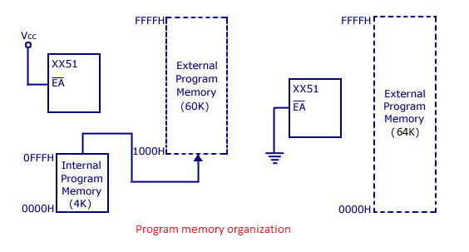
ROM
Architecture of 8051

Slide 16
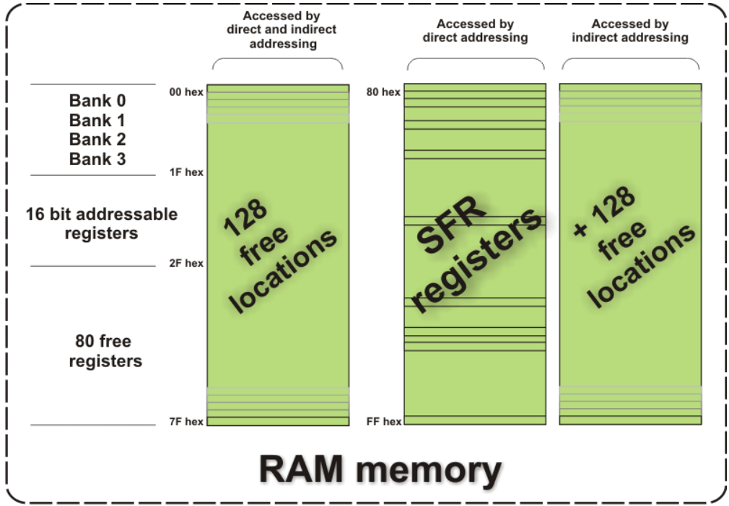
RAM Memory
Architecture of 8051

Slide 17
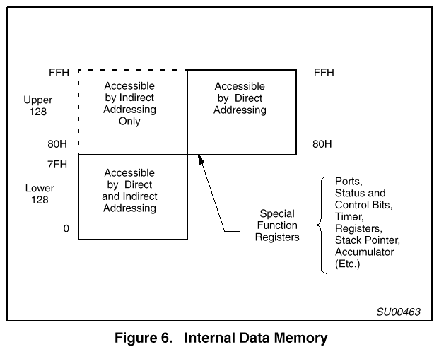
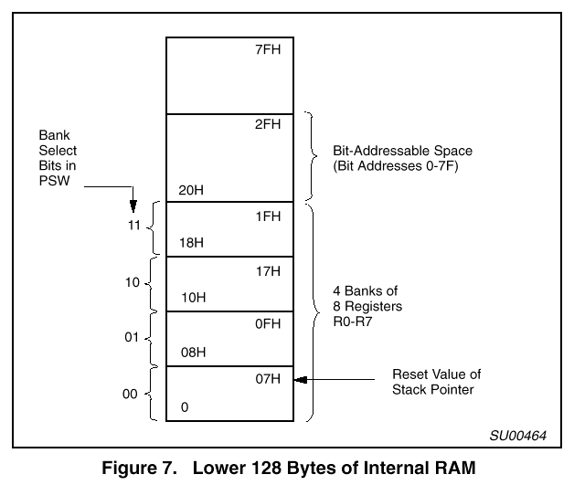
Internal and External Memories
Internal data memory contains all the processor state
  Lower 128 bytes: registers, general data
  Upper 128 bytes:
    indirectly addressed: 128 bytes, used for the stack (small!)
    directly addressed: 128 bytes for “special” functions
Architecture of 8051

Slide 18
Memory mapping in 8051
ROM memory map in 8051 family
4k
8k
32k
0000H
0000H
0000H
0FFFH
DS5000-32
8751
AT89C51
1FFFH
8752
AT89C52
7FFFH
from Atmel Corporation
from Dallas Semiconductor
Architecture of 8051

