Slide 1
MICROCONTROLLER AND INTERFACING (22EC104013)

Slide 2
UNIT-3 Programming 8051 at Assembly Level
Syllabus:
Addressing modes
Instruction setand Examples
Data transfer instructions
Arithmetic instructions
Logical instructions
Branch instructions
Bit manipulation instructions

Slide 3
Textbooks & References
Kenneth J. Ayala, The 8051 Microcontroller-Architecture, Programming & Applications, 3 rd Edition, Cengage learning, June 2007.
Muhammad Ali Mazidi and Janice Gillespie Mazidi and Rollin D, The 8051 Microcontroller and Embedded Systems-using assembly and C, PHI, 2006/ Pearson New International Edition 2014.

Slide 4
Addressing Modes 8051
Method of specifying the data to be operated by the instruction
CPU can access the data in various ways.
-- data could be in reg./Memory/immediate value.
It is a way the MC to access data / operand from internal memory /external memory (or) Register specific data.
The use of efficient modes of a program (addressing mode) will increase the processing speed of CPU as well as processing time can be shortened

Slide 5
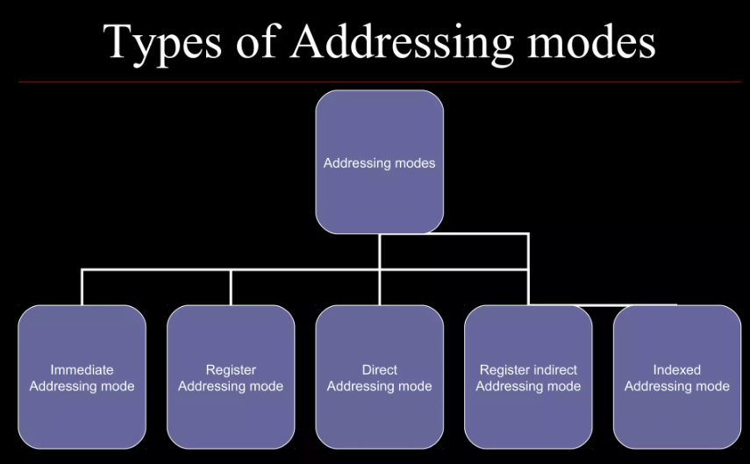
Contd.,

Slide 6
Register Addressing mode
Instruction will specify the name of the Reg. in which data is available
This addressing instruction involves information transfer between registers
(at least one of the R0-R7 register involved)
Source & Destination reg.’s match in Size:
Eg: MOV A, R0 MOV R2, A ADD A, R5
Eg: MOV R4, R5 (Invalid Instruction)
Size of Source & Destination will vary:
Eg: MOV DPTR, A (Error)
MOV DPTR, #12A3H
MOV R2, DPL MOV R1, DPH

Slide 7
Example:
ADD A, R7 ; add content of A with the content of R7
MOV R0,#00 ; move data 00 to the register R0
DJNZ R3, LOOP ; Decrement content of R3 and Jump if Not LOOP
MOV R0, A ; The instruction transfers the content of accumulator A into the R0 register.

Slide 8
Direct Addressing mode
The Address of the data is directly specified in the instruction.
The entire 128 bytes of RAM can be accessed with memory locations 30H to 7FH
Eg: MOV B, 2 MOV 4, 2 (OR) MOV R4, R2
MOV A, 7 MOV A, R7 (OR) MOV A, 7
Eg: MOV R0, 40H
MOV R4, 7FH
MOV 40H, A
MOV A, P3 ; Transfer the contents of Port 3 to the accumulator
MOV A, 020H ;Transfer the contents of RAM location 20H to the accumulator
MOV P1, AA H ; Transfer the contents of A to Port 1
MOV 20H, 40H ; Transfer the contents of the address 40H to the address 20H
ADD A, 55H ; Add the contents of A with the contents of the address 55H

Slide 9
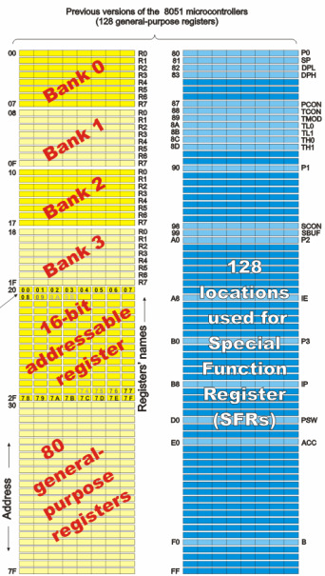
Addressable memory used by direct addressing mode. From 00 to 7F and also address specified by special register
Valid memory Address for Direct
Addressing Mode
P0(80H),
P1(90H),
P2(A0H),
P3(B0H) &
PSW(D0H)
PSW(D0H)

Slide 10
Indirect Addressing mode
MOV @ R0, A ;Store the content of accumulator into the memory location pointed to by the contents of register R0. R0 could have an 8-bit address, such as 60H.
MOV A, @R0 ;move the contents of RAM at location designated by R0 into accumulator
MOVX A, @ DPTR ; Transfer the contents from the memory location pointed to by DPTR into the accumulator DPTR could have a 16-bit address, such as 1234 H.
INC @R1 ;add one into the content designated by the R1
Advantages of Indirect addressing Mode:
Looping is most efficient & Block data transfer
Limitations: need to access the external RAM

Slide 11
Immediate Addressing mode
This mode of addressing uses either an 8- or 16-bit constant value as the source operand
This constant is specified in the instruction, rather than in a register or a memory location
The destination register should hold the same data size which is specified by the source operand
Examples:
ADD A, # 030H ;Add 8-bit value of 30H to the accumulator register (which is an 8-bit register).
MOV DPTR, #0FE00 H ;Move 16-bit data constant FE00H into the16-bit Data Pointer Register.

Slide 12
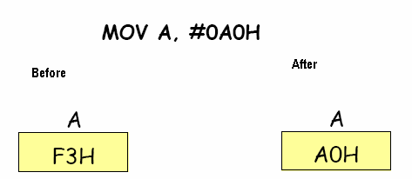
MOV A, # A0H ; data A0H transfer to the A
ADD A, # 4EH ; add the contents of A with the data 4EH & store in Acc. A
CJNE A, # 20H, LOOP ;compare the data 20H with content of Acc (A), jump to LOOP if the value not equal to zero.

Slide 13
Indexed Addressing mode
On-Chip ROM access
The Indexed addressing is useful when there is a need to retrieve data from a look-up table
A 16-bit register (data pointer/program counter – DPTR/PC)holds the base address and the accumulator holds an 8-bit displacement or index value
The sum of these two registers forms the effective address for a JMP or MOVC instruction
Example:
MOV A, #08H ; Offset from table start
MOV DPTR, #01F00H ; Table start address
MOVC A, @ A+DPTR ; Gets target value from the table start address + offset and puts it in A.
(Contents of A are added to the 16 bit reg. DPTR to form the 16 bit address of need data )
(A) { (A=00) + (Add. Of content) }
After the execution of the above instructions, the program will branch to address 1F08H (1F00H+08H) and transfer into the accumulator the data byte retrieved from that location (from the look-up table)

Slide 14
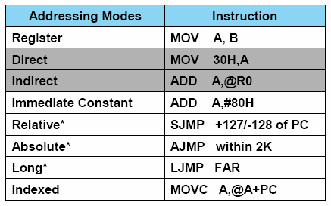
Contd.,

Slide 15
Instruction set
8051 has simple instruction set in different groups. There are:
Data Transfer Instructions
Arithmetic instructions
Logical instructions
Branching and looping instructions
Bit control instructions

Slide 16
Instruction set
An instruction is an order or command given to a processor by a computer program. All commands are known as instruction set and set of instructions is known as program.
8051 have in total 111 instructions, i.e. 111 different words available for program writing.
Where first part describes WHAT should be done, while other explains HOW to do it.
The latter part can be a data (binary number) or the address at which the data is stored.
Depending upon the number of bytes required to represent 1 instruction completely.
Instructions are divided into 3 types;
One/single byte instruction.
Two/double byte instruction.
Three/triple byte instruction.

Slide 17
Data Transfer Instructions
These instructions are used to transfer the data from the source operand to the destination operand.
Instructions | Definition/Meaning
MOV | Transfer data from source to destination.
XCHG | Swap the contents of two registers or a register and a memory location.
PUSH | Push data onto the stack.
POP | Pop the data from the stack.

Slide 18
Arithmetic instructions
Instructions | Definition/Meaning
ADD, SUB, ADC, SBB | Sum, difference, sum with carry, difference with borrow.
INC, DEC: | Increment, decrement.
MUL, IMUL, DIV, IDIV: | Multiplication and division (unsigned and signed).

Slide 19
Logical instructions
Instructions | Definition/Meaning
AND, OR, XOR, NOT | Bitwise logical operations.
TEST | Bitwise AND operation modifies flags while operands remain unchanged.
SHL, SHR, SAL, SAR | Shift left, shift right (logical and arithmetic).
ROL, ROR, RCL, RCR | Left rotate, right rotate (with carry).

Slide 20
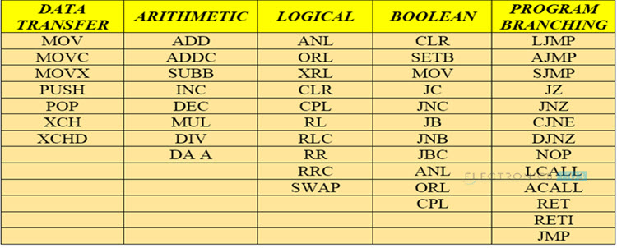
Contd.,

