Slide 1

Student Academic Performance Analytics Dashboard
A centralized, intelligent platform integrating attendance, internal marks, and machine learning to monitor, analyze, and predict student academic performance — empowering institutions to support every learner's success.
ACADEMIC INNOVATION
DATA ANALYTICS
MACHINE LEARNING
GOLLI BHARAT KUMAR
323129512016

Slide 2

The Problem: Academic Risk Goes Undetected
Most institutions lack a unified system to monitor student performance in real time. Faculty rely on manual records, delayed reports, and intuition — often identifying struggling students only after failure occurs.
Siloed Data
Reactive Intervention
No Predictive Insight
Attendance, marks, and results exist in disconnected systems with no cross-referencing.
Students at risk are identified too late for meaningful academic support.
Faculty lack tools to forecast performance or personalize mentoring.

Slide 3
Project Objectives
This platform is designed to transform academic monitoring from reactive to proactive through six core objectives.
Unified Data Integration
Real-Time Monitoring
Consolidate attendance, internal marks, exam results, and historical records into one platform.
Track subject-wise performance, attendance percentages, and grade trends as they happen.
Predictive Intelligence
Automated Alerts
Apply ML models to forecast outcomes and flag at-risk students early.
Notify faculty and students of low attendance, poor performance, and academic risk.
Analytical Reports
Secure & Scalable
Generate performance summaries and predictive statistics for faculty and administrators.
Deliver a role-based, secure platform for schools, colleges, and universities.

Slide 4
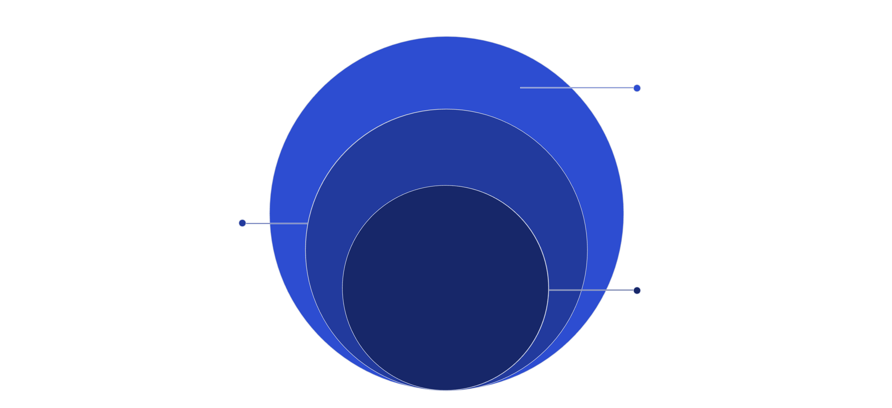
System Architecture
Data & Presentation
Attendance, marks, results; dashboards, alerts, reports
Processing Layer
Data cleaning, normalization, feature engineering
Core ML Analytics
Risk classification, performance prediction, trend modeling
The platform follows a modular four-layer architecture — from raw data ingestion through intelligent processing to role-based dashboards — ensuring clean data flow, scalable ML pipelines, and a responsive user experience for all stakeholders.

Slide 5
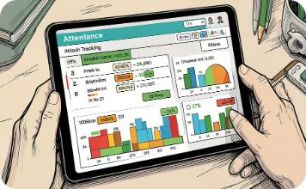
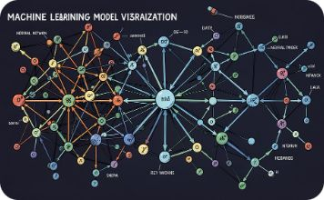
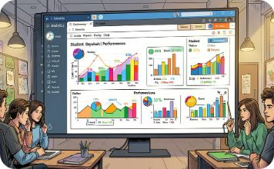
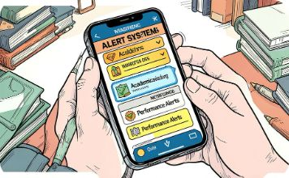
Core Platform Modules
Attendance & Marks Tracker
Predictive ML Engine
Interactive Dashboard
Alert & Reporting System
Trained regression and classification models that forecast grades, detect academic risk, and recommend interventions.
Automated attendance capture and internal marks entry with real-time percentage calculations and threshold alerts.
Subject-wise performance charts, attendance heatmaps, grade trend lines, and predictive scorecards for all user roles.
Automated notifications for low attendance and poor performance, plus downloadable analytical reports for administrators.

Slide 6
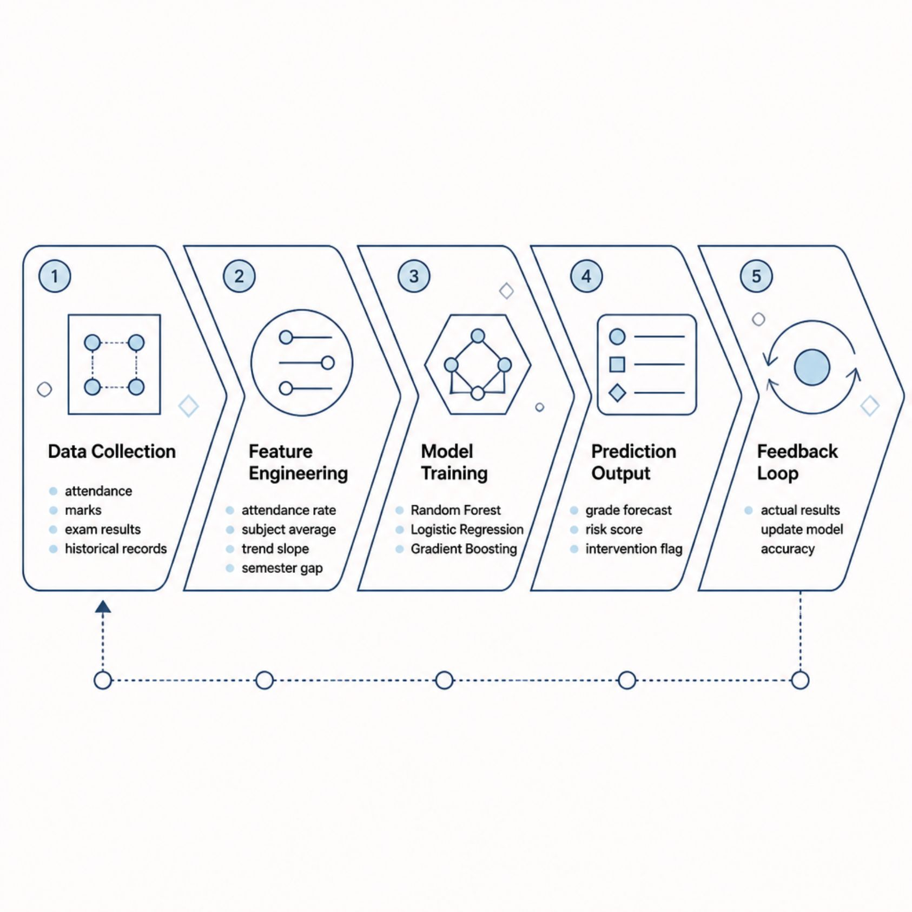

Machine Learning & Predictive Analytics
Predictive Capabilities
Grade Forecasting: Predicts end-of-semester grades using current attendance and internal marks.
Risk Classification: Binary and multi-class models identify students at low, medium, or high academic risk.
Trend Modeling: Time-series analysis reveals performance trajectories across semesters.
Intervention Scoring: Recommends personalized mentoring actions based on predicted outcomes.
Models are retrained each semester using updated academic records, continuously improving prediction accuracy.

Slide 7
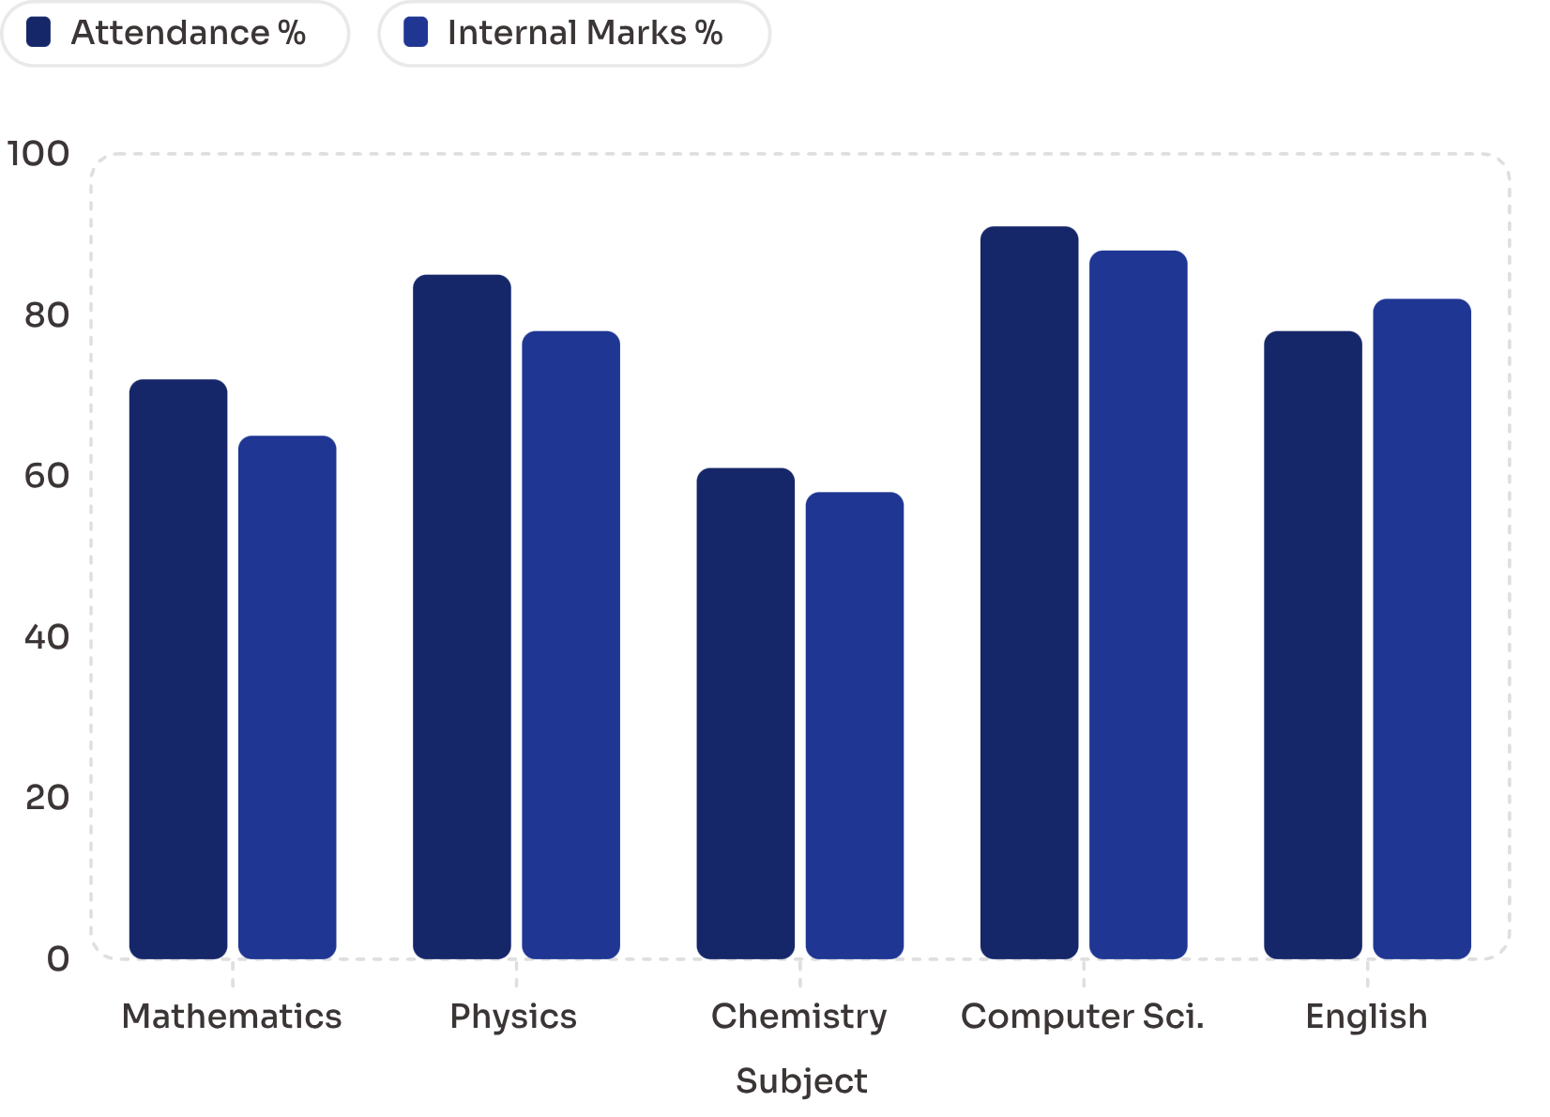
Dashboard & Data Visualization
What the Dashboard Delivers
Subject-wise attendance vs. performance correlation charts
Semester-over-semester grade trend lines per student
Class-level performance distribution and cohort comparisons
Predicted vs. actual grade gap analysis
At-risk student list with risk scores and recommended actions
Faculty and administrators access role-based views with drill-down capabilities from institution-wide summaries to individual student profiles.

Slide 8

Implementation Methodology & Technology Stack
Backend Development
Testing & Deployment
Requirements & Design
Frontend & Integration
APIs, database setup, ML model training
UAT, security audit, pilot launch
Stakeholder interviews, schema, wireframes
Dashboard UI, alerts, report generation
The project follows an agile, phased approach — from requirements gathering through iterative development to pilot deployment — ensuring each component is validated before advancing.
Backend
ML & Analytics
Python · Django/Flask · REST API
Scikit-learn · Pandas · NumPy · Matplotlib
Frontend
Database & Cloud
React.js · Chart.js · Bootstrap
PostgreSQL · Redis · AWS/GCP

Slide 9

Security, Scalability & Real-World Applications
Security & Access Control
Role-based access control (Student, Faculty, Admin)
Encrypted data storage and HTTPS transmission
Session management and audit logging
Scalability
Cloud-native architecture supporting hundreds to thousands of users
Modular microservices for independent scaling of ML and reporting
Real-World Applications
Early warning systems for academic advisors
Curriculum effectiveness analysis for departments
Personalized student mentoring and counseling
Institutional accreditation and compliance reporting

Slide 10

Expected Outcomes & Conclusion
30%
1
Faster Risk Detection
Unified Platform
Estimated reduction in time to identify at-risk students through automated ML alerts.
A single dashboard replacing fragmented manual record-keeping across departments.
24/7
Continuous Monitoring
Real-time performance tracking available to students and faculty at any time.
This platform bridges the gap between raw academic data and actionable insight. By integrating attendance, internal marks, and ML-driven predictions, it empowers institutions to shift from reactive remediation to proactive student success — fostering a data-driven culture of academic excellence.

