Slide 1

CSC 2552- Topics in Computational Social Science
Project Proposal
Analysis of News Popularity among Reddit Communities
A Presentation By,
Bharadwaj (Bharath) Janarthanan | bharadwaj@cs.toronto.edu

Slide 2
Agenda
Research Question
Research Methodology
Data Collection
Methodology
Analysis and Results
Limitations of Study
Possible extension

Slide 3
Research Question
Are different content- self vs blog links vs news links, popular due to similar influences of user, community, content and temporal aspects?
Notes:
*1. Diab, Pui, Yankelevich, & Highhouse, 2011; Eastwood, Snook, & Luther, 2012
2. Önkal, Goodwin, Thomson, Gönül, & Pollock, 2009; Promberger & Baron, 2006
3. Shaffer, Probst, Merkle, Arkes, & Medow, 2013
**1. Dawes, 1979; Einhorn, 1986; Highhouse, 2008
2. Dawes, 1979
3. Highhouse, 2008
4. Dawes, 1979; Grove & Meehl, 1996
5. Grove & Meehl, 1996
6. Dawes, 1979
7. Grove & Meehl, 1996

Slide 4
Data Collection
Collected Nov, 2016 reddit data dump from PushShift.io
Selected only subreddits with more than 1,000 submissions by more than 100 different users over November, 2016
[Total subreddits considered: 1,010]
Chose domains to analyse with > 5,000 posts overall and text-based links
[Total domains considered: 11]
Removed submissions made by bots
[Total submissions considered: 2,178,319]
Removed submissions from deleted users
[Total User: 858,586]
Notes:
Thought about extracting comments and performing a nested analysis, but then changed direction to analyse without looking at comment content. However, might have been interesting to view how, first few comments further initiated more comments

Slide 5
Domains Considered
News Links:
miamiherald.com
washingtonpost.com
theguardian.com
nytimes.com
cnn.com
huffingtonpost.com
Blog Links:
blogspot.com
wordpress.com
Social Media Links:
Twitter.com
Facebook.com
Own Content:
reddit.com
Notes:
I chose to ignore soundcloud.com, imugr.com which are mostly shares of non-textual content, I believe we need different analysis to understand popularity of non-textual data

Slide 6
Feature Considered
Content Based:
Score (Upvotes, Downvotes) received by a submission
Is submission adult content?
Submission Link has Flair tags?
Submission Title Subjectivity
Submission Title Sentiment
Submission Title Length
Self Text Title Length
Submission Title Similarity to Subreddit Language
Submission Title Similarity to Domain Language
Community Based:
Previous post no. of comments
Subreddit Popularity within reddit
User Based:
User Popularity in community- Avg. comments
User spread- # of unique subreddits and # of unique domains posting on
User has Flair tags?
Notes:
The feature groups were broadly focussing on creator, content, community and time dimensions

Slide 7
Feature Considered
Time Based:
Time of Submission (Day and Hour)
Time elapsed since previous submission in subreddit- in domain, by user
Moderation:
# of removed posts in subreddit

Slide 8
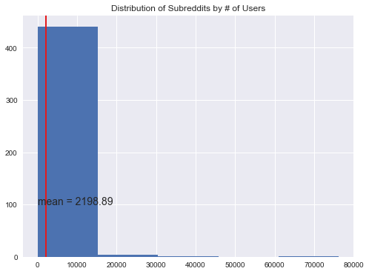
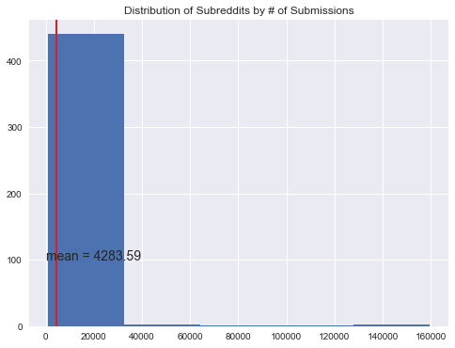
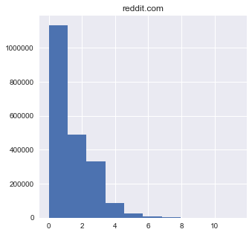
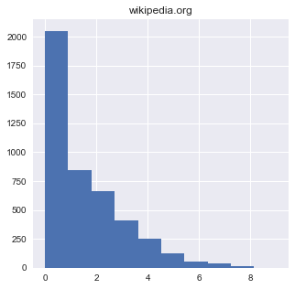
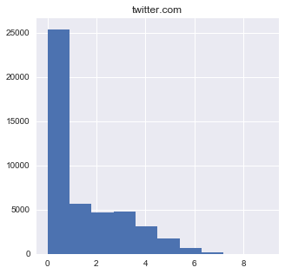
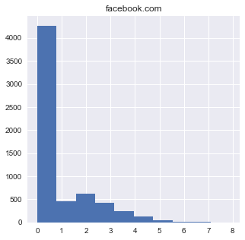
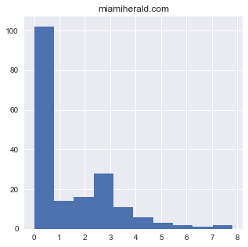
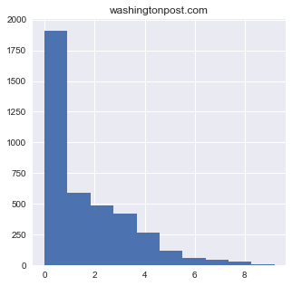
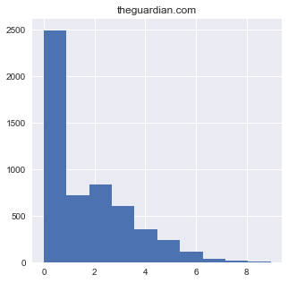
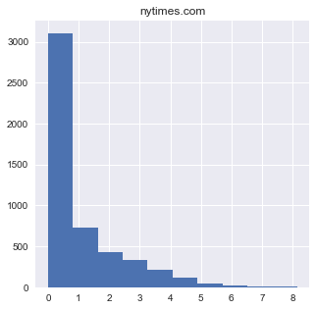
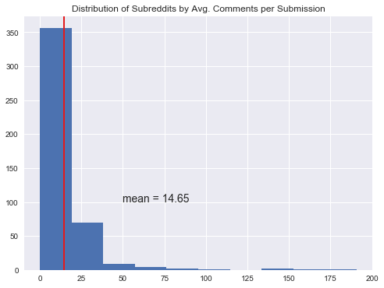
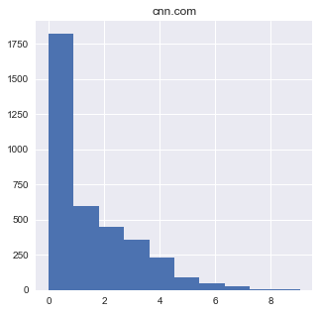
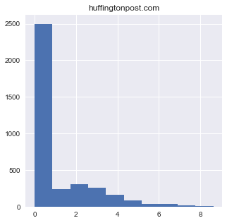
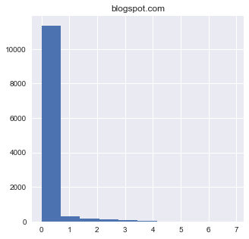
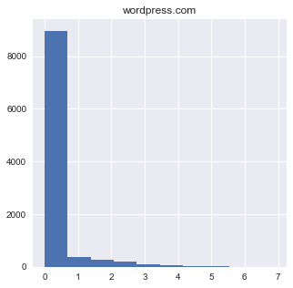
Distribution across Domains
Notes:
Most submissions are about 5-6 comments across domains, on an average about 14 comments. About 2000 users per subreddit with around 4000 submissions, roughly around 2-3 submissions

Slide 9
Analysis Methodology
Identified number of comments a submission receives as an indication of it’s popularity
Initial distribution suggests a large number of submissions receive very few comments
Text Polarity and Subjectivity:
Simple bag of words approach, averaging out word polarity and subjectivity scores from corpus, using TextBlob
Content Similarity:
Computed by transforming pre-processed title content into feature vectors using Doc2Vec (a combination of DM and DBOW model)
Further performed PCA to identify if the dimensionality of feature space could be reduced
Computed subreddit2Vec and domain2Vec as average of feature vectors of submissions in respective subreddits and domains
Cosine similarity measure between submission vector and subreddit vector for similarity to submissions in subreddit and likewise for domain
Notes:
Distributed Memory Paragraph vector model considers word order into play similar to predicting word given context.
It acts as a memory that remembers what is missing from the current context — or as the topic of the paragraph. While the word vectors represent the concept of a word, the document vector intends to represent the concept of a document
PCA was done to check if the feature vector dimensionality could be reduced
Further evaluation was done using word analogies and inspecting sentence similarities

Slide 10
Analysis Methodology
Subreddit moderation: # of posts removed from subreddit during that period
All other features were either used in their raw form from data or computed from aggregations
Removing Bot submissions, pattern matching in author name for names ending or beginning with “bot” and not part of a word.
Domain level model:
Training data reweighted by inverse of proportion of submissions from subreddit
Gradient boosting model vs Lasso Regression

Slide 11
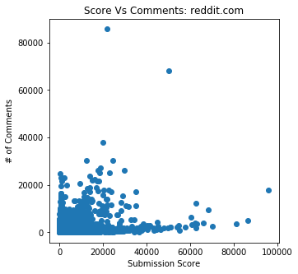
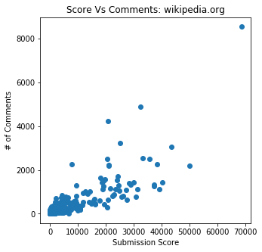
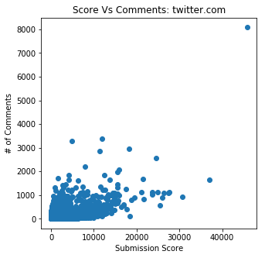
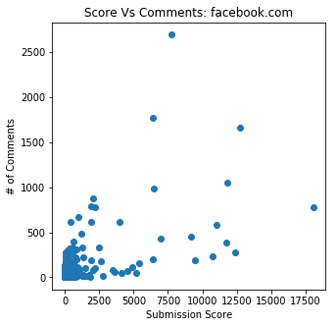
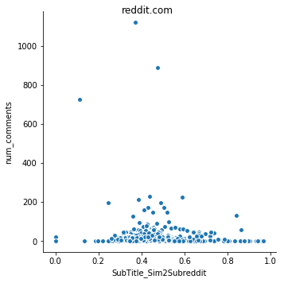
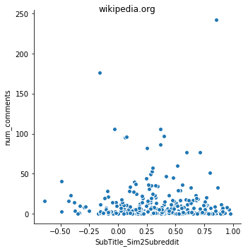
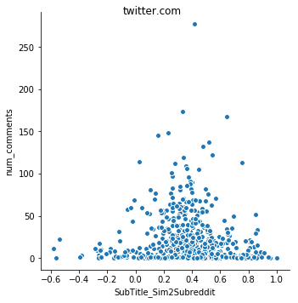
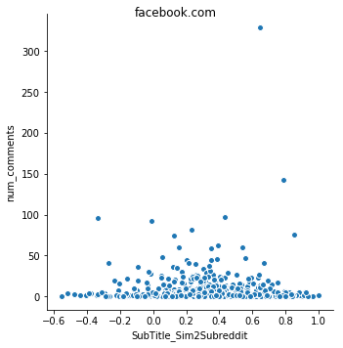
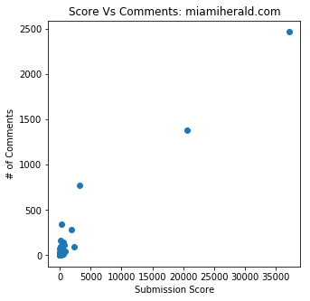
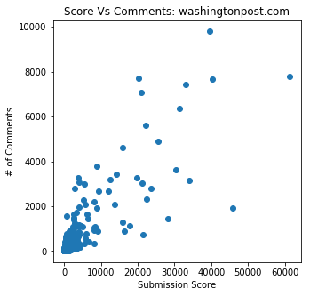
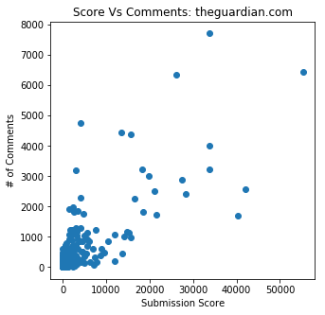
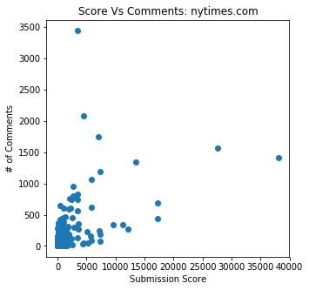
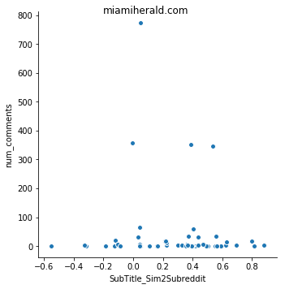
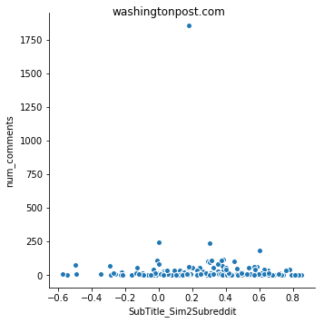
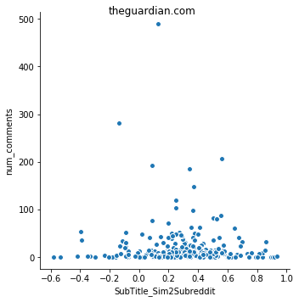
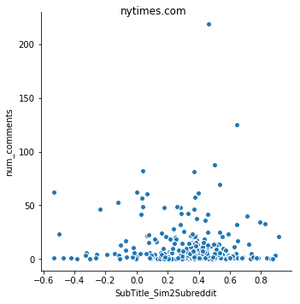
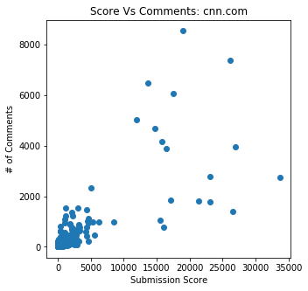
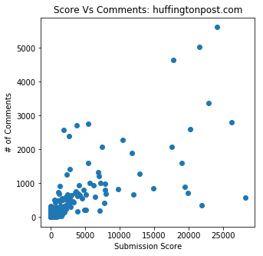
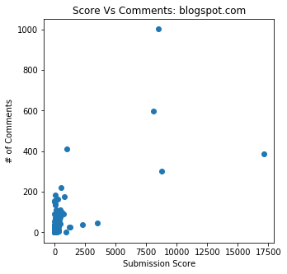
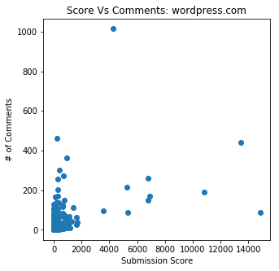
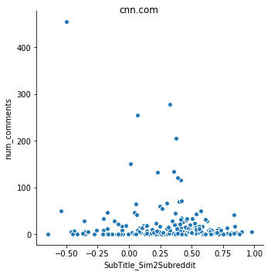
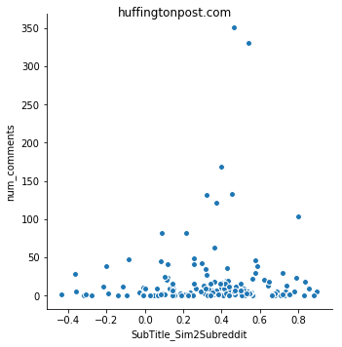
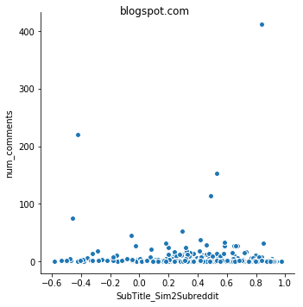
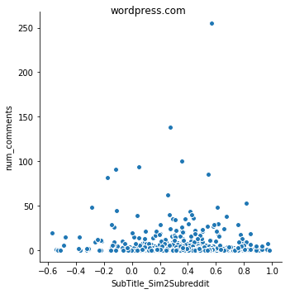
Analysis and Results- Content
The score of a submission is a significant indicator of it’s popularity, the score determines getting featured on the front page
(R- Square = 0.15, p-value<<0.01)
Content similarity to subreddit is a very weak indicator of popularity
(R- Square = 0.003, p-value<<0.001).
* Similar observations with content similarity to domain submissions

Slide 12
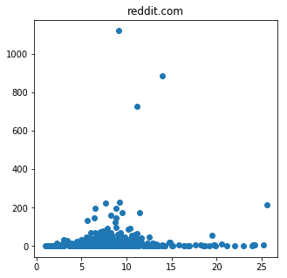
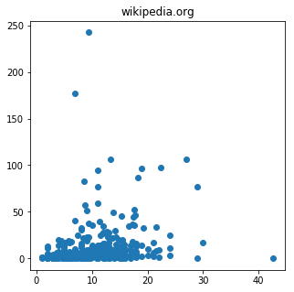
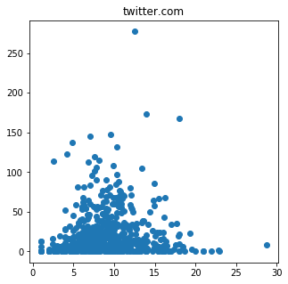
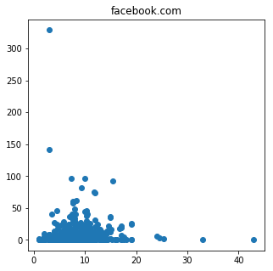
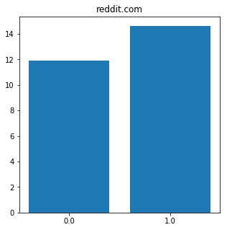
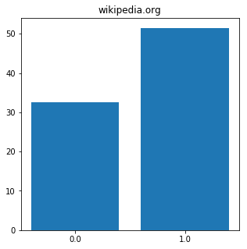
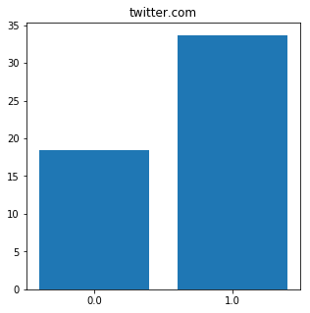
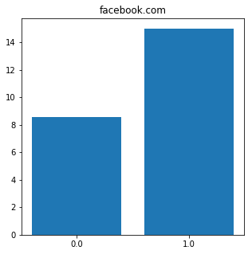
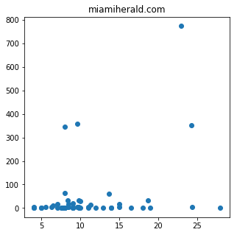
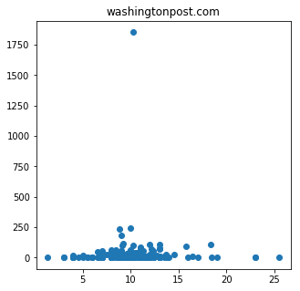
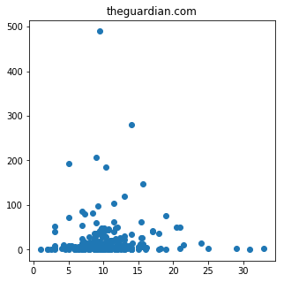












Analysis and Results- Content
The title length of submission is an indicator of it’s popularity
(R- Square = 0.098, p-value<<0.0001)
Links with flair receive much higher comments than links without them across most domains

Slide 13
























Analysis and Results- Community
The no. of comments of previous submission is a significant indicator of it’s popularity, the score determines getting featured on the front page
(R- Square = 0.92, p-value<<0.001)
Subreddit popularity is an indicator of popularity (R- Square = 0.07, p-value<<0.001).

Slide 14
























Analysis and Results- User
The Avg. comments received for author post in a subreddit of a submission is related to the number of the comments their submission receives ( Corr.= 0.66)
Spread of author across different subreddits, versus average number of comments received by submissions within a subreddit

Slide 15


Analysis and Results- Time
Avg. no. of comments per submission, log transformed
Time elapsed, in minutes since last submission by User in Subreddit, hours
With increase in time between submissions by users in a subreddit, the number of comments increases
10-5 PM weekday submissions receive higher comments over weekends on an average
Notes:
The longer the time elapsed and the more prime time the better the likelihood of content being popular

Slide 16

Analysis and Results- Moderation
With increased moderation on an average comments decrease, though not significantly
Notes:
Moderation affects number of comments on subreddit posts

Slide 17
Analysis and Results- Performance Evaluation
Boosting overfits, with high train R- squares while high test RMSE when compared with Lasso
Notes:
As such the R-Square fits of Lasso Models are lesser than that of GBM. However, the ensemble model currently overfits as revealed in the differences in test RMSE of comments
Miamiherald model has extreme overfit due to the very few subreddits in which they are available
Reddit.com self posts are inherently difficult to predict popularity for with features considered

Slide 18

Analysis and Results- Feature Matrix
Submission score and title length are common indicators of submission popularity, followed by moderation and subreddit popularity and user spread. [Note: Feature Rank plot is from Lasso model]
Notes:
It seems to me like, for blog links, nothing but submission score matters,
for social media links prior post popularity matters
For reddit own posts the time of submission, length of title and score matters
For News link submissions, Author and Subreddit popularity matters and time spent and time gaps matter
None of them returned content as an influencer.
All of these associations are subject to the data analysed

Slide 19
Limitations of Study
Data Limitations:
Observations and analysis biased to one month of reddit submissions
Could be influenced from external events
Non-text popularity might be associated with different features of submission
Only select domains by rank of number of submissions in data chosen for analysis,
Self vs Social Media vs Blogs vs News Media
Text words might be prone social media lingos, spelling correction mechanism not incorporated
Feature Limitations:
Developed features don’t explain variance well in comments across submissions
No feature explored, suggesting how informative is self text for reddit own submissions
Comments for submissions is seen to be dependent on time, might be a time series problem
Methodological Limitations:
All features identified are associations in data used for analysis
Can’t use study to identify what type of information is more discussed in each domain
(Topic modelling)

Slide 20
Work to be done
Feature:
How informative is self text for reddit own submissions
Methodology:
Predict for comment range instead of continuous response
Incorporate a time series based model for submissions, treat each subreddit as a longitudinal data with each per day submission aggregate as a cross sectional view

Slide 21
Appendix: Backup Graphs and Analysis

Slide 22


Text Length distribution

Slide 23

PCA on Doc2Vec feature vector matrix

Slide 24



PCA on Doc2Vec feature vector matrix
Trump: Sander | Donald: ?
Black: White | Male: ?

Slide 25
Analysis and Results- Performance Evaluation
Domain | No. of Submissions | No. of subreddits, in model | Lasso Model R- Square | Lasso Model RMSE Ratio | Lasso Test RMSE | GBM Model R Square | GBM Model RMSE Ratio | GBM Test RMSE
reddit.com | 16,10,609 | 984 | 14.28% | 1.17 | 189 | 38.42% | 1.45 | 199
nytimes.com | 3,520 | 225 | 32.72% | 0.57 | 56 | 79.14% | 0.87 | 47
theguardian.com | 4,182 | 225 | 58.86% | 0.99 | 174 | 88.98% | 2.23 | 204
wordpress.com | 3,381 | 422 | 37.54% | 2.20 | 33 | 80.75% | 4.03 | 34
twitter.com | 30,962 | 566 | 50.81% | 0.97 | 78 | 50.03% | 1.08 | 87
facebook.com | 3,747 | 468 | 37.69% | 1.54 | 72 | 85.59% | 3.23 | 73
blogspot.com | 3,126 | 328 | 73.93% | 3.36 | 43 | 95.19% | 2.97 | 16
wikipedia.org | 3,601 | 263 | 80.20% | 1.17 | 133 | 93.57% | 2.04 | 133
washingtonpost.com | 3,281 | 181 | 67.88% | 0.61 | 160 | 84.29% | 1.22 | 222
cnn.com | 2,873 | 194 | 69.01% | 0.92 | 196 | 93.83% | 1.98 | 189
huffingtonpost.com | 1,706 | 141 | 57.12% | 0.99 | 201 | 93.27% | 2.93 | 234
miamiherald.com | 137 | 41 | 99.62% | 4.28 | 85 | 99.80% | 8.63 | 124
Lasso Regression vs Gradient Boosting Model comparison, with minimal hyperparameter tuning, GBM overfits to data. The model training samples were reweighted by proportion of submissions from subreddit

