Slide 1
PULSEOPS / PROGRAMMANAGER
ProgramManager - Demo
Status collection now runs as a provider-neutral, graph-backed delivery loop.
July 1, 2026
13
18
10
feature commits since Jun 1
fixes and hardening commits
infra, docs, and test changes
Source: git history, repo docs, and local QA screenshots.

Slide 2
The project now proves the core status loop
The demo is no longer just an architecture story. It shows an end-to-end loop that asks for status, records evidence, keeps ambiguity visible, and rolls the result up for each persona.
41
non-merge commits in the window
-
Developers can be prompted through chat instead of meeting-driven status chasing.
-
Replies become structured delivery signals with source quality and confidence.
Phase 1
Silence, stale data, and ambiguous replies stay out of green rollups.
Sense loop is the current product center
-
-
Leaders can consume portfolio health without seeing raw direct-message content.
Local
demo stack uses fake and mock providers
ProgramManager demo | 2026-07-01

Slide 3
Delivery moved from foundation to runnable product
Foundation
Sense loop
Demo operations
-
Hexagonal backend and React shell are in place.
-
Daily check-ins dispatch through the workflow layer.
-
Mock Slack provides a credential-free local test surface.
-
Provider seams keep core logic vendor-neutral.
-
Replies parse into progress, blocker, ETA, and mood signals.
-
Runtime config is graph-backed and admin-managed.
-
Container runtime and persistence paths are proven.
-
Rollups compute developer, pod, project, and program health.
-
Jira and Git sync scopes are configurable.
Representative commits: 1229fe7, fcac736, 701ea01, 1c1e62f, d54f44b, 7ee5746, d4bfb6c.
ProgramManager demo | 2026-07-01

Slide 4
The graph is now the operational source of truth
-
Admins configure programs, projects, pods, members, assignments, and links at runtime.
Program
typed graph node
-
Read integrations append provider-neutral facts instead of mutating source systems.
Project
typed graph node
-
Persona APIs and dashboards read from one graph, then apply role-scoped access.
Pod
typed graph node
Developer
typed graph node
Result: status can be traced from a portfolio cell back to the lower-level source facts that made it red, amber, green, or unknown.
Task + facts
typed graph node
ProgramManager demo | 2026-07-01

Slide 5
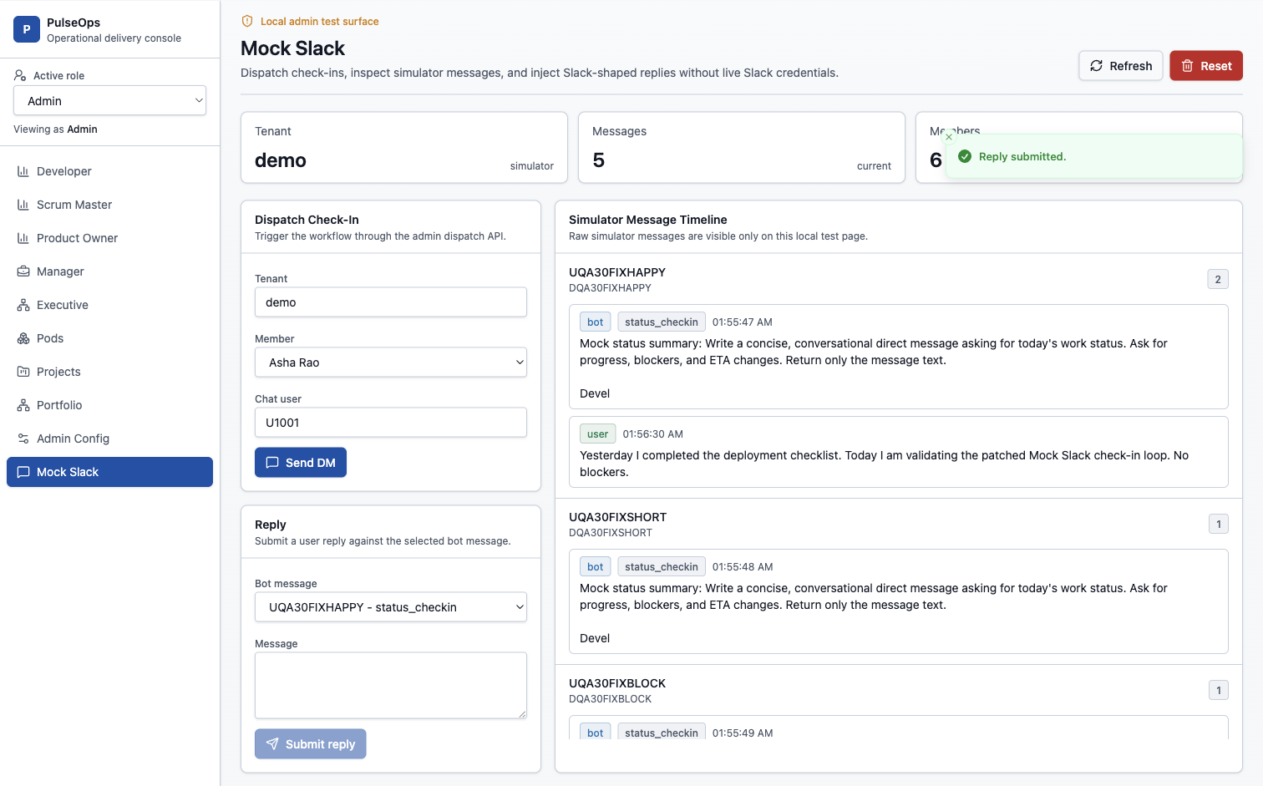
The check-in loop is visible and testable
Mock Slack makes the agent loop visible without live Slack credentials.
-
Admin dispatch creates an outbound direct message.
-
A developer reply is processed through the simulator/webhook path.
-
The check-in records raw reply, correlation, and scheduled as-of date.
-
Persona status can update without exposing the raw message broadly.
ProgramManager demo | 2026-07-01

Slide 6
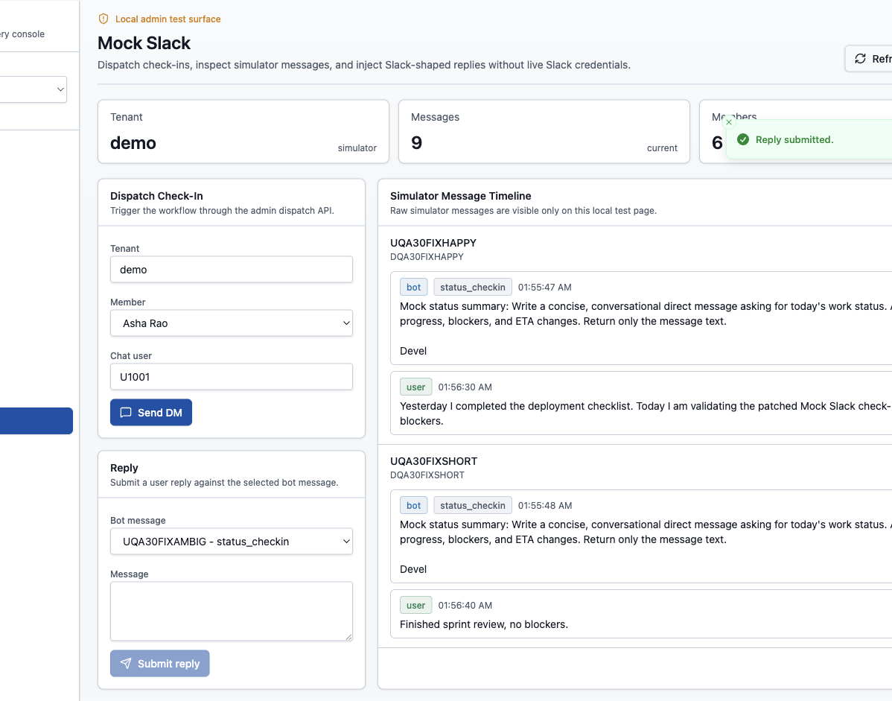
Parsing now treats ambiguity as a product state
-
Short complete updates can finalize a confirmed daily status.
-
Explicit blocker text is preserved in the status summary.
-
Trivial acknowledgements such as ok stay open instead of becoming false green.
-
Duplicate replies do not overwrite the first persisted final status.
Confirmed
Blocked
Ambiguous
This matters because the product promise depends on trustworthy rollups, not optimistic defaults.
ProgramManager demo | 2026-07-01

Slide 7
Leaders now have portfolio flow visibility
The most recent feature work lifts the same source-backed status into program and portfolio views.
Executive signal
Manager signal
Trust boundary
-
Portfolio page selects a program root and as-of date.
-
Program health rolls up from projects, pods, and developers.
-
Executives see aggregates, not raw developer DM text.
-
Heatmap cells show RAG by entity kind and ID.
-
Unknown and stale statuses remain visible.
-
Portfolio navigation is role-gated.
-
Tree and cell data carry source, confidence, and factors.
-
Drill-oriented factors explain why a node changed color.
-
Admin can still manage the hierarchy and dispatch workflows.
Anchor commit: cc64268 feat: give leaders portfolio flow visibility
ProgramManager demo | 2026-07-01

Slide 8
Provider seams made the demo stack credible
The architecture work shows up directly in demo behavior: providers can change without rewriting the core application services.
Chat
mock_slack locally, Slack-shaped webhook mapping at the edge
Directory
mock Slack users sync into configured members idempotently
Issue + VCS
Jira and Git/GitHub scopes are configurable and read-only
Workflow
DBOS, Temporal, and fake modes remain selectable by config
Persistence
graph, status, rollup, sync cursor, and conversation stores
ProgramManager demo | 2026-07-01

Slide 9
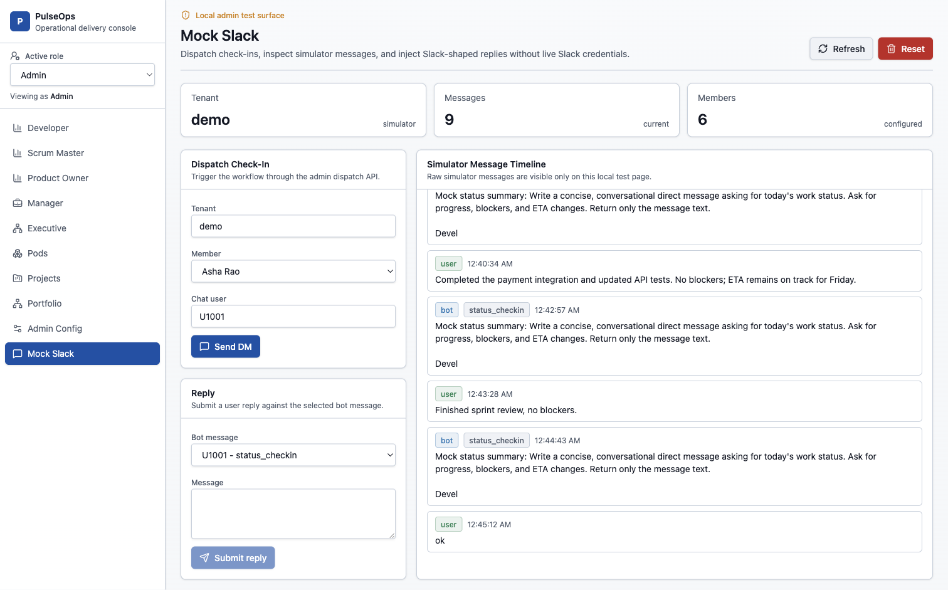
QA shifted from smoke checks to a documented matrix
45
Mock Slack E2E rows covered through Attempt 30
173
backend unit tests passed in the full unit suite
5
focused status parsing and collector tests passed
ProgramManager demo | 2026-07-01

Slide 10
Next: reconcile, predict, coach
The next phase is about making the rollups harder to fool and more useful before delivery risk becomes urgent.
Reconcile
Predict
Coach
-
Compare stated status with Jira, Git, PR, and CI facts.
-
Detect repeated blockers and stale work.
-
Generate standup, retro, and stakeholder updates.
-
Expose richer confidence scores and drift indicators.
-
Forecast milestone or release slip probability.
-
Suggest load balancing with privacy boundaries.
-
Add approved Jira write-back with audit and reversibility.
-
Flag cross-team dependency stalls earlier.
-
Answer natural-language portfolio questions.
Keep the current rule: external writes must remain idempotent, logged, and reversible.
ProgramManager demo | 2026-07-01

