Slide 1
OpenProgram - Demo
OpenProgram product, business, and feature readout
One canonical delivery graph. Proactive status collection. Explainable rollups for every role.
July 2, 2026
OpenProgram
01

Slide 2
THE HOOK
Status is expensive when humans assemble it by hand.
Teams spend recurring time chasing updates instead of acting on exceptions.
14
18
11
Silence is easy to misread as healthy progress.
features shipped
fixes hardened
infra/test/docs
since 2026-06-02
same period
delivery support
Manual rollups hide the path from program risk back to the source blocker.
Leader views need signal without exposing raw developer messages.
Source: git history since 2026-06-02; PR metadata was unavailable locally.
The hook
02

Slide 3
PRODUCT MODEL
OpenProgram keeps one live operating model of delivery.
The product connects chat, Jira, GitHub, calendar, and workflow events into a graph-backed system of record that every persona reads through a different lens.
Sense
Model
Roll up
Act
Collect status through proactive chat check-ins and read-only delivery sync.
>
Store programs, projects, pods, people, tasks, workstreams, and facts in one graph.
>
Compute RAG, confidence, blockers, completeness, and portfolio heatmap cells.
>
Surface role-specific dashboards, flow metrics, feed events, and ask-anything answers.
Business takeaway: a program review becomes a drillable operating view, not a weekly reconstruction exercise.
Product model
03

Slide 4
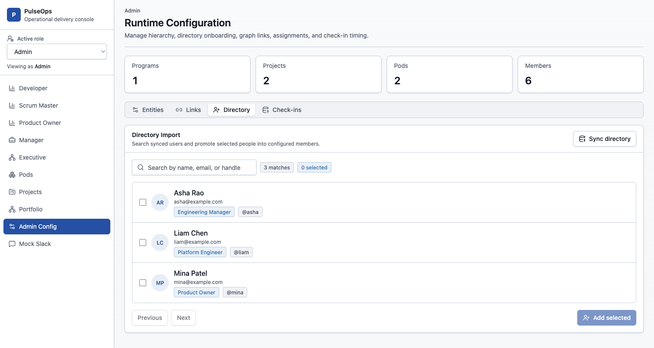
FEATURE 1
Runtime configuration makes the delivery graph business-owned.
Admins can manage programs, projects, pods, members, links, assignments, and check-in timing at runtime.
Directory sync promotes real users into configured members without hardcoded seed data.
Jira and GitHub scopes are configured on project and pod definitions, so scheduled sync follows the business structure.
The same graph powers selectors, detail pages, and rollups across the product.
Runtime Configuration: directory-backed member onboarding
Feature 1
04

Slide 5
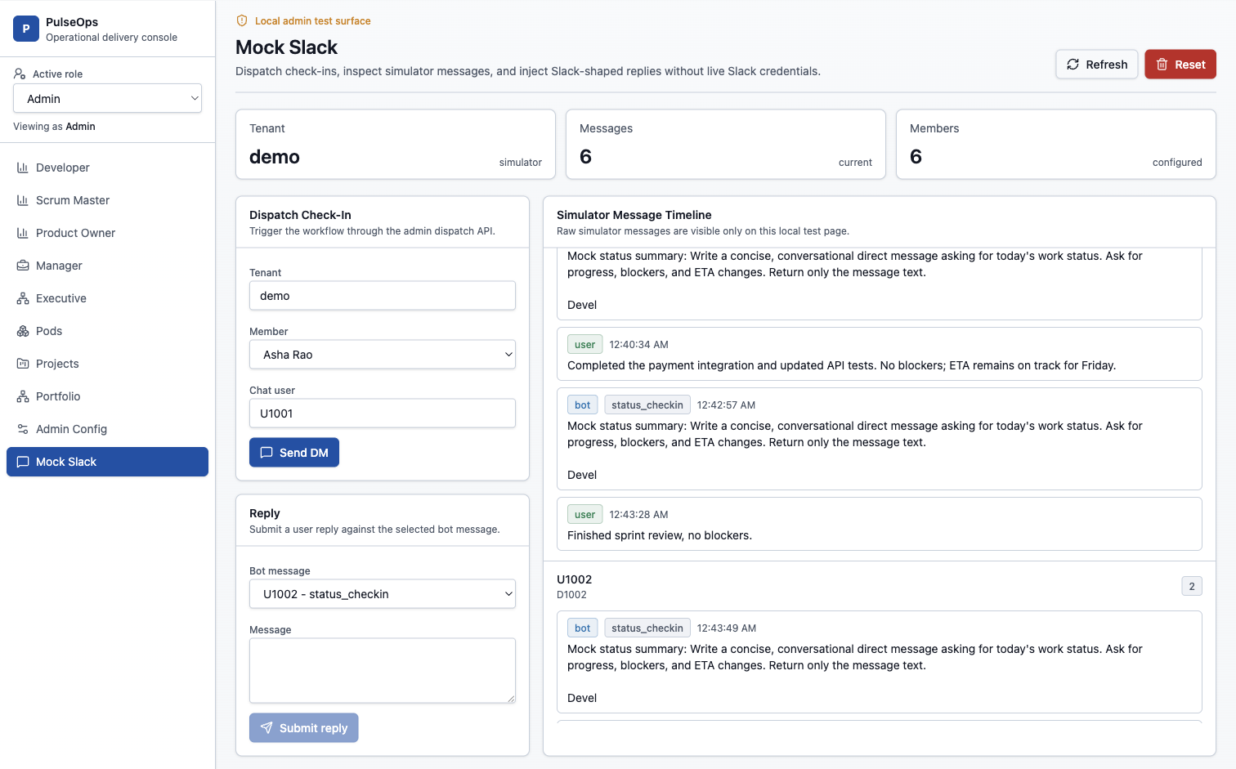
FEATURE 2
Daily check-ins move status collection into the flow of work.
1
Ask
Workflow dispatch sends each developer a contextual DM with a correlation ID.
2
Interpret
Replies are parsed into progress, blockers, ETA, source quality, and clarification needs.
3
Protect
Duplicate, ambiguous, non-status, and stale replies are handled without falsely turning status green.
Mock Slack surface used for local/admin check-in QA
Feature 2
05

Slide 6
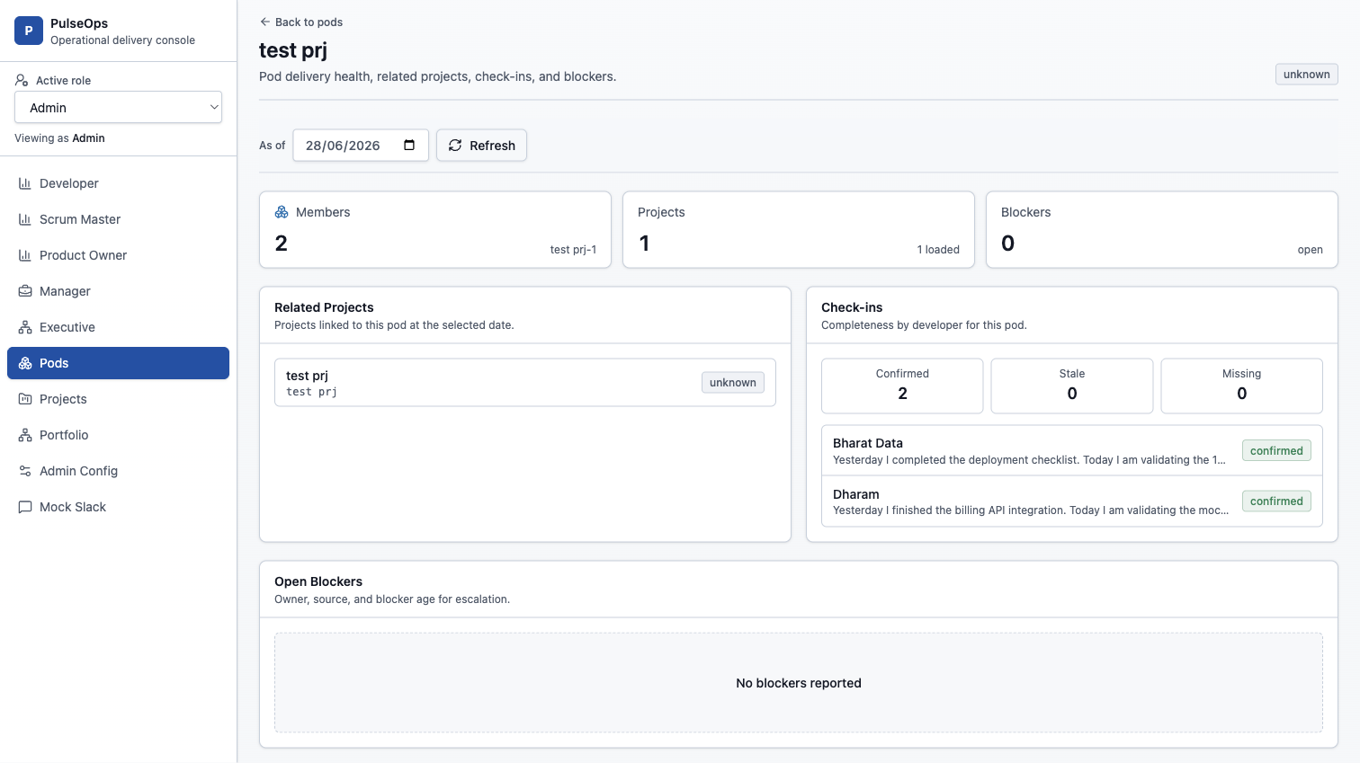
FEATURE 3
Role views translate signals into decisions.
Each persona gets the slice that maps to their daily decision, while high-level views avoid exposing raw DM content.
Developer
focus, tasks, blockers
Scrum master
check-in completeness, blocker board
Product owner
project progress and task health
Manager / Exec
hierarchy, heatmap, portfolio health
Pod detail view: check-in completeness and blockers
Feature 3
06

Slide 7
FEATURE 4
Portfolio flow shows what is moving and what is stuck.
The latest product work adds workstreams, work items, flow metrics, a portfolio feed, and a natural-language ask endpoint for leaders.
A
F
S
X
The business shift
active work
in flight
stale
abandoned
Leaders can move from status color to delivery motion: what changed, what aged, and where intervention is needed.
currently in active states
feature work moving
idle for 7+ days
idle for 21+ days
Leader question
Signal
Action
What changed?
Feed
Review new risks first
Where is motion slow?
Cycle time
Move blockers or scope
Which workstream needs attention?
RAG + age
Drill into owners and facts
Can I ask a custom question?
LLM answer
Use sourced portfolio context
Feature 4
07

Slide 8
EVIDENCE
Trust is a product feature, not a backend detail.
Read-only integrations
Provider-neutral runtime
Jira, GitHub, and calendar sync feed facts without writing back in the current phase.
Fake and real adapters sit behind stable ports, with DBOS and Temporal selectable by configuration.
Access and privacy
Behavioral proof
Admin surfaces are gated; portfolio views do not expose raw developer-message content.
The Mock Slack matrix covers all 45 rows, and the unit suite reached 173 passing tests in the latest QA log.
This matters because leaders will only act on automated rollups when the system makes source, freshness, and boundaries explicit.
Evidence
08

Slide 9
NEXT STEPS
What's next: close the loop from sense to action.
Reconcile
Predict
Coach
Compare stated status with Jira, PR, and CI facts; surface drift and confidence.
Forecast milestone slip, stale dependencies, repeated blockers, and scope pressure.
Generate standup and stakeholder updates, recommend load balancing, and answer portfolio questions.
Recommended demo path: configure the graph, dispatch check-ins, inspect role dashboards, review portfolio flow, then ask a portfolio question.
Next steps
09

