Slide 1
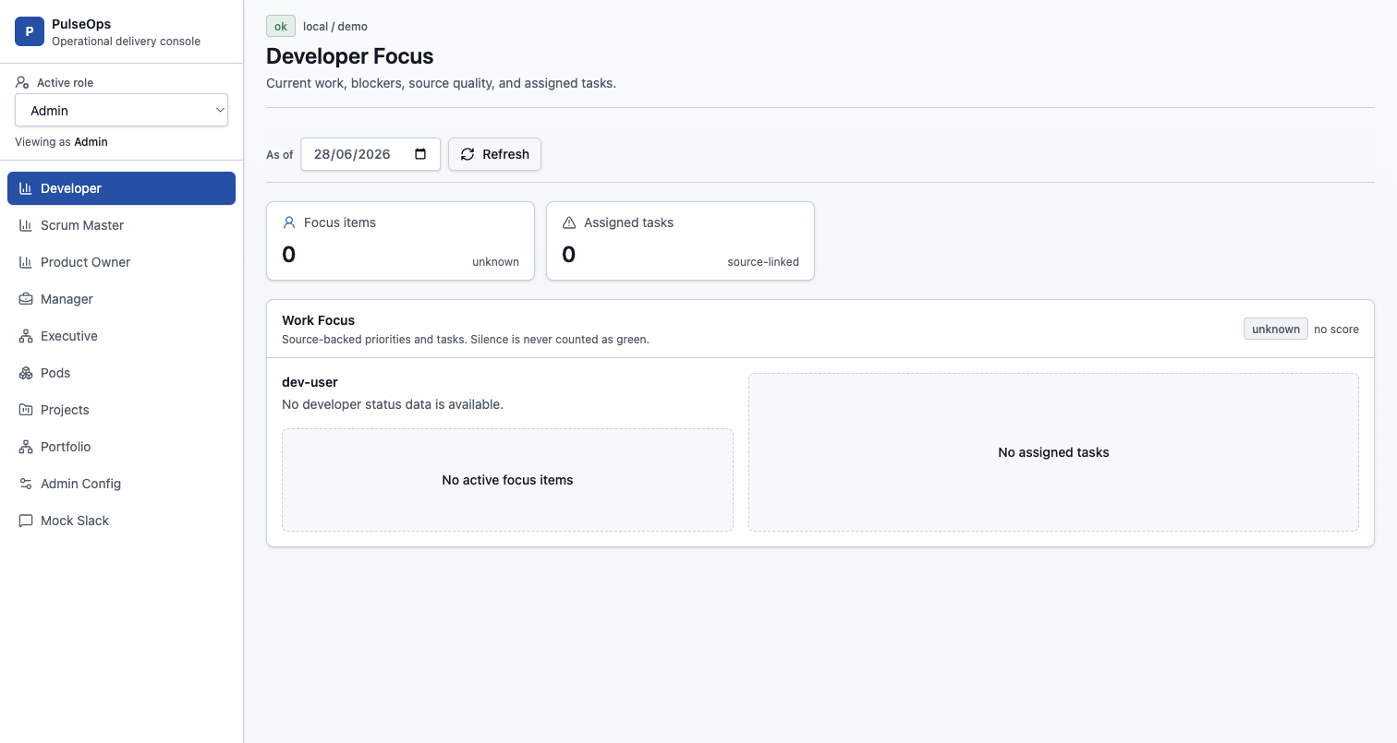
OPENPROGRAM
Agentic program management for live delivery status
A graph-backed operating console that collects human status, reconciles delivery signals, and gives every role a decision-ready view.
Operational delivery console
01

Slide 2
Software status still depends on manual chasing
Teams already leave signals across chat, Jira, Git, calendars, and CI. The business problem is that those signals are fragmented, human summaries arrive late, and silence often looks healthier than it is.
Status reporting burns coordination time
Scrum masters and managers spend energy collecting updates instead of unblocking delivery.
Late information hides delivery risk
Blockers, stale tasks, and mismatched progress can stay invisible until the next review.
Rollups are hard to trust
A green portfolio signal is weak if it cannot trace back to source tasks, developers, and facts.
02

Slide 3
OpenProgram turns status into a continuous operating loop
The product does not wait for a dashboard refresh or a meeting. It asks, parses, records, rolls up, and exposes the next action.
Ask
Parse
Record
Roll up
Act
Proactive chat check-ins respect preferences and context.
Free text becomes progress, blockers, ETA, and mood signals.
Graph facts and conversation turns stay source-linked.
RAG status propagates from dev to pod, project, program.
Dashboards, nudges, and workflow dispatch focus attention.
Business result: less manual chasing, no false green from silence, and status that can be traced back to evidence.
03

Slide 4
Four feature pillars anchor OpenProgram
Each pillar maps to a business question: what is true, who needs to answer, how health is derived, and who needs to act.
Graph of Truth
Status Collector
Explainable Rollups
Persona Views
Programs, projects, pods, developers, tasks, workstreams, repos, sprints, and source facts.
Proactive chat check-ins, reply parsing, clarification, duplicates, nudges, and non-response handling.
RAG health escalates blockers, avoids stale green, and stores factors for drill-down.
Developer focus, team blockers, project progress, portfolio heatmaps, flow, and admin config.
A single product loop supports both everyday team operations and executive portfolio review.
04

Slide 5
Every role gets the view that matches its decision
OpenProgram is not one generic dashboard. It reuses the same delivery graph and presents different decision surfaces for developers, team leads, product, management, executives, and admins.
Persona | Decision owned | OpenProgram surface
Developer | What needs focus today? | Focus items, blockers, assigned tasks, check-in preference
Scrum Master | Who is blocked or missing? | Pod blockers, check-in completeness, stale signals
Product Owner | What will ship and what is at risk? | Project progress, task mix, source confidence
Manager | Where should leadership intervene? | Program tree, portfolio heatmap, flow metrics
Executive | Which programs need attention? | Portfolio health without raw developer-message exposure
Admin | How is the operating model configured? | Hierarchy, directory, assignments, check-in timing, dispatch
05

Slide 6
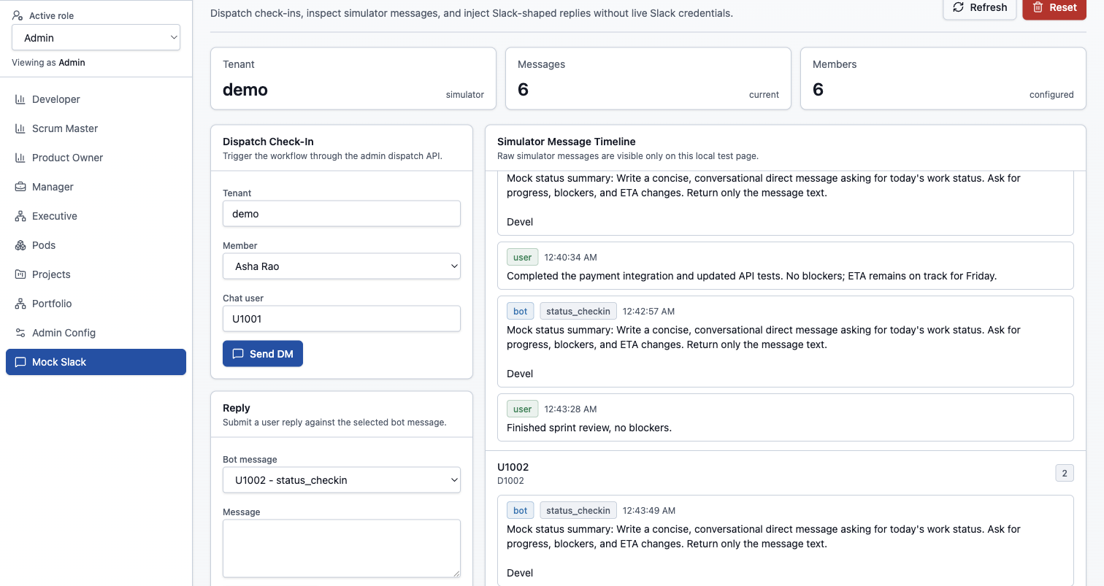
The current product already shows the operating loop
The UI includes role-based navigation, persona dashboards, runtime configuration, and a local Slack-shaped simulator that proves the check-in path without live credentials.
Role-focused delivery dashboard
Chat check-in loop under test
06

Slide 7
Provider-neutral architecture is the product moat
OpenProgram keeps vendor details at the edge. The core works through capability ports, so chat, issue tracking, VCS, calendar, workflow, LLM, and persistence providers can change without rewriting the business logic.
External systems
Capability ports
Product surfaces
Slack or Teams
Jira
GitHub or GitLab
Google or Microsoft calendar
ChatProvider
IssueTracker
VcsProvider
CalendarProvider, LlmProvider, repositories
Graph of Truth
Status Collector
Rollup engine
Persona dashboards and admin workflows
Core stays vendor-neutral
07

Slide 8
Current maturity: Phase 0 plus Sense
The implemented center is the Phase 0 foundation and a large portion of Phase 1 Sense: runtime app shell, read-oriented integrations, check-ins, rollups, persona APIs, and admin configuration.
10
10
11
42
API router modules covering health, graph, personas, config, workflows, check-ins, ask, and webhooks.
Frontend page modules spanning dashboards, pods, projects, workstreams, flow, portfolio, admin, and mock Slack.
BDD feature files describing product behavior from sync and status collection to UI workflows.
Backend test files, with core coverage gate configured at 85 percent for domain and application code.
Current boundary: no issue-tracker, VCS, or calendar write-back; full reconciliation, prediction, people-health, and full SSO remain roadmap items.
08

Slide 9
Roadmap: Sense to Coach
Sense is the current product center
Read integrations, proactive check-ins, structured replies, RAG rollups, role-scoped views.
The roadmap is staged so trust builds before automation writes back or predicts risk. Current work proves the source-of-truth and check-in loop first.
Reconcile makes green trustworthy
Cross-check human status with Jira, Git, PR, and CI facts; detect drift; write back with approval.
Phase 0
Phase 1
Phase 2
Foundation
Sense
Reconcile
Predict surfaces risk before review
Forecast milestone slip, detect dependency stalls, identify repeated blockers, and escalate by policy.
Phase 3
Phase 4
Predict
Coach
Coach turns insight into team support
Standup/retro generation, load balancing, people-health signals, and natural-language portfolio queries.
09

Slide 10
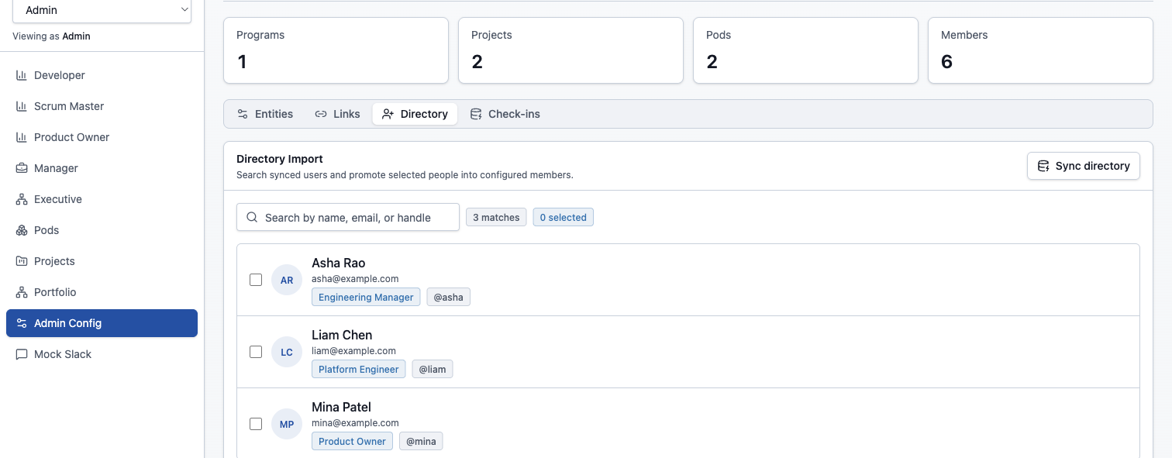
The next product push should validate trust, then expand automation
The most valuable near-term motion is not adding more dashboards. It is proving that the loop collects better status with less human chasing and that leaders can trust the rollup trail.
Pilot the Sense loop with one real delivery pod
Instrument evidence quality and false-green reduction
Prioritize Reconcile before write-back automation
Keep provider neutrality as a product requirement
OpenProgram can become the operating rhythm for software delivery: current, source-linked, role-aware, and eventually predictive.
10

