Slide 1



CAPSTONE PROJECT
Strategic Analysis of Chennai Super Kings (CSK) Performance in IPL (2008–2025)
Presented By
Student Name: Rathod Bharatsinh N.
College Name: J.G University
Department: Computer Science Student
Email ID: rathodbharatsinh115@gmail.com
Notes:
1

Slide 2
OUTLINE:
Problem Statement (Should not include solution)
Proposed System/Solution
System Development Approach (Technology Used)
Algorithm & Deployment
Result (Output Image)
Conclusion
Future Scope
References

Slide 3
Problem Statement:
The Challenge: In a high-stakes tournament like the IPL, team success depends on more than just talent; it requires data-driven strategy.
The Gap: Fans and analysts often struggle to identify the specific factors (stadium conditions, toss decisions, or player strike rates) that lead to a CSK victory versus a loss.
The Goal: The crucial part is identifying the patterns in historical match data to predict favorable match conditions for the team.

Slide 4
Proposed Solution:
Data Analytics Approach: Build an interactive Power BI dashboard using historical IPL datasets to forecast team success.
Components:
Data Collection: Gather match-by-match and ball-by-ball data from 2008 to the present.
Preprocessing: Clean data using Python (Pandas) or Power Query to handle missing scores or abandoned matches.
Visualization: Use Line Charts for trend analysis and Maps for venue-based performance.

Slide 5
System Approach:
System Requirements: Power BI Desktop, Microsoft Excel.
Libraries Required: If using Python for cleaning: Pandas, NumPy, and Matplotlib.
Platform: Deployment via Power BI Service for cloud-based sharing.

Slide 6
Algorithm & Deployment:
Algorithm Selection: Use Descriptive Analytics and Trend Projection to analyze player and team performance over time.
Data Input: Historical runs, wickets, venue names, toss winners, and match outcomes.
Prediction Process: Use Slicers to filter data by "Opponent" or "Season" to see how CSK's win probability changes based on historical patterns.
Interactive Controls: Implemented Tile Slicers for seasonal match filtering.
Dynamic Filtering: Enabled cross-visual interaction to allow users to isolate CSK's performance by specific IPL years.
Real-time Response: All DAX measures and visuals update instantly based on slicer selection, providing a responsive data exploration experience.

Slide 7
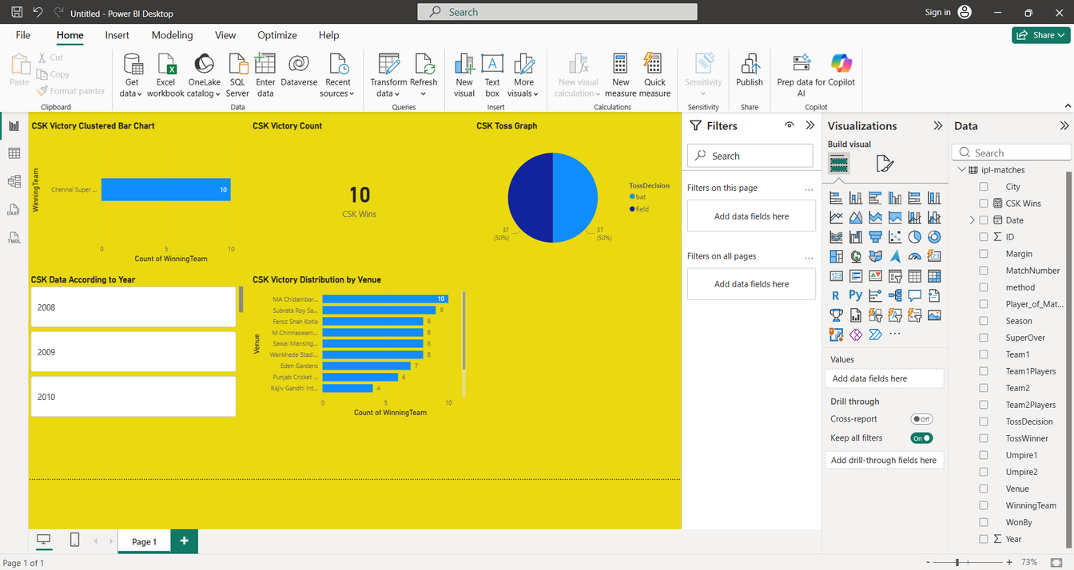
Result:
The Power of the Slicer: Interactive Data Control
Dynamic Performance Tracking: It enables "Time-Series Analysis," meaning you can instantly compare how CSK performed in their championship years (like 2010, 2011, or 2021) versus other seasons.
Enhanced User Experience (UX): By using a "Button" or "Tile" style slicer, the dashboard becomes more intuitive and user-friendly, similar to a modern mobile application.
Efficiency: Instead of creating 15 separate slides for 15 different IPL seasons, one single slide with a slicer can display all the information dynamically.

Slide 8
Conclusion:
Conclusion: Data-driven insights confirm that CSK performs significantly better at MA Chidambaram Stadium compared to away venues.
The analysis concludes that CSK's performance is highly correlated with specific venues and toss decisions. The interactive Power BI dashboard successfully allows for season-by-season strategic evaluation.

Slide 9
Future scope:
Future Scope: Integrate Machine Learning (Random Forest or LSTM) to predict the score of the next match in real-time based on the current run rate.
In the next phase, I plan to integrate a Machine Learning model using Python (Random Forest) to predict match winners based on real-time stadium weather and player strike rates.

Slide 10
References:
Data Sources:-
Kaggle IPL Dataset (2008-2022): Primary source for match-level and ball-by-ball data used in the analysis. [Link: kaggle.com/datasets]
IPL Official Website (iplt20.com): Used for verifying historical team records and stadium information.
GitHub Link Section:-
Project Repository: https://github.com/bharatsinhrathod/IPL-CSK-Analysis-PowerBI

Slide 11
Thank You
Notes:
11

