Slide 1
BUFFER OVERFLOWS
by Dinesh Kumar and Bharatvaj
of Computer Science and Engineering Department

Slide 2
BUFFER OVERFLOWS
One of the most common vulnerability found in a software.
Particularly problematic when present in system libraries and other code that runs with high execution privileges.
Still of major concern due to
legacy of widely deployed buggy
continued careless programming techniques

Slide 3
ABSTRACT
This paper will explain about the Stack overflow technique which is used to exploit the application program(JBOSS) with a feasible approach , which can be reproduced under the specific circumstances. The Stack overflow technique is well documented and is explained as a “rare occurrence”, but can be seen in many applications(even in highly celebrated applications such as JBOSS, nginx, etc).This paper also explains about the Buffer overflow defense(inclusive of Stack Bufferflow) and also avoid occurrence of Buffer flow.

Slide 4
BUFFER OVERFLOW BASICS
Caused due to careless programming.
Allows more data to be stored than capacity available in a fixed sized buffer.
Buffer can be on STACK,HEAP,GLOBAL DATA
Overwriting adjacent memory locations
corruption of program data
unexpected transfer of control
memory access violation
execution of code chosen by attacker

Slide 5
HOW IT WORKS
Application reserves adjacent memory locations (buffer) to store arguments to a function, or variable values.
Attacker gives an argument too long to fit in the buffer.
The application copies the whole argument, overflowing the buffer and overwriting memory space.
If the conditions are “just right” this will enable to attacker to gain control over the program flow and execute arbitrary code, with the same privileges of the original application.

Slide 6
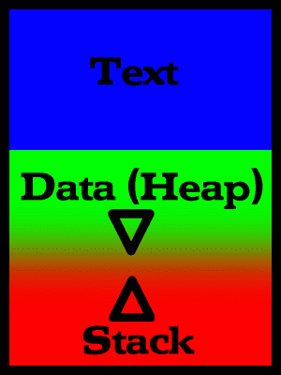
Stack Buffer Overflow Basics
Lower Memory Addresses
A process in memory:
- text (Program code;
marked read-only, so any attempts to write to it will result in segmentation fault).
- data segment (Global and
static variables)
- stack (Dynamic variables)
The process is blocked and is rescheduled to run again with a larger memory space if the user attack exhausts available memory.
High Memory Addresses

Slide 7
STACK SMASHING
<previous stack frame>
Function (sub-routine) calls results in an activation frame being pushed onto a memory area called the stack.
function arguments
return address
previous frame pointer
local variables
local buffer variables
Direction of Stack growth

Slide 8
The general idea is to overflow a buffer so that it overwrites the return address.
When the function is done it will jump to whatever address is on the stack.
We put some code in the buffer and set the return address to point to it!

Slide 9
MEMORY MANAGEMENT
Stack
The stack, which contains activation frames, starts at the highest memory address allocated for the process, and grows downwards
Variable-length data (e.g., strings) that are read dynamically, are kept in the heap, which grows upwards
This arrangement maximizes flexibility of virtual memory management
Direction of stack growth
Direction of heap growth
Heap
unitialized variables
initialized variables
code instructions
Breno de Medeiros
FLORIDA STATE UNIVERSITY
FALL 2005

Slide 10
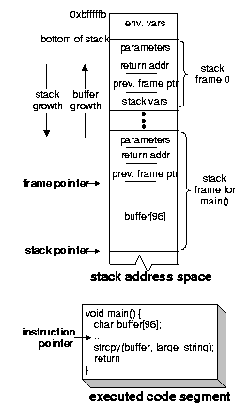
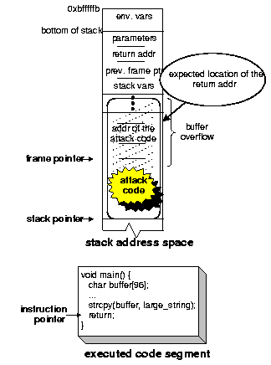
(i) Before the attack
(ii) After injecting the attack code

Slide 11
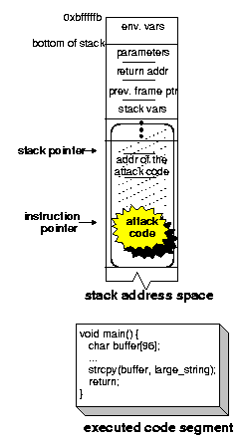
(iii) Executing the attack code

Slide 12
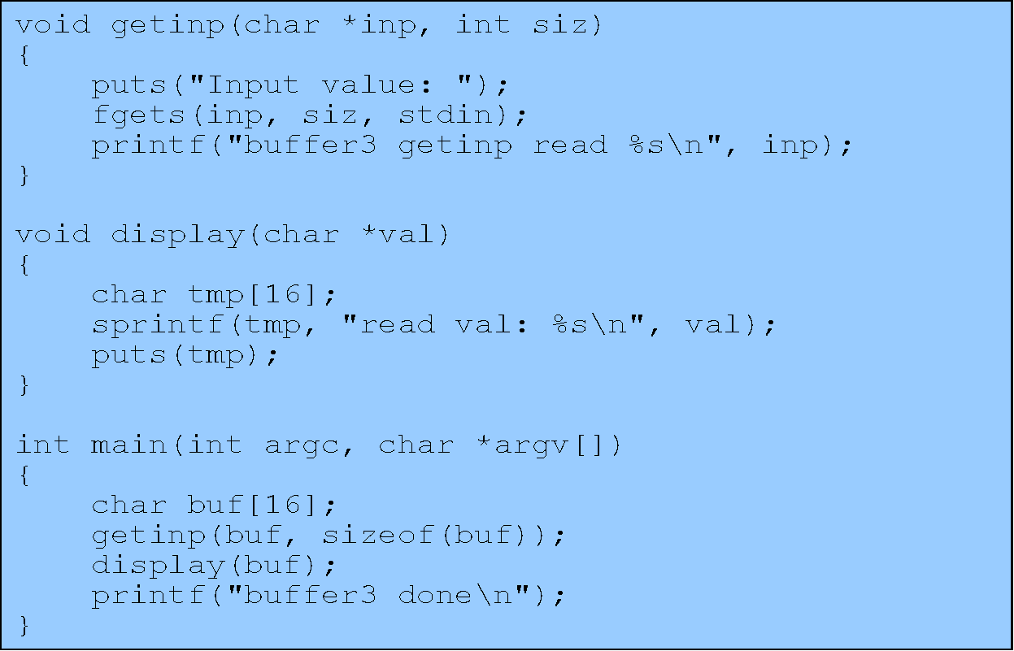
STACK OVERFLOW EXAMPLE

Slide 13
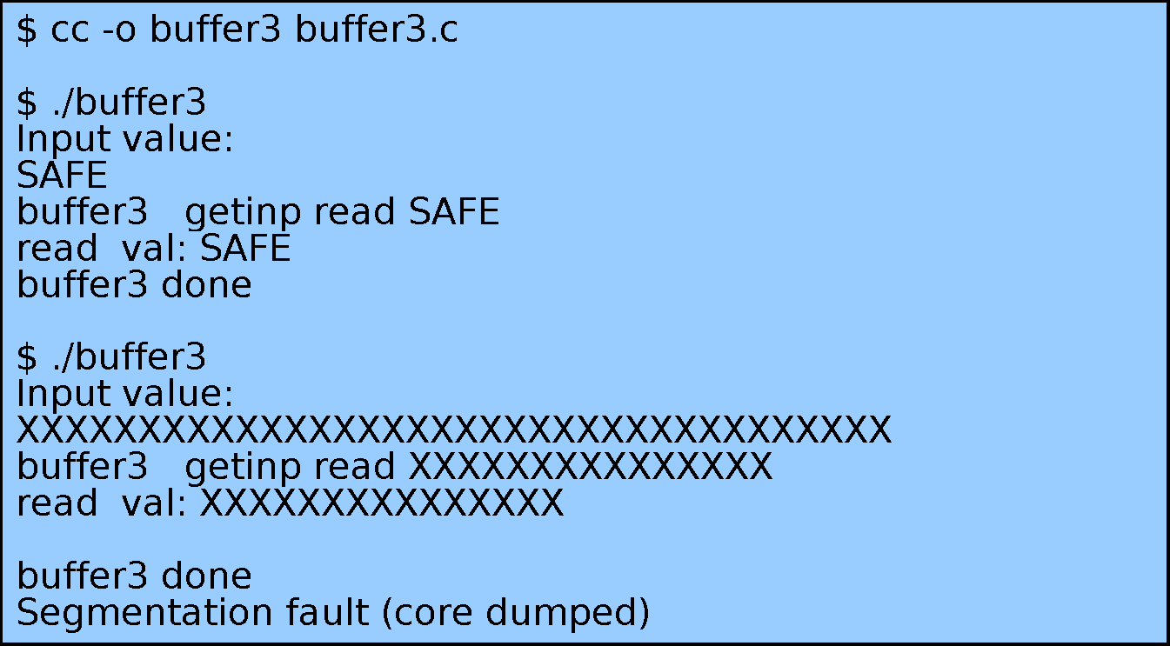
OUTPUT

Slide 14
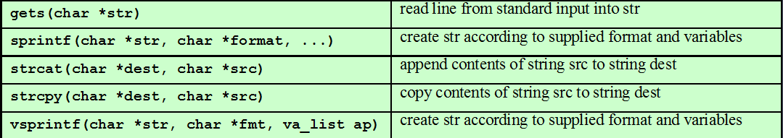
COMMON UNSAFE C FUNCTIONS

Slide 15
BUFFER OVERFLOW DEFENSES
Buffer overflows are widely exploited
Large amount of vulnerable code in use
despite cause and countermeasures known
Two broad defense approaches
compile-time - harden new programs
run-time - handle attacks on existing programs

Slide 16
Compile-Time Defenses
Safe Coding Techniques
If using potentially unsafe languages .
Eg :- C
Programmer must explicitly write safe code
by design with new code.
extensive after code review of existing code, (e.g., OpenBSD).
Buffer overflow safety a subset of general safe coding techniques .
Allow for graceful failure (know how things may go wrong) check for sufficient space in any buffer.

Slide 17
Language Extension, Safe Libraries
Proposals for safety extensions (library replacements) to C performance penalties
must compile programs with special compiler
Several safer standard library variants
1.) New functions, e.g. strlcpy()
2.)safer re-implementation of standard
functions as a dynamic library,
e.g. Libsafe

Slide 18
STACK PROTECTION
Stack guard: add function entry and exit code to check
stack for signs of corruption
Use random canary
e.g. Stack guard, Win/GS, GCC
check for overwrite between local variables and saved frame pointer and return address
abort program if change found
issues: recompilation, debugger support
Or save/check safe copy of return address (in a safe, non-corruptible memory area), e.g. Stackshield, RAD

Slide 19
Run-Time Defenses
Non Executable Address Space
Many BO attacks copy machine code into buffer and transfer control to it
Use virtual memory support to make some regions of memory non-executable (to avoid exec of attacker’s code)
e.g. stack, heap, global data
need h/w support in MMU
long existed on SPARC/Solaris systems
recent on x86 Linux/Unix/Windows systems
Issues: support for executable stack code

Slide 20
Guard Pages
Place guard pages between critical regions of memory (or between stack frames)
flagged in MMU (memory management unit) as illegal addresses
any access aborts process
Can even place between stack frames and heap buffers
at execution time and space cost

Slide 21
OTHER OVERFLOW ATTACKS
have a range of other attack variants
Stack overflow variants.
Heap overflow
Global data overflow
Format string overflow
Integer overflow
more likely to be discovered in future
some cannot be prevented except by coding to prevent originally

Slide 22
CONCLUSION
By using this techniques,we can protect our data from malicious hackers.
This type of techniques must be made familiar to all the Universities and Colleges who are maintaining the databases, in order to prevent the attacks from competitors

Slide 23
CASE STUDY

