Slide 1
BIOMETRIC SYSTEM
Kamesh M | Goutham S M
Gowri Shankar K | Dravid A

Slide 2
The Proposed Solution
Security Process
The total security system is divided into 4 levels.They include voice recognition, fingerprint recognition, facial scanner and retina/iris scanner.
The first level of security is voice recognition where the person requiring access has to speak the entering password which will be generated every day.
If the person succeeds within three tries then he is grant access to the next level else the security is alerted.
In the next level he needs to use his/her fingerprint for scanning and recognition purpose. If they are not recognisable the security is alerted else he enters the next level.
The next level is facial recognition where the face of the person is scanned, this is a critical level where any one who fraudulently uses the fingerprint gets caught in this process.
If the person succeeds the 3rd level then he/she enters the final level of security check, that is retina or iris scan which is unique for every single person compared to the finger print of a person
Now those who successfully complete all security scans can enter the lair else the security is alerted and they get caught. Thus it is more efficient than any other biometric system that is present in current market currently in use.

Slide 3
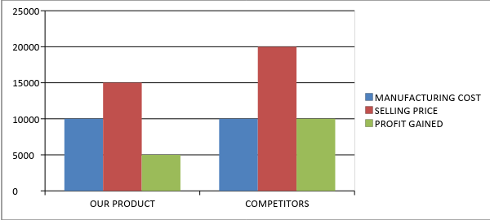
Financial Feasibility
The cost of this project is very low compared to the competitors present in the market. The cost of the total project is given in form of a table.
COMPONENTS | PRICE
RASPBERRY PI | 3000₹-4000₹
FINGERPRINT SCANNER | 1600₹-2400₹
IP CAMERA | 800₹-1500₹
IR CAMERA | 1000₹-1500₹
MICROPHONE | 120₹-500₹
RELAY SWITCH | 300₹-500₹
TOTAL | 6820₹-10400₹
Now if you take a look at the graph we can see that the profit margin of the competitors is higher than that of us but the competitors have implemented only one of the biometric concept (like either voice recognition or facial recognition or retina scanning), but if you consider our project we have combined all of the biometric concepts and implemented it into a single project and still we earn some profit and the cost is low for our government too.

Slide 4
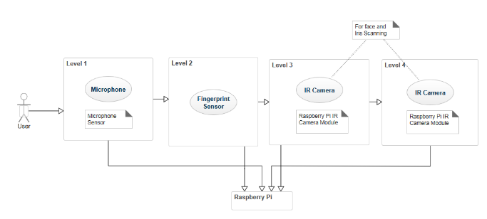
Flowchart

Slide 5
Technology Stack
Front end:
HTML5/CSS3
Javascript
Ionic
Back end:
C/C++
Python
Mongo DB
TENSOR FLOW

Slide 6

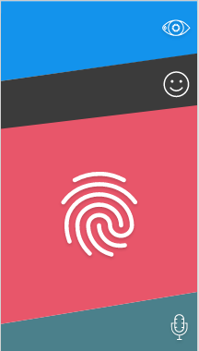
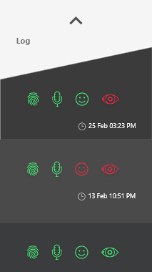
Design(for client)

Slide 7

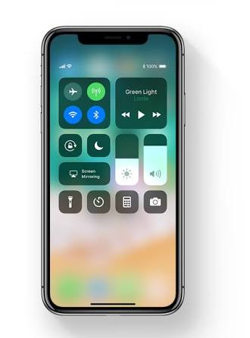

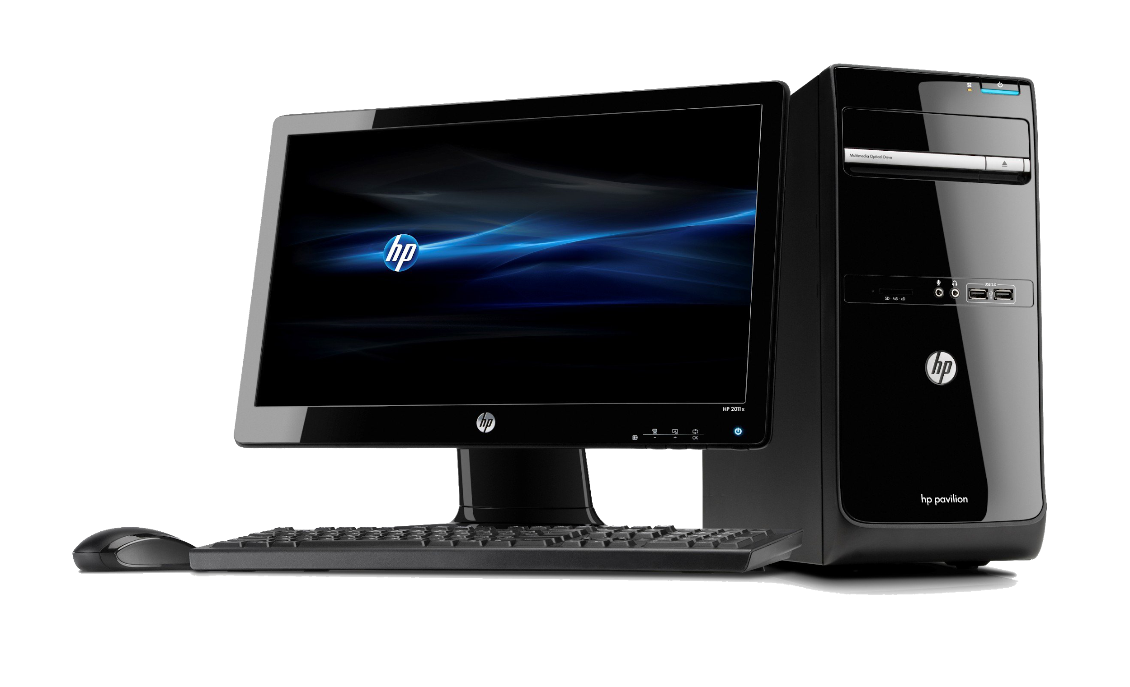
Available platforms(To send alerts and password)
Powered by Ionic Framework v3
iOS
Android
Desktop

Slide 8

Server side platform

