Slide 1
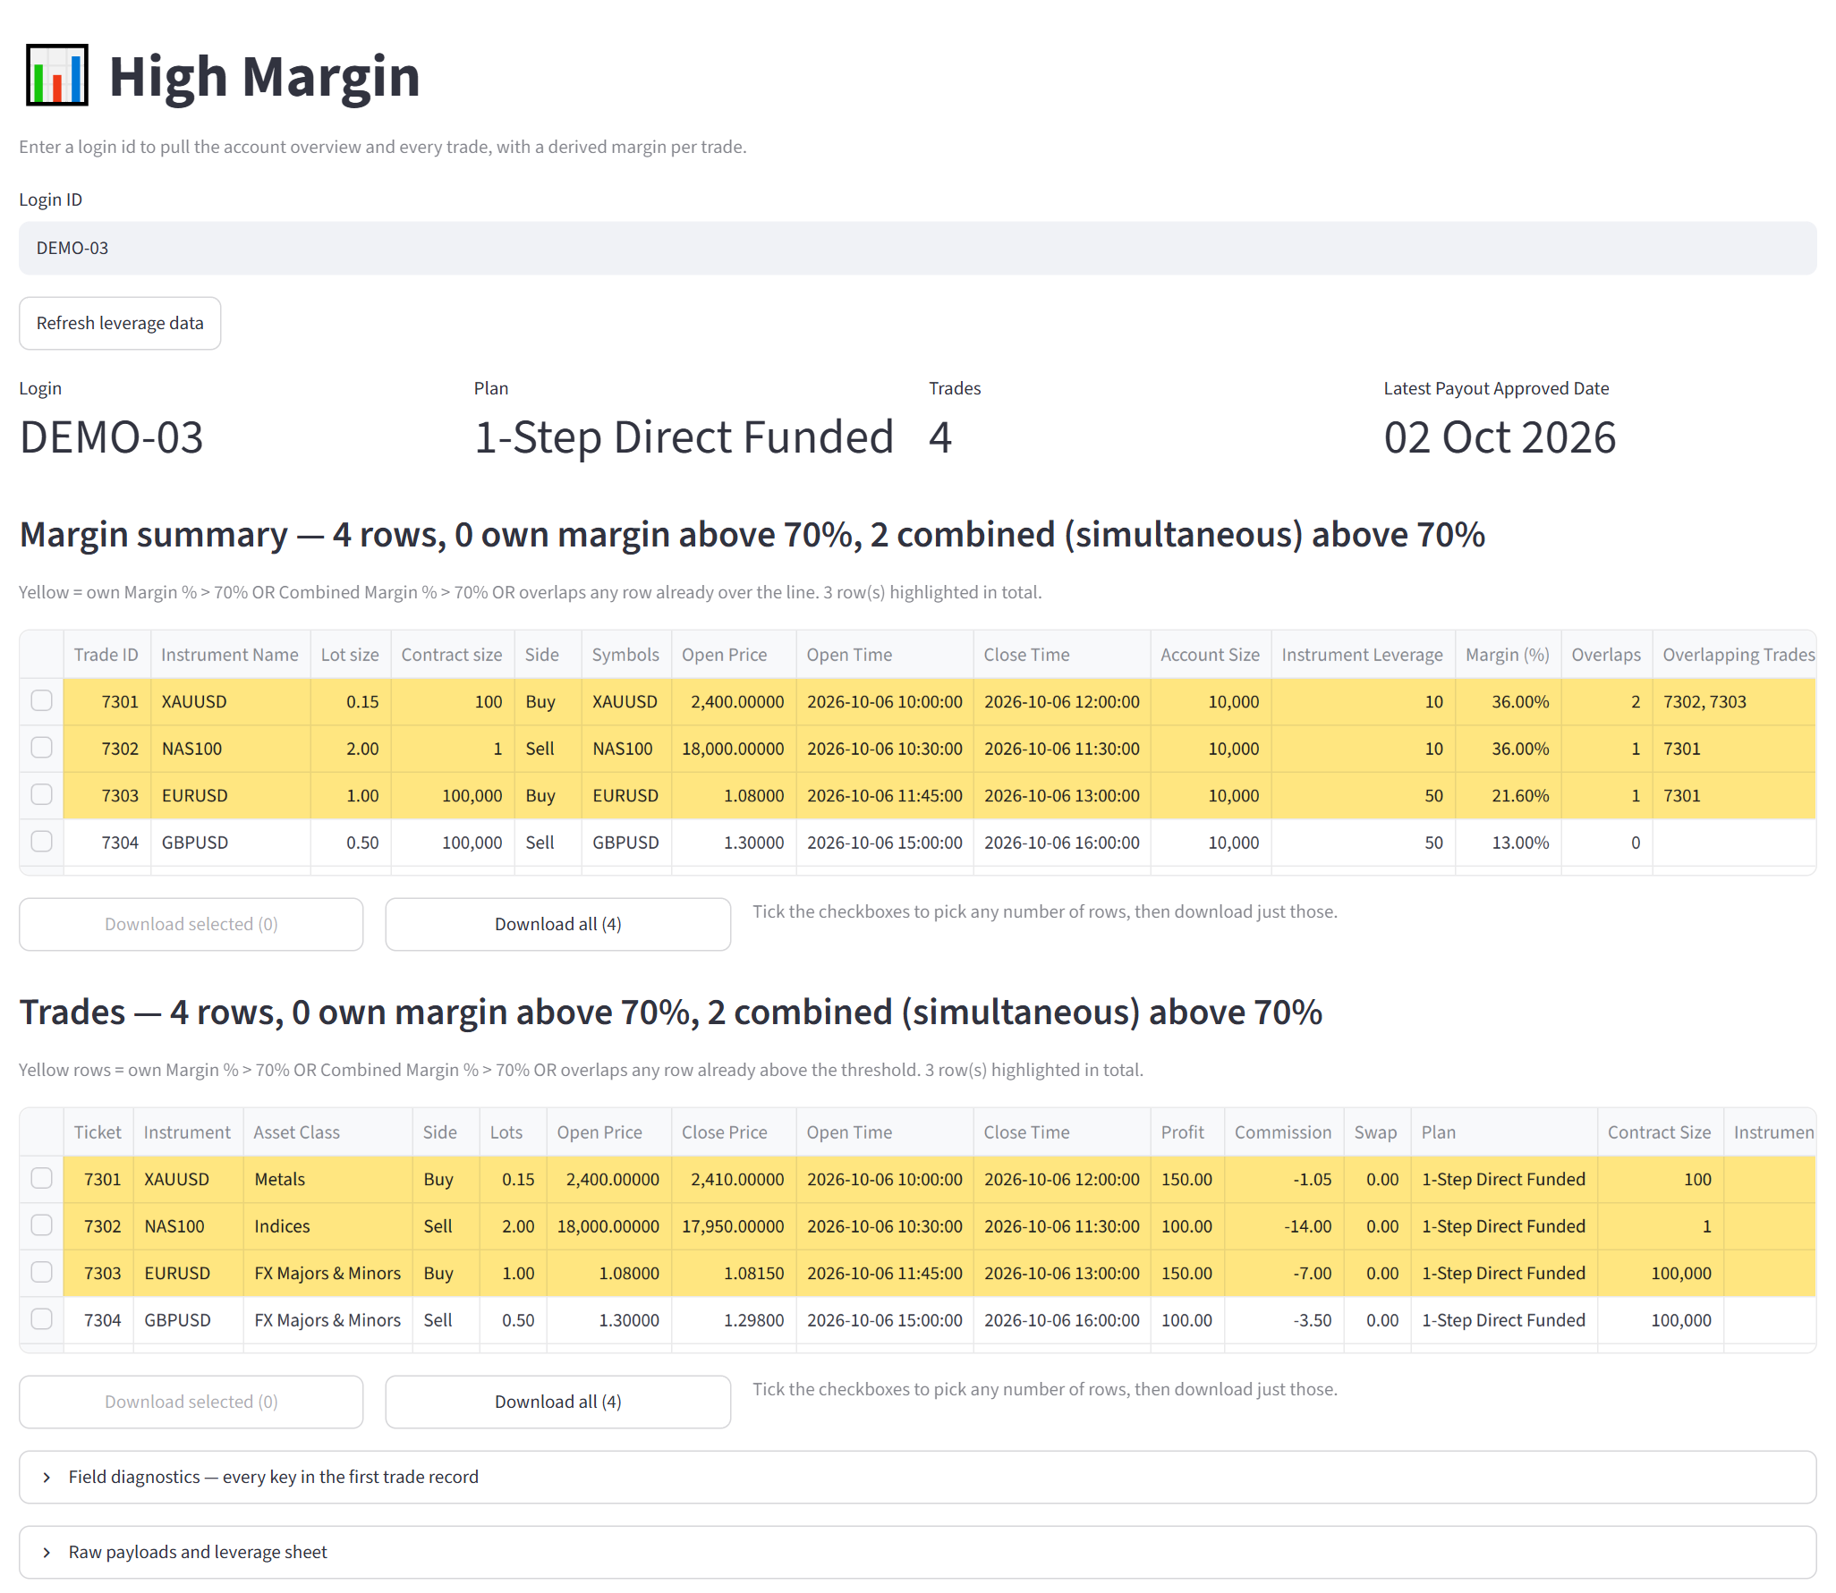
High Margin
RISK TOOLS · BEGINNER'S GUIDE
Learn the app step by step — what every part of the screen means and how to read it
No trading experience needed
Examples use sample accounts, not real clients
October 2026
Notes:
Welcome. This guide teaches the High Margin app from zero. You do not need any trading experience: every word is explained the first time it appears, and every screenshot comes from the real app, using sample accounts instead of real clients.

Slide 2
What does the High Margin app do?
START HERE
1
You type a Login ID
2
The app collects the data
3
It shows the margin
The Login ID is the trading account's number. Type it into the box and press Enter.
It fetches the account's details and all of its trades, and looks up each instrument's leverage in a Google Sheet.
Margin = how much of the account's money a trade ties up while it is open. Trades that use too much are shaded yellow.
70%
is the warning line.
If a trade — or several trades open at the same time — use more than 70% of the account size, those rows turn yellow.
Account size = the amount the account started with, for example 10,000.
Notes:
Big picture first. You give the app one account number. It collects that account's trades and works out, for every trade, how much of the account's money the trade tied up. If that is more than 70% of the account — one trade alone or several trades open at the same time — the rows turn yellow so you notice them straight away.

Slide 3
Words you need to know
BASICS
Login ID
The trading account's number, e.g. 500123.
Plan
The account type, e.g. “2-Step Prime Funded”. It decides which leverage is used.
Account size
The money the account started with, e.g. 10,000.
Trade · Trade ID
One buy or sell. Each trade has its own ID number, e.g. 6202.
Lot size
How big the trade is. 1 lot of EURUSD = 100,000 euros.
Contract size
Units in 1 lot: 100,000 for currency pairs, 100 for gold (XAUUSD).
Leverage
How much bigger the trade is than the money behind it. At 1:10, 1 unit of money controls 10.
Margin
The money a trade ties up while it is open.
Margin %
Margin compared with the account size. 72% = the trade used 72% of the account.
Overlap
Two or more trades that were open at the same time.
Notes:
Ten words come up again and again. Read them once now; every later slide uses them. The most important pair is margin and margin %: margin is money, margin % is that money compared with the size of the account.

Slide 4
How the app works out margin — in 3 steps
BASICS · HOW MARGIN IS WORKED OUT
1
How big is the trade?
Open price × Lots × Contract size
Example: 2,400 × 0.30 × 100 = 72,000
EXAMPLE · ACCOUNT DEMO-02, TRADE 6202
Gold (XAUUSD) · Buy 0.30 lots
Account size 10,000
Plan 2-Step Prime Funded
Leverage 1:10 (from the Prime tab)
Open price 2,400.00
Contract size 100 (gold)
Trade size 72,000
Margin 7,200
2
How much money does it tie up?
Trade size ÷ Leverage → this is the margin
Example: 72,000 ÷ 10 = 7,200
3
What share of the account is that?
Margin ÷ Account size × 100 → Margin %
Example: 7,200 ÷ 10,000 × 100 = 72%
Good to know: for instruments not priced in the account's currency (e.g. EURGBP), the app also converts the margin using the trade's own profit. Here that factor is ×1.00.
72%
of the account — more than 70%, so this row turns yellow.
Notes:
Walk through the three steps with the gold trade. Step 1: the trade controls 72,000 worth of gold. Step 2: with leverage 1:10 the account only has to put up a tenth of that, 7,200 — that is the margin. Step 3: 7,200 out of a 10,000 account is 72%, which is over the 70% line, so the row turns yellow.

Slide 5
Reading the screen
01
PART 1
Follow along with DEMO-01, a healthy sample account
Inside: The screen · Login ID · Account header · Margin summary · Trades table
Notes:
Part 1 walks down the screen from top to bottom, using DEMO-01 — a sample account where nothing is wrong. Learn what normal looks like first.

Slide 6
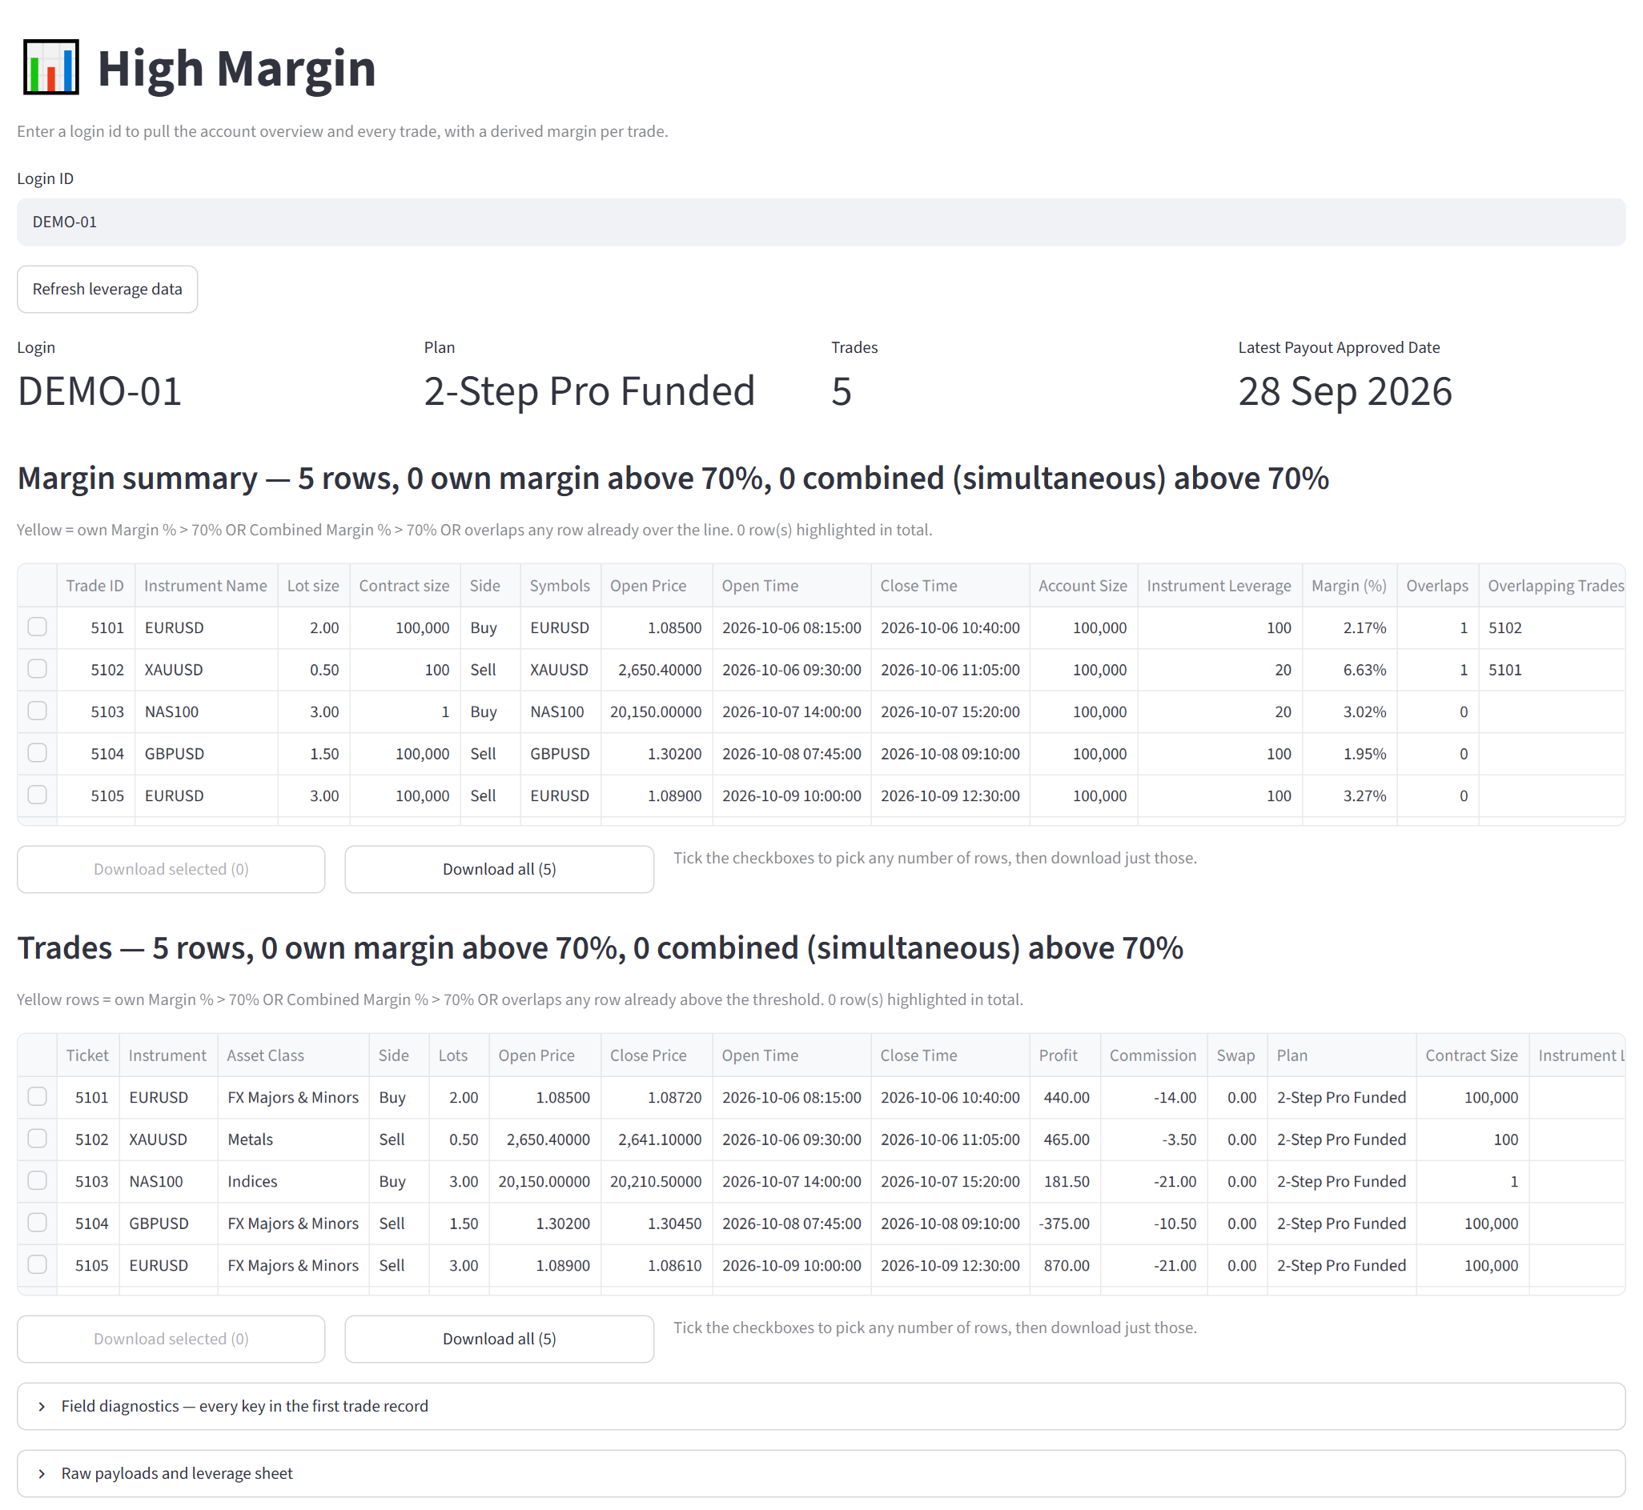
The screen, from top to bottom
PART 1 · THE SCREEN
1
Login ID box
Where you type the account number. The only place you type.
1
2
2
Refresh leverage data
Reloads the leverage numbers from the Google Sheet. You rarely need it.
3
4
3
Account header
Four boxes that confirm which account you opened.
4
Margin summary
The main table — one row per trade with its margin. Read this first.
5
5
Trades
The same trades with every detail: profit, fees and notes.
6
Diagnostics
Two closed sections with raw data for the Data team. You can skip them.
6
Notes:
The whole app is one long page. You only ever type in one place — the Login ID box. Everything below it belongs to the account you typed. Most of the time you will read part 4, the Margin summary.

Slide 7
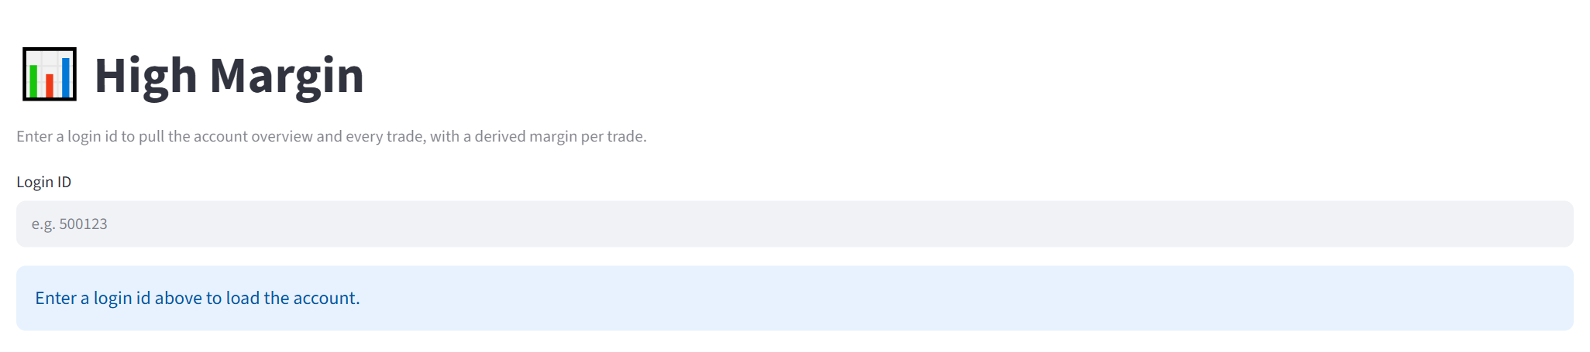
Step 1 — Type a Login ID and press Enter
PART 1 · STEP 1
1
2
1
Login ID box
2
Blue message
Tip
Click in the box, type the account number and press Enter. The grey “e.g. 500123” is only a hint.
“Enter a login id above to load the account.” It means nothing is loaded yet — that is normal.
Open the same account again within 5 minutes and the app shows the saved result instantly.
Notes:
When the app opens, the page is almost empty. That is normal. Click in the box, type the account number and press Enter. The blue message disappears as soon as the account loads.

Slide 8
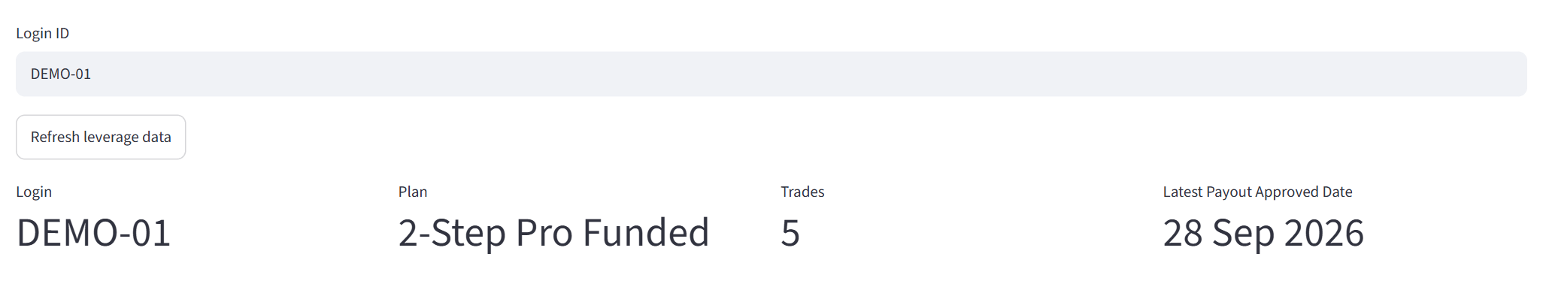
Step 2 — Check that you opened the right account
PART 1 · STEP 2
1
2
3
4
5
1
Refresh leverage data
2
Login
3
Plan
4
Trades
5
Latest Payout Approved Date
The account number. Make sure it is the one you meant.
The account type. Its name must contain Prime, Pro or Direct — that picks the leverage.
How many trades the account has.
Reloads leverage from the Google Sheet. Only needed after someone edits the sheet.
When the trader's last payout was approved. “—” means no payout yet.
Notes:
Before reading any numbers, check the header. Is the login the one you meant? Does the plan name contain Prime, Pro or Direct? If not, the app cannot pick a leverage and margins will be empty.

Slide 9
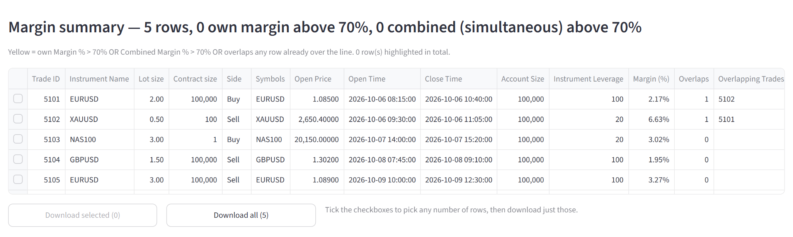
Step 3 — Read the Margin summary table
PART 1 · STEP 3
1
1
Heading
How many trades, and how many are over 70%. Both counts 0 = all fine.
2
2
Highlight rule
Explains when a row turns yellow and counts the yellow rows.
3
4
3
Tick boxes
Tick the rows you want to download (see slide 17).
Column | What it tells you
Margin (%) | How much of the account this one trade used.
Instrument Leverage | The leverage for this instrument on the account's plan.
Overlaps | How many other trades were open at the same time.
Overlapping Trades | The IDs of those trades.
Combined Margin % | This trade plus the trades open with it, as % of the account. “None” = no overlap. Scroll right to see it.
4
Download buttons
Save the rows as a CSV file you can open in Excel.
Notes:
This is the most important table. Start with the heading: if both counts are 0, no trade went over the line. Then look for yellow rows. Here, with DEMO-01, everything is under 70%, so nothing is yellow.

Slide 10
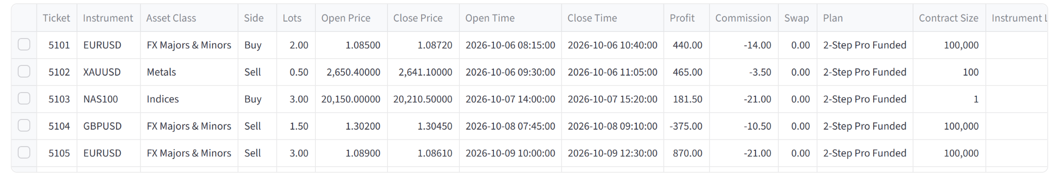
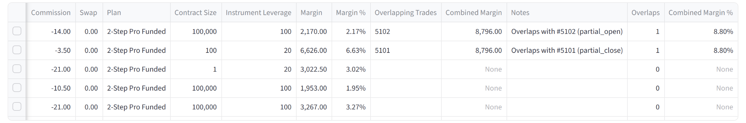
Step 4 — The Trades table has every detail
PART 1 · STEP 4
1
2
3
1
Asset Class
The type of instrument: currencies, metals, indices…
2
Profit · Commission · Swap
The trade's result and its fees.
3
Plan
The account plan used to pick the leverage.
4
5
6
5
4
Margin and Margin %
The margin as money, and as % of the account.
5
Combined columns
“None” simply means no other trade was open at the same time.
Top: left side of the table. Bottom: the same table scrolled right. To scroll sideways, hover over the table and use Shift + mouse wheel.
6
Notes
Plain-word explanations, e.g. “Overlaps with #5102”, or why a margin is missing.
Notes:
The Trades table lists the same trades as the summary, with every field. It is wider than the screen, so scroll sideways to reach Margin, the combined columns and Notes. Notes explains anything unusual in plain words.

Slide 11
What results look like
02
PART 2
Four examples, each using a sample account
Inside: Wrong login · One trade over 70% · Trades open together · No trades · Downloading rows
Notes:
Part 2 shows four situations you will meet. Each one uses a sample account, named DEMO-xx, so you can see the result without real client data.

Slide 12
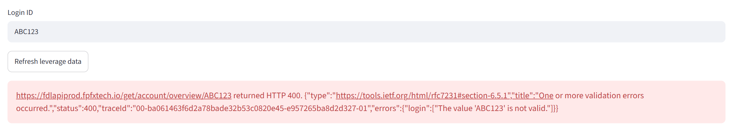
Wrong Login ID — you get a red error box
EXAMPLE 1 · LOGIN ABC123
1
2
1
What you typed
2
Red error box
What to do
The Login ID that was sent. “ABC123” is not a valid login number.
Red means the app stopped. Read the end of the message: “The value 'ABC123' is not valid.”
Check the number and try again. If a correct number still fails, wait a few minutes, retry, then ask the Data team.
Notes:
Red means the app stopped. The message looks technical, but the useful part is at the end: “The value 'ABC123' is not valid.” Check the number and try again.

Slide 13
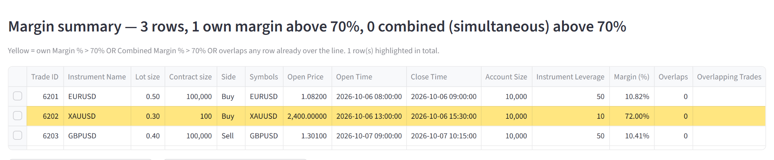
One trade uses more than 70% — its row turns yellow
EXAMPLE 2 · LOGIN DEMO-02
1
1
Heading
“1 own margin above 70%” = one trade is over the line by itself.
2
3
2
Caption
“1 row(s) highlighted in total.”
3
Yellow row
Trade 6202 (gold) used 72.00% of the account. It is yellow in the Trades table too.
How much of the account each trade used
6201 EURUSD
10.82%
6202 XAUUSD
72.00%
6203 GBPUSD
10.41%
70% line
Trade 6202 tied up 7,200 of a 10,000 account = 72%. That is more than 70%, so it is yellow — even though no other trade was open at the same time.
Notes:
Trade 6202 tied up 7,200 of a 10,000 account: 72%. It is yellow on its own, even though no other trade was open at the same time. This is the simplest kind of yellow row.

Slide 14
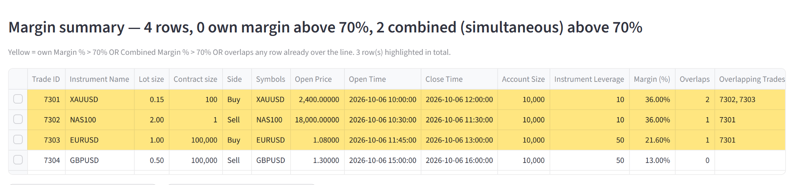
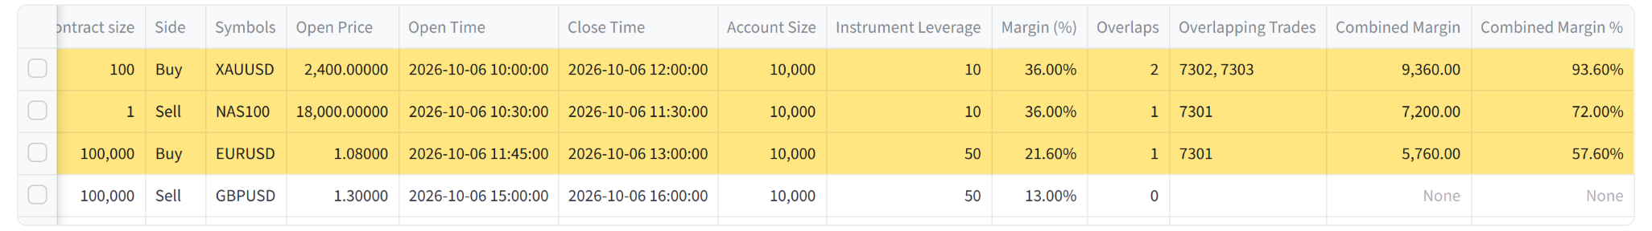
Trades open at the same time are added together
EXAMPLE 3 · LOGIN DEMO-03
1
1
Heading
“0 own, 2 combined above 70%”: no trade is too big alone, but together they are.
2
7301
36% alone, plus 7302 and 7303 open at the same time: 36 + 36 + 21.6 = 93.6%.
3
7302
36% + 36% (from 7301) = 72%.
2
3
4
4
7303
21.6% + 36% = 57.6% — under 70%, but it was open together with 7301, which is over the line, so it is yellow too.
5
Top: left side of the Margin summary. Bottom: the same rows scrolled right to the combined columns.
Read it like this
Yellow = this trade was part of too much risk at once. The Overlapping Trades column shows which trades were open together.
5
7304
Opened after the others closed: nothing to add, stays white.
Notes:
No single trade here is over 70%. But some were open at the same time, so the app adds their margins. 7301 and 7302 together are over the line, and 7303 was open at the same time as 7301, so all three are yellow. 7304 came later, alone, and stays white.

Slide 15
Picture it on a timeline
EXAMPLE 3 · WHY THESE ROWS
DEMO-03 · trades on 6 Oct 2026 · each bar = open to close
A row turns yellow if any of these is true
7301 XAUUSD
own 36.0%
together 93.6% → yellow (rule 2)
1
The trade alone is over 70%
Like trade 6202 in example 2.
7302 NAS100
own 36.0%
together 72.0% → yellow (rule 2)
2
Trades open together are over 70%
Its own margin plus every trade open at the same time (7301, 7302).
7303 EURUSD
own 21.6%
together 57.6% → yellow (rule 3)
7304 GBPUSD
own 13.0%
alone → stays white
3
It was open with a yellow trade
Even if its own total is lower (7303).
10:00
11:00
12:00
13:00
14:00
15:00
16:00
Open at the same time
Yellow row in the app
White row in the app
Tip: the shaded bands on the timeline are the moments when two trades were open at the same time.
When do trades overlap? When one opens before the other has closed.
If one closes at the exact moment the other opens, they do not overlap. A trade that is still open overlaps every trade that comes after it.
Notes:
Each bar is one trade, from when it opened to when it closed. Where bars sit above each other, the trades were open at the same time — that is an overlap. The three rules on the right decide which rows turn yellow.

Slide 16
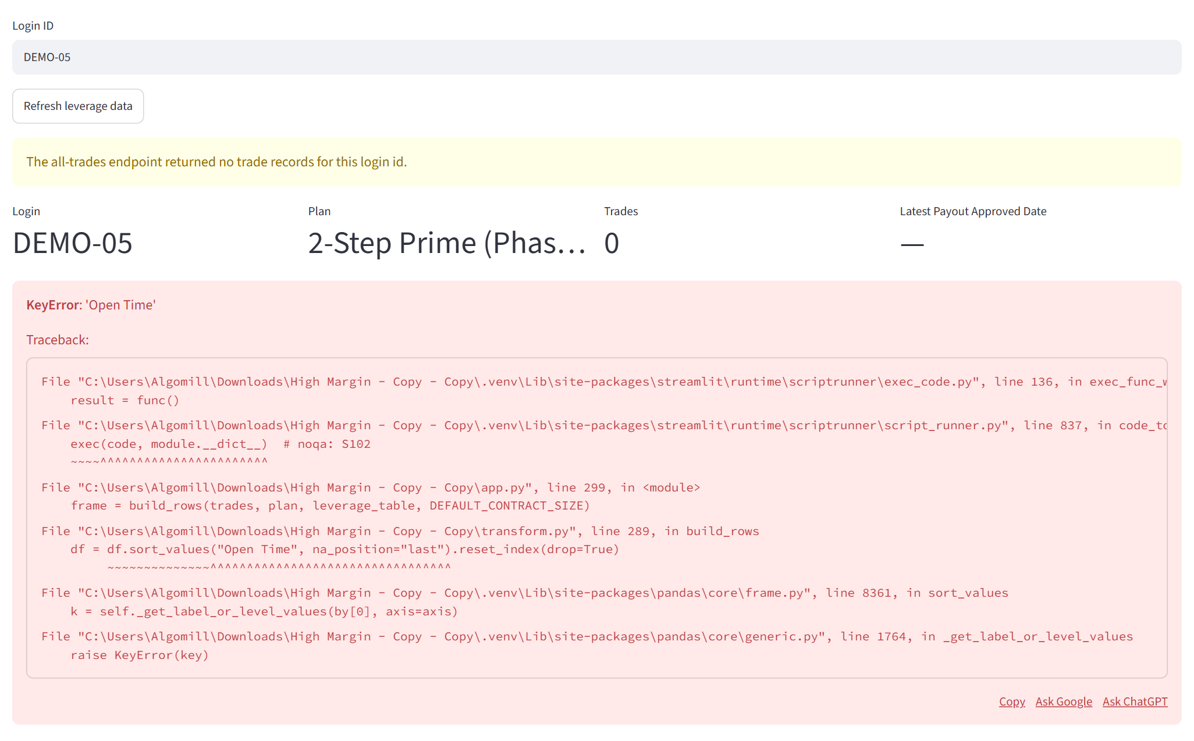
An account with no trades — a warning, then a red box
EXAMPLE 4 · LOGIN DEMO-05 · KNOWN ISSUE
1
Yellow warning
“The all-trades endpoint returned no trade records for this login id.” In plain words: this account has no trades.
1
2
2
Trades = 0
The header still loads, so you know you opened the right account.
3
3
Red box
“KeyError: 'Open Time'” looks scary, but it is a known app bug — not a problem with the account.
What to do
Nothing — there are no trades to check. The Data team can fix the app so it shows an empty table instead.
Notes:
This account has never traded. The yellow warning says so. The red box below it looks alarming, but it is a known bug in the app, not a problem with the account. There is simply nothing to check.

Slide 17
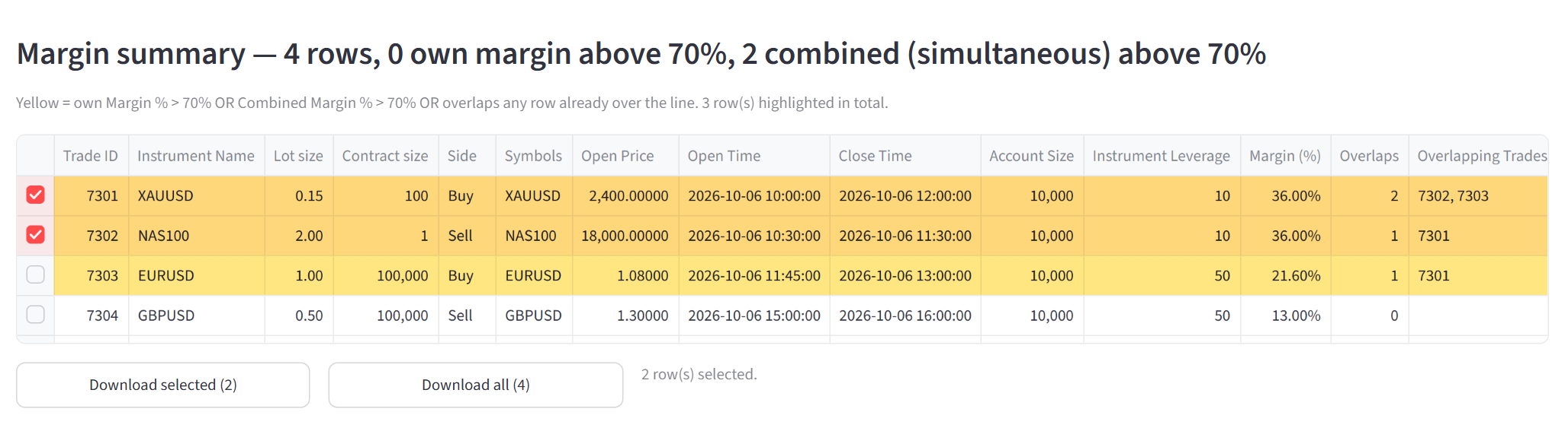
Save the rows you need as a CSV file
LAST STEP · DOWNLOADS
1
Tick boxes
Click the small box at the start of a row. Ticked rows turn orange; click again to untick.
1
2
Download selected
Saves only the ticked rows. It stays grey until you tick at least one.
2
3
4
What you get
A .csv file that opens in Excel or Google Sheets, with every column of the table.
Dates look like 06-10-2026 10:00:00 and percentages like 72.00%.
The file name includes the login, e.g. margin_summary_DEMO-03_selected.csv.
3
Download all
Saves every row in the table.
4
Counter
Shows how many rows you ticked.
Notes:
To take data out of the app, tick the rows you want and press Download selected — or press Download all for the whole table. The file opens in Excel or Google Sheets.

