Slide 1
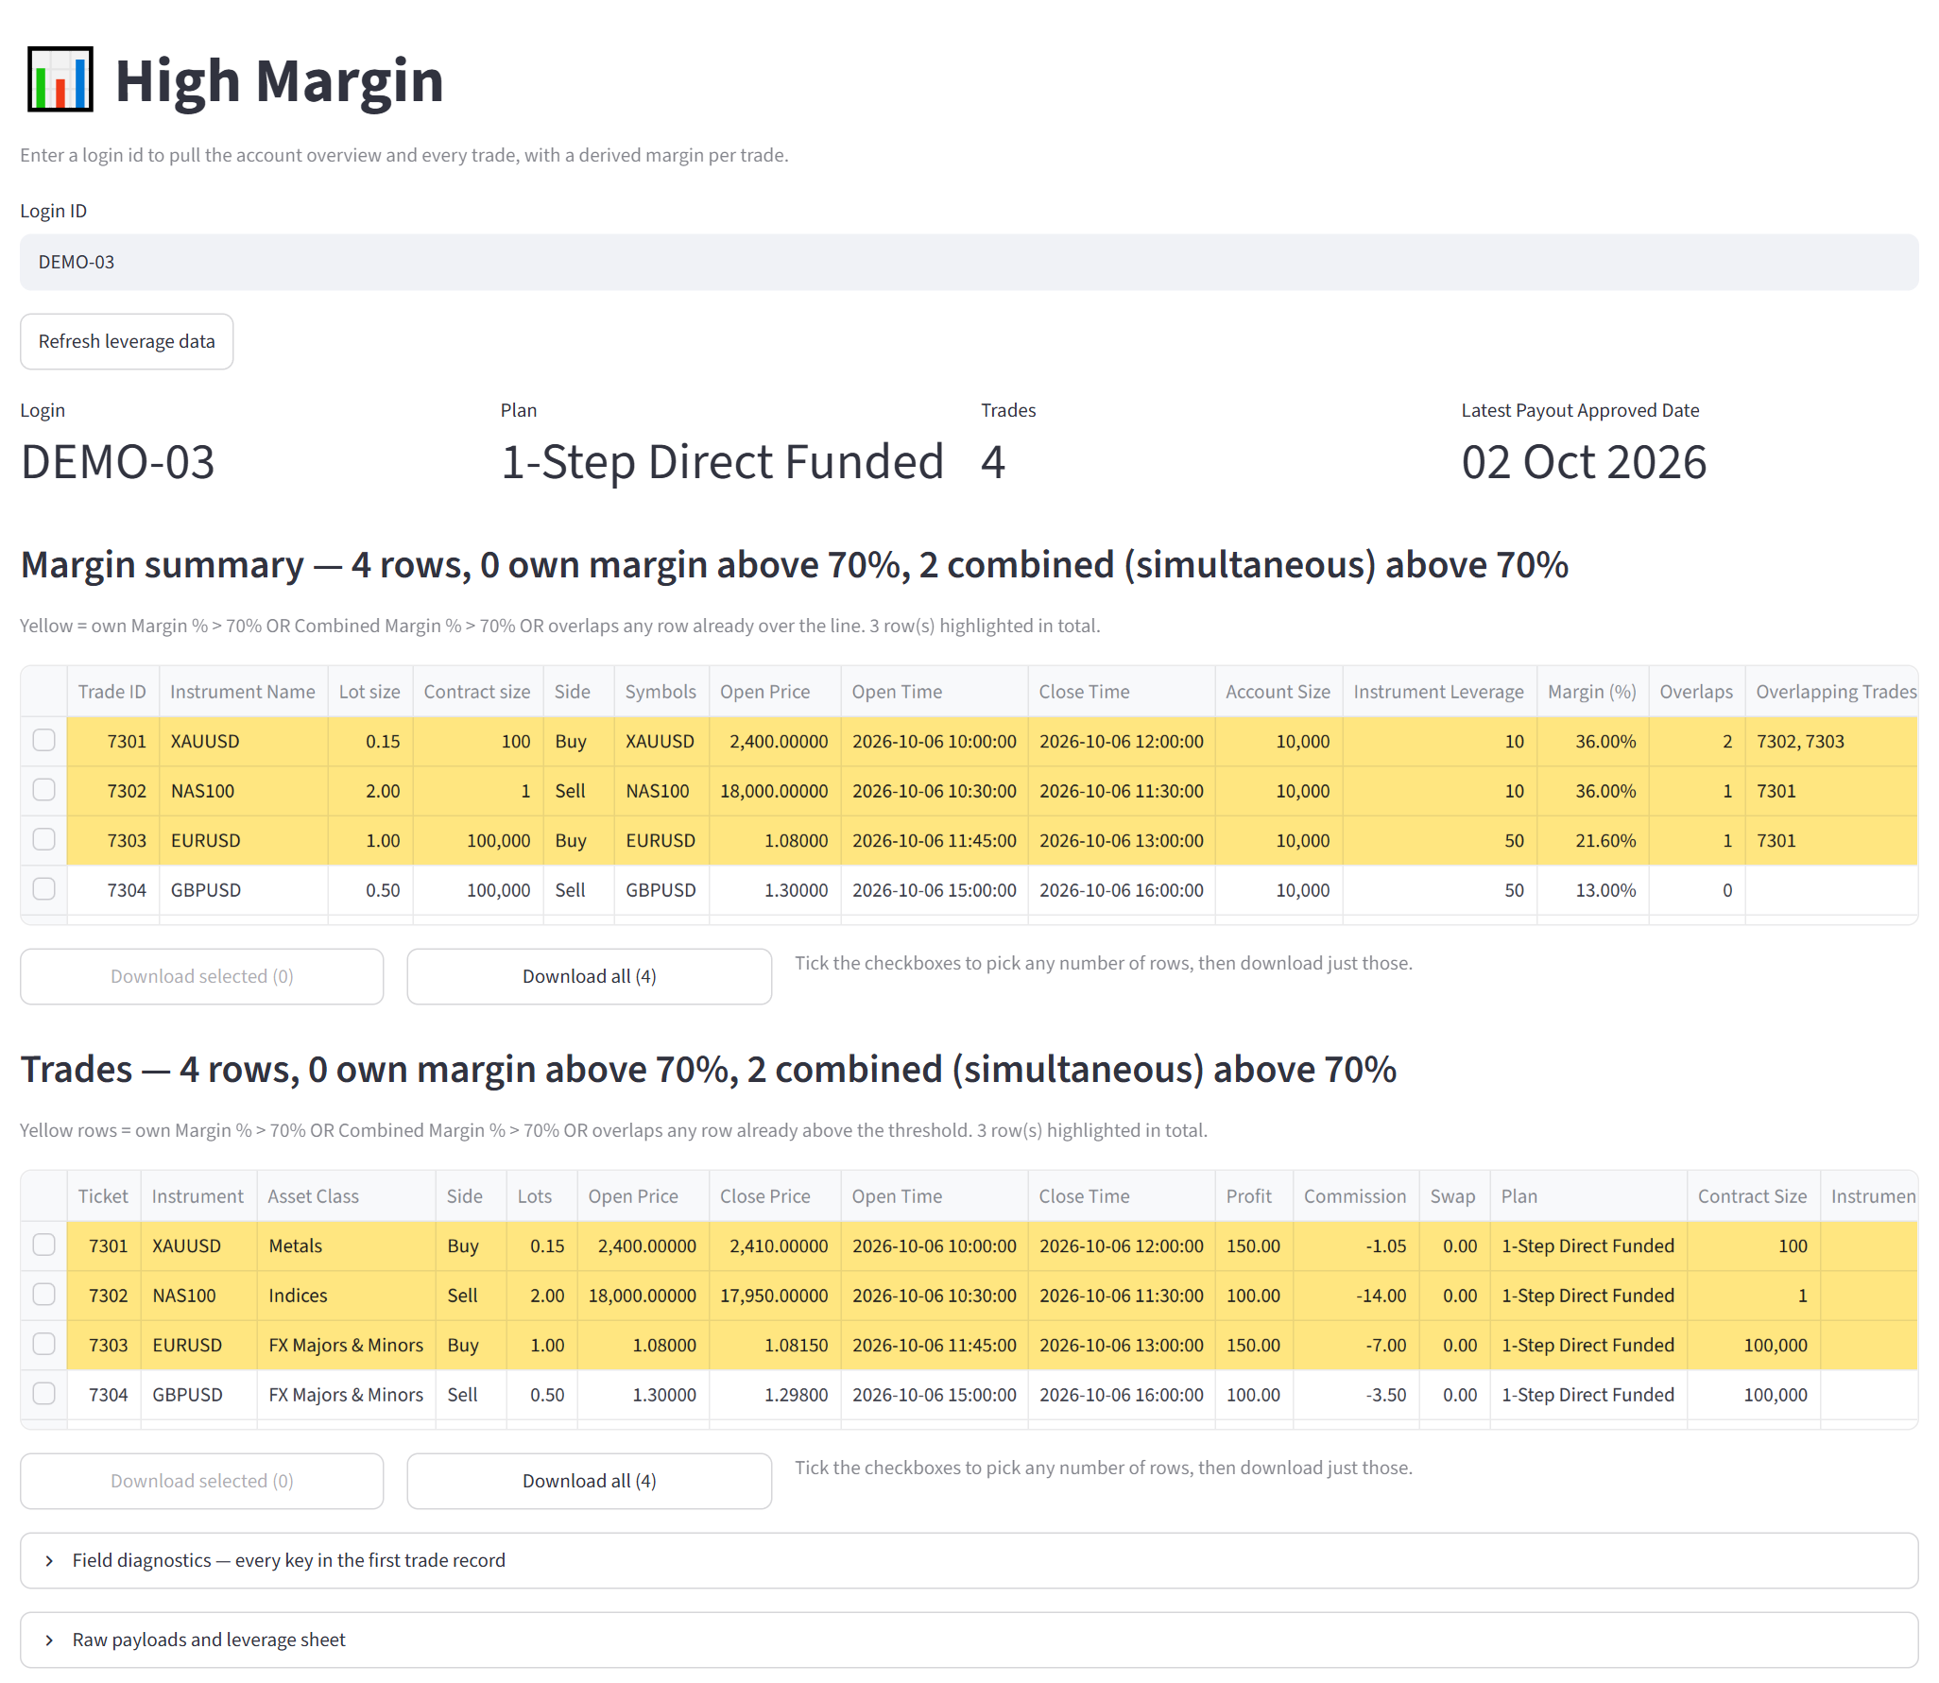
High Margin
RISK TOOLS · INTERFACE GUIDE
How to read every screen of the app — with a test account for every case
Screens captured from the real app, loaded with sample accounts
October 2026
Notes:
Interface guide for the High Margin app. Every screenshot comes from the real app, loaded with sample (DEMO) accounts so no client data is shown.

Slide 2
One login ID in — every trade's margin out
OVERVIEW
1
Enter a Login ID
2
The app gathers the data
3
Read the result
Open the app link, type the trading account's login number and press Enter.
Account overview, every trade and the payout history from the FPFX API — plus instrument leverage from the Google Sheet tab for the account's plan (Prime, Pro or Direct).
Each trade gets a Margin and a Margin %. Trades using more than 70% of the account size — alone or together with trades open at the same time — are shaded yellow.
70%
of the account size is the line.
A trade — or a group of trades open at the same moment — above it is shaded yellow. The line is fixed in the app.
Account size = the plan's starting balance, not today's balance.
Notes:
Three steps: enter a login, the app gathers data from the FPFX API and the leverage sheet, then shows margin per trade with risky rows in yellow.

Slide 3
Margin = position size ÷ leverage, in account currency
HOW MARGIN IS WORKED OUT
Margin =
(Open price × Lots × Contract size ÷ Leverage)
× ( |Profit| ÷ |(Open − Close) × Lots × Contract size| )
Margin % = Margin ÷ Account size × 100
WORKED EXAMPLE · DEMO-02, TRADE 6202
XAUUSD · Buy 0.30 lots · Prime plan
Open 2,400.00 → close 2,408.50
Profit 255.00 · Contract size 100
Leverage 10 (from the Prime tab)
2,400 × 0.30 × 100 ÷ 10 = 7,200
255 ÷ |−8.50 × 0.30 × 100| = 1.00
Margin = 7,200 × 1.00 = 7,200
1
Position ÷ leverage
The money the trade ties up, in the instrument's quote currency.
2
Profit ÷ price move
A currency rate taken from the trade's own result, so pairs like EURGBP convert to the account currency.
3
Leverage depends on the plan
Read from the plan's tab: EURUSD is 1:50 on Prime and Direct but 1:100 on Pro. The app never borrows another plan's number.
72%
of a 10,000 account — above 70%, so the row is yellow.
Notes:
Walk through the formula with the DEMO-02 gold trade: 7,200 margin on a 10,000 account is 72%, so the row turns yellow.

Slide 4
Reading the screen
01
PART 1
A walk-through with DEMO-01 — an account where everything is fine
Inside: The page · Login ID · Header · Margin summary · Trades table
Notes:
Part 1 walks through the page top to bottom using DEMO-01.

Slide 5
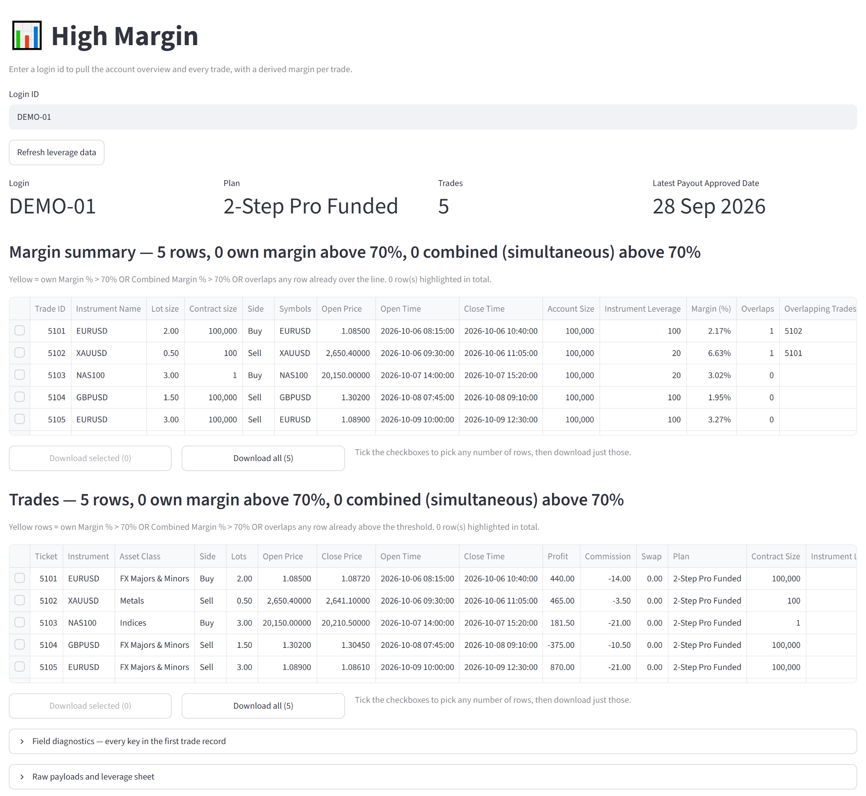
The page reads top to bottom in six parts
PART 1 · THE PAGE
1
Login ID
Type the account's login number and press Enter.
1
2
2
Refresh leverage data
Re-reads the Google Sheet. Use it right after someone edits leverage; otherwise it refreshes itself every minute.
3
4
3
Account header
Login, plan, number of trades and the latest approved payout.
4
Margin summary
One row per trade with only the inputs and results of the margin check.
5
5
Trades
The full record of every trade, including profit, commission and Notes.
6
Diagnostics
Two closed sections for checking the raw data when something looks wrong.
6
Notes:
Point out the six parts in order. Everything below the Login ID box belongs to the account that was entered.

Slide 6
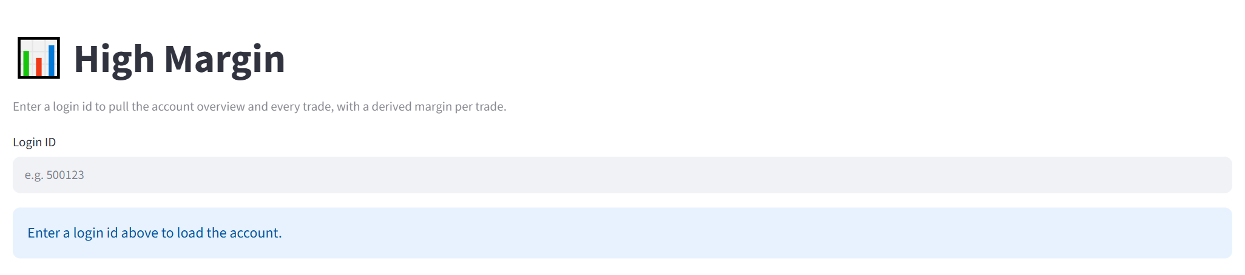
Start by typing a Login ID
PART 1 · STEP 1
1
2
1
Login ID box
2
Blue message
Good to know
Type the account's login number and press Enter. The grey “e.g. 500123” is only a hint.
“Enter a login id above to load the account.” Nothing is loaded until an ID is entered.
Results are kept for 5 minutes. Entering the same login again within 5 minutes shows the same data without asking the API again.
Notes:
Show the empty page. Nothing loads until a login is entered.

Slide 7
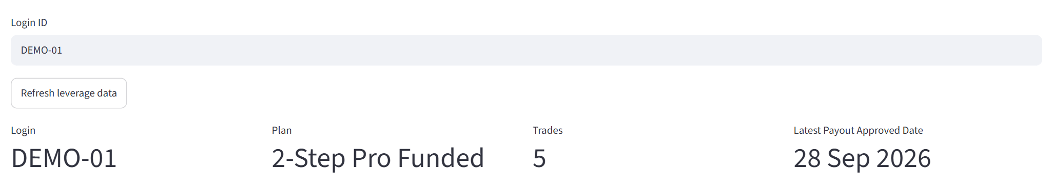
The header confirms whose account you are looking at
PART 1 · ACCOUNT HEADER
1
2
3
4
5
1
Refresh leverage data
2
Login
3
Plan
4
Trades
5
Latest Payout Approved Date
The account this data belongs to.
Chooses the leverage tab: a name containing Prime, Pro or Direct uses that tab.
How many trades the API returned for this login.
Re-reads leverage from the Google Sheet now.
Newest payout with status Approved. “—” means none approved yet.
Notes:
Check the login and plan first. The plan decides which leverage tab is used.

Slide 8
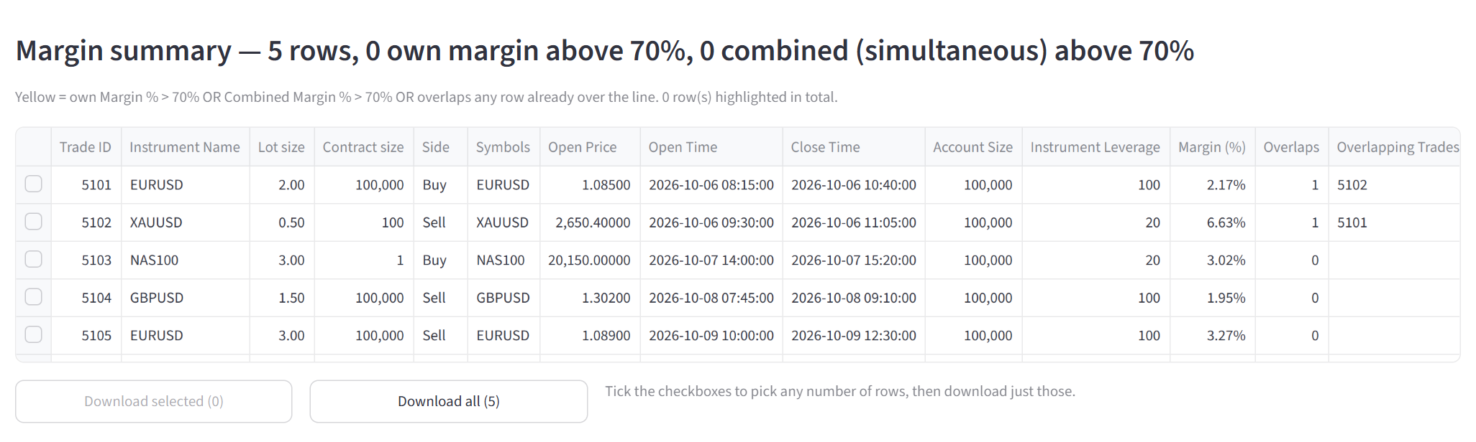
Margin summary: one row per trade, only what drives margin
PART 1 · MARGIN SUMMARY
1
1
Heading
Rows, trades over 70% on their own, and trades over 70% combined with others open at the same time.
2
2
Highlight rule
When a row turns yellow, and how many rows are yellow now.
3
4
3
Tick boxes
Select rows to download only those (slide 21).
Column | What it means
Margin (%) | This trade's margin ÷ account size × 100.
Instrument Leverage | From the plan's tab in the leverage sheet.
Overlaps | How many other trades were open at the same moment.
Overlapping Trades | Their Trade IDs.
Combined Margin % | This trade plus every overlapping trade, ÷ account size. “None” when nothing overlaps. Scroll right to see it.
4
Download
“Download selected” or “Download all” saves a CSV file.
Notes:
The summary is the table to read first. Columns to the right hold the combined exposure.

Slide 9
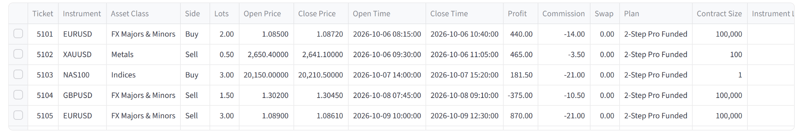
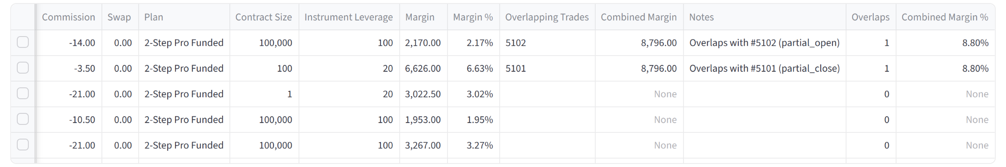
Trades table: the full record — scroll right for Notes
PART 1 · TRADES TABLE
1
2
3
1
Asset Class
From the leverage sheet: FX, Metals, Indices…
2
Profit · Commission · Swap
As reported by the API.
3
Plan
The plan used to pick the leverage tab.
4
5
6
5
4
Margin and Margin %
Margin in account currency, and as % of account size.
5
Combined columns
“None” when the trade overlapped nothing.
Top: left part of the table. Bottom: the same table scrolled right. Hover over a table and scroll sideways to see every column.
6
Notes
Why a value is missing, and which trades overlap — e.g. “Overlaps with #5102 (partial_open)”.
Notes:
The Trades table repeats every trade with all fields. Scroll sideways to reach Margin, Combined Margin and Notes.

Slide 10
Every case, one by one
02
PART 2
Eight situations — each with a test login you can try
Inside: Wrong login · One trade over 70% · Trades open together · No margin · Plan not on sheet · Missing data · Sheet unavailable · No trades · Downloads · Diagnostics
Notes:
Part 2 shows every situation the screen can be in, each with a test login.

Slide 11
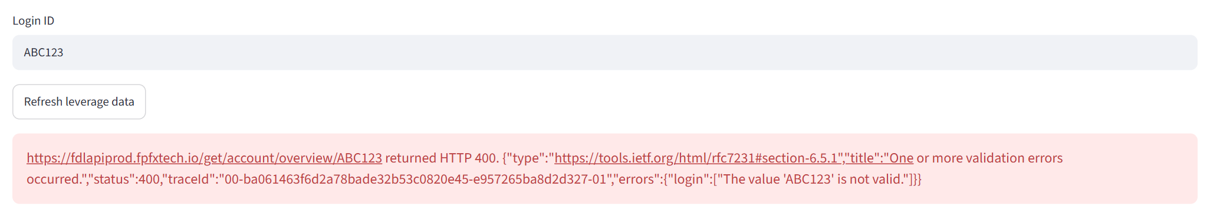
Wrong login ID: a red error, and nothing else loads
CASE 1 · LOGIN ABC123
1
2
1
The ID typed
2
Red error box
What to do
Exactly what was sent to the API. Check for typos and extra characters.
The API refused the request. HTTP 400 with “is not valid” means it is not a valid login. Other codes (404, 500) mean the login was not found or the API had a problem.
Fix the login and press Enter again. If a correct login keeps failing, try again later or contact the Data team.
Notes:
ABC123 goes to the live API, which rejects it with HTTP 400.

Slide 12
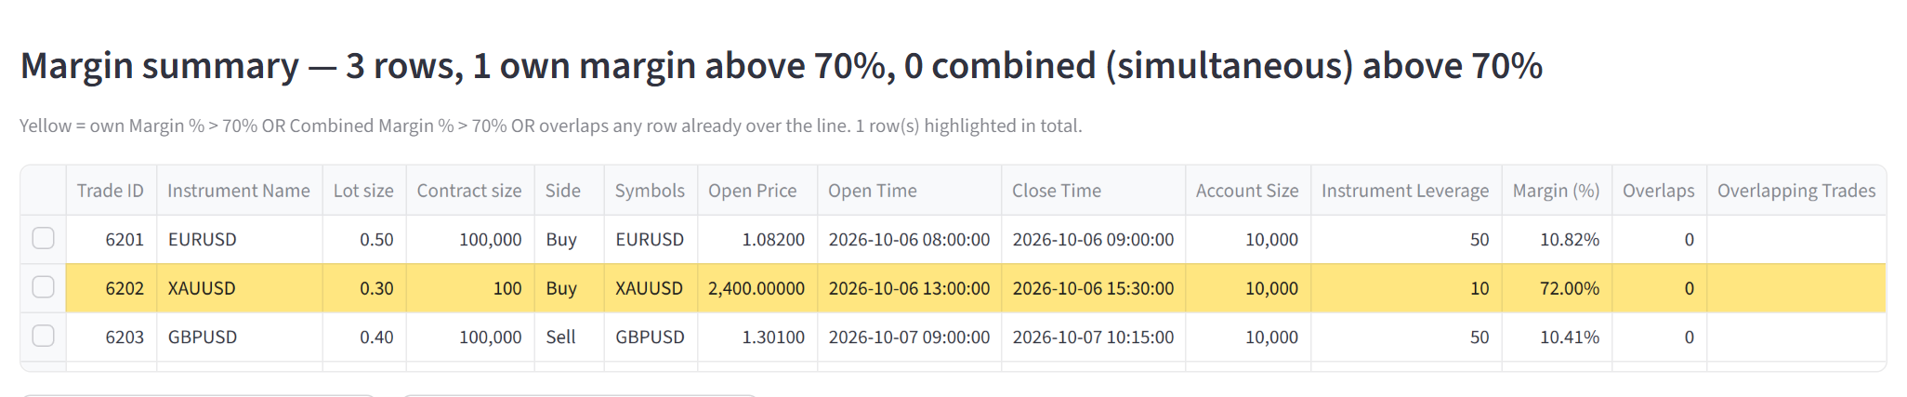
One trade above 70% on its own: that row turns yellow
CASE 2 · LOGIN DEMO-02
1
1
Heading
“1 own margin above 70%” — one trade is over the line on its own.
2
3
2
Caption
“1 row(s) highlighted in total.”
3
Yellow row
Trade 6202: Margin (%) 72.00%. The same row is yellow in the Trades table below.
Margin (%) per trade
6201 EURUSD
10.82%
6202 XAUUSD
72.00%
6203 GBPUSD
10.41%
70% line
Trade 6202: margin 7,200 ÷ account size 10,000 = 72.00%. No other trade was open at the same time — it is over the line on its own.
Notes:
Trade 6202 alone uses 72% of the 10,000 account.

Slide 13
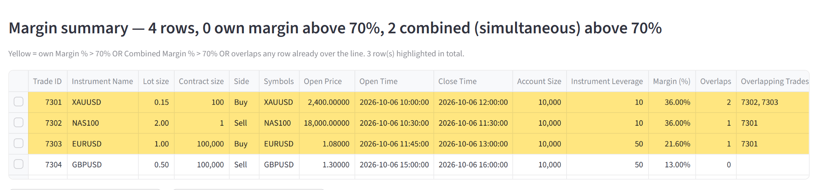
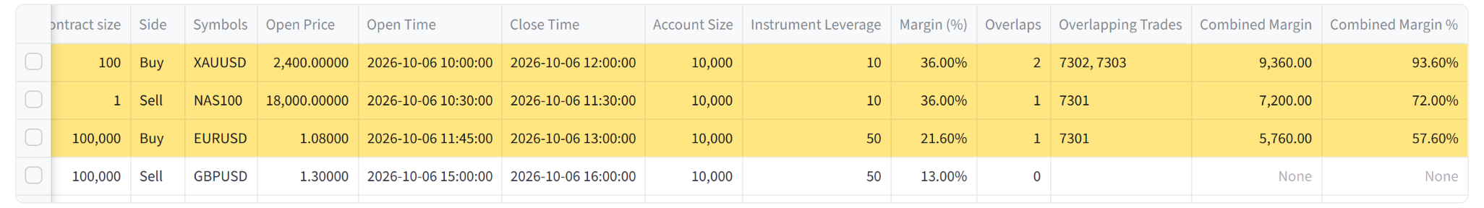
Trades open at the same time add up — all turn yellow
CASE 3 · LOGIN DEMO-03
1
1
Heading
“0 own margin above 70%, 2 combined above 70%” — no trade is over the line alone.
2
7301
Combined 93.60%: its own 36% plus 7302 and 7303, open at the same time.
2
3
7302
Combined 72.00%: its own 36% plus 7301.
3
4
5
4
7303
Combined only 57.60%, but it overlaps 7301, which is over the line — so it is yellow too.
Top: left part of the Margin summary. Bottom: the same rows scrolled right to the combined columns.
Read it like this
A yellow row was part of risky exposure — alone or together with others. Overlapping Trades tells you which trades were open at the same time.
5
7304
Opened after the others closed: no overlap, stays white.
Notes:
No trade is over 70% alone, but 7301 and 7302 are over it combined, and 7303 overlaps 7301.

Slide 14
How the app decides which trades were open together
CASE 3 · WHY THESE ROWS
DEMO-03 · trades on 6 Oct 2026
A row is yellow when any rule is true
7301 XAUUSD
own 36.0%
combined 93.6% → yellow (rule 2)
1
Own Margin % over 70%
The trade alone uses more than 70% of the account (Case 2).
7302 NAS100
own 36.0%
combined 72.0% → yellow (rule 2)
7303 EURUSD
own 21.6%
combined 57.6% → yellow (rule 3)
2
Combined Margin % over 70%
Own margin plus every trade open at the same moment (7301, 7302).
7304 GBPUSD
own 13.0%
no overlap → white
10:00
11:00
12:00
13:00
14:00
15:00
16:00
3
Overlaps a flagged trade
Shares time with a trade caught by rule 1 or 2 (7303).
Open together
Yellow row in the app
White row in the app
Overlap test: B opens before A closes AND B closes after A opens.
Trades that only touch — one closes at the exact moment the other opens — do not overlap. A trade with no close time counts as still open.
Combined Margin adds every trade that overlapped this one at any point — even trades that never overlapped each other.
Notes:
Overlap test: B opens before A closes and B closes after A opens. Then the three highlight rules.

Slide 15
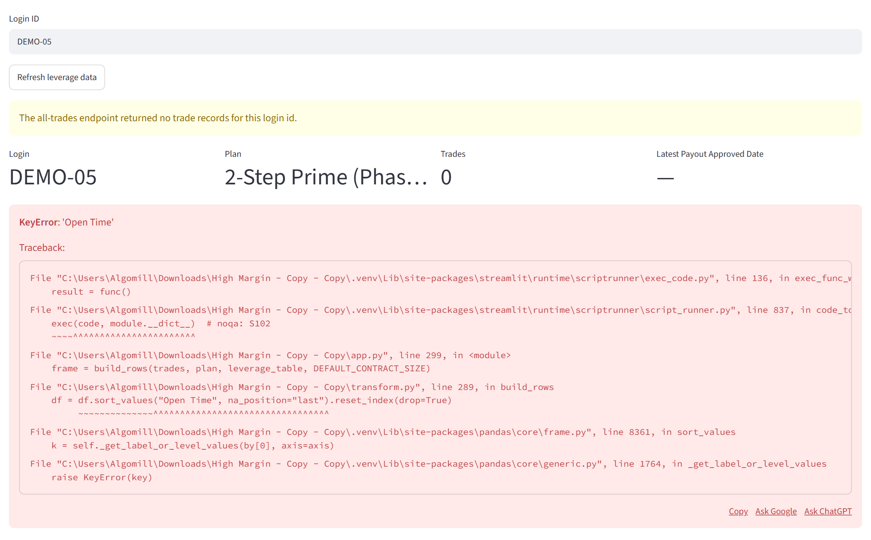
Account with no trades: a warning, then a red error box
CASE 8 · LOGIN DEMO-05 · KNOWN ISSUE
1
Yellow warning
“The all-trades endpoint returned no trade records for this login id.” This part is correct.
1
Trades = 0
The header still shows the account details.
2
2
3
3
Red error box
“KeyError: 'Open Time'” — the app does not yet handle an empty trade list. Nothing is wrong with the account.
Known issue
A small fix in transform.py will replace the error with an empty table. Until then, the warning is the answer: this account has no trades.
Notes:
Known issue: build_rows in transform.py fails on an empty trade list.

Slide 16
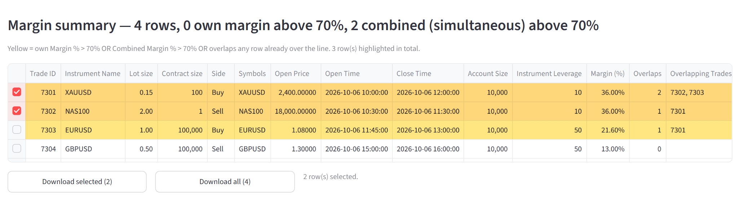
Tick rows and download them as a CSV file
PART 2 · DOWNLOADS
1
Tick boxes
Click the box at the start of a row. Ticked rows turn orange; click again to untick.
2
Download selected
Saves only the ticked rows. Greyed out until a row is ticked.
1
2
3
4
3
Download all
Saves every row of that table.
What the CSV file contains
Every column of the table you downloaded from.
Dates as DD-MM-YYYY HH:MM:SS; percentages with a % sign.
File name: margin_summary_<login>.csv or trades_<login>.csv — “_selected” is added for ticked rows.
4
Counter
Shows how many rows are ticked.
Notes:
Selected rows turn orange. Download selected saves only those rows.

