Slide 1
KRITICAL HACKS’26 / ONLINE ROUND
Yojana
Verifier
NoVibeCoders
Ayush Bhardwaj
Saksham Arora
Sanat Pahuja
Ayush Gori
Scholarship discovery that shows its sources.
TinyFish-powered search & fetch • Evidence-backed eligibility • Human verification
WORKING PROTOTYPE
yojana-verifier.streamlit.app
github.com/bhardwaj-ayush03/Yojana-Verifier
Notes:
Project links: https://yojana-verifier.streamlit.app/ and https://github.com/bhardwaj-ayush03/Yojana-Verifier. Important demo caveat: on 19 Oct 2026, the public deployment displayed MOCK / curated seed data; the local LIVE mode was verified separately. Before judging, configure Streamlit secrets and YOJANA_MOCK_MODE=false so the public URL demonstrates TinyFish. Event source: https://docs.google.com/document/d/1xUDI09_dWUyyTtNW_gKzmseAhTUgb1OIv4HhPp0Wesg/edit?usp=sharing

Slide 2
YOJANA VERIFIER
The problem: “eligible” is hard to verify
A scholarship match needs more than a search-result title.
01
02
03
Scattered sources
Profile-specific rules
Stale certainty
National and state portals publish schemes across different pages and PDF guidelines.
Domicile, category, course, income and marks change what actually applies.
Old guideline pages can describe a scheme without proving this year’s application window is open.
Cost of failure: wasted applications, missed deadlines, and misplaced confidence.
02 / 08
Notes:
Problem framing is based on the product design and observed source behavior, not on a quantified market survey. The app deliberately treats a guideline as insufficient proof of a current open cycle. See README and src/discovery.py in https://github.com/bhardwaj-ayush03/Yojana-Verifier.

Slide 3
YOJANA VERIFIER
One profile → source-backed guidance
The student clicks Find scholarships. The app retrieves, checks and explains.
1 PROFILE
2 OFFICIAL EVIDENCE
3 DECISION SUPPORT
State • category • course • income
TinyFish Search → trusted-source filter → Fetch
Groq extraction → deterministic checks → source link
What users see
Relevant schemes
Why / why not
Needs verification
Official source
03 / 08
Notes:
Flow verified against code: app.py user-triggered button; src/discovery.py profile-derived queries, relevance/trusted .gov.in/.nic.in filtering and Fetch; src/extraction.py structured extraction with source quotes; src/eligibility.py and src/ranking.py deterministic checks; src/verification.py optional TinyFish Agent. https://github.com/bhardwaj-ayush03/Yojana-Verifier. No application submission is performed.

Slide 4
REAL INTEGRATION / TECH STACK
TinyFish is on the critical path
Not a logo in the README: the live result depends on TinyFish data.
Streamlit + Pydantic
TinyFish Search
TinyFish Fetch
Groq + Python
→
→
→
Profile form & validation
4 profile-derived queries
Up to 8 official URLs
Extract, verify & rank
Optional TinyFish Agent checks a public portal page. It never logs in, enters personal data, solves CAPTCHA or submits.
04 / 08
Notes:
Code evidence: src/tinyfish_client.py uses Search GET with X-API-Key and query parameter; Fetch POST with URLs and markdown; Agent POST with constrained goal. src/discovery.py builds four profile-derived queries, fetches up to eight URLs, extracts at most two usable candidates. src/verification.py stops before login, personal data, CAPTCHA and submission. Stack: Streamlit, Pydantic, Groq openai/gpt-oss-120b, Python deterministic checks, SQLite FTS5 evidence store. https://github.com/bhardwaj-ayush03/Yojana-Verifier

Slide 5
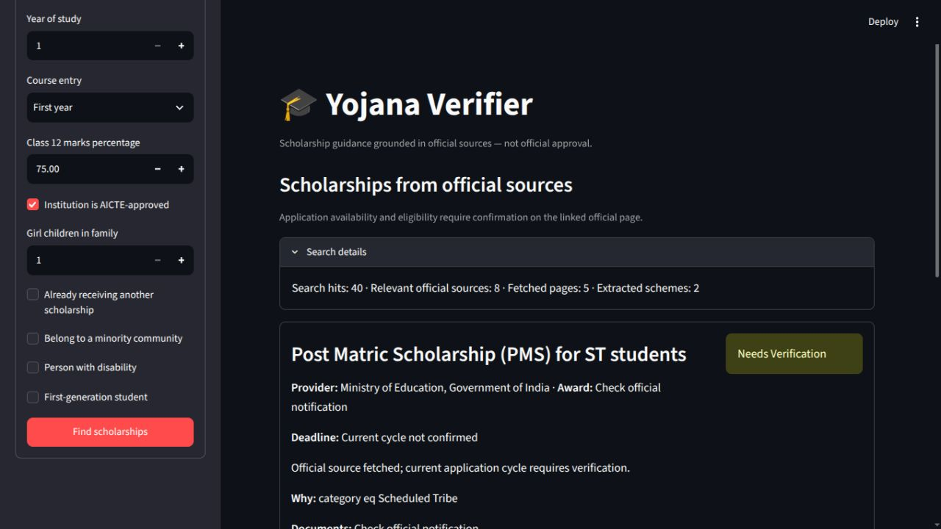
YOJANA VERIFIER
Proof: a live Bihar/ST search
Local run • 19 Oct 2026 • UG / B.Tech profile
40
search hits
8
relevant official sources
5
readable fetched pages
2
extracted schemes
Outcome: official PMS for ST guideline found; current cycle not confirmed.
05 / 08
Notes:
Measured local UI run, 19 Oct 2026: Bihar, ST, female, UG, B.Tech, government institution, income INR 250000. App Search details reported 40 hits, 8 relevant official sources, 5 fetched pages, 2 extracted schemes. Result: Post Matric Scholarship (PMS) for ST students, official guideline https://scholarships.gov.in/public/schemeGuidelines/EDUPostMatricScholarshipPMSforSTstudents.pdf. Status Needs Verification; no current deadline confirmed. Screenshot captured from localhost:8505 LIVE mode, not the public Streamlit deployment. Results may change with web content/providers.

Slide 6
YOJANA VERIFIER
Price economics: an auditable scenario
Published rates × explicit assumptions; not an actual usage invoice.
COMPONENT
ASSUMPTION
ESTIMATED COST
TinyFish Search + Fetch
4 queries + up to 8 URLs
$0 within free limits
Groq extraction
2 calls; total 8k input + 1k output tokens
$0.0018 / search
Optional TinyFish Agent
5-step portal verification
$0.08 / run
Demo hosting
Streamlit Community Cloud
Free prototype tier
Math: (8,000 × $0.15 + 1,000 × $0.60) / 1,000,000 = $0.0018
Excludes support, production hosting, failed retries and taxes. Rate limits still apply.
06 / 08
Notes:
Pricing checked 19 Oct 2026. TinyFish Search and Fetch free within 30 requests/min, 500 requests/hour and 150 URLs/min, 1000 URLs/day respectively; Agent $0.016 per step: https://www.tinyfish.ai/pricing. Groq openai/gpt-oss-120b input $0.15 per million tokens and output $0.60 per million tokens: https://console.groq.com/docs/model/openai/gpt-oss-120b. Streamlit Community Cloud is free for prototypes: https://streamlit.io/cloud. Model token assumptions are scenario estimates, not measured usage. Search uses four query calls; Fetch selects up to eight URLs; extraction is capped at two jobs in src/discovery.py.

Slide 7
YOJANA VERIFIER
Revenue model: free students, paid institutions
A proposed pilot, not current revenue or validated willingness to pay.
STUDENTS
COLLEGES / SCHOLARSHIP CELLS
₹0
₹1,999 / month
Profile search, source links and transparent uncertainty stay free.
Pilot hypothesis: up to 500 discovery checks, reporting and reminders.
Why this starting price?
Adjacent India education SaaS advertises from ₹5/student/month. At 500 checks, modeled Groq extraction is ~$0.90; delivery, support and Agent usage need separate pricing.
07 / 08
Notes:
Revenue plan is a hypothesis, not sales or a market survey. Adjacent education SaaS pricing anchor: iVake lists pricing from INR 5 per student per month, https://www.ivake.com/pricing; this is not a direct scholarship-verifier competitor. At 500 discovery checks × modeled $0.0018 Groq extraction = $0.90 variable model cost only, assuming each fits TinyFish free rate/volume limits. Institution price INR 1999/month is proposed for customer interviews; no exchange-rate gross margin is asserted. Paid Agent verification would be separately metered or limited; 5 steps cost $0.08 at current published TinyFish rates. Student access should remain free to avoid a fee barrier around public scheme information. Validate willingness to pay with college scholarship cells before launch.

Slide 8
FUTURE SCOPE / SUBMISSION
What comes next
01
Cycle monitoring
Detect changed deadlines and opening dates with evidence snapshots.
02
Better coverage
Expand state portals; add more robust PDF and page extraction.
03
Institution pilot
Test counselor dashboards, reminders and pricing with colleges.
Try the prototype
yojana-verifier.streamlit.app
github.com/bhardwaj-ayush03/Yojana-Verifier
08 / 08
Notes:
Future scope is planned, not already built. The repo and deployed prototype links are visible on this slide. Before submitting, switch public Streamlit from MOCK to LIVE and set TinyFish/Groq keys in Streamlit secrets, then demonstrate the Search details evidence. Event rules request functional TinyFish use, a public GitHub repository, demo video and social post as submission components; confirm current Unstop requirements. Event document: https://docs.google.com/document/d/1xUDI09_dWUyyTtNW_gKzmseAhTUgb1OIv4HhPp0Wesg/edit?usp=sharing.

