Slide 1
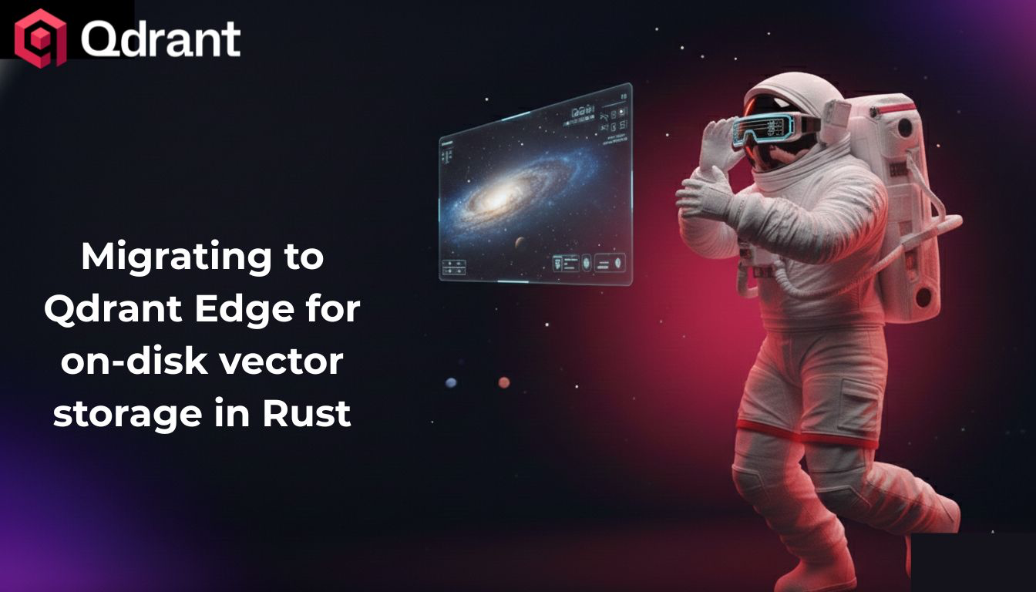

Slide 2




About Me
Open Source Engineer At LlamaIndex
Passionate about AI, programming and OSS
Mostly a python coder, but I also use Go, TS and Rust
/in/clelia-astra-bertelli-583904297/
@itsclelia

Slide 3

A Background On Today’s Discussion
Created by Logan Markewich (Head of OSS at LlamaIndex) in August 2025
Document intelligence
for the CLI
Parses unstructured documents with LlamaParse
Now at v3.0.0,
1.6K stars on GitHub
semtools
Embeds with static embeddings, and performs local search (+ RAG with OpenAI)
Written in Rust for high performance and reliability

Slide 4

Give Semtools A Star!
github.com/run-llama/semtools

Slide 5

Storage:
The Initial Approach
Support for vector embeddings
and metadata
Rust SDK
Embedded storage
backed up to disk

Slide 6



Three Main Problems
Verbosity: Table-based syntax
made LanceDB-related Rust difficult
to read and write
Size: the total binary size accounted approximately to 2.8GB
Slow CI, slow deployments
(between 20 and 40 minutes)
Security: the LanceDB
crate had several dependencies that did
not pass the security checks
with cargo audit

Slide 7

Qdrant Edge to the Rescue
No vulnerable dependencies
Embedded vector and metadata storage with disk backups
Rust SDK with Payload Metadata and Filtering-based syntax (more intuitive)
Smaller binary size

Slide 8



The Wins
-100 LoC, but more
test coverage!
Size: smaller binary size (from 2.8 → 1.6GB!)
Faster CI/CD (testing on MacOS/Windows
went down from 23 to 6 minutes, almost 4x!)
Sub-second search performance on 200+ arXiv papers (embedded line-by-line)

Slide 9



The Caveats
Qdrant Edge is currently a Git dependency, which means you can’t publish to cargo
Qdrant Edge does
not index the embeddings
(every search is a full-scan)
The Rust SDK currently has
only minimal docs and
examples (need to read
the source code sometimes!)

Slide 10
Why is Qdrant Edge Good for Semtools
✅ 100% Local And Persistent
✅ Small binary size
✅ Great Speed and Performance
✅ Embeddings and Metadata storage in one solution
✅ Expected a relatively low number of embeddings (no indexing is fine)

Slide 11

Thanks for your attention!
If you want to follow me on my journey in the AI
Space, feel free to connect with me on my
Social Media accounts!

