Slide 1
Kafka
Stream Processing

Slide 2
Uses
Massively Scalable Pub/Sub queue
Designed for high-throughput low-latency real-time data feeds
Highly available

Slide 3
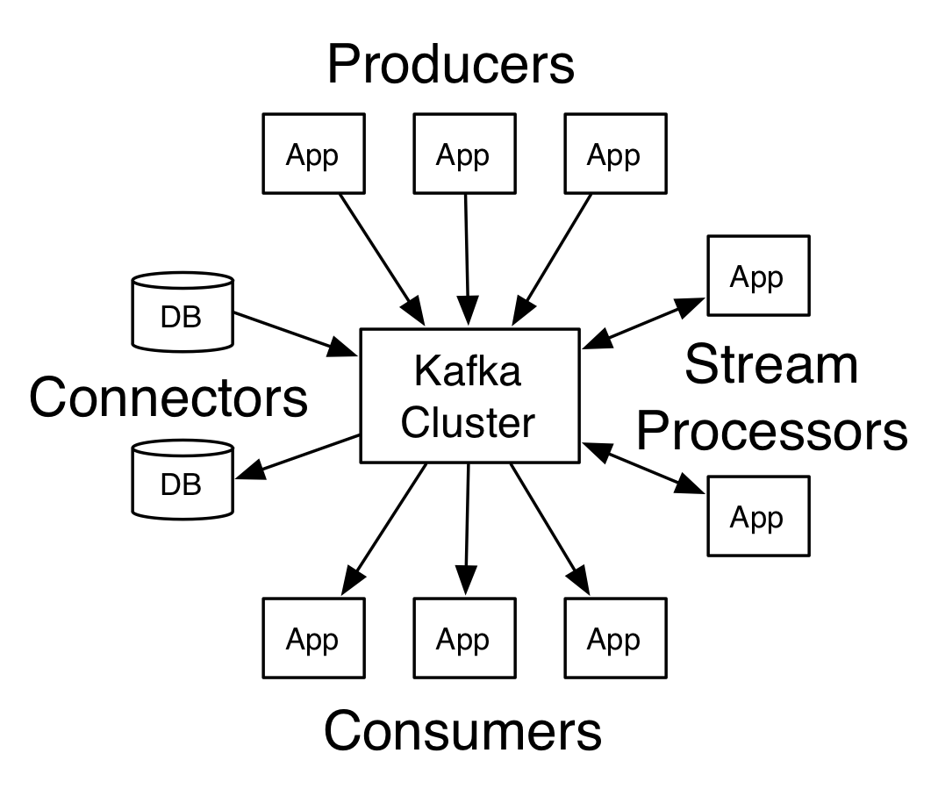
General Overview

Slide 4
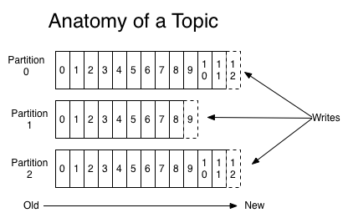
Topics
Messages are written to topics
Topics are partitioned to increase throughput

Slide 5
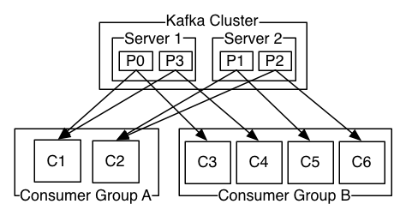
Clusters
Kafka is designed to work in clusters with no master node.
Messages are pushed to arbitrary nodes and pushed back to all subscribers

