Slide 1


A
Study Based Seminar
on
Query Optimization In Multidatabase
Systems
GUIDED BY :
DR. S.C. GUPTA
PROF. & HEAD
NIC DELHI
PRESENTED BY :
HARSH CHITLANGIA
07/CTA/08
ME CTA 1st YEAR

Slide 2

INTRODUCTION
Objective
Multi - database system (MDBS) .
Functionalities and Key Features.
Two major approaches to designing an MDBS.
    1. Global schema
    2. Multidatabase language

Slide 3
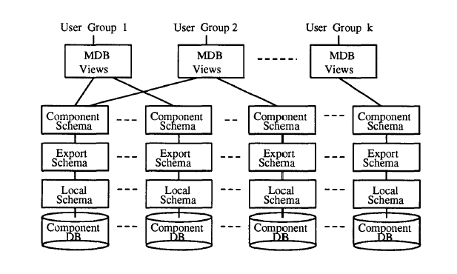
MULTIDATABASE SCHEMAS

Slide 4
MULTIDATABASE SCHEMAS
Key features : Local autonomy
    1. Design Autonomy
    2. Communication Autonomy
    3. Execution Autonomy
Differences with local DDBS.

Slide 5
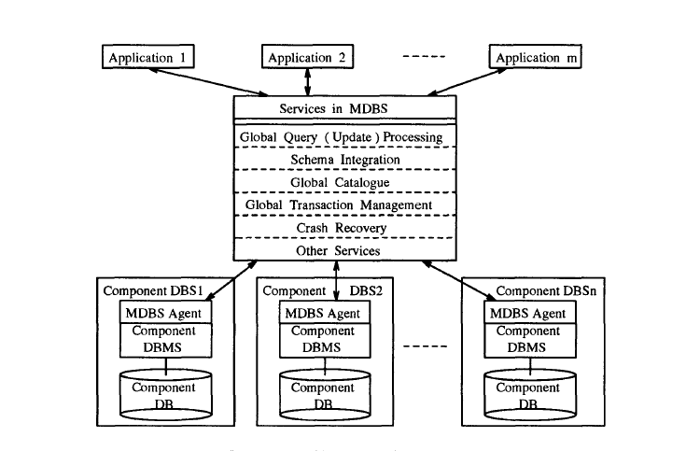
MULTIDATABASE SERVICES

Slide 6
CHALLENGES
Several Level Translations are needed.
Different local Capabilities are assumed.
Response time of local request may not predictable.
More constraints needed to be concerned.
Implementation of Component DBMS cannot be changed.

Slide 7
Query Processing and Optimization
Query Processing Approach
Two-Phase Optimization Approach
Optimization Objective

Slide 8
Query Processing Approach
Compilation Approach :
  Better when queries are executed repetitively.
Interpretation Approach :
  Better when queries are executed once.

Slide 9
Two-Phase Optimization Approach
    Phase I (Compile time)
    Phase II (Run time)
Optimization Objective
Minimum Total Cost
Minimum Response Time.

Slide 10
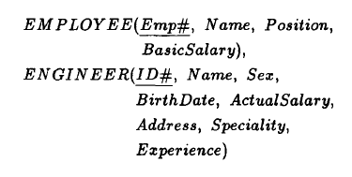

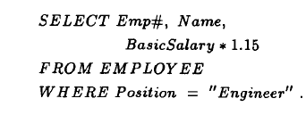
Compile-Time Optimization
Semantic query Optimization
Global User Query at site A

Slide 11
Run Time Optimization
1. Parametric Query Optimization :
    Use of two type of info. to improve query processing.
      The runtime values for the parameters of a query
      The intermediate results and dynamic system characteristics
2. Adaptive Query Optimization :
    Intermediate results and dynamic system characteristics is known during the execution of query.

Slide 12
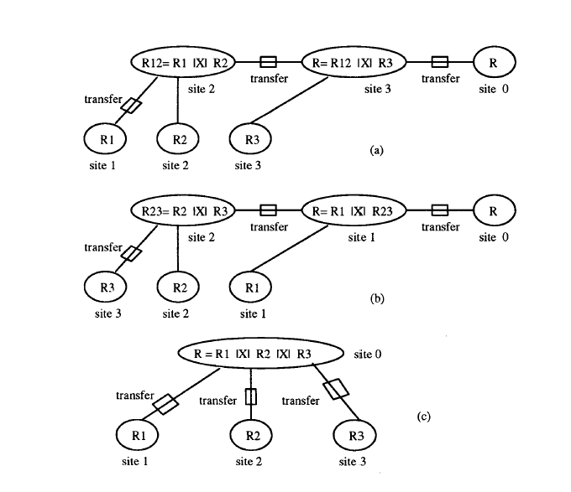
Global Access Plan

Slide 13
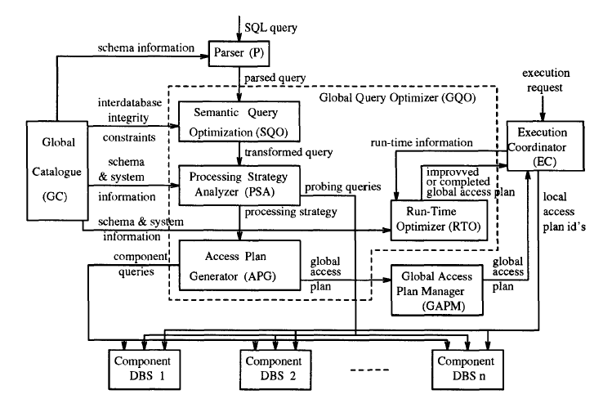
Architecture of the Global Query Optimizer

Slide 14
CONCLUSION AND FUTURE WORK
A key feature of an Multi-Database System (MDBS) is Local Autonomy.
Differentiate MDBS from Traditional Distributed Database System.
Query Optimization in MDBS is performed at both Global and Local level.
Global Access Plan for a query is either complete or incomplete in Compilation Approach. But in Interpretation Approach Global Access Plan is either Improved or Completed.

Slide 15

THANK YOU
Queries…??

