Slide 1
[How Things Work]: Linux
On Processes
2024-05-03

Slide 2
“Knowledge Understanding Is power”
Notes:
The more we build-on, run-on or support Linux the more it becomes essential to understand how it works. The difference between shallow understanding and deep understanding is the difference between few million rps vs few thousands, mitigate an issue in minutes vs days, weeks. Or ops overhead in minutes vs hours.

Slide 3
Groundwork
8 sessions – one a week.
With ample time for Q/A towards the end of each session.
Demos and content will be on Bootcamp ADO (we are looking at github for long-term solution).
Most of demos are done in C to remove abstraction layers typically added by modern languages.
We will not cover everything Linux. But for whatever we won’t cover we will provide some pointer for your continued “understanding” journey.
Notes:
We have a plan but it is not carved in stones, if we see a reason to change, we will change (your feedback is highly appreciated)

Slide 4
On Processes

Slide 5
Process: Modern Kernel View

Slide 6
syscall?
userspace
Kernel primary job is H/W resource abstraction, process Management + compartmentalization and resource governance.
Process to Kernel:
A process that needs H/W resources (this includes *everything* including memory) needs to execute a syscall. Which is an api interface offered by the kernel. Syscalls are executed by writing 6 values in arch specific 6 well-known registers (#0 is syscall id). Then raises soft irq. The irq is handled by the kernel which executes it then exits back to user mode.
Kernel copyfromuser() copytouser() funcs are used to copy large buffers from/to kernel space.
Kernel does not provide “call back” mechanism*. But it can send signals to process or a group of them.
Thus..
write(2)
glibc/musl/etc
Write inputs
Raises soft irq
Saves instruction pointer
exit
Kernel Space
A Process: Modern Kernel View

Slide 7
Code that runs on Linux
Code that runs
in a process
Code that runs in kernel space executing a syscall on behalf of a process
Kernel thread, kworker (top half)
Interrupt handler
(bottom half)
A Process: Modern Kernel View

Slide 8
Let there be “something”
A computer that only runs “the kernel” does not really provide value for user – why?
Once kernel boot sequence is completed*, kernel executes init process. This “init” process is the “parent” and is responsible for running everything else. Exiting init exits the system.
Each process (including each thread) has a pid and ppid. Each process is represented as “struct task_struct” in a doubly linked list inside the kernel.
Process come in sessions (w/ controlling terminal or not) and groups (multiple sessions). A process group can be signaled all at once (POSIX).
Think of an executing process as a giant “int main(..)” that has exit code. Parent must reap exit code for child. Kernel will not remove process info until it reaped. If not reaped it will become a zombie (and you don’t want those).
Like everything else a process is a state machine:
Running/able || Sleeping || sTopped || Zombie || D (uninterruptable sleep) || I (idle filler)
s is for Session leader, l (small l) is for multi-threading L is for memory locking (i.e., no swapping*)
Linux “Program Loader” recognizes the following format
ELF files
Text Files via “shebang line” (pointing to ELF executable)
binfmt_misc which register other program loaders (ELF) to load other files -> (MONO, QEMU and others use this clever trick).
Notes:
* We have a session focused on that. Stay tuned

Slide 9
A Process Modern Kernel View
Parent
Starts by syscalls executed by the parent process.
Bound to a set of cpus (typically all) unless some are masked out. And has a ”nice” value describing scheduling priority*
Runs as the user who started it (or the one started its parent) or the user who created the executable (setuid(2) setgid(2)).
Automatically gets:
FDs: stdin, stdout, stderr
TTY
A unique memory address space (aka proc mem-map, not to be confused with mmap(2)).
fork(2)
clone(2) execve(2)
exec(2)
Process

Slide 10
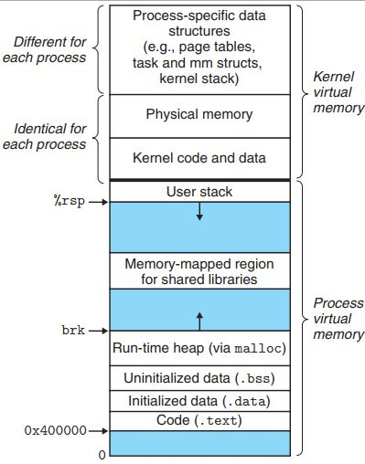
Process Memory
Each process gets a full 64bit int of address space.
General placement order of things is static, but actual start address is randomized (i.e, x40..0 is random).
Kernel is mapped in all processes.
struct thread_task saved at the top of the address space (bottom of kernel stack) allowing kernel to do quick lookup to current process.
Kernel manages memory as chunks of <PAGE_SIZE> usually 4K. Userspace memory is entirely virtualized (e.g. virtual pages are mapped to physical memory). And is done by MMUs TLB (Translation Lookaside buffer).
Processes can be configured for HTLB. Idea being if you map a large continuous chunk of physical mem say 1GB then memory addresses within the chunk won’t need to go to through MMU TLBs (for super-duper high throughput apps).
Source: Computer Systems: a programmer’s perspective
A Process: Modern Kernel View

Slide 11
Process Memory
Process memory
Physical memory
Process typically call:
brk(2) which increases uninit-ed data segment (the .bss) which effectively increases the heap size.
mmap(2) by using anonymous/private maps process maps parts of its memory space to physical memory || FILE || DEVICE (WHERE SUPPORTED).
Both are done via malloc(3) in glibc (or equivalent) which makes the decision internally.
Memory is allocated in chunks of <page-size> and mapped to physical memory. A continuous space in virtual mem != continuous space in physical memory. Memory is not allocated until it is read or written.
Heap
…
Page
Page
Page
Page
…
A Process: Modern Kernel View

Slide 12
More On: A Process (Modern Kernel View)
Has “Resource Limits” that are:
Set on pid-by-pid basis. Enforced directly on process and are usually inherited from or system default (i.e., rlimits).
Set on a “cgroup”. Enforced because the pid is a member of it.
Some resource are only controlled by rlimits (e.g., # of FDs). Some are controlled only by cgroups (e.g., I/O). Some are controlled by both (e.g., memory) Whichever less has more precedence followed by rlimits then cgroups.
Some – e.g., network limits – are controlled by other components of the systems such as tc, iptables (and yes, they overlap with cgroups). precedence…depends ¯\_(ツ)_/¯.

Slide 13
More On: A Process
Has an assigned set of capabilities. Each map to a set of “possible things to do”. Some are selectively inheritable or or set/unset on process. Capabilities allows running a privilege process without certain capabilities or unprivileged process with them.
Has a view of system resource:
root* and cwd
An optionally – customized/different - view of the system resources such as file system tree (mounts), network, time, users etc.
Those views are called namespaces.

Slide 14
Processes: IPC
Notes:
* We have a session focused on that. Stay tuned

Slide 15
Processes: IPC
IPC allows process to “talk” to each others. IPC exited before networking but was limited to single box.
IPC toolchain choice depends on
Performance.
Security.
Ease of use (e.g., easy one support request/response style “talking”).

Slide 16
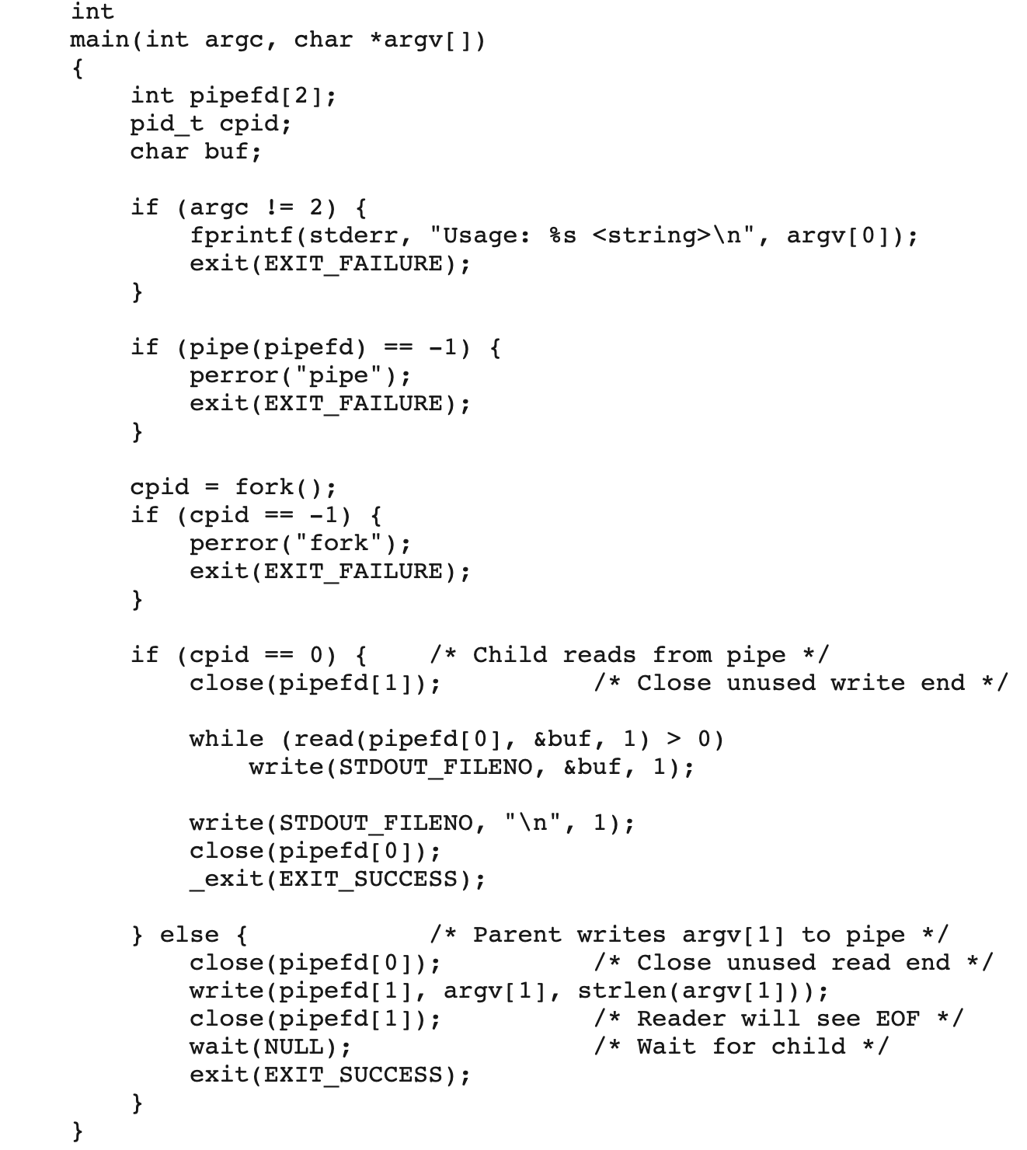
IPC: pipe(2) Creates a unidirectional pipe described by two FDs
Notes:
FDs can be sent over unix domain sockets
FDs can be sent over dbus
FDs can be duplicated using dup(2) and bound/redirected via dup2(2).

Slide 17
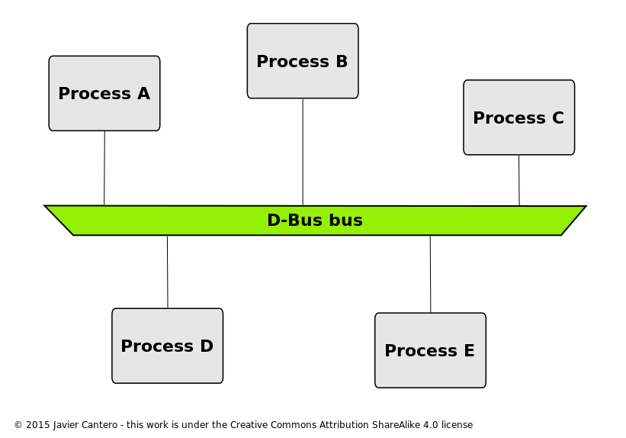
IPC: dbus
dbus is “desktop” bus. Was originally designed for desktop applications to communicate with each others.
Supports pub/sub style messaging.
Communication is done over unix domain socket abstracted by libdbus.
Dbus is a userspace implementation (there is a kdbus too!).

Slide 18
IPC: Shared Memory
Two or more processes can map a memory space based on a shared memory object (created via shm_open(3)) or using mmap(2).
Steps:
Call fd = shm_open(<name>)); // once
Call mmap(fd,…); // for each process
Call munap(fd..); // for each process
Call shm_unlink(<name>); // once
Fastest IPC possible because it bypasses the kernel entirely (vs unix/af_net sockets or pipe(2) which go through the kernel).
Requires inter process synchronization typically done by using a well-known address (e.g., first 64bit of the map) as a lock. Locks are typically acquired using compare-swap calls (e.g., spin-wait). Alternatively, semaphores can also be used (but they tend to be clunky).
You can also use HTLB memory during mapping.
Process X memory
Physical memory
Process Y memory
Heap
…
Heap
…
Page
Page
Page
Page
Page
Page
…
…

Slide 19
IPC: More?
Fifo pipes via mkfifo(3)
Message queue via msgsnd(3)
Signaling + semaphores
Some of the tools available now have been available since System V days (circa 1982). The reason they are not heavily used is portability.

Slide 20
Demos

Slide 21
In conclusion
A Process:
Started by syscalls* executed by a parent process
runs a set of instructions as described by an ELF file.
runs with resource limits inherited by parent or as set by the control group(s) it runs in
also has an optionally customized view of the system resources.
Each process has its own memory map and is represented in a –hashed – linked list in kernel memory. Each process references its representation via a reference saved at the topmost address of the process memory.
Process can talk to each other via a well-defined set of IPC interfaces and tools.
*Syscall is an API provided by the kernel for user-space programs to interact with it.

Slide 22
Feedback
Please send feedback to:
https://aka.ms/workingwithlinux/feedback

