Slide 1
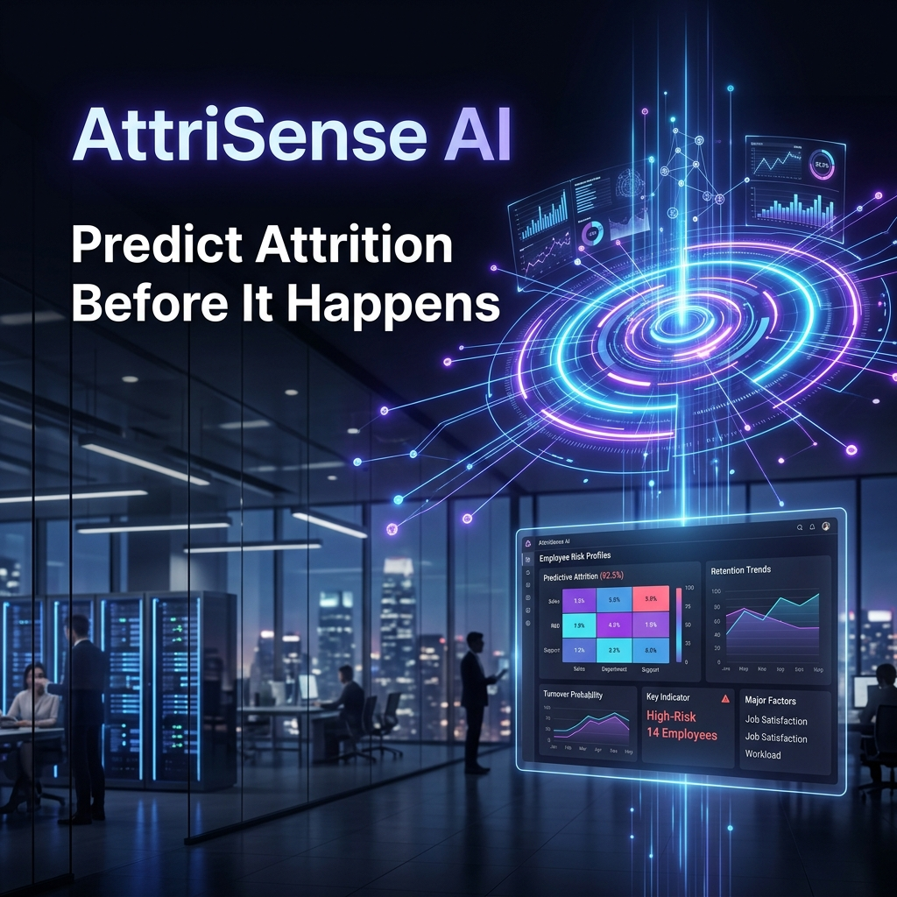
AttriSense AI
Predictive Attrition
Intelligence Platform
LTTS Global Hackathon 2026 | Jury Presentation

Slide 2
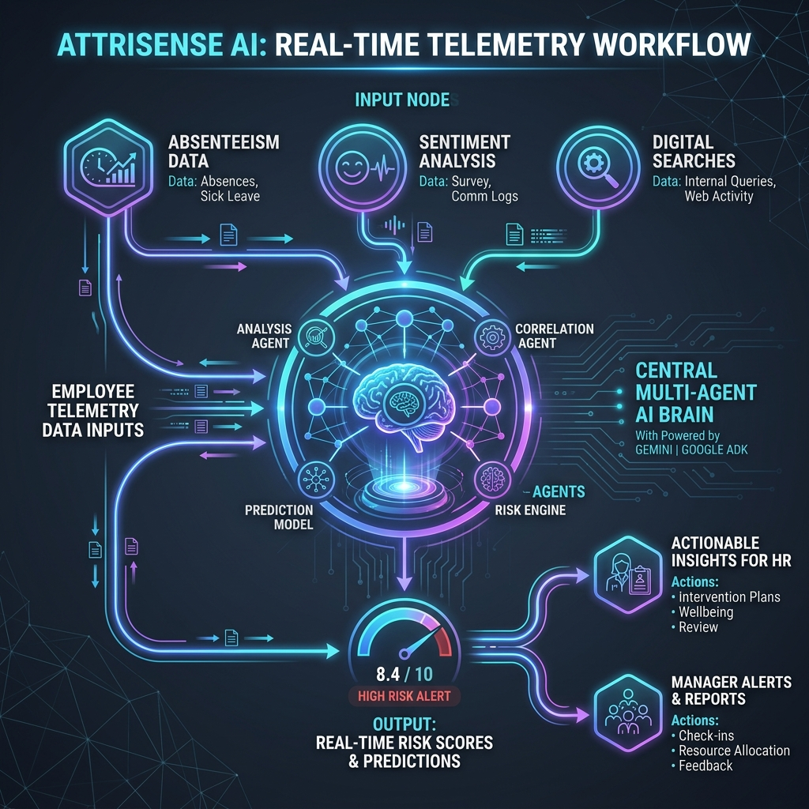
Multi-Agent System Architecture
Google ADK 2.4.0 + Specialist Agent Orchestration
• Step 1: Telemetry Sensor Network
Aggregates 15 continuous behavioral and work-life telemetry signals via mcp_server.
• Step 2: Sentiment NLP Analyzer
Runs real-time sentiment extraction & disengagement theme detection on employee voice data.
• Step 3: Risk Score Calculator
Processes weights to compile a real-time risk index (0-100%) and categorizes flight risk.
• Step 4: AI Retention Playbook Advisor
Maps risk drivers to corporate mitigation playbooks to synthesize direct action steps.
• Step 5: Security & Privacy Gateway
Enforces PII redaction, prompt injection defense, and role-based view/edit permissions.

Slide 3
Step 1: Telemetry Sensor Network
Continuous Behavioral Sensing Across 15 Core Parameters
• Absenteeism Rate (12% Weight)
Identifies sudden increases in unscheduled leave. Warning: >10%, Critical: >15%.
• NLP Sentiment Score (10% Weight)
Quantifies employee feelings from communications/reviews. Warning: <-0.1, Critical: <-0.3.
• Performance Trend (10% Weight)
Detects drop-offs in performance ratings. Warning: Declining trend, Critical: Steep drop.
• Compensation Gap (10% Weight)
Positions salary against market rate percentile. Warning: <40th pct, Critical: <30th pct.
• Manager Scorecard (8% Weight)
Tracks manager-employee relationship scores. Warning: <6.0, Critical: <5.0.
• Promotion Gap (8% Weight)
Measures years elapsed since last promotion. Warning: >2 years, Critical: >3 years.
• Internal Job Searches (8% Weight)
Monitors internal portals for active queries. Warning: >5 searches, Critical: >8 searches.
• Meeting Participation (6% Weight)
Tracks active engagement in collaborative work/meetings.
• Collaboration Index (6% Weight)
Measures cross-team interaction levels and outgoing syncs.
• Training Activity (6% Weight)
Flags low professional development (Warning: <2 trainings/year).
• Recognition & Awards (6% Weight)
Identifies employees with zero recognition in the past year.
• Location Mismatch (5% Weight)
Flags fresher relocations to mismatched locations (High attrition risk).
• Cross-Functional Work (3% Weight)
Measures exposure to projects outside immediate teams.
• Team Social Engagement (2% Weight)
Tracks participation in voluntary out-of-work events.
• 🔥 Signal #15: Weekly Working Hours (5% Weight)
Added telemetric parameter. Redflags potential burnout from excessive workload. Warning: >48 hours/week, Critical: >55 hours/week.

Slide 4
Step 2 & 3: Sentiment NLP & Risk Indexing
Empathetic Text Processing + Categorical Attrition Windows
Step 2: Sentiment NLP Processing
• Real-Time NLP Parsing: Evaluates employee written feedback, pulse surveys, and ticket updates.
• Numeric Mood Indexing: Converts qualitative feedback into a scalar range from -1.0 (Highly Disengaged) to +1.0 (Enthusiastic).
• Core Theme Extraction: Identifies specific pain points such as 'burnout', 'career_stagnation', 'workload_pressure', or 'manager_friction'.
• Contextual Synthesis: Enables the Orchestrator to understand the human story behind the numbers.
Step 3: Risk Level Classification
🔴 CRITICAL (Score >= 80%)
Action Window: < 3 months. Requires immediate senior HR intervention and salary/overtime audit.
🟠 HIGH (Score 60% - 79%)
Action Window: < 6 months. Triggers automated manager check-ins, skip-levels, and workload cap.
🟡 MODERATE (Score 35% - 59%)
Action Window: < 12 months. Requires quarterly reviews, skill alignment, and training incentives.
🟢 LOW (Score < 35%)
Stable tier. Monitored on a standard bi-annual cycle.

Slide 5
Step 4 & 5: Retention Playbooks & Security Safeguards
Prescriptive Mitigation + Enterprise Privacy and Governance Guardrails
Step 4: AI Retention Advisor
• Overtime & Hours Playbook: Mitigates burnout by enforcing strict weekend caps, shifting loads, or introducing flexi-time.
• Compensation Review Playbook: Initiates salary percentile benchmarks vs. market averages and prepares business case for increases.
• Career Stagnation Playbook: Fast-tracks performance appraisals, assigns mentors, and allocates training budgets.
• Manager Alignment Playbook: Initiates skip-level check-ins and offers communication support to the team lead.
Step 5: Security & Privacy Gateways
• PII Redaction Engine
Automatically strips employee names, emails, phones, and actual salaries before queries reach the LLM.
• Prompt Injection Guardrail
Intercepts adversarial inputs (e.g. 'ignore instructions') and logs them in a security ledger.
• Role-Based View Permissions
Enforces distinct workspace boundaries: - HR Admin: Complete demographics & core data. - Analyst: Behavioral telemetry & sentiment. - Manager: Performance feedback & check-ins. - Employee: Self-service timeline & own metrics only.

Slide 6
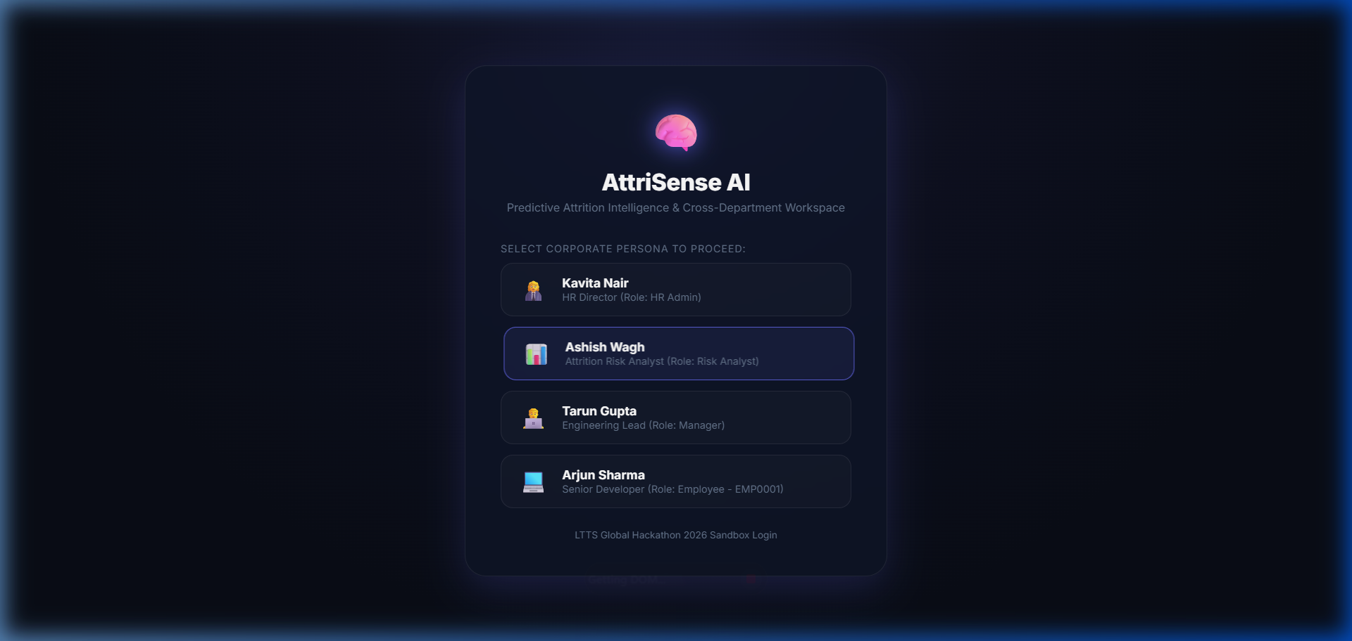
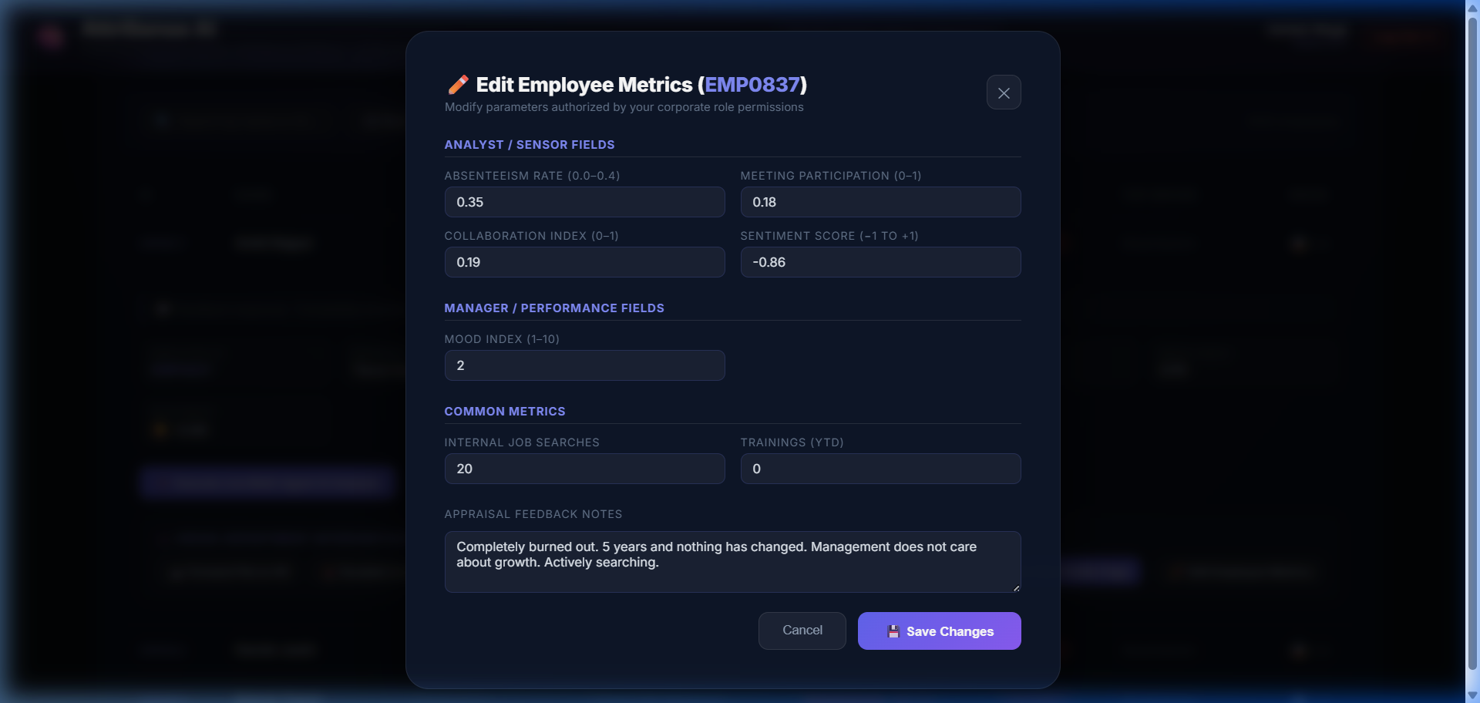
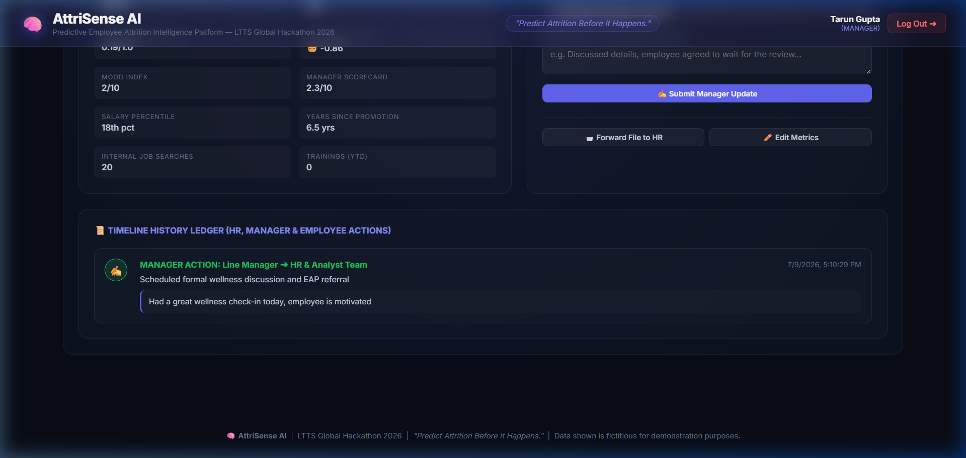
AttriSense AI Product Showcase
Working UI: Generalized Logins, Employee Cockpits, and Auditable Timelines
1. Role-Generalized Portals & Linked Employee Selection List
2. Role-Aligned Form Permissions (Analyst Modal shown)
3. Employee Profile & Chronological Intervention Timeline

Slide 7
Jury Figures, Financial ROI & Future Path
AttriSense AI: Making the Case to Leadership
• Industry Landscape: Global IT attrition averages 15% - 20%. LTTS historical attrition hovers around 13% - 18%. Healthy attrition target is 8% - 12%.
• Replacing Employee Cost: Recruitment, onboarding, productivity loss, and knowledge transfer costs average $10,000 to $15,000 per person.
• LTTS Financial ROI Impact: For an LTTS-sized base (~23,000 employees) at 15% attrition: - Exits: ~3,450/year costing $34.5M to $51.75M. - Retaining just 10% of exiting high-performers translates to annual savings of $3.45M to $5.17M. - System run cost: under $12,000/year (300x+ ROI!).
• Model Accuracy: Built and calibrated against research achieving up to 95% classification accuracy on attrition patterns.
🔮 Future Steps & Managerial Index
• Managerial Influence (16th Parameter)
We plan to feed a new signal measuring a manager's history: standard deviation of attrition rates in their team, average team mood ratings, and historical scorecards.
• Automatic Coaching & Training
If a manager's team shows elevated risk flags, the system proactively triggers an internal 'Leadership Development & Management Coaching' program, supporting the manager with skill development rather than penalizing them.
• Integrations with Corporate HRMS
Connect MCP server natively to Workday, SAP SuccessFactors, and local IT logs (Jira, Git, active hours telemetry) for fully automated, continuous prediction.

