Slide 1
This week’s Progress Report for BTP
1 – Extraction of required components.
2 – Removed and detected connected wires to get connected components.
3 – Created new improved version of Dataset of different components’ type of over 100 images.
4 – Tried training and testing the model for classification of components but couldn’t get much success, might be making some silly mistakes.
( will figure that out by next week. )

Slide 2
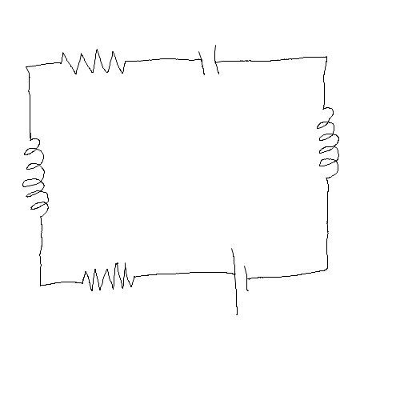
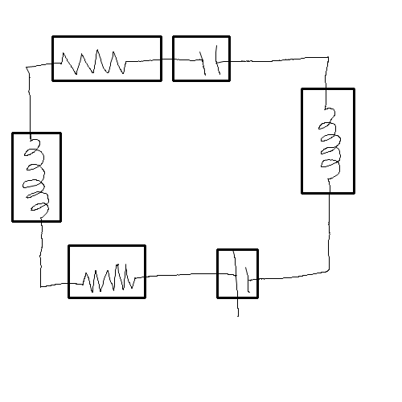
Sample of Detection of components from Handrawn Circuit
Original Input Circuit
Bounding box of Detected Components

Slide 3
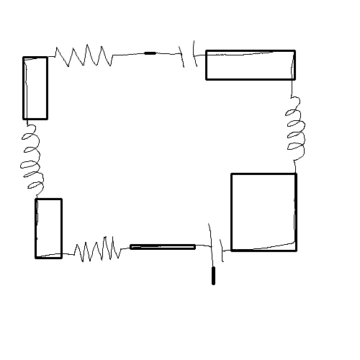






Detection of Wires and separation of components
Bounding Box of connecting Wires
Separated out components for further classification

