Slide 1
Travelling Salesman Problem
Bhargav Modha (21BCE503)

Slide 2
Overview
Problem Statement
Approaches
Solution (better than brute force)

Slide 3
What is Travelling Salesman Problem ?
Travelling Salesman Problem is based on a real-life scenario, where a salesman from a company must start from his own city and visit all the assigned cities exactly once and return to his home till end of the day. The exact problem statement goes like this,
"Given a set of cities and distance between every pair of cities, the problem is to find the shortest possible route that visits every city exactly once and returns to the starting point.“

Slide 4
What is Travelling Salesman Problem ?
Though this problem is easy enough to explain, it is very difficult to solve.
There are two important things to be cleared about in this problem statement,
• Visit every city exactly once
• Cover the shortest path
Shortest Hamiltonian cycle (i.e. tour).
Grow exponentially

Slide 5
Applications
The TSP has many practical applications
plane routing
telephone routing
networks
traveling salespeople

Slide 6
Major Practical Extension of the TSP
Vehicle Routing - Meet customers demands within given time windows using lorries of limited capacity
10am-1pm
7am-8am
3am-5am
4pm-7pm
6pm-7pm
Depot
8am-10am
6am-9am
2pm-3pm

Slide 7
Different Approaches to Solve problem of TSP

Slide 8
Mainly three types
Brute Force Method
(n-1)! possibilities – grows faster than exponentially
If it took 1 microsecond to calculate each possibility takes 10140 centuries to calculate all possibilities when n = 100
Greedy Approach (Nearest Neighbor)
Optimized approach using Dynamic Programming

Slide 9
The Nearest Neighbour Method – A ‘Greedy’ Method
Start Anywhere
Go to Nearest Unvisited City
Continue until all Cities visited
Return to Beginning

Slide 11
Brute Force Method
To determine the optimal solution:
Represent the problem with a complete, weighted graph.
List all possible Hamilton circuits for this graph.
Determine the cost (or distance) associated with each of these Hamilton circuits.
The Hamilton circuit with the lowest cost (or shortest distance) is the optimal solution.

Slide 12
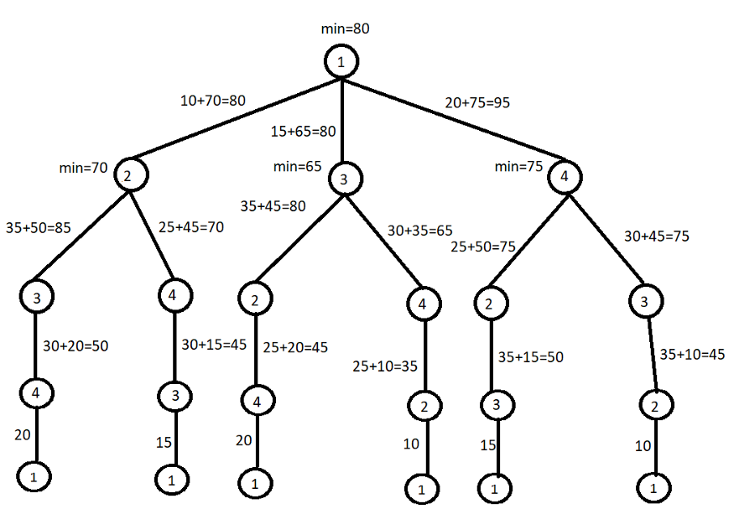

Slide 13
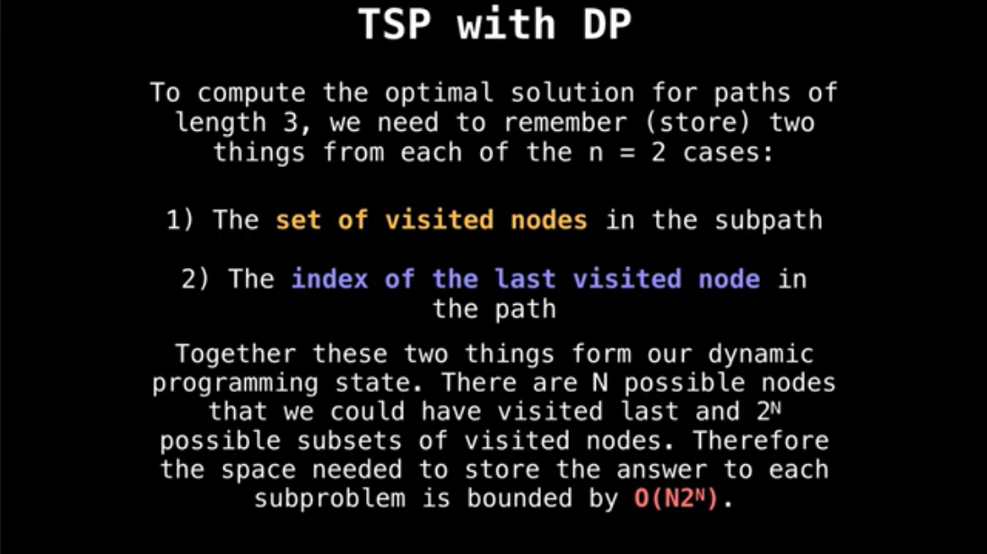
SOLUTION
We will create a 2D array for which will store the shortest path sum values for each (i,j) nodes.
We will also maintain one variable “Visited” which will denote total permutations whether city is visited or not with the help of concept of Bit masking.

Slide 14
Steps
Step 1: - Creating Adjacency Matrix of the graph
Step 2:- Getting shortest path between cities using DP and bit masking

Slide 15

Time Complexity comparison

Slide 16

In order to understand recursion, one must first understand recursion.
-Anonymous

