Slide 1



Amazon
Product Reviews
Customer Reviews
with
New Customer Review
Contact Buyer
Advanced Database Management Project
Bhargav Rishi Medisetti

Slide 2






MARIADB DATA BASE DESCRIPTION
MariaDB
The Amazon Product Reviews database is built on MariaDB, an efficient and open-source relational database management system (DBMS). It is designed to remain free under the GNU General Public License. It is highly compatible with MySQL.
Ideal Application for Online Retail Platforms
Efficient Data Organization
High Performance
CRUD Operations
Store and retrieve data
Handling a large volume
Organized and easily accessible.
Optimized for speed, with features like the Aria storage engine and thread pooling
Supports a wide range of storage engines, plugins, etc.
Create: Adding new Information
Read: Retrieving data
Update: Modifying existing information
Delete: Removing data that is no longer needed
Efficient retrieval and analysis of product reviews
Integrity and seamless relationship
Generate massive amounts of content

Slide 3
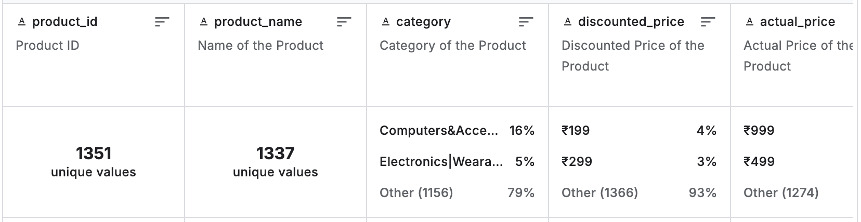
AMAZON REVIEWS DATASET – KDD NUGGETS
Source: https://www.kaggle.com/code/mehakiftikhar/amazon-sales-dataset-eda/notebook
Dataset is scraped from the official website of Amazon
1K+ Amazon Product's Ratings and Reviews
Each product entry includes attributes such as product ID, name, category, pricing information, discount percentage, average rating, and rating count, providing a comprehensive view of each product's performance on Amazon.
Brand Reputation Management
Sentiment Analysis
Potential
Applications
Product Recommendation Systems
Market Research
Quality Analysis

Slide 4
DATA STRUCTURE
Attribute | Description
user_id | Unique identifier for each user
user_name | Name of the customer
products table: Store detailed information about products sold on Amazon.
users table: Store information about users who have signed up on Amazon.
reviews table : Store information about product reviews.
Transactional, supporting consistent, reliable operations
Transactional Design
ACID (Atomicity, Consistency, Isolation, Durability) compliance
Relational Integrity
Products table: Atomic operations, indexed product ID for efficient access.
Users table: Primary key on user ID, preventing duplicates.
Reviews table: Foreign keys linking products and users, maintaining data accuracy
users
Attribute | Description
product_id | Unique identifier for each product
product_name | Product name
category | Product category
discounted_price | Original price of the product
actual_price | Price after applying discounts
disount_percentage | Percentage discount applied
rating | Average user rating for the product
rating_count | Number of ratings the product has received
about_product | Brief description of the product
products
Tables
Attribute | Description
review_id | Unique identifier for each review
review_tittle | stores the title of the review
review_content | stores the content of the review
image_link | Link to the product's image
product_link | URL to the product's official Amazon page
product_id | Unique identifier for each product
user_id | Unique identifier for each user
reviews

Slide 5

TRANSACTIONAL INTEGRITY WITH ACID COMPLIANCE
Operations with multiple tables complete fully or not at all.
Avoids partial updates and inconsistencies.
E.g. Adding a new review with a link to an existing user and product
A
Atomicity
Constraints like primary and foreign keys ensure data validity.
Transactions always leave the database in a valid state.
C
Consistency
Concurrent transactions can happen without interference.
Multiple users can submit reviews without data corruption.
E.g. Multiple users may submit or edit reviews simultaneously
I
Isolation
Committed transactions are saved permanently.
Data survives crashes or unexpected shutdowns.
E.g. New reviews, user updates, or product pricing changes
D
Duration

Slide 6
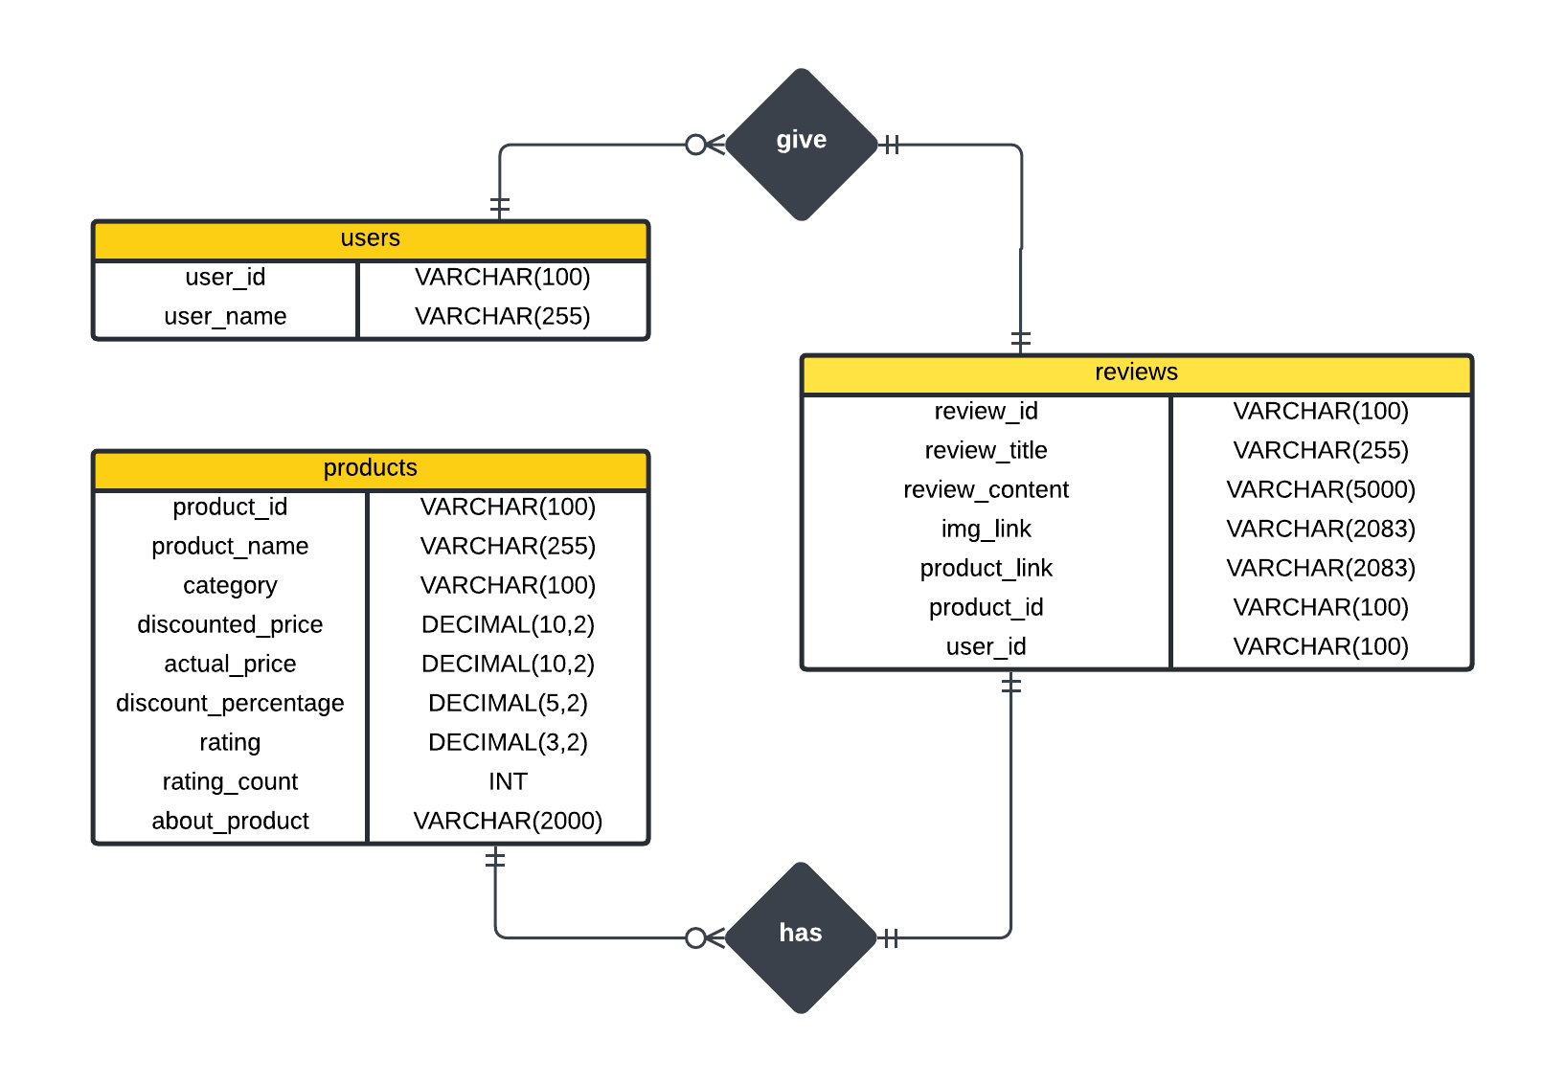

ENTITY RELATIONSHIP DIAGRAM (ERD)
PK
user_id, product_id, review_id are the primary keys, ensuring that each product has a unique ID
User_id and product_id are the foreign keys in reviews table to establish the relationship with users and products tables.
PK
PK
FK
FK

Slide 7

CREATE READ UPDATE DELETE (CRUD) OPERATIONS
Create(INSERT)
Read(SELECT)
Update (UPDATE)
Delete (DELETE)
Adding new records into a table
Retrieving or querying data from a table
Modifying existing records in a table
Removing records from a table
CREATE TABLE products (
product_id VARCHAR(100) NOT NULL,
product_name VARCHAR(255) NOT NULL,
category VARCHAR(100),
discounted_price DECIMAL(10, 2),
actual_price DECIMAL(10, 2),
discount_percentage DECIMAL(5, 2),
rating DECIMAL(3, 2),
rating_count INT,
about_product VARCHAR(2000),
PRIMARY KEY (product_id)
);
CREATE TABLE users (
user_id VARCHAR(100) NOT NULL,
user_name VARCHAR(255),
PRIMARY KEY (user_id)
);
CREATE TABLE reviews (
review_id VARCHAR(100),
review_title VARCHAR(255),
review_content VARCHAR(5000),
img_link VARCHAR(2083),
product_link VARCHAR(2083),
product_id VARCHAR(100) NOT NULL,
user_id VARCHAR(100) NOT NULL,
PRIMARY KEY (review_id),
CONSTRAINT fk_product FOREIGN KEY(product_id) REFERENCES products(product_id),
CONSTRAINT fk_user FOREIGN KEY (user_id) REFERENCES users(user_id)
);
CREATE TABLES
Creating tables products, users and reviews

Slide 8
CRUD OPERATIONS – CREATE STATEMENTS
--Insert a new product
INSERT INTO products (product_id, product_name, category, discounted_price, actual_price, discount_percentage, rating, rating_count, about_product)
VALUES ('B00KXULGJQ', 'TP-Link AC750 Wifi Range Extender | Up to 750Mbps | Dual Band WiFi Extender, Repeater, Wifi Signal Booster, Access Point| Easy Set-Up | Extends Wifi to Smart Home & Alexa Devices (RE200)', 'Computers&Accessories', 0.00, 0.00, 66.00, 4.20, 49, 'Boosts wireless signal');
--Inserting new reviews
INSERT INTO reviews (review_id, review_title, review_content, img_link, product_link, product_id, user_id)
VALUES ('R110CR4AD558XA', 'Very helpful', 'The product is so good', 'https://m.media-amazon.com/images/I/312J9hg8ypL._SX300_SY300_QL70_FMwebp_.jpg', 'https://www.amazon.in/Tp-Link-300Mbps-AC750-Range-Extender/dp/B00KXULGJQ/ref=sr_1_57?qid=1672902997&s=computers&sr=1-57', 'B00KXULGJQ', 'AFOVQIU4VXRHWZ2ON5VX6DOVPRVQ');
--Inserting new users
INSERT INTO users (user_id, user_name)
VALUES ('AG1234567890', 'Peter Mazuryk');
INSERT INTO users (user_id, user_name)
VALUES ('AH0987654321', 'Sean Bezerra');

Slide 9
CRUD OPERATIONS UPDATE AND SELECT STATEMENTS
UPDATE STATEMENTS( U )
SELECT STATEMENTS( R )
--Update the discounted price of a specific product
UPDATE products
SET discounted_price = 89.99
WHERE product_id = 'B00KXULGJQ’;
--Update the user_name of a specific user
UPDATE users
SET user_name = 'Johnathan Doe'
WHERE user_id = 'AG1234567890’;
--Update the review content of a specific review
UPDATE reviews
SET review_content = 'This product is fantastic!'
WHERE review_id = 'R110CR4AD558XA';
--Select all products in a specific category, ordered by rating
SELECT product_id, product_name, category, rating
FROM products
WHERE category LIKE '%Electronics%'
AND rating > 4.0
ORDER BY rating DESC;
--Select all users ordered by user_name
SELECT user_id, user_name
FROM users
ORDER BY user_name ASC;
--Select the number of reviews for each product, having more than 5 reviews
SELECT product_id, COUNT(1) AS no_of_reviews
FROM reviews
GROUP BY product_id
HAVING no_of_reviews > 5;

Slide 10
CRUD OPERATIONS - DELETE STATEMENTS(D)
--Delete all reviews for a specific product
DELETE FROM reviews
WHERE product_id = 'B07JW9H4J1';
--Delete a specific product
DELETE FROM products
WHERE product_id = 'B09XYZ1234’;
--Delete a specific user:
DELETE FROM users
WHERE user_id = 'AG1234567890';

