Slide 1
Ultrasonic distance measurer with Arduino UNO
Project review I
cse322

Slide 2
Group Members
Bhargav Maniar (13BCE1075)
Kashish Kohli (13BCE1067)

Slide 3
Abstract
The Ultrasonic Distance Measurer uses Ultrasonic waves and the Echo principle to detect obstacles. This module is often used on robots and toy cars to locate obstacles but it can be used to measure distances as well.
The maximum range of HC-SR04 is 4 meters, and the shortest measurable distance is 2cm with an accuracy of 3mm.

Slide 4
Abstract (Contd.)
The system transmits a burst of ultrasonic sound waves towards the subject and then receives the corresponding echo. According to the reflection time, Arduino calculates the distance thanks to the following formula:
Test distance = (high level time × speed of sound*) / 2
*speed of sound in air is 340m/s

Slide 5
Abstract (Contd.)
Other two things are required if you want your distance meter to do more accurate measurements:
A spirit level
A laser pointer

Slide 6
Advantages
An ultrasonic sensor’s response is not dependent upon the surface color or optical reflectivity of the object. For example, the sensing of a clear glass plate, a brown pottery plate, a white plastic plate, and a shiny aluminum plate is the same.
The response of analog ultrasonic sensors is linear with distance. By interfacing the sensor to an LED display, it is possible to have a visual indication of target distance. This makes ultrasonic sensors ideal for level monitoring or linear motion monitoring applications.

Slide 7
Disadvantages
Ultrasonic sensors must view a surface (especially a hard, flat surface) squarely (perpendicularly) to receive ample sound echo. Also, reliable sensing requires a minimum target surface area, which is specified for each sensor type. Smooth surfaces reflect sound energy more efficiently than rough surfaces; however, the sensing angle to a smooth surface is generally more critical than to a rough surface.
Ultrasonic sensors have a minimum sensing distance.

Slide 8
Components Reqd.
Liquid Crystal Library for Arduino
LCD 16x2 display
Arduino UNO
USB cable
The Arduino IDE installed on your PC
Set of cables
Breadboard
An HC-SR04 ultrasonic sensor

Slide 9
PIN Description of SR04
5V Supply
Trigger Pulse Input
Echo Pulse Output
0V Ground

Slide 10
Specification of sr04
Working Voltage: DC 5 V
Working Current: 15mA
Working Frequency: 40Hz
Max Range: 4m
Min Range: 2cm
Measuring Angle: 15 degree

Slide 11
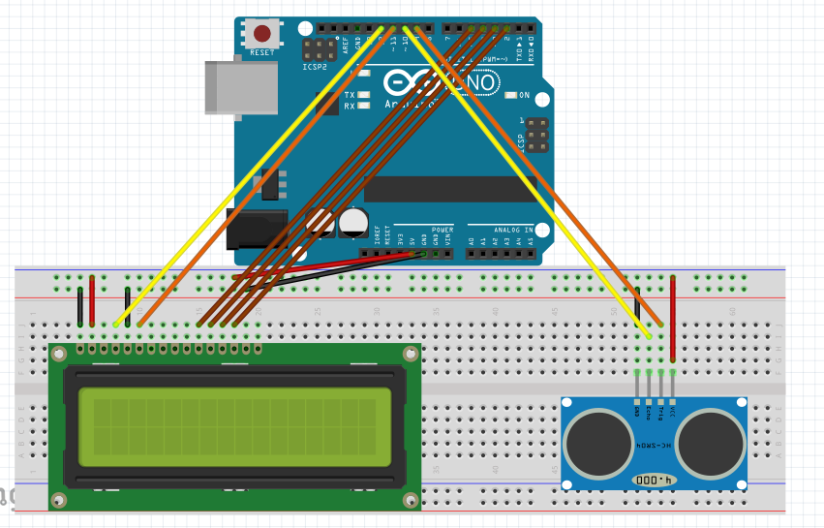
Circuit Diagram

Slide 12
Connection description
Ultrasonic sensor connection :
VCC pin - 5V pin of Arduino
GND pin - Ground pin of Arduino
TRIG pin - Digital pin 9 of Arduino
ECHO pin - Digital pin 10 of Arduino
LCD connections :
LCD RS pin to digital pin 12
LCD Enable pin to digital pin 11
LCD D4 pin to digital pin 5
LCD D5 pin to digital pin 4
LCD D6 pin to digital pin 3
LCD D7 pin to digital pin 2
LCD R/W pin to ground

Slide 13
Procedure
Create LCD Object
Define PIN with variable name
Define PIN Mode as OUTPUT/INPUT
Start LCD and set cursor position
Give a pulse to Trigr PIN of SR04 by making signal low-high-low
Read the output of echo PIN of SR04 and calculate the distance
Then print the distance on the LCD display

Slide 14
Code explanation
#include <LiquidCrystal.h>
Call to a LCD Library
LiquidCrystal LCD(12,10,11,5,4,3,2); // LiquidCrystal(rs, rw, enable, d4, d5, d6, d7)
Creation of LCD object by specifying numbers of the interface pins
void setup()
To setup the direction of pins and starting values of Arduino
pinMode()
To define port as an input/output
LCD.begin(16,2);
Tell Arduino to start your 16 column 2 row LCD
LCD.setCursor(0,0);
Set LCD cursor to upper left corner, column 0, row 0
LCD.print("Target Distance:");
Print Message on First Row

Slide 15
Code explanation
void loop()
Main Loop of program
delayMicroseconds(10);
Delay in Microseconds
#include <NewPing.h>
Ping Library to send pulse/ping to sensor
NewPing sonar(trigPin,echoPin, MAX_DISTANCE);
Declare Ping Object
sonar.ping();
Send Ping and return the time duration value

Slide 16
Formula Logic
distance = (duration/2) / 29.1;
We divide by two because it goes out and back so the time would be double that of a one-way travel.
The 29.1 is some sort of calibration factor to relate duration to actual distance.
he approximate speed of sound in dry air is given by the formula:
c = 331.5 + 0.6 * [air temperature in degrees Celsius] m/s
At 20°C, c = 331.5 + 0.6 * 20 = 343.5 m/s
If we convert the speed in centimeters per microseconds we get:
c = 343.5 * 100 / 1000000 = 0.03435 cm/ss
Instead of using the Speed of Sound, we can also use the "Pace of Sound".
The Pace of Sound = 1 / Speed of Sound = 1 / 0.03435 = 29.1 ss/cm
In this case the equation to calculate the distance become: D = (Δt/2) / Pace of sound

Slide 17
Thank you

