Slide 1
A Framework For Web Opinion Mining Using Lexicalized Hidden Markov Model

Slide 2
Introduction
With the rapid expansion of e-commerce, more and more products are sold on the web, and more and more people are buying products online. It has become a common practice for online merchants to ask their customers to share their opinions and hands-on experiences on products they have purchased. Unfortunately, reading through all customer reviews is difficult, especially for popular items, the number of reviews can be up to hundreds or even thousands. Our goal in this research is to design a framework that is capable of extracting, learning and classifying product related entities from product reviews.

Slide 3
Abstract
Merchants selling products on the Web often ask their customers to share their opinions and hands-on experiences on products they have purchased. As e-commerce is becoming more and more popular, the number of customer reviews a product receives grows rapidly. This makes it difficult for a potential customer to read them to make an informed decision on whether to purchase the product. In this research, we aim to mine customer reviews of a product and extract highly specific product related entities on which reviewers express their opinions. Opinion expressions and sentences are also identified and opinion orientations for each recognized product entity are classified as positive or negative. Different from previous approaches that have mostly relied on natural language processing techniques or statistic information, we propose a novel machine learning framework using lexicalized HMMs. The approach naturally integrates linguistic features, such as part-of-speech and surrounding contextual clues of words into automatic learning. The experimental results demonstrate the effectiveness of the proposed approach in web opinion mining and extraction from product reviews.

Slide 4
Problem Definition
Specifically, given a particular product, the system first identifies potential product related entities and opinion related entities from the reviews, and then extracts opinion sentences which describe each identified product entity. The experimental results demonstrate the effectiveness of the proposed approach in web opinion mining and extraction from product reviews.

Slide 5
What is meant by sequence labeling?
Sequence labeling is a type of pattern recognition task that involves the algorithmic assignment of a categorical label to each member of a sequence of observed values. A common example of a sequence labeling task is part of speech tagging, which seeks to assign a part of speech to each word in an input sentence or document

Slide 6
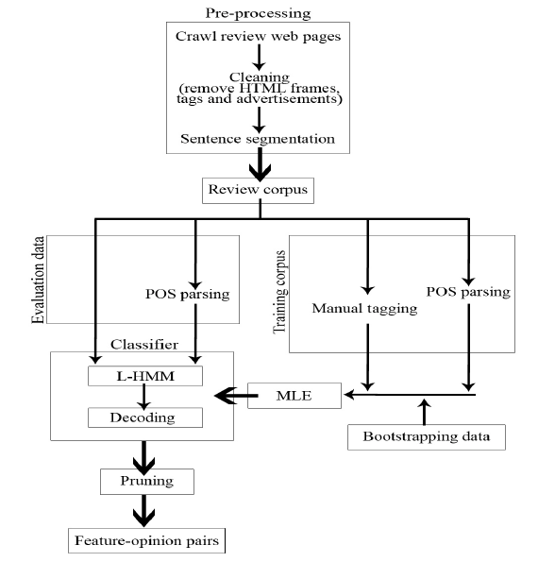
System architecture

Slide 7
Entity Categories and Tag Sets
COMPONENTS FUNCTIONS FEATURES OPINIONS | Physical objects of a camera including the camera itself, e.g., LCD, viewfinder, battery Capabilities provided by a camera, e.g., movie playback, zoom, automatic fill flash, auto focus Properties of components or functions, e.g., color, speed, size, weight, clarity Ideas and thoughts expressed by reviewers on product features / components / functions.

Slide 8
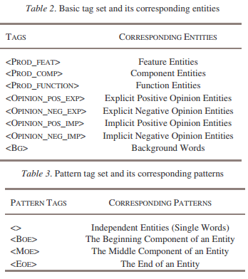
Entity Categories and Tag Sets Contd.
The following example illustrates the hybrid tag and basic
tag representations of an opinion sentence “I love the ease
of transferring the pictures to my computer.”
Hybrid tags:
<BG>I</BG><OPINION_POS_EXP>love</OPINION_P
OS_EXP><BG>the</BG><PROD_FEATBOE>ease</PROD_FEAT-BOE>
<PROD_FEAT-MOE>of</PROD_FEAT-MOE><PROD_FEATMOE>transferring</PROD_FEAT-MOE><PROD_FEAT-MOE>the</PROD_FEAT-MOE>
<PROD_FEAT-EOE>pictures</PROD_FEAT-EOE>
<BG>to</BG><BG>my</BG><BG>computer</BG>
Basic tags:
<BG>I</BG><OPINION_POS_EXP>love</OPINION_P
OS_EXP> <BG> the </BG> <PROD_FEAT>ease of
transferring the pictures </PROD_FEAT> <BG> to
</BG><BG>my</BG><BG>computer</BG>

Slide 9
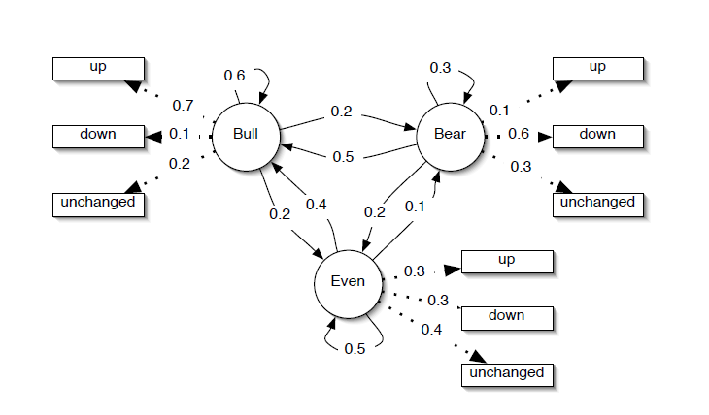
Hidden Markov Model

Slide 10
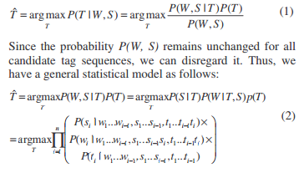
Lexicalized HMMs
Different from traditional Hidden Markov Models, in our work, we integrate linguistic features such as part-of speech and lexical patterns into HMMs. An observable state is represented by a pair (word i , POS(word i)) where POS(word i) represents the part-of-speech of word i.
The task is then described as follows: Given a sequence of words W= w1w2w3…wn and corresponding parts-of-speech S = s1s2s3…sn, the task is to find an appropriate sequence of hybrid tags n Tˆ = t1 t2 t3 that maximize the conditional probability P(T|W,S), namely

Slide 11
Lexicalized HMMs Contd
Two types of approximations are made to simplify the general model.
The first approximation is based on the independent hypothesis used in standard HMMs. First-order HMMs is used in view of data sparseness, i.e., P(ti | ti-K…ti-1 ) ≈ P(ti | ti-1 ).
The second approximation combines the POS information with the lexicalization technique where three main hypotheses are made:
1. The assignment of current tag ti is supposed to depend not only on its previous tag ti-1 but also previous J (1≤J≤i-1) words wi-J…wi-1.
2. The appearance of current word wi is assumed to depend not only on the current tag ti , current POS si , but also the previous K(1≤K≤i-1) words wi-K…wi-1.
3. The appearance of current POS si is supposed to depend both on the current tag ti and previous L(1≤L≤i-1) words wi-L…wi-1.

Slide 12


Lexicalized HMMs Contd
With a view to the issue of data sparseness, we set J=K=L=1. Based on these assumptions, the general model in equation (2) can be rewritten as:
Maximum Likelihood Estimation (MLE) is used to estimate the parameters in equation (3). For instance, P(si | wi-1, ti) can be estimated as:

Slide 13
Opinion Sentence Extraction
This step identifies opinion sentences in the reviews. Opinion sentences in our work are defined as sentences that express an opinion on product related entities. In the pruning step, the following two types of sentences are not considered as effective opinion sentences:
1. Sentences that describe product related entities without expressing reviewers’ opinions.
2. Sentences that express opinions on another product model’s entities

Slide 14
Algorithms
Pre -Processing:
All the stop words present in a given input text file which consists of selected product reviews are removed.
The text file that contains all the selected product reviews is given as input to the program.
The program processes the text file and then splits each word of the file.
Each word of the file is compared with the set of stop words.
If the word that is present in the file is a stop word, then it is eliminated.
Since all the stop words are removed the resultant file has no stop words.
The program creates a file and then writes all the reviews that do not contain the stop words.

Slide 15
Algorithms
Parts of speech tagging:
Each word in the text file is tagged with the respective parts of speech.
The output text file from the step-2 is given to the step-3 for parts of speech tagging.
In this step the Stanford-postagger.jar file is used to tag the parts of speech of any given text.
The .jar file can be accessed by using a command in the command prompt.
The command is embedded in a java program and use process builder that opens the command prompt and directs to the path that is given where the Stanford-POStagger is present.

Slide 16
Algorithms
Calculating Emission and Transition Probabilities:
All the particular words are stored in a particular excel sheet along with their number of occurrences in noun form and adjective form.
The output file from step-3 is dynamically given to step-4 for calculating probabilities.
The words are represented in the excel sheet with the number of occurrences as noun and adjective.
Then we calculate the probability of the word occurring as a noun and it occurring as an adjective respectively.
The transition probability is 2X2 matrix which is generated by calculating the probabilities of transition from NOUN -> NOUN, NOUN ->ADJECTIVE, ADJECTIVE -> NOUN, ADJECTIVE -> ADJECTIVE.

Slide 17
Algorithms
Feeding the probabilities to MATLAB HMM ALGORITHM:
To generate a random sequence of states and emissions from the model, use hmmgenerate with TRANS and EMIS probabilities.
Given the transition and emission matrices TRANS and EMIS, the function hmmviterbi uses the Viterbi algorithm to compute the most likely sequence of states the model would go through to generate a given sequences of emissions.
The functions hmmestimate and hmmtrain estimate the transition and emission matrices TRANS and EMIS given a sequence seq of emissions.

Slide 18
Algorithms
Word Orientation and testing:
Based on these estimations the words’ orientation is judged where noun means it’s a feature word and adjective means it’s an opinion word.
A new set of features list is generated from the estimated transition and emission probabilities.
The new set of features is compared with the features list the company has declared for the product.
Precision and Recall are calculated based on the hits obtained.

