Slide 1

BMS INSTITUTE OF TECHNOLOGY & MANAGEMENT, YELAHANKA, BANGALORE. Department of Computer Science & Engineering
EMOTION PERCEPTION USING REINFORCEMENT LEARNING
Adarsh Kumar Sah (1BY15CS006)
Bhargav Sagiraju (1BY15CS016)
Chandrashekar S (1BY15CS020)
Under the guidance of
Dr. THIPPESWAMY.G
Professor and Dean- Academics

Slide 2
INCORPORATION OF SUGGESTIONS
Idea of Intelligent agent was narrowed down to emotion perception from text, speech and visuals.
Change of ML approach from conventional LSTM & SVM to LSTM combined with RNN for textual emotion detection.

Slide 3
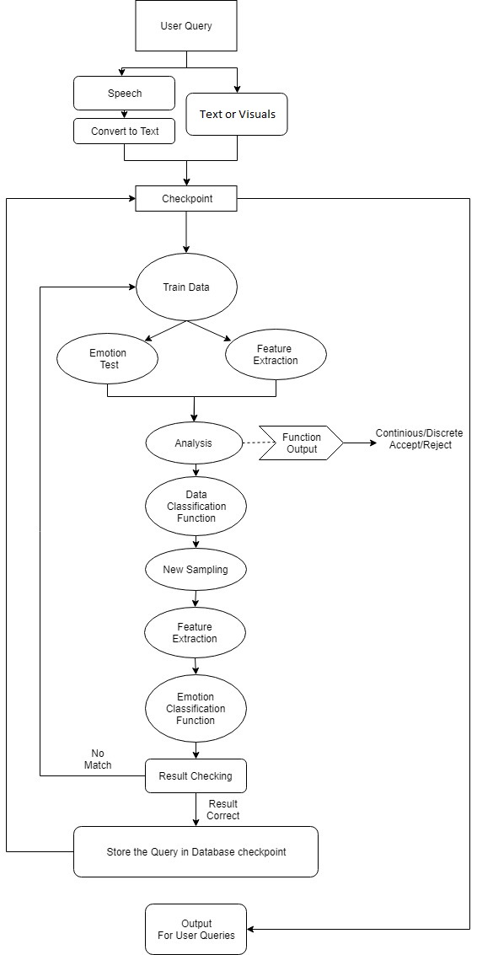
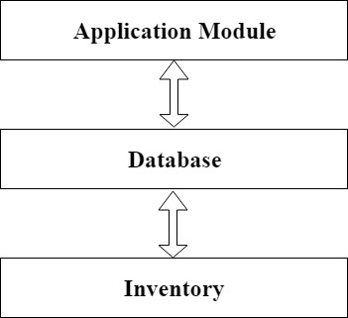
IMPLEMENTATION
Sub Systems
Flow chart

Slide 4
IMPLEMENTATION
Programming language, IDE & Tools
Python IDE console with conda environment for initial setup.
OpenCV and TensorFlow backend is used.
Major Data Structures
Python Dictionary based file storing and retrieval from database.
AIML dialect has elements such as categories, patterns and templates are used to create the interactive UI.
Integration Criteria
All software components uses common backend tensorflow, hence on same vector plane.
Noobs OS installer is used for interfacing the Raspberry pi and the software components.
Functions & Algorithms
Emotion perception from text using LSTM with RNN.
Emotion perception from visuals using deep CNN.

Slide 5
TESTING

Slide 6
INTEGRATION TESTING:
Test Case ID | Test Assertion | Precondition | Steps | Expected Result | Post Condition
ITC_001 | Integrate both text and facial emotion | Both components have started execution. | Start the system calls for both the modules. | The system runs the modules through the Interactive UI. | PASS (Module execution successful)
ITC_002 | Flash both components onto the Raspberry Pi and core runs successfully. | Components are ready to execute and Raspbian OS is booted up. | Boot Raspbian OS and start Python IDE to run the code. | The Raspberry Pi runs the code and computes the required inputs. | FAIL (System Kernel failed to run both components)
ITC_003 | Run both components on Raspberry Pi after using common external kernel. | Raspberry Pi has the integrated components ready to execute. | Start the system calls for both modules and start the Interactive UI to call batch jobs. | The Raspberry Pi runs the code and computes the required inputs after connecting to external Kernels. | PASS (System Kernel runs all components after connecting the external kernels)

Slide 7
COMPONENT TESTING TEST CASES:
Test Case ID | Test Assertion | Precondition | Steps | Expected Result | Post Condition
TC_001 (A) | Detection of Textual Emotion | Detect emotion from a given sentence | Use LSTM architecture to process given text | Display predicted emotion. | PASS (Resultant accuracy – 62%)
TC_002 | Detection of Textual Emotion | Detect emotion from a given sentence using white box model approach | Use SVM to process given text | Display Predicted emotion | PASS (Resultant accuracy – 57%)
TC_003 (B) | Detection of Textual Emotion | Detect emotion from a given sentence | Use LSTM in combination with RNN to process given text | Display predicted emotion. | PASS (Resultant accuracy – 92%)
TC_004 (C) | Detection Facial Emotion | Detect emotion from a given facial expression | Use OpenCV with TensorFlow backend and Deep CNN | Display predicted emotion after processing the face from the given image. | PASS (Resultant accuracy – 83%)

Slide 8
SYSTEM TESTING
Test Case ID | Test Assertion | Precondition | Steps | Expected Result | Post Condition
A+C | System Run Successful | Pre-requisites flashed onto Raspberry Pi | Start Core system | System runs successfully | FAIL (Requisite accuracy is not reached)
B+C | System Run successful | Pre-requisites flashed onto Raspberry Pi | Start Core system | System runs successfully | PASS (Requisite accuracy is reached with parallel batch jobs)

Slide 9
System Testing:
Software designed was tested and validated. All modules used are written in Python and tested independently.
After all the modules were tested successfully, the entire core component was flashed onto the Raspberry Pi for the computation part as required by the system.
The connection to external kernels was established and the complete system was ready to execute which functioned as expected and desired results were produced.

Slide 10
EXPERIMENTAL RESULT & ANALYSIS
Experimental Dataset
The pre-trained vectors (JSON and .hdf5 file format) are used for the training purpose .
Performance Analysis
The Kaggle kernel makes it easy for GPU matrix calculations 4X better than initially proposed performance on Movidius Neural Compute Stick. Hence, the Kaggle is used to pre process and train the dataset for text-based emotion analysis

Slide 11
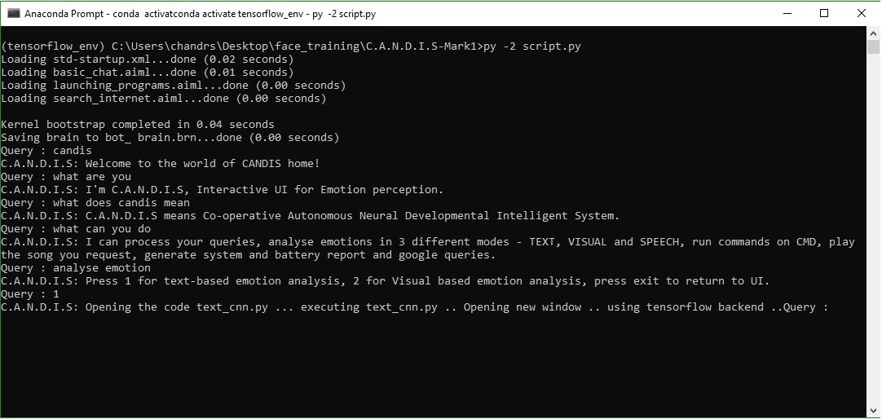
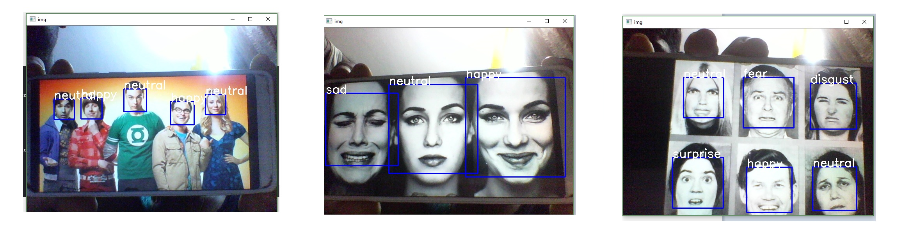
FACIAL EMOTION RECOGNITION

Slide 12
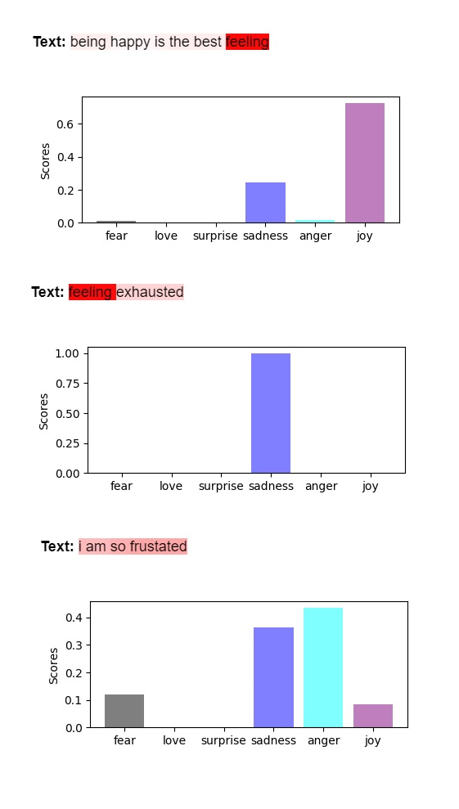
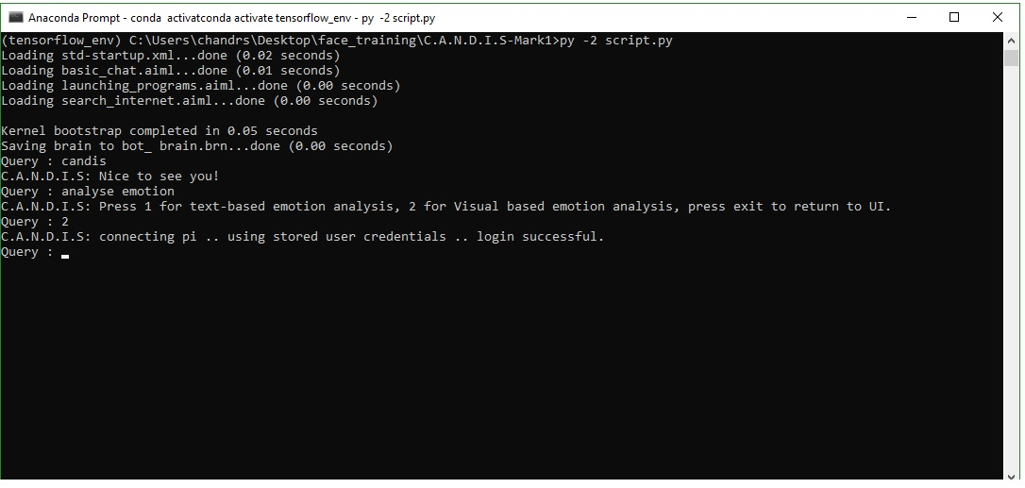
TEXT EMOTION DETECTION

Slide 13
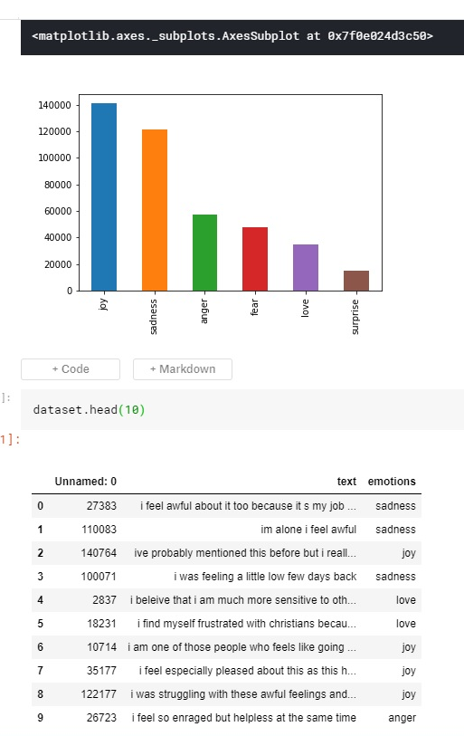
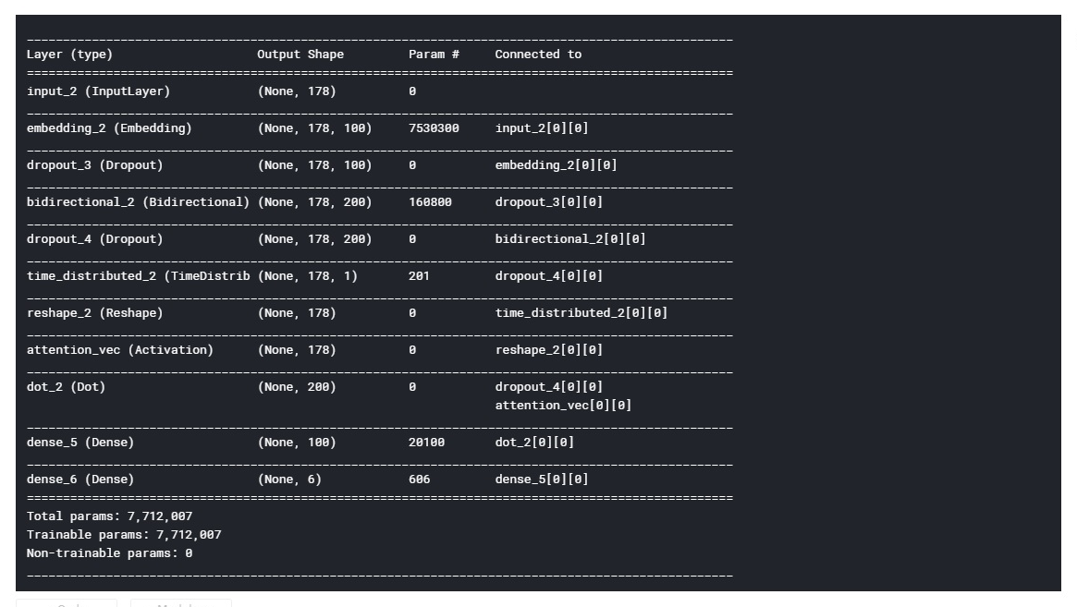
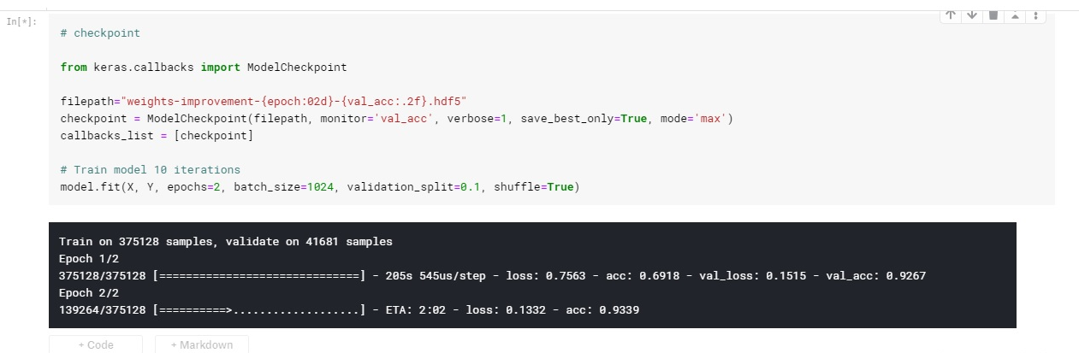
TRAINING SEQUENCE

Slide 14
CONCLUSION & FUTURE WORK
The proposed system uses LSTM for Text-based analysis and deep CNN for visual-based analysis of human emotions with an accuracy of 92 % and 83 % respectively.
Speech based emotion can be implemented using API engines for speech to text translation, the same can be given as an input to the system for emotion analysis.
Prediction of such emotions greatly influences the preferences, decisions and behaviour which is termed as Affective Forecasting, which helps in building intelligent agent.
This can be practically used for personalized solutions like interview analysis, debate monitoring, appointment monitoring, business meets, etc.

Slide 15
DEMONSTRATION OF THE PROJECT

Slide 16
REFERENCES
[1] Peng Zhou, Wei Shi, Jun Tian, Zhenyu Qi, Bingchen Li, Hongwei Hao, Bo Xu 2013, Attention-Based Bidirectional Long Short-Term Memory Networks for Relation Classification.
[2] Jeffrey Pennington, Richard Socher, Christopher D. Manning 2014, GloVe: Global Vectors for Word Representation.
[3] Erik Tromp, Mykola Pechenizkiy 2014, Rule-based Emotion Detection on Social Media: Putting Tweets on Plutchik’s Wheel.
[4] Benaissa Azzeddine Rachid, Harbaoui Azza and Ben Ghezala Henda 2018, Sentiment Analysis Approaches based on Granularity Levels.
[5] R.Anish Menon, Anurag De, B.Priyanka Reddy, B.Sukanya 2016, Various approaches for human emotion recognition: a study.
[6] Jelena Milosevic, Dexmont Pe˜na, Andrew Forembsky, David Moloney 2018, Reporting Accuracy, Inference Time and Power Consumption for Face Emotion Recognition on Embedded Systems.
[7] Guillaume Daval-Frerot, Abdessalam Bouchekif, Anatole Moreau 2018, Epita at SemEval-2018 Task 1: Sentiment Analysis Using Transfer Learning Approach.
[8] A. Kalyani, B. Premalatha, K.Ravi kiran 2018, Real Time Emotion Recognition from Facial Images using Raspberry Pi.
[9] David Zimbra, Ahmed Abbasi, Daniel Zeng, Hsinchun Chen 2018, The State-ofthe- Art in Twitter Sentiment Analysis: A Review and Benchmark Evaluation.
[10] R. Cowie, E. Douglas-Cowie, N. Tsapatsoulis, G. Votsis, S. Kollias, W. Fellenz, J.G.Taylor 2001, Emotion Recognition in Human-Computer Interaction.

Slide 17
Thank you.

