Slide 1

BMS INSTITUTE OF TECHNOLOGY & MANAGEMENT, YELAHANKA, BANGALORE. Department of Computer Science & Engineering
EMOTION PERCEPTION USING REINFORCEMENT LEARNING
Adarsh Kumar Sah (1BY15CS006)
Bhargav Sagiraju (1BY15CS016)
Chandrashekar S (1BY15CS020)
Under the guidance of
Dr. THIPPESWAMY.G
Professor and Dean

Slide 2
INTRODUCTION
Emotion Perception is the process of identifying emotions from text, speech or visuals using reinforced learning to allow its decision making.
The model is trained to make a sequence of decisions from the provided environment, it uses reinforcement learning to observe all the trial and error scenarios to come up with the emotion-based solution.
It consists of several interconnected systems like ANNs, LSTMs and Reward Systems to pipeline the processes involved to deliver the final outcome.
The goal of the proposed system is to recognise the user query with maximum accuracy and respond accordingly, with related emotions and the adaption to the previous corrected user queries.

Slide 3
DESIGN SPECIFICATION ANALYSIS DETAILED DESIGN ANALYSIS:
The system is mainly divided into 3 subsystems:
Application module/Interface,
Inventory
Database
Application Module/Interface:
It keeps track of the conversations.
Separate module stores the processed & analysed information in JSON format.
It can open three different windows based on the mode selected by the user (text, speech, visual).
Further, a raspberry pi module will be used to take inputs in the form of text, speech and visuals.

Slide 4
Database:
Uses SQLite 3 for faster retrieval of structured data and django for maintenance.
It doesn’t hold the training data but maps the processed results every time.
It makes use of hierarchical file format.
After a level of training is completed, a MOVIDIUS stick is used to enhance the processing which is inserted to the Raspberry pi module.
Inventory:
Offers a user-friendly interaction between the user and the system, with multiple options for interaction in different platforms.
The System can be used as a web localhost or as a compiled script on a pc or a hardware module (Raspberry pi).
Raspberry pi comes with a digital display which helps track the inputs and the computations happening as well as the output can be checked.

Slide 5
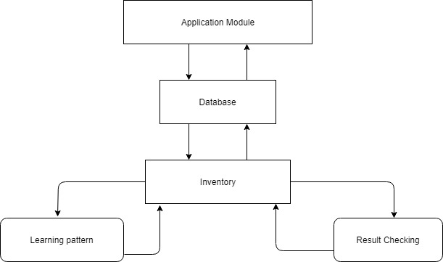
HIGH LEVEL DESIGN ANALYSIS: ARCHITECTURAL DESIGN

Slide 6
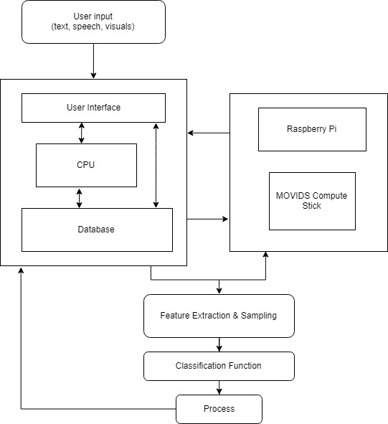
COMPONENT DESIGN

Slide 7
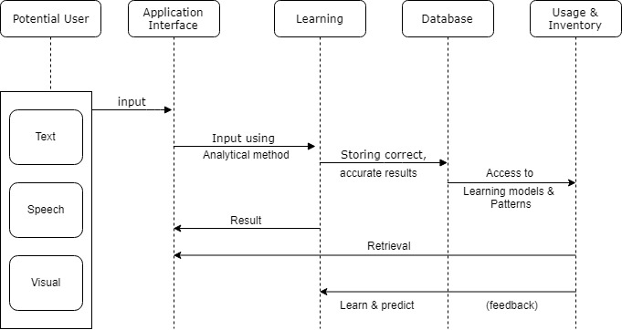
BEHAVIORAL DESIGN

Slide 8
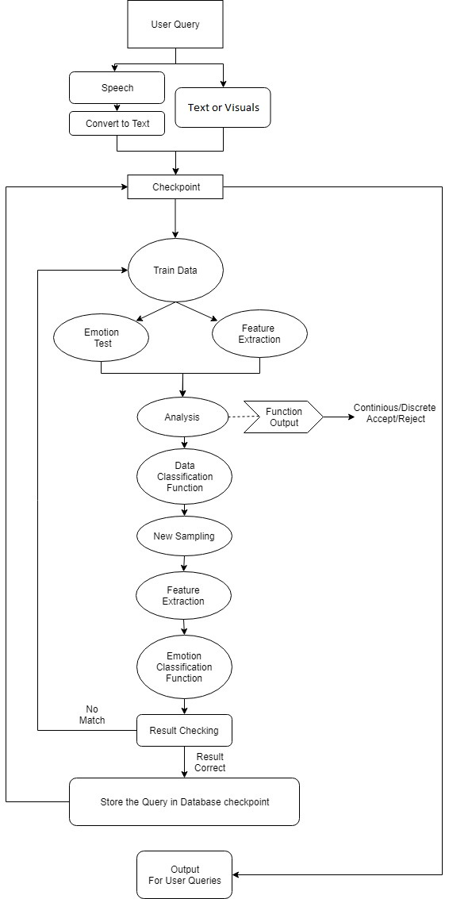
PROCESS FLOWCHART

Slide 9
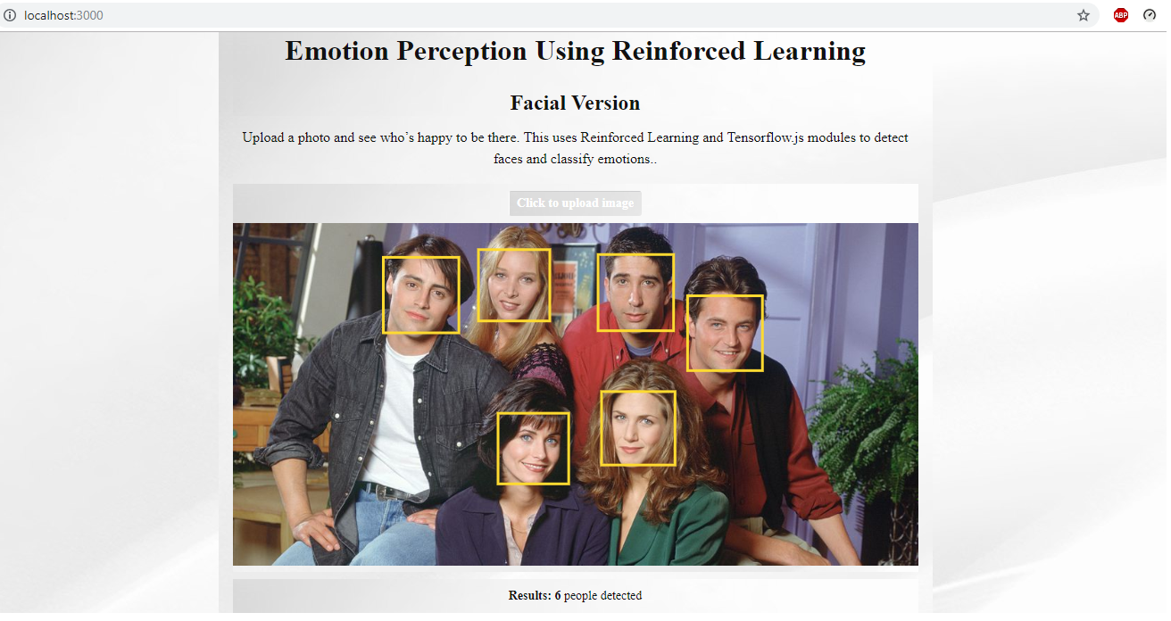
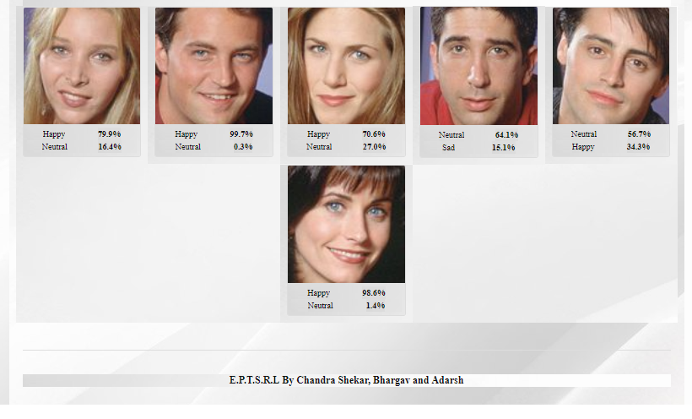
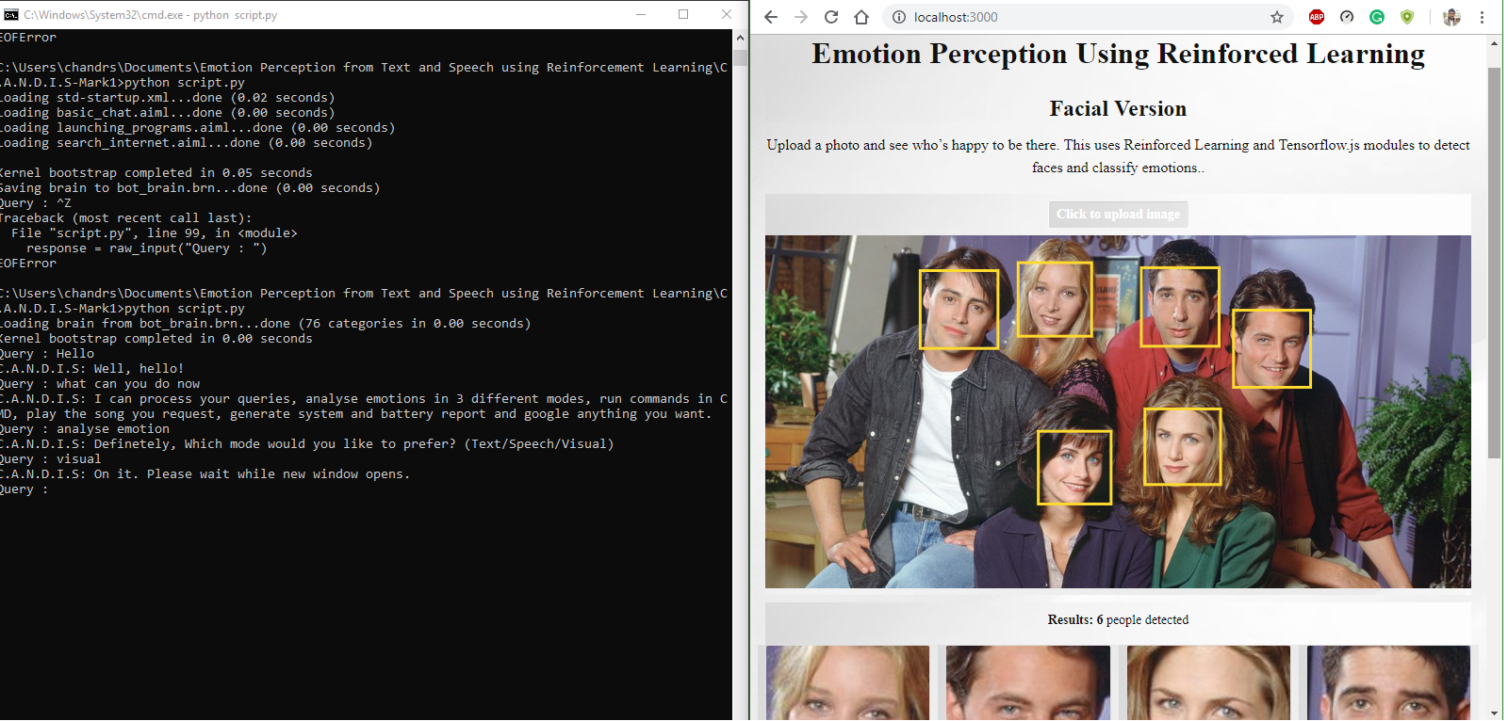
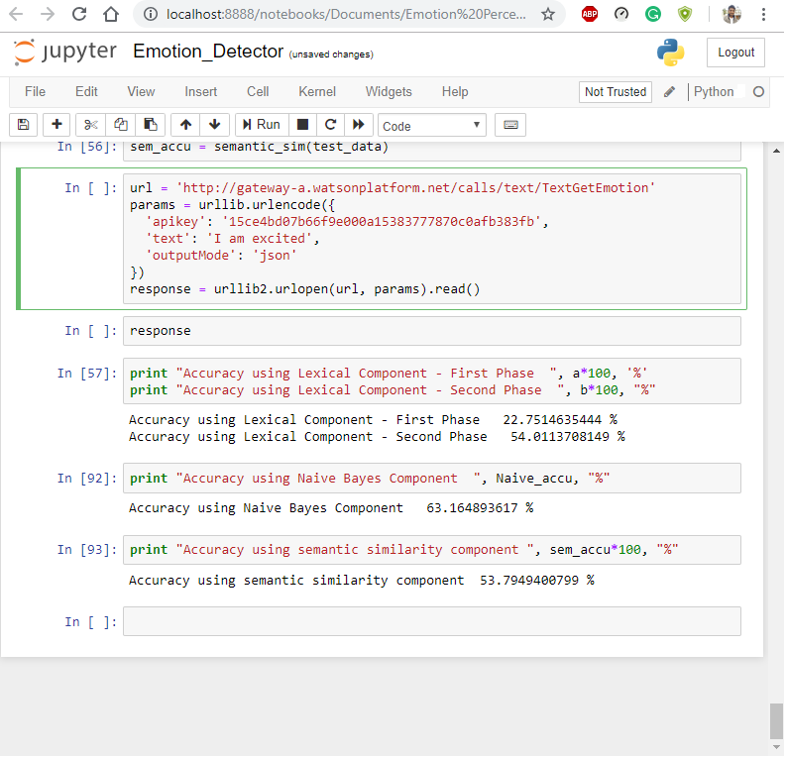
EXPERIMENTATION AND OPTIMIZATION
SCREENSHOTS:

Slide 10
WORK IN PROGRESS
1. Dynamic Emotion Perception:
The system will be able to detect 8 core emotion types from speech and text: Joy, Trust, Fear, Surprise, Sadness, Disgust, Anger and Anticipation.
Similar logistics will be applied to facial patterns or visual inputs.
2. Hardware Integration:
The entire system will be flashed onto a Raspberry Pi 3B+ and will offload the processing to the MOVIDIUS stick.
The system will integrate various sensors such as speech and camera modules to detect user input.
3. Code Modularization:
The code will be fully connected across individual modules to allow the full computation of the current system and existing modules will be scaled to allow faster convergence.

Slide 11
Thank you.

