Slide 1
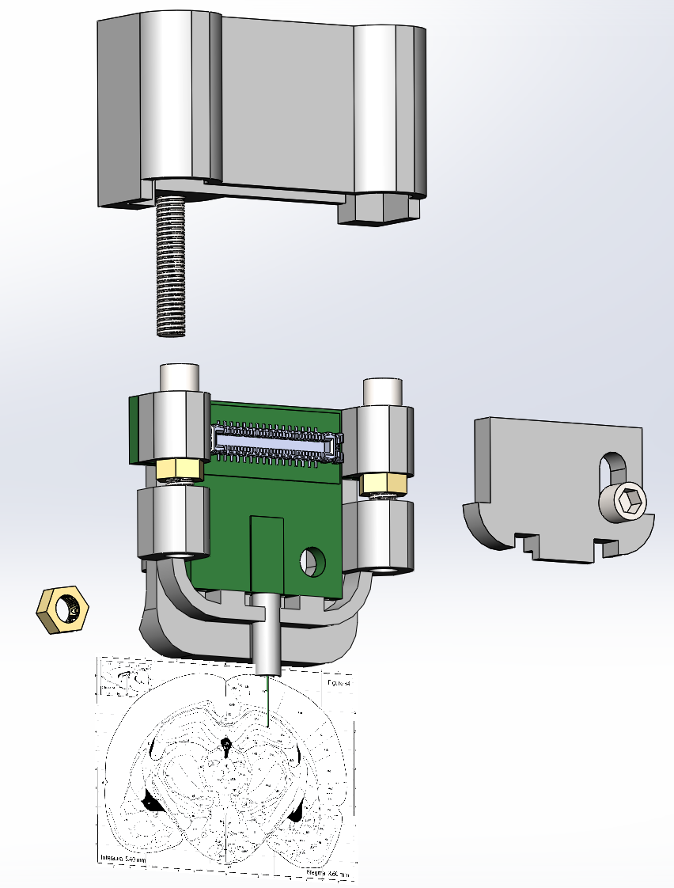
Drivable silicon probe cartridge
Dust cover
Drive bolt
Flex
connector
Probe PCB
Silicon
Probe
Cover plate

Slide 2
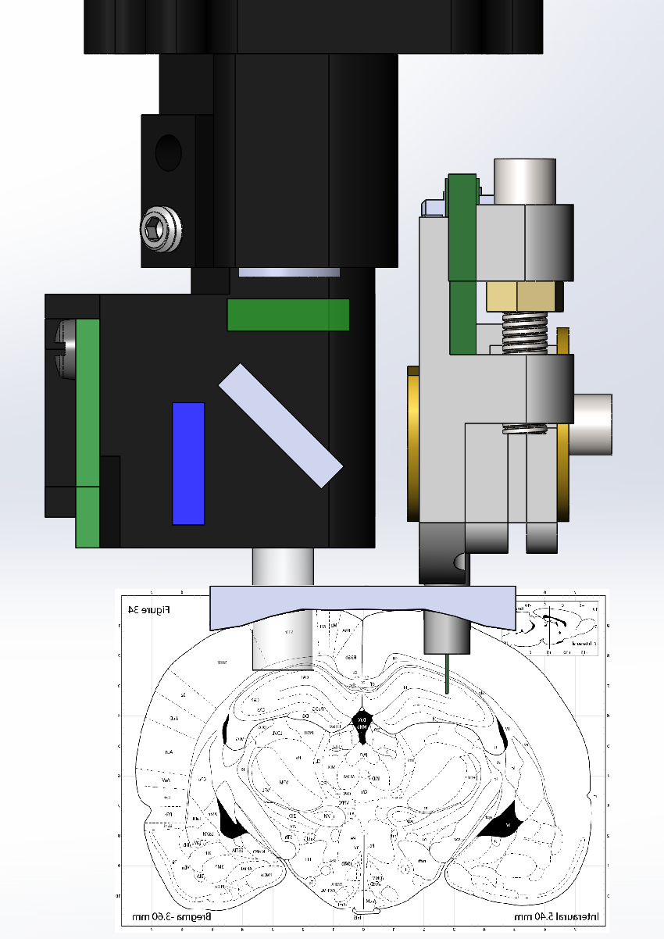
Side-by-side mounting with miniscope
Miniscope
Flex cable
to miniscope
Probe
Cartiridge
GRIN lens
Probe
tip

Slide 3
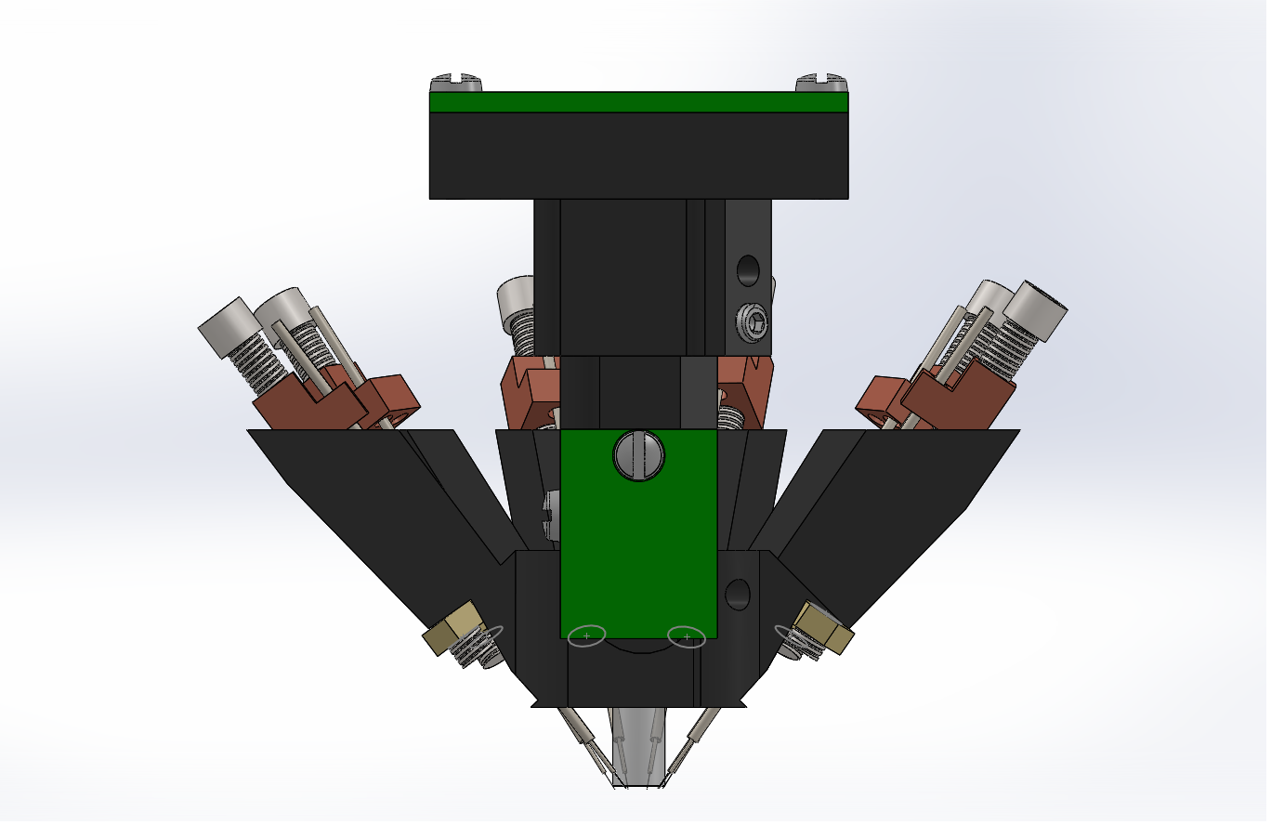
Tetrode Microdrives for miniscope
Miniscope
Tetrode
Probe shuttles
GRIN lens
Tetrode
Probe tips

Slide 4
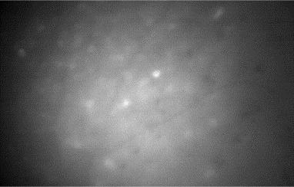
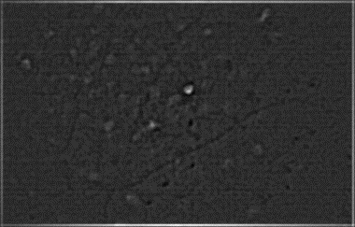
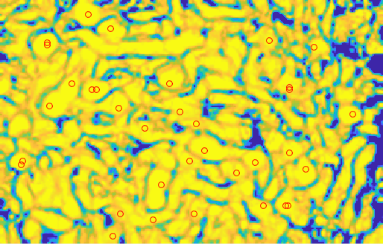
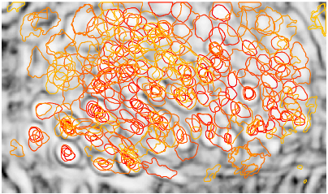
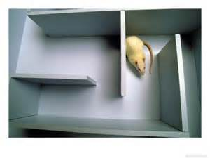
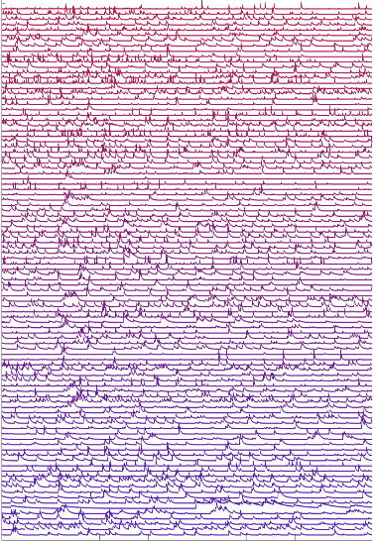
Pipeline for calcium imaging analysis
CAIMAN
MOTION
CORRECTION
CONTRAST
FILTER
INITIALIZATION
(PNR & CORR MAP)
CNMF
SOURCE
EXTRACTION
DECODER
MATLAB + C + FPGA
MATLAB + C
MATLAB

Slide 5
Predictive motion correction
RIGID
NON-RIGID
Accelerometer
LSTM
LSTM

