Slide 1
ShieldOne
Next-Generation Cyber Defense & Real-Time Threat Intelligence Platform
OUR SOLUTION IN ONE LINE
“Democratizing cybersecurity by unifying enterprise-grade SOC threat telemetry with AI-powered personal scam defense on a single real-time platform.”
PROJECT PRESENTER
Bhargav-24BCS11028 Jaydev Semwal-24BCS10996 Kalap Hastir-25BCS12409
Core Tech: React 19 • Node.js • Socket.io WebSockets • Leaflet Maps • Google Gemini 2.5 Flash • 5 Global Feeds

Slide 2
Slide 2 of 8
PROBLEM ANALYSIS & INDUSTRY GAP
The Cybersecurity Crisis: Who Is Struggling and Why?
1. ENTERPRISES & SOC ANALYSTS
Overwhelmed by complexity, alert fatigue, and delayed response times.
• Massive Alert Fatigue: SOC analysts parse thousands of daily events. Over 60% of alerts are false positives or lack severity scoring.
• Fragmented Threat Feeds: Crucial intelligence is siloed across disparate feeds (Abuse.ch, CISA, SANS) with no unified correlation.
• High MTTD & MTTR: Mean-Time-To-Detect and Mean-Time-To-Respond remain dangerously high; tier-1 analysts struggle with slow manual triage.
• Compliance Overhead: Auditing against SOC 2, ISO 27001, and GDPR requires labor-intensive manual evidence collection.
2. EVERYDAY CITIZENS & STUDENTS
Vulnerable targets of rampant digital deception, financial fraud, and panic lures.
• Explosion of Social Engineering: Rampant surge in 'Digital Arrest' warrants, fake electricity disconnection SMS, and bogus part-time job lures.
• No Instant Verification Tool: Common users have zero accessible platforms to check suspicious WhatsApp messages or links before clicking.
• Financial & Identity Loss: Victims are manipulated into sharing OTPs or wiring money via UPI due to urgent, threatening narratives.
• Reporting & Recovery Void: Citizens do not know where to turn when targeted; official helplines (1930, cybercrime.gov.in) lack immediate integration.

Slide 3
Slide 3 of 8
ARCHITECTURE & SOLUTION CONCEPT
Our Solution: The ShieldOne Dual-Tier Defense Platform
01
Professional SOC Intelligence
Enterprise Real-Time Operations
✓ Live WebSocket Streaming: Sub-second 2-second event push without browser reloads.
✓ Interactive Global Attack Map: Geographic origin plotting powered by Leaflet.
✓ Dynamic Risk & Anomaly Gauge: Real-time threat score calculating severity distribution.
✓ Audit & Compliance Tracker: Continuous SOC 2, ISO 27001, and GDPR controls.
02
Contextual AI Threat Explainer
Gemini 2.5 Flash Triage Engine
✓ 1-Click Alert Investigation: Translates raw hex/IP logs into human-readable breakdowns.
✓ Root-Cause Attribution: Maps attack patterns directly to MITRE ATT&CK techniques.
✓ Actionable Playbooks: Generates immediate containment and firewall blocking rules.
✓ Interactive SOC Chatbot: Conversational assistant for deep technical queries.
03
Personal Security Center
Zero-Cost Citizen Cyber Shield
✓ Indian Cyber Scam Analyzer: Detects Digital Arrest, Electricity fraud, UPI, and KYC lures.
✓ Malicious URL / Link Scanner: Analyzes fraudulent domains and credential-stealing pages.
✓ Automated Incident Response: Generates step-by-step guidance on what to do and document.
✓ Helpline 1930 Integration: Direct access to National Cybercrime Portal & RBI Sachet.

Slide 4
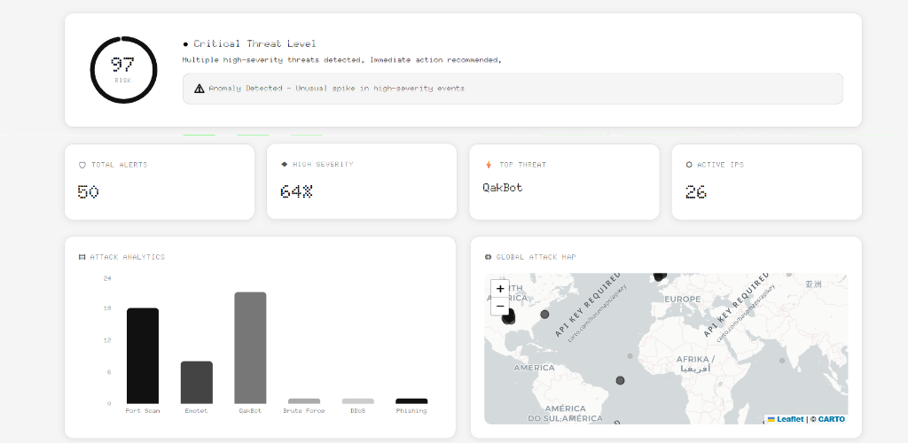
Slide 4 of 8
OPERATIONAL WALKTHROUGH & DEMO
How It Works: End-to-End User Journeys & Live Interface
JOURNEY A: ENTERPRISE SOC ANALYST
• 1. Automated Ingestion: Backend syncs with 5 global threat feeds every 30 mins.
• 2. Real-Time Telemetry: Events streamed via Socket.io directly to the live dashboard.
• 3. Visual Triage: Leaflet world map pinpoints attack origins; dynamic gauge flags anomalies.
• 4. 1-Click AI Mitigation: Analyst requests AI diagnosis -> receives instant mitigation steps.
──────────────────────────────────────────────
JOURNEY B: EVERYDAY CONSUMER / STUDENT
• 1. Input Suspicious Text/URL: User pastes suspicious WhatsApp SMS, phishing link, or notice.
• 2. AI Threat Forensics: Gemini 2.5 Flash analyzes threat indicators, urgency lures, and spoofing.
• 3. Plain-Language Verdict: Clear Risk Level (Safe/Medium/High) with identified red flags.
• 4. Immediate Escalation: Direct connection to National Cybercrime Helpline 1930 & RBI Sachet.
LIVE DASHBOARD TELEMETRY IN ACTION
Dynamic circular risk gauge (97 Risk Critical), anomaly spike banner, real-time threat distribution chart, and live Leaflet attack map.

Slide 5
Slide 5 of 8
VALUE PROPOSITION & INNOVATION
What Makes ShieldOne Different? Competitive Differentiators
🌐 Dual-Spectrum Accessibility
Enterprise SOC + Public Citizen Defense
Traditional SIEM solutions (Splunk, IBM QRadar) cost hundreds of thousands of dollars and serve only corporate SOCs. ShieldOne uniquely bridges enterprise-grade intelligence to citizen cyber defense on one unified platform.
⚡ Zero-Lag WebSocket Streaming
Push Architecture vs. Polling Delays
Legacy monitoring systems poll APIs periodically (every 5-15 mins). ShieldOne pushes live threat telemetry every 2 seconds via Socket.io full-duplex WebSockets, eliminating detection latency.
🧠 Contextual LLM Reasoning
Gemini 2.5 Flash vs. Rigid Regex Rules
Traditional scanners match static blacklists that attackers easily bypass. ShieldOne utilizes generative AI to comprehend psychological manipulation, urgency cues, and emerging fraud vectors.
🛡️ Automated Multi-Source Fusion
5 Global Authoritative Threat Feeds
ShieldOne fuses Abuse.ch Feodo Tracker, MalwareBazaar, ThreatFox, CISA KEV, and DShield honeypot telemetry into a unified ingestion pipeline with zero manual analyst curation required.

Slide 6
Slide 6 of 8
SYSTEM DESIGN & TECH IMPLEMENTATION
Technology Stack & AI Architecture
LAYER 1: USER INTERACTION & VISUALIZATION (FRONTEND)
Stack: React 19 • Vite • Leaflet & React-Leaflet • Recharts • GSAP Animations • Vanilla CSS Tokens
Responsive single-page web app with real-time UI re-rendering, interactive world map coordinates, dynamic SVG risk meters, and dual personal/professional dashboard routing.
LAYER 2: STREAMING & INGESTION BACKEND (MICROSERVICES)
Stack: Node.js • Express 5 • Socket.io (WebSockets) • Axios • Rate Limiting • CORS Middleware
High-throughput server pushing 2-second telemetry broadcasts, running 30-minute cron feed synchronizers, and serving secure RESTful authentication and analysis endpoints.
LAYER 3: AI REASONING & LLM TRIAGE ENGINE
Stack: Google Gemini 2.5 Flash • OpenRouter API • Custom Prompt Engineering • JSON Schema Validation
Generative AI engine performing 1-click incident explanations, MITRE ATT&CK attribution, actionable remediation playbooks, and localized Indian cyber scam pattern analysis.
LAYER 4: THREAT INTELLIGENCE & PERSISTENCE LAYER
Stack: Abuse.ch (Feodo, MalwareBazaar, ThreatFox) • CISA KEV • SANS DShield • Supabase Auth • Nodemailer
Authoritative feeds providing active botnet C2 IPs, payload signatures, ransomware indicators, and honeypot records with fallback in-memory stores and OTP email delivery.

Slide 7
Slide 7 of 8
REAL-WORLD VIABILITY & GROWTH
Impact, Feasibility & Scalability
QUANTIFIABLE IMPACT
• 60%+ Triage Acceleration: Reduces Tier-1 analyst mean triage time from 20 mins to under 30 seconds via 1-click AI explanations.
• Proactive Fraud Prevention: Empowers everyday consumers to verify scam texts and phishing links BEFORE transferring money or sharing credentials.
• Public Awareness & Redressal: Directly bridges users to the National Cybercrime Portal (1930) and RBI Sachet, boosting official reporting rates.
• Continuous Audit Readiness: Replaces periodic manual compliance checks with real-time SOC 2 and ISO 27001 posture tracking.
TECHNICAL FEASIBILITY
• Working End-to-End Prototype: Fully functional system deployed with live WebSocket broadcasting and integrated Gemini 2.5 Flash LLM.
• Zero External Database Dependencies: Graceful fallback architecture with in-memory session caching when cloud services are unavailable.
• Resilient Rate-Limiting: Intelligent 30-minute ingestion workers prevent external feed rate limits while keeping data fresh.
• Cost-Efficient Model: Utilizes open-source threat intelligence feeds and lightweight server-sent WebSocket events.
HORIZONTAL SCALABILITY
• WebSocket Fan-Out Architecture: Node.js + Socket.io can distribute live telemetry to thousands of simultaneous analysts.
• Microservices & Cloud Ready: Decoupled ingestion, AI triage, and UI components can be containerized with Docker / Kubernetes.
• Enterprise Multi-Tenancy: Extensible RBAC allows multiple organizations to run isolated SOC dashboards on shared infrastructure.
• Browser Extension Roadmap: Underlying scam analyzer API ready to power real-time browser phishing interception.

Slide 8
Slide 8 of 8
FUTURE HORIZONS & PROJECT OWNERSHIP
Execution Roadmap & The Team
STRATEGIC EXECUTION ROADMAP
PHASE 1: FOUNDATION & INTELLIGENCE (COMPLETED)
• Real-time SOC Dashboard with 2-second WebSocket broadcasts.
• Live Leaflet global attack map with geographic coordinates.
• Integrated 5 threat feeds (Feodo, MalwareBazaar, ThreatFox, CISA, DShield).
• Gemini 2.5 Flash Attack Explainer and Personal Scam Analyzer.
PHASE 2: ENTERPRISE INTEGRATIONS & ENDPOINTS (Q1-Q2)
• Corporate Syslog / CEF log forwarder agent for internal enterprise SIEM ingestion.
• Automated SOAR playbooks for firewall IP blocking and quarantine.
• Chrome Browser Extension for real-time URL & phishing scam interception.
PHASE 3: COLLABORATIVE DEFENSE & SCALING (Q3-Q4)
• Community Threat Sharing Network using STIX/TAXII open standards.
• Crowdsourced fraud reporting database for fast scam pattern neutralization.
• Enterprise Multi-Tenant SaaS deployment with customizable compliance frameworks.
PROJECT OWNERSHIP & CONTACT
Lead Developer & Architect:
Bhargav
Student UID:
24BCS11028
Academic Section:
803A
Department / Degree:
Computer Science & Engineering
Primary Email:
bhargav3509@gmail.com
Domain:
Cybersecurity
“ShieldOne — From raw threat intelligence to real-time security awareness for everyone.”

