Slide 1

Review - 1
A Machine Learning Framework for Prediction of Breast Cancer
Presented by
15MIS0115
G Bhargav
Guided by: BRINDA.K

Slide 2
Contents
Abstract
Hardware and Software requirements
Detailed Design
System Architecture
Implementation

Slide 3
Abstract
A breast Cancer is a malignant tumor that starts from cells of the breast. A malignant tumor is a group of cancer cells that may grow into (invade) surrounding tissues or spread (metastasize) to distant areas of the body. Breast Cancer occurs mainly in omen, but men can get it, too. Many people do not realize that men have breast tissue and that they can develop breast cancer. Male breast cancer is a relatively rare cancer in men that originates from the breast. As it presents a similar pathology as female breast cancer. Male breast cancer remains under diagnosed and, due to delays in diagnosis, is often also undertreated. The investigation and management of male breast cancer are based on studies on female patients.
Detection of breast cancer metastasis at the earliest stage is important for the management and prediction of breast cancer progression. Emerging Techniques using the analysis of circulating tumor cells promising results in predicting and identifying the early stages of breast cancer metastasis in patients.

Slide 4
Hardware and software requirements
Hardware Requirements
Processor : Any Update Processor
Ram : Min 4 GB
Hard Disk : Min 100 GB
Software Requirements
Operating System : Windows Family
Language : Python 3.6 or Anaconda
Other Tools : RStudio and Rapid Miner

Slide 5
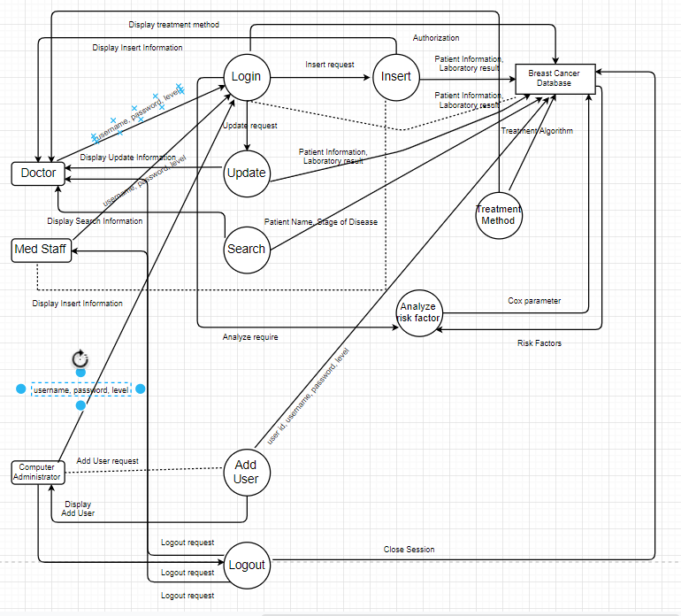
Detailed design
--
System Architecture

Slide 6
Implementation
data.describe()
data.drop('id',axis=1,inplace=True)
data.drop('Unnamed: 32',axis=1,inplace=True)
data['diagnosis'] = data['diagnosis'].map({'M':1,'B':0})
datas = pd.DataFrame(preprocessing.scale(data.iloc[:,1:32]))
datas.columns = list(data.iloc[:,1:32].columns)
datas['diagnosis'] = data['diagnosis']
datas.diagnosis.value_counts().plot(kind='bar', alpha = 0.5, facecolor = 'b', figsize=(12,6))
plt.title("Diagnosis (M=1 , B=0)", fontsize = '18')
plt.ylabel("Total Number of Patients")
plt.grid(b=True)
import os
import numpy as np
import pandas as pd
import seaborn as sns
import datetime as dt
import matplotlib.pyplot as plt
from IPython import get_ipython
get_ipython().run_line_magic('matplotlib', 'inline')
from sklearn import preprocessing
from sklearn.model_selection import train_test_split
from sklearn.metrics import confusion_matrix
data = pd.read_csv('D:/breastcancer.csv')
data.info()
data.head()
data.diagnosis.unique()

Slide 7
Implementation

