Slide 1
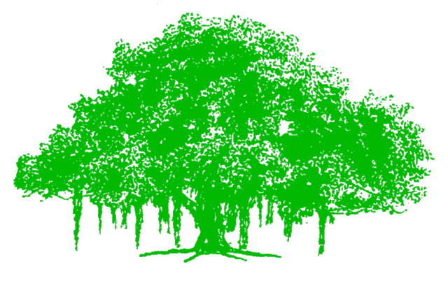
Learning a classification model for Image Segmentation CSE-471 Statistical Methods for Artificial Intelligence IIIT Hyderabad

Slide 2
Problem Statement
Learning a classification model for Image Segmentation.
We have implemented segmentation of road from images.
Learned different classifiers for the same.

Slide 3
Tools Used
Dataset used : KITTI Road Dataset
Programming Language: Python
Libraries used:
OpenCV and Scikit-Image for Python Image Processing
Scikit-Learn for implementing Classifiers
Mahotas for Feature Extraction
Matplotlib and PIL for Image manipulation and plotting

Slide 4
Classification Models used
For Pixel-based Classification:
Naïve Bayes
Support Vector Machine (Linear)
K-nearest Neighbours
Random Forests
Gaussian Mixture Model

Slide 5
Superpixel-based Classification:
Support Vector Machine
Naive Bayes
K-Nearest Neighbours
Random Forests
Neural Network Based Classification
Convolutional Neural Network

Slide 6
Feature Vector Formation
For Pixel-based Classification:
RGB values,HSV values, Luminosity values of each pixel, Local Binary Pattern vector.
[R,G,B,H,S,V,LBP,Luminosity] (8x1 vector for each pixel)
For Superpixel-based Classification:
Haralick Texture feature (first 4 components of the Haralick texture vector (4x1 vector))

Slide 7
Disadvantages
Pixel-based Classification
Some texture features are difficult to extract per pixel.
Computational time is very high.
Couldn’t segment the image well.

Slide 8


